Slide 1
Digital Portfolio
STUDENT NAME: VENNILA V
REGISTER NO AND NMID: 2422J0025 & asbruap2422j0025
DEPARTMENT: BCA
COLLEGE: PPG COLLEGE OF ARTS AND SCIENCE

Slide 2
PROJECT TITLE

Slide 3


AGENDA
Problem Statement
Project Overview
End Users
Tools and Technologies
Portfolio design and Layout
Features and Functionality
Results and Screenshots
Conclusion
Github Link
3/21/2024 Annual Review

Slide 4

PROBLEM STATEMENT
Traditional resumes often fail to fully capture a student's technical abilities, learning progress, and creative growth. There is a need for an engaging, interactive digital portfolio that can present projects, skills, and academic milestones in a more compelling, organized format.

Slide 5

PROJECT OVERVIEW
This project centers on designing a digital portfolio tailored for college students. It enables structured presentation of academic projects, technical skills, and personal achievements, while also showcasing learning progression and adaptability to new technologies.

Slide 6

WHO ARE THE END USERS?
Students aiming to showcase their skills and projects
Recruiters or employers seeking deeper insight into a candidate’s capabilities
Instructors evaluating student progress and creativity
Academic or professional collaborators interested in the student’s technical journey

Slide 7

TOOLS AND TECHNIQUES
Web technologies: HTML5, CSS3, JavaScript
Presentation software: PowerPoint
GitHub for version control and sharing code samples

Slide 8
PORTFOLIO DESIGN AND LAYOUT
Clean, modern, and easy-to-navigate structure
Sections for about me, project showcases, skills, results, and contact details
Consistent color scheme and clear typography for readability
Visuals such as images, icons, and (if applicable) code snippets to enhance engagement
8

Slide 9
FEATURES AND FUNCTIONALITY
Overview and highlights of key academic or technical projects
Dedicated section for skills and software proficiencies
Downloadable or interactive resume link
Integration with platforms like GitHub for project repositories
Responsive design for cross-device compatibility

Slide 10
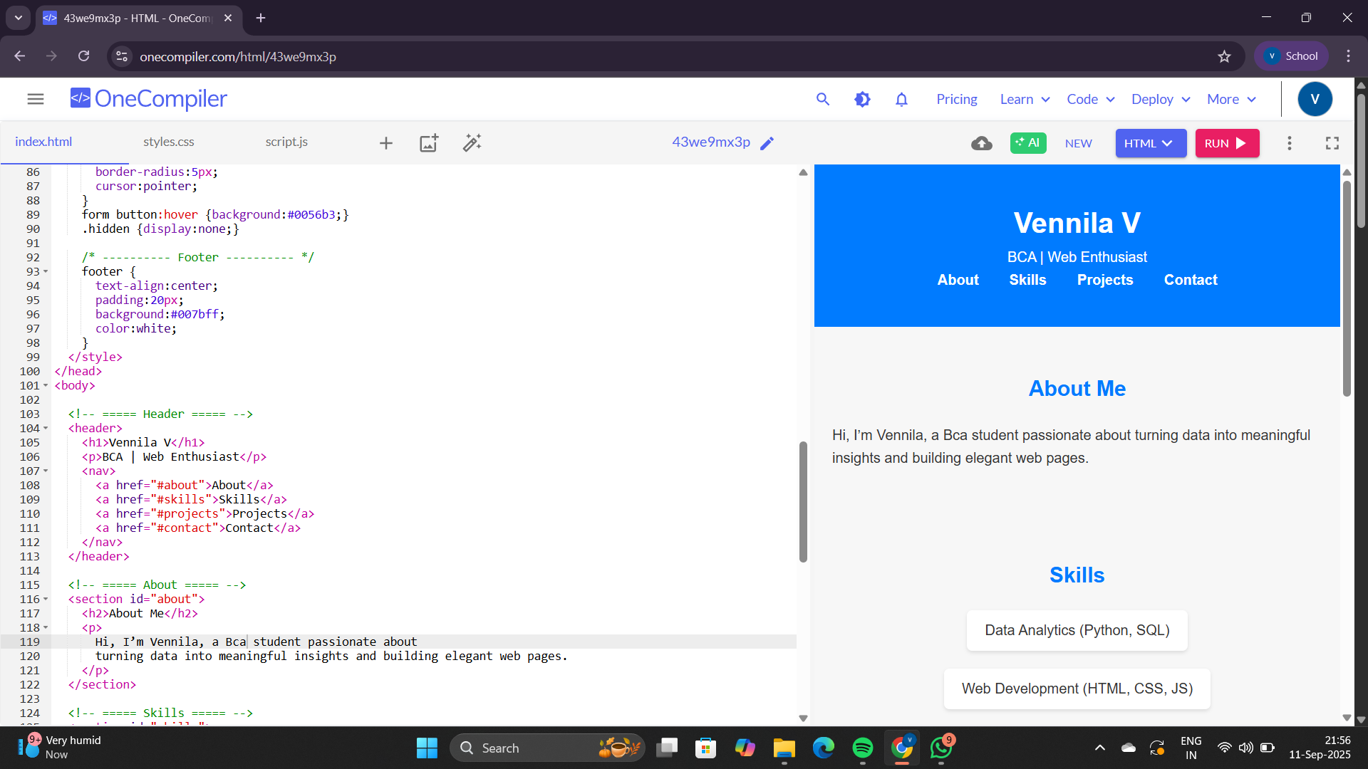

RESULTS AND SCREENSHOTS
3/21/2024 Annual Review
10

Slide 11
CONCLUSION
A well-designed digital portfolio serves as a dynamic record of your technical journey, making your achievements and growth visible to educators, employers, and peers. It fosters deeper opportunities for feedback, collaboration, and career advancement
11

