Slide 1

STUDENT NAME:luqmaan aadhil.A
REGISTER NO: 24Bca056
NMID: E3F20F405E9A72EBB0B4CC3CDF4DB2CC
DEPARTMENT: B.C.A Computer Application
COLLEGE: Mohamed Sathak College of Arts and Science

Slide 2
PROJECT TITLE
DIGITAL PORTFOLIO

Slide 3


AGENDA
Problem Statement
Project Overview
End Users
Tools and Technologies
Portfolio design and Layout
Features and Functionality
Results and Screenshots
Conclusion
Github Link
3/21/2024 Annual Review

Slide 4

PROBLEM STATEMENT
In today’s competitive digital world, individuals lack a centralized, professional, and visually
appealing platform to showcase their academic
achievements, skills, and projects.
A digital portfolio is necessary to present
personal and professional information effectively.

Slide 5

PROJECT OVERVIEW
The Digital Portfolio Website is a personal platform designed to highlight academic, technical, and creative skills.
It contains sections such as About Me, Education,
Projects, Skills, Certifications, and Contact information.
The website is responsive, user-friendly, and
customizable.

Slide 6

WHO ARE THE END USERS?
Students – Showcase academic achievements and skills Job Seekers – Highlight projects and certifications Professionals – Build an online personal brand Recruiters/Employers – View candidate portfolios easily

Slide 7

TOOLS AND TECHNIQUES
Frontend: HTML, CSS, JavaScript, Bootstrap
Backend: Python (Flask/Django) or PHP (if required)
Database: MySQL / SQLite (optional) Hosting: GitHub Pages / Netlify
Version Control: Git & GitHub

Slide 8
PORTFOLIO DESIGN AND LAYOUT
The design follows a clean, minimal, and
Professional layout with proper navigation. Sections include: Home, About, Skills, Projects, Education, Certifications, and Contact.
The portfolio is responsive for both desktop and mobile devices.

Slide 9
FEATURES AND FUNCTIONALITY
User-friendly interface with smooth navigation
Responsive design for mobile and desktop Sections for About, Projects, Skills, and Contact Integration with LinkedIn/GitHub Downloadable Resume option

Slide 10
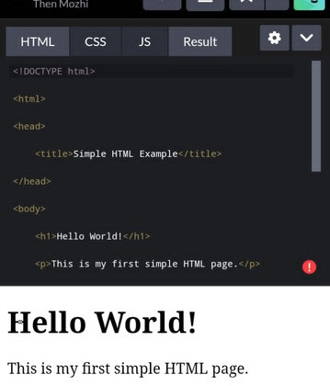
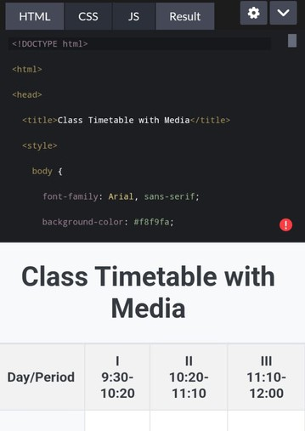

RESULTS AND SCREENSHOTS
3/21/2024 Annual Review

Slide 11
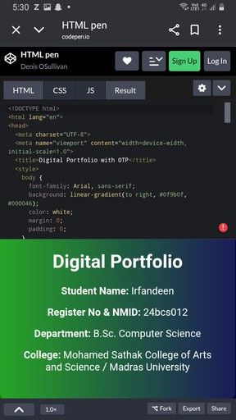
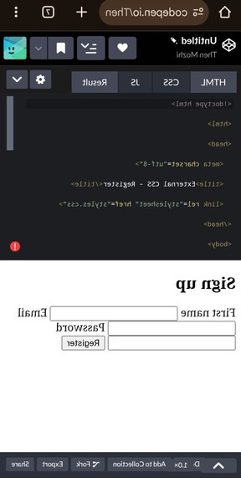
RESULTS AND SCREENSHOTS
3/21/2024 Annual Review

Slide 12
CONCLUSION
The Digital Portfolio Website provides an organized and professional way to present personal achievements, skills, and projects.
It enhances career opportunities and creates a strong digital presence

