Slide 1
STUDENT NAME: Abdul Rahman.k REGISTER NO AND
NMID: 24bcae005 & FCCEC53A64D8EA6A7004297A7CB5DD90
DEPARTMENT: BCA Computer application
COLLEGE: Mohamed Sathak College of Arts and Science

Slide 2
PROJECT TITLE
DIGITA
PLO RTFOLI O

Slide 3


AGENDA
Problem Statement
Project Overview
End Users
Tools and
PToecrhtfnoolliogideessign
Layout
2. Features
and
Fuanncdtionality
Results and Screenshots
Conclusion
Github Link
3/21/2024 Annual
Review

Slide 4

PROBLEM STATEMENT
In today’s competitive digital world, individuals lack a centralized, professional, and visually
appealing platform to showcase their academic achievements, skills, and projects.
A digital portfolio is necessary to present
personal and professional information effectively.

Slide 5

PROJECT OVERVIEW
The Digital Portfolio Website is a personal platform designed to highlight academic, technical, and creative skills.
It contains sections such as About Me, Education,
Projects, Skills, Certifications, and Contact information.
The website is responsive, user-friendly, and customizable.

Slide 6

WHO ARE THE END USERS?
Students – Showcase academic achievements and skills Job Seekers – Highlight projects and certifications Professionals – Build an online personal brand Recruiters/Employers – View candidate portfolios easily

Slide 7

TOOLS AND TECHNIQUES
Frontend: HTML, CSS, JavaScript, Bootstrap
Backend: Python (Flask/Django) or PHP (if required)
Database: MySQL / SQLite (optional)
Hosting: GitHub Pages / Netlify Version
Control: Git & GitHub

Slide 8
POTFOLIO LAYOUT
DESIGN AND
The design follows and
a clean, minimal,
professional layout with proper navigation. Sections include: Home,
About,
Skills,
Projects, Education, Certifications, and Contact.
The portfolio is responsive for
both
desktop and mobile devices.

Slide 9
FEATURES AND
FUUseNr-fCrieTndIlOy inNteArfaLceITwiYth smooth navigation Responsive design for mobile and desktop
Sections for About, Projects, Skills, and Contact
Integration with LinkedIn/GitHub Downloadable Resume option

Slide 10
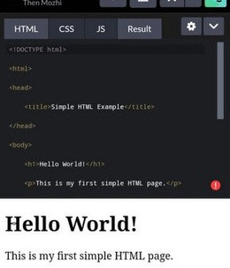
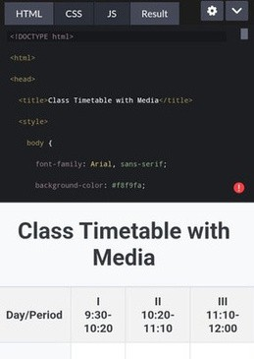

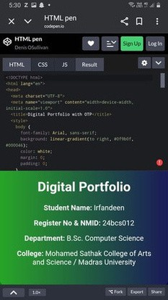
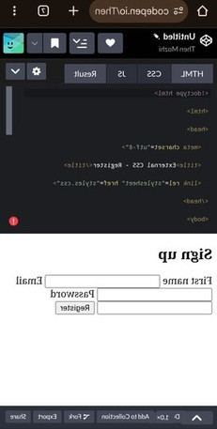
RESULTS AND SCREENSHOTS
3/21/2024 Annual Review
10

Slide 11
CONCLUSION
The Digital Portfolio Website provides an organized and professional way to present personal achievements, skills, and
projects.
It enhances career opportunities and creates a strongdigital presence
10

