Slide 1
Digital Portfolio
STUDENT NAME: MANIKANDAN G
REGISTER NO AND NMID: 35524U09019/6A9A41E9CF4282185254CBEF8685A263
DEPARTMENT: II-BCA
COLLEGE: COLLEGE/ UNIVERSITY
GOVERNMENT ARTS AND SCIENCE COLLEGE TIRUPATTUR/
THIRUVALLUVAR UNIVERSITY

Slide 2
PROJECT TITLE
TICKET BOOKING SYSTEM

Slide 3


AGENDA
Problem Statement
Project Overview
End Users
Tools and Technologies
Portfolio design and Layout
Features and Functionality
Results and Screenshots
Conclusion
Github Link
3/21/2024 Annual Review

Slide 4

PROBLEM STATEMENT
1. Manual Process Issues – Traditional ticket booking (bus, train, movie, events) is time-consuming and prone to human errors. 2. Accessibility Problem – Customers face difficulties booking tickets outside working hours or from remote areas. 3. Data Management Issues – Manual systems struggle to maintain records of bookings, cancellations, and payments. 4. User Convenience – Lack of an easy, quick, and reliable platform for customers to check availability and book tickets online. 5. Overbooking / Mismanagement – Without automation, duplicate or overbooked tickets often occur. 6. Payment Handling – Manual handling of payments is unsafe and inefficient. 7. Scalability Problem – As the number of users grows, manual systems fail to meet demand.

Slide 5

PROJECT OVERVIEW
1. Project Title – Ticket Booking System 2. Objective – To provide a digital solution for easy and quick ticket booking. 3. Problem Addressed – Removes long queues, manual errors, and time-consuming booking methods. 4. Scope – Online ticket search, booking, cancellation, and e-ticket generation. 5. Features – User login, seat availability, secure payment, booking history. 6. Technology Used – HTML, CSS, JavaScript, backend language (PHP/Java/Python), and MySQL database. 7. Target Users – General public (customers) and administrators. 8. Expected Outcome – Faster process, user convenience, and efficient record management. 9. Impact – Saves time, enhances accuracy, and improves customer satisfaction.

Slide 6

WHO ARE THE END USERS?
1. General Customers – People who book tickets for travel, movies, or events. 2. Administrators – Manage bookings, update schedules, and handle cancellations. 3. Travel/Event Agencies – Service providers who list and manage ticket availability. 4. Cashiers/Operators (if hybrid system) – Assist customers in semi-digital/physical counters. 5. Support Staff – Handle user queries, complaints, or technical issues.

Slide 7

TOOLS AND TECHNIQUES
1. Frontend Tools – HTML, CSS, JavaScript (for user interface design). 2. Backend Tools – PHP / Java / Python (for server-side logic). 3. Database – MySQL / SQL Server (for storing user and booking data). 4. Frameworks – Bootstrap, React, or Angular (for responsive design). 5. Payment Gateway Integration – PayPal, Razorpay, Stripe (for secure online payments). 6. Web Server – Apache / Node.js / Tomcat (to host the application). 7. Security Techniques – Data encryption, SSL, user authentication, OTP verification. 8. Testing Tools – Selenium / JUnit (for system and user acceptance testing). 9. Version Control – Git/GitHub (for code management). 10. Deployment – Cloud platforms like AWS, Azure, or local server hosting.

Slide 8
POTFOLIO DESIGN AND LAYOUT
1. Cover Page – Project title, your name, roll number, institution details. 2. Abstract / Overview – Short summary of the project. 3. Table of Contents – Easy navigation to different sections. 4. Problem Statement – Issues in the existing ticket booking system. 5. Objectives – Main goals of the project. 6. System Design – Flowcharts, ER diagrams, and architecture layout. 7. Implementation – Tools, techniques, and coding details. 8. Screenshots / UI Layout – Sample designs of login page, booking page, payment page. 9. Results / Output – Booking confirmation, e-ticket generation. 10. Conclusion – Benefits and future scope of the project. 11. References – Books, websites, or resources used.
8

Slide 9
FEATURES AND FUNCTIONALITY
The online ticket booking system ensures convenient features like easy registration, event search, seat/slot selection, secure digital payment, instant e-ticket, booking history, and cancellation; while following rules such as providing valid user details, adhering to payment and refund policies, and respecting booking limits & terms of service.

Slide 10

RESULTS
1. Displays booking confirmation with unique booking ID. 2. Shows passenger/user details and selected schedule. 3. Provides seat/slot number allocation. 4. Includes payment status (successful, pending, failed). 5. Generates an e-ticket or receipt for download/print. 6. Sends confirmation via SMS/Email/Notification.
3/21/2024 Annual Review
10

Slide 11
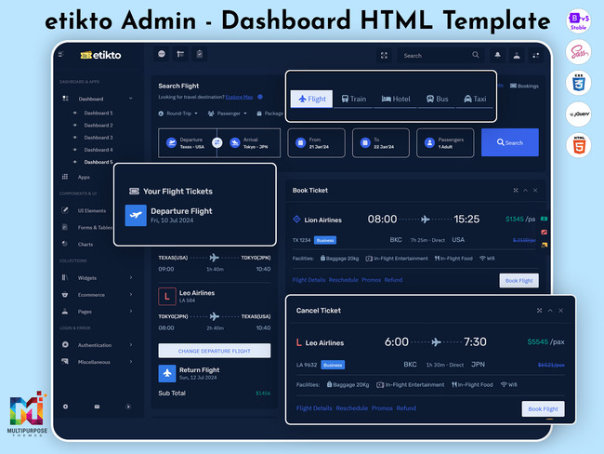
SCREENSHOTS

Slide 12
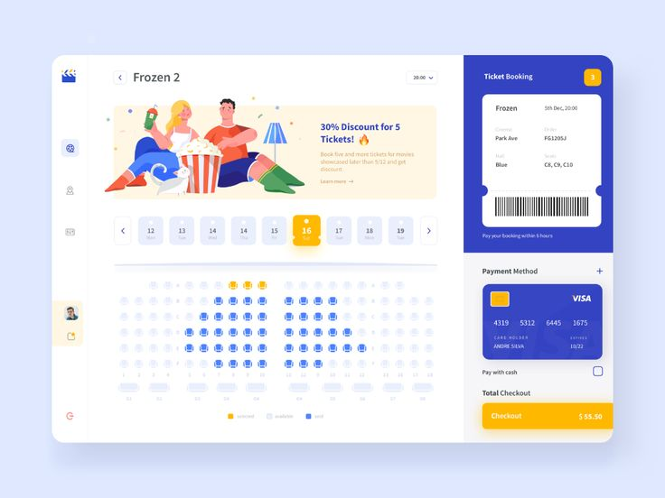
SCREENSHOTS

Slide 13
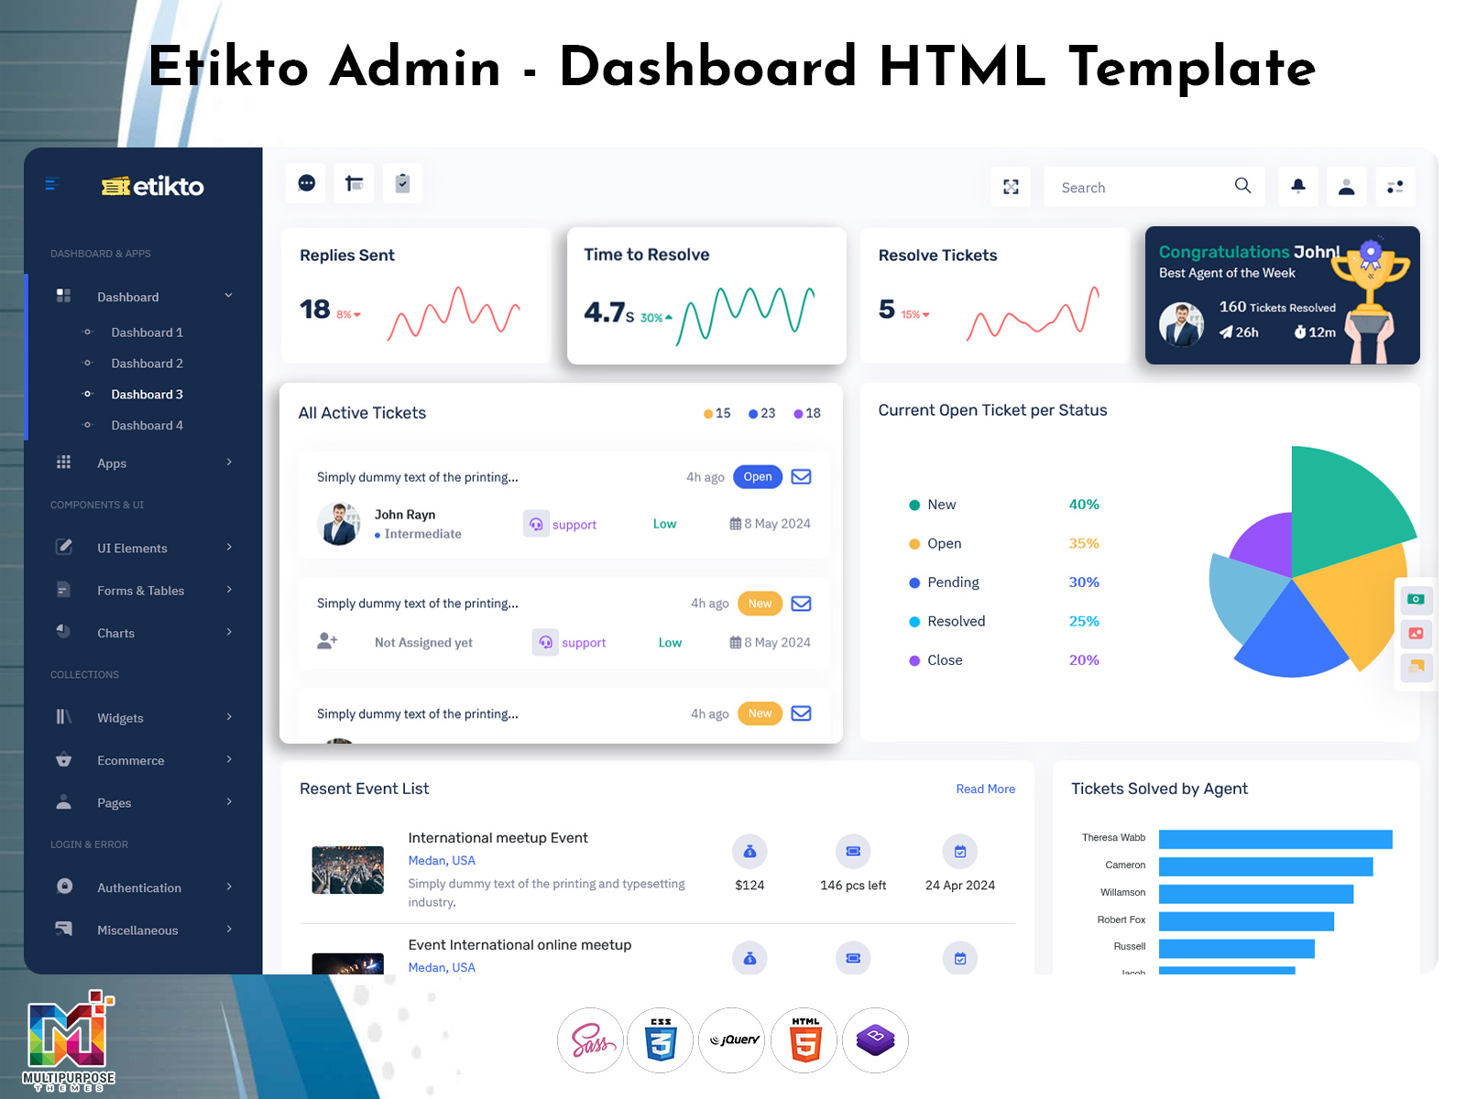
SCREENSHOTS

Slide 14
CONCLUSION
The ticket booking system is a reliable and efficient solution that simplifies the entire process of reserving tickets. It allows users to book anytime and anywhere, reducing manual effort and saving valuable time. The system ensures accuracy in booking details, secure payment processing, and quick confirmation of tickets. By providing a user-friendly interface and minimizing errors, it enhances customer satisfaction. Overall, the ticket booking system improves service quality and makes the booking process faster, easier, and more convenient.
14

Slide 15
GITHUB LINK
https://github.com/24bcanm19-in/MANIKANDAN-NAANMUDTHALVAN-2025.git

