Slide 1
Digital Portfolio
STUDENT NAME: K.madhusri
REGISTER NO AND NMID: 2426j0101,asbruap2426j0101
DEPARTMENT: Information technology
COLLEGE: PPG COLLEGE OF ARTS AND SCIENCE/BHARATHIYAR UNIVERSITY

Slide 2
PROJECT TITLE
SIMPLE PORTFOLIO

Slide 3


AGENDA
Problem Statement
Project Overview
End Users
Tools and Technologies
Portfolio design and Layout
Features and Functionality
Results and Screenshots
Conclusion
Github Link
3/21/2024 Annual Review

Slide 4

PROBLEM STATEMENT
Many individuals such as beginners, freelancers, or job seekers find it challenging to create a professional and attractive online portfolio that effectively showcases their skills, projects, and contact details. They need a simple, easy-to-build website without requiring advanced programming knowledge or complex tools.

Slide 5

PROJECT OVERVIEW
The project is a straightforward, static portfolio website created using HTML and CSS. It contains sections for "About Me," "Projects," and "Contact," providing a clean and organized way for users to present their personal information and work. The site uses basic navigation for smooth scrolling between sections and has a minimalistic design for readability and ease of use.

Slide 6

WHO ARE THE END USERS?
Job seekers and freelancers wanting to showcase their skills and projects online.
Recruiters and hiring managers looking for quick access to a candidate’s portfolio.
Clients interested in reviewing a professional’s previous work.
Beginners in web development who want a template to build their first portfolio.

Slide 7

TOOLS AND TECHNIQUES
HTML5:
To structure the webpage content semantically.
CSS3:
For styling and layout, creating a visually appealing design.
Web Browser:
To view and test the portfolio locally.
Optional Deployment Platforms:
GitHub Pages, Netlify, or any static web hosting service for publishing the portfolio online.

Slide 8
POTFOLIO DESIGN AND LAYOUT
Portfolio Design and Layout
The portfolio uses a clean, minimalistic design with a simple color scheme to keep the focus on content. The layout is divided into clear sections:
Header: Displays the name and navigation links for quick access to different parts of the page.
About Me: A brief introduction to the person.
Projects: Highlights of key projects with titles and descriptions.
Contact: Easy-to-find contact information including email and LinkedIn.
Footer: A small copyright note.
8

Slide 9
FEATURES AND FUNCTIONALITY
Single-page navigation: Clicking on the navigation links smoothly scrolls to the relevant section.
Simple and clean typography: Easy-to-read fonts with good contrast.
Section separation: Each section is visually distinct with background and border styling.
External links: The LinkedIn URL opens in a new tab to keep the portfolio accessible.
Cross-browser compatibility: The site works well on modern browsers without needing JavaScript or backend code.

Slide 10
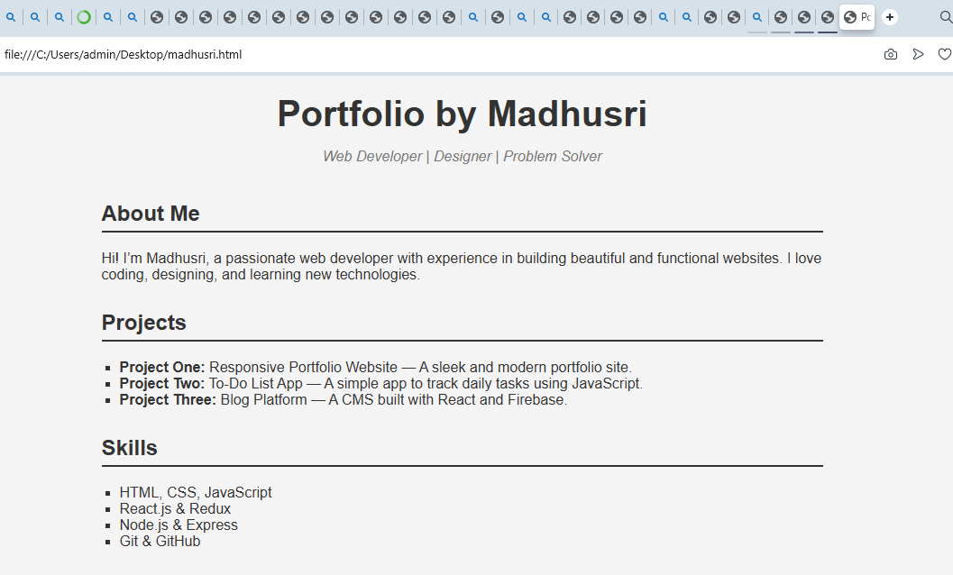

RESULTS AND SCREENSHOTS
3/21/2024 Annual Review
10

Slide 11
CONCLUSION
This simple portfolio design demonstrates how minimal HTML and CSS can create a professional, easy-to-use website for showcasing personal projects and contact information. It solves the problem of needing a straightforward, customizable portfolio template without complex tools created by Belshiya.
Users can expand or customize it further by adding more projects, improving responsiveness, or integrating interactive features as their skills grow.
11

