Slide 1
Digital Portfolio
STUDENT NAME: Dharshna B
REGISTER NO: 2426J0406
NMID: EB2F17BF0F38565978D4F4C0EDCEBA14
DEPARTMENT: Information technology
COLLEGE: Sri Krishna Adithya College of Arts and Science / Bharathiyar University

Slide 2
PROJECT TITLE
Iot enabled smart refrigerator for food monitoring

Slide 3

AGENDA
Problem Statement
Project Overview
End Users
Tools and Technologies
Portfolio design and Layout
Features and Functionality
Results and Screenshots
Conclusion
Github Link

Slide 4
AGENDA
Problem Statement
Project Overview
End Users
Tools and Technologies
Portfolio design and Layout
Features and Functionality
Results and Screenshots
Conclusion
Github Link

Slide 5

PROBLEM STATEMENT
*Problem:* Food spoilage, waste, and health risks due to lack of real-time monitoring and management of stored food in traditional refrigerators.
*Goal:* Develop an IoT-enabled smart refrigerator that tracks food inventory, detects spoilage, and alerts users to reduce waste and improve food safety.

Slide 6
PROJECT OVERVIEW
Food tracking and inventory management
Freshness monitoring (temperature, humidity, gas sensors)
Real-time alerts and notifications
Recipe suggestions
5. Remote monitoring via mobile app

Slide 7

WHO ARE THE END USERS?
Students – who need resumes for internships or higher studies.
Job Seekers – freshers and experienced people applying for jobs.
Freelancers – who want to show their skills and projects.
Colleges / Placement Cells – helping students prepare resumes.

Slide 8
TOOLS AND TECHNIQUES
*Hardware:*1. *Sensors*: Temperature, humidity, gas, and camera.2. *Microcontrollers*: Raspberry Pi, Arduino, or ESP32.3. *Communication Modules*: Wi-Fi, Bluetooth, or cellular.*
Software:*1. *Cloud Platforms*: AWS, Google Cloud, or Azure.2. *Mobile Apps*: iOS and Android apps for remote monitoring.3. *Machine Learning*: Image recognition and predictive analytics

Slide 9
PORTFOLIO DESIGN AND LAYOUT
PORTFOLIO DESIGN:
Clean, professional layout for presenting the project.Sections for introduction, system architecture, and working flow.Responsive design for portfolio site (HTML, CSS, JavaScript).
9

Slide 10
Clean, professional layout for presenting the project.Sections for introduction, system architecture, and working flow.Responsive design for portfolio site (HTML, CSS, JavaScript).

Slide 11
FEATURES AND FUNCTIONALITY
Real-time food monitoring (quantity, expiry date, freshness).Notifications for low-stock/expired food.Automatic shopping list generation.Cloud synchronization for remote access.Data visualization (graphs/charts of usage patterns).

Slide 12
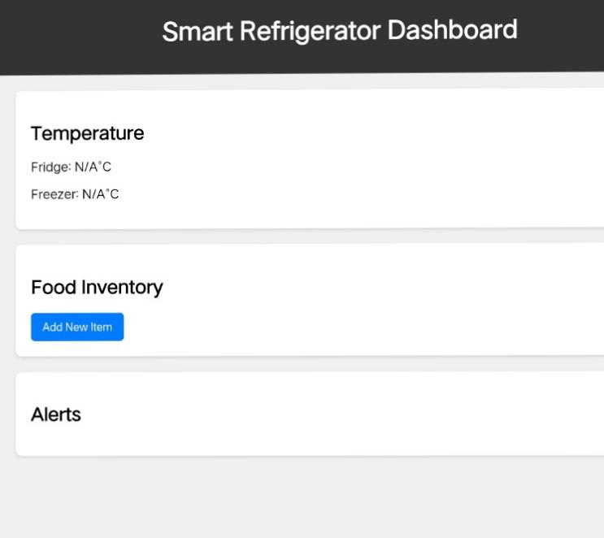
RESULTS AND SCREENSHOTS
12

Slide 13
CONCLUSION
Summarize benefits: reduced food waste, cost savings, efficient food management.Highlight scalability for households and commercial use.Mention possible future enhancements (AI-based food freshness detection, voice assistant integration).
13

Slide 14
Github Link
https://github.com/24bsit114dharshnab-bot/TNSDC-FWD-DIGITAL_PORTFOLIO.git

