Slide 1
Digital Portfolio
STUDENT NAME: KANISHKA A
REGISTER NO: 2426J0418
NMID: FEFCC38FDFC2266B211431CB8D8FD021
DEPARTMENT: Information technology
COLLEGE: Sri Krishna Adithya College of Arts and Science / Bharathiyar University

Slide 2
PROJECT TITLE
Blockbusters Effect
Portfolio Using
Frontend Developer

Slide 3

AGENDA
Problem Statement
Project Overview
End Users
Tools and Technologies
Portfolio design and Layout
Features and Functionality
Results and Screenshots
Conclusion
Github Link

Slide 4

PROBLEM STATEMENT
• Producers must decide whether to pursue risky, high-budget blockbusters or invest in a larger number of smaller projects
• Distributors/platforms struggle with inventory management, marketing costs, and balancing hits vs. niche content.
• Consumers face limited diversity in mainstream offerings as companies chase “safe bets.”

Slide 5
PROJECT OVERVIEW
Industries covered: Film, music, publishing, gaming, and digital streaming.
Perspectives: Producers, distributors, platforms, and consumers.
Focus: Market concentration, risk management, and future trends.

Slide 6

WHO ARE THE END USERS?
Consumers/Audiences → who watch, read, listen, or play blockbuster content. Content Platforms/Distributors → like Netflix, Spotify, or cinemas, that rely on blockbusters to attract users. Advertisers/Marketers → who use blockbuster popularity to reach mass audiences.

Slide 7
TOOLS AND TECHNIQUES
1. Data Analytics & Algorithms → Used to predict audience demand and recommend blockbuster content.
2. Streaming & Distribution Platforms → Netflix, Spotify, YouTube help spread hits quickly to global audiences.
3. Mass Marketing & Advertising → Trailers, posters, social media campaigns build hype and visibility. 4. Star Power & Influencers → Famous actors, singers, or creators attract large audiences. 5. Franchising & Sequels → Successful blockbusters are extended into series, games, or spin-offs. 6. Cross-Promotion & Merchandising → Partnerships with brands, products, and ads boost revenue.

Slide 8
PORTFOLIO DESIGN AND LAYOUT
PORTFOLIO DESIGN:
1. Cover Page – Title, tagline, your name, cinematic background. 2. About Project – Introduction, objective, scope. 3. Features / Highlights – Influence on lifestyle, trends, psychology, economy, culture. 4. Methodology – Research → Data → Analysis → Findings → Conclusion. 5. Results / Findings – Charts, statistics, key outcomes. 6. Conclusion & Future Scope – 3–4 key points. 7. Contact / Footer – Your details + thank you note.
8

Slide 9
LAYOUT:
1. Cover – Title, tagline, your name, movie theme background. 2. About – Intro, objective, scope. 3. Highlights – Lifestyle, fashion, psychology, economy, culture. 4. Methodology – Research → Data → Analysis → Findings → Conclusion. 5. Results – Charts, stats, key outcomes. 6. Conclusion & Future Scope – 3–4 points. 7. Footer – Contact + thank you note.

Slide 10
FEATURES AND FUNCTIONALITY
Hit-Driven Success → Only a few products become blockbusters and drive most of the revenue.
High Risk & Reward → Companies invest heavily in big projects that can either succeed massively or fail.
Market Concentration → Popular blockbusters dominate sales and attention, leaving smaller works behind.
Consumer Influence → Audiences, trends, and word-of-mouth decide which products become hits.
Cross-Industry Impact → The effect works across movies, music, books, games, and streaming platforms.

Slide 11
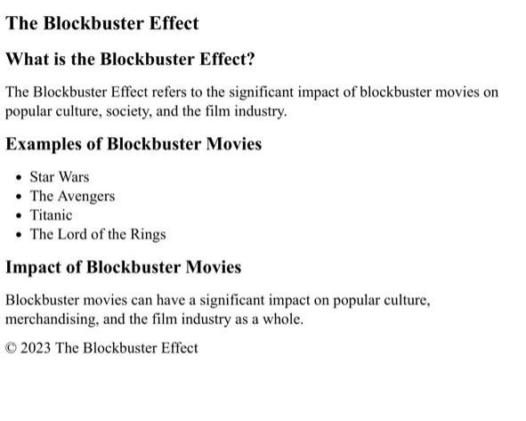
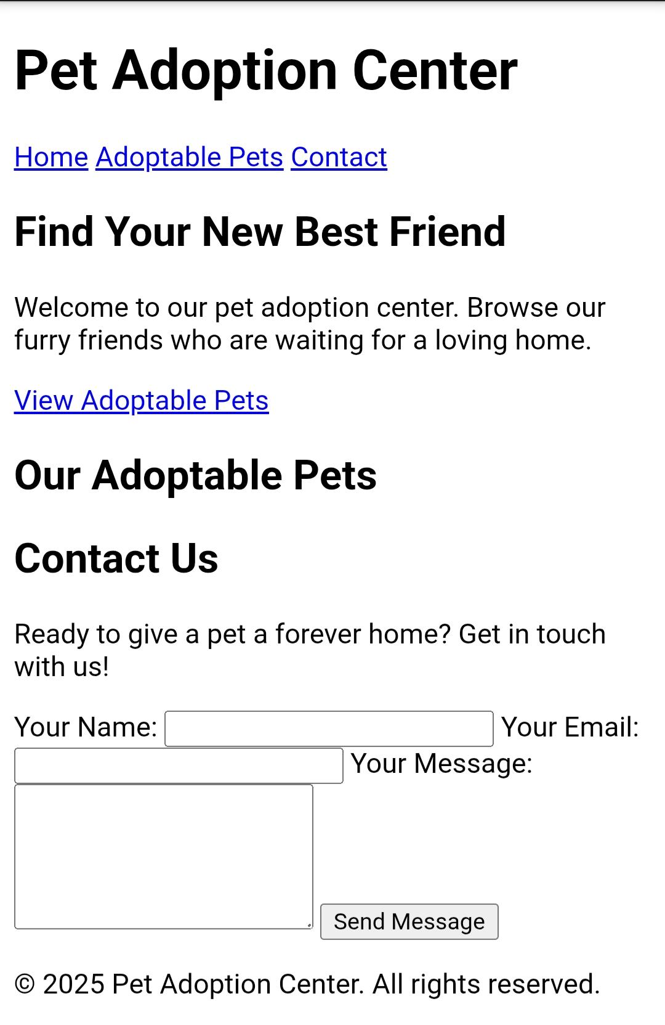
RESULTS AND SCREENSHOTS
Homepage With Blockbusters Effect
11

Slide 12
CONCLUSION
The Blockbuster Effect shows that a small number of hits generate most of the revenue while many products struggle. This creates both opportunities and risks for companies, as success can be massive but failure costly. To sustain growth, businesses must balance investing in blockbusters with supporting diverse content and adapting to changing consumer trends.
12

Slide 13
Github Link
https://github.com/24bsit126kanishkaa-maker/TNSDC-FWD-DIGITAL_PORTFOLIO.git

