Slide 1
NAME: Ganesh Aditya JP
REGISTER NUMBER:2426J0472
NMID:05CDBE112A8587C9A624B48C4F2D54B9
DEPARTMENT: INFORMATION TECHNOLOGY
COLLEGE:Sri Krishna Adithya College of arts and science/Bharthiyar University

Slide 2
PROJECT TITLE
WEB-BASED
OLA REGISTRATION FORM

Slide 3
AGENDA
Problem Statement
Project Overview
End Users
Tools and Technologies
Portfolio Design & Layout
Features & Functionality
Results & Screenshot
Conclusion

Slide 4
PROBLEM STATEMENT
In the modern world, online ride-booking platforms like Ola require a smooth and secure registration system to allow users to create accounts. Without proper registration, users cannot access essential services like ride booking, fare estimation, and trip management. The challenge is to design a user-friendly, responsive, and validated registration form that ensures data correctness and enhances user experience.

Slide 5
PROBLEM OVERVIEW
This project is a web-based registration form for Ola users, developed using HTML, CSS, and JavaScript. The system collects user details such as Name, Email, Phone, Password, Gender, and City. It validates inputs (e.g., correct email, valid phone number, password strength) before allowing successful registration.
The project is designed to be lightweight, responsive, and easy to integrate into larger applications

Slide 6
END USERS
Customers: Individuals registering for Ola rides.
Ola Admin Team: Uses collected details to manage user accounts.
Developers/Students: Can use this as a learning project for form validation and UI design

Slide 7
TOOLS AND TECHNIQUES
HTML5: For structuring the form and input fields.
CSS3: For styling, layout, and responsive design.
JavaScript: For form validation and dynamic interaction.
Browser (Chrome/Edge/Firefox): For testing the application

Slide 8
FORM DESIGN AND LAYOUT
Header: Project title ("Ola Registration").
Form Layout:
Input fields: Name, Email, Phone, Password, Gender (dropdown), City.
Error messages shown below the form if validation fails.
Styling: Clean and professional look with green-themed buttons (matching Ola’s branding).
Responsiveness: Works well on desktop and mobile screens

Slide 9
FEATURES AND FUNCTIONALITY
✅ User registration form.
✅ Input validation (empty fields, valid phone, password length).
✅ Error messages for incorrect input.
✅ Reset after successful submission.
✅ Success alert for confirmation.

Slide 10
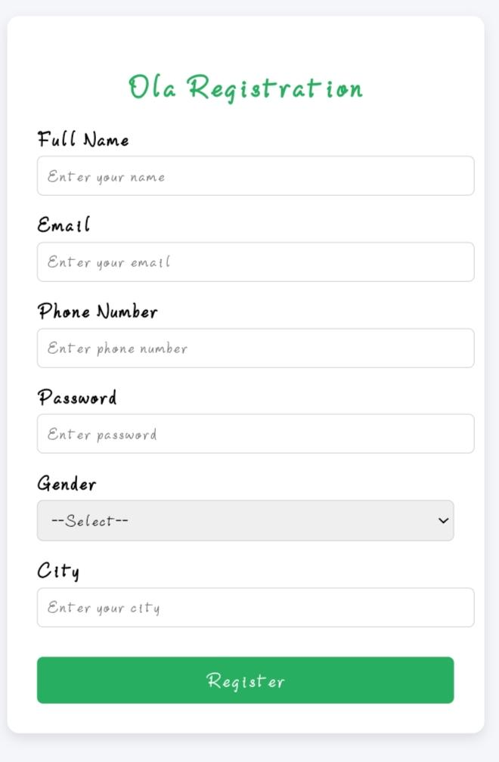
THIS IS MY RESULT

Slide 11
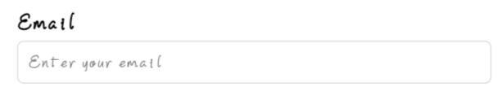
E-MAIL

Slide 12
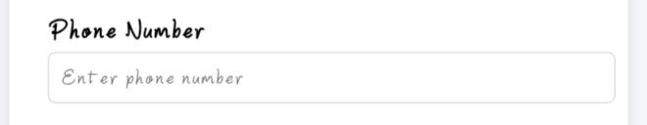
Phone Number

Slide 13
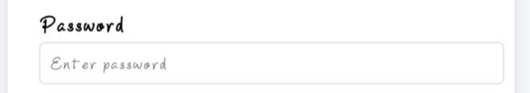
PASSWORD

Slide 14
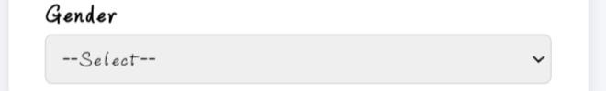
GENDER

Slide 15
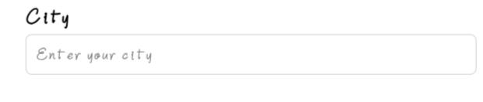
CITY:

Slide 16
GITHUB LINK:
24bsit216ganeshadityap-sudo

