Slide 1
CHARUSAT CSE · SGP 5 · REVIEW 2 EVALUATION
AI-IGMS
AI-Enabled Integrated Government School Management System
A Multilingual 5-Role Digital Academic Platform Powered by Live LLM & MongoDB
STUDENT PRESENTER
Prince Patel
Student ID: 24CS066,24CS68,24CS073
B.Tech Computer Science & Engg
Semester 5 · 2025–26
DEPARTMENT & GUIDE
CHARUSAT University
CSPIT · Dept. of Computer Science
Prof. Akshita kadam
SGP Review 2 Examination
SYSTEM HIGHLIGHTS
100% Live Architecture
• 5 Distinct Portals with RBAC
• Multilingual AI Exam Generator
• 18 Indexed MongoDB Collections
• 0-Second Auto-Grading Engine

Slide 2
01 | BACKGROUND & MOTIVATION
Critical Bottlenecks in Traditional School Administration
CHALLENGE 01 · MANUAL PAPER REGISTERS
45+ Hours Monthly Administrative Drain
Teachers spend over 45 minutes daily hand-marking physical attendance registers and calculating aggregates. Physical logs suffer from dampness, loss, tampering, and zero instant reporting to headmasters.
CHALLENGE 02 · EXAMINATION FATIGUE
High Cognitive Load & Days of Grading Lag
Creating custom terminal question papers across Grades 1–12 requires extensive teacher effort. Furthermore, grading 40+ paper answer sheets takes days, delaying learning feedback and creating human grading variance.
CHALLENGE 03 · RURAL PARENTAL DISCONNECT
Complete Blind Spot on Child Progress
Parents in rural government schools lack real-time visibility into whether their children attended school or how they performed on tests, leading to unchecked absenteeism and high dropout rates.
THE QUANTIFIABLE IMPACT OF EXISTING PROCESSES:
⚡ 78% Manual Admin Overhead | 📉 Zero Real-Time Attendance Sync | ⏱️ 3-5 Days Evaluation Lag | 🚫 No Multilingual Question Generator

Slide 3
02 | OBJECTIVES & VALUE PROPOSITION
AI-IGMS: The 4-Pillar Modernized School Ecosystem
PILLAR 1
Unified 5-Role Digital Portal
Provides isolated, secure dashboards for Super Admin, Principal, Teacher, Student, and Parent with role-specific access controls.
PILLAR 2
Live Multilingual AI Engine
Groq Cloud LLM integration automatically generates standardized, syllabus-aligned question papers in English, Gujarati, and Hindi in under 2 seconds.
PILLAR 3
Online Exam & 0s Auto-Grading
Fully automated MCQ testing platform that instantly evaluates student submissions against MongoDB keys with zero teacher workload.
PILLAR 4
Transparent Academic Operations
Real-time attendance tracking, marks entry with automatic grade calculation (A+–F), and timetable management across all standards.

Slide 4
03 | TECHNICAL ARCHITECTURE
3-Tier System Architecture & Communication Pipeline
TIER 1: PRESENTATION CLIENT
React 18 · Vite 5 · Tailwind CSS
• Responsive Single Page Application (SPA)
• 5 Dedicated Role Portals with Dynamic Routing
• Multi-Language UI (English / Gujarati / Hindi)
• Axios HTTP Client with JWT Bearer Interceptors
TIER 2: APPLICATION & LOGIC
Node.js · Express.js REST API
• Stateless REST API with Granular Route Guards
• JWT Token Generation & Bcrypt 10-Salt Hashing
• Groq Cloud SDK Bridge with JSON Schema Enforcement
• Circuit-Breaker Guard with 2.5s Failover Timeout
TIER 3: DATA & AI INTELLIGENCE
MongoDB Atlas & Groq LPU Engine
• 18 Normalized Collections with Indexed Keys
• Multi-Tenant Isolation via schoolId & studentId
• Llama-3.3-70B/8B Ultra-Fast Inference via Groq Cloud
• Dual Cluster Resiliency (Atlas Cloud + Local Fallback)

Slide 5
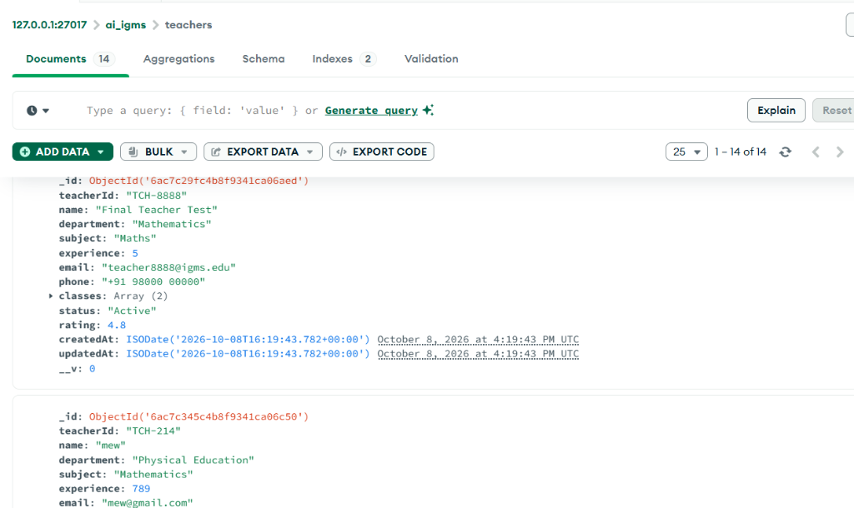
04 | PERSISTENCE & DATA MODEL
MongoDB Database Architecture: 18 Indexed Collections
18 COLLECTIONS STRUCTURED BY DOMAIN
📁 Auth & System (Users, Schools, Audits)
Manages credentials, school profile, and audit logs with role-based claims.
📁 Stakeholder Profiles (Students, Teachers, Parents)
Maintains relational entities linked through unique IDs (teacherId, studentId).
📁 Exams & AI Engine (Exams, Submissions, Results)
Stores published AI papers, questions with answer keys, and student submission logs.
📁 Academic Operations (Attendance, Timetables, Leaves, Notices)
Tracks daily attendance rosters, 6-period weekly matrices, and official circulars.
LIVE MONGODB COMPASS INSPECTION · ai_igms > teachers

Slide 6
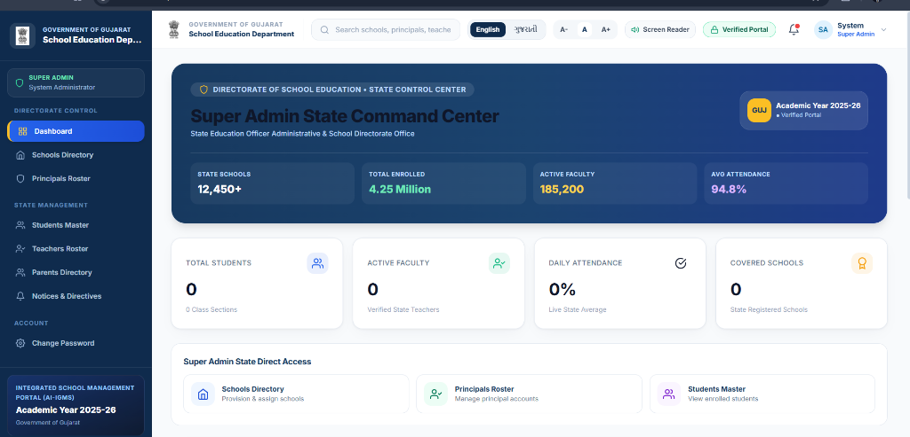
05 | ROLE-BASED ACCESS CONTROL
5 Dedicated Portals with Granular RBAC Security
GRANULAR ROLE GOVERNANCE
👤 Super Admin Portal
State command center, onboard schools, district audits, state-wide enrolment metrics.
👤 Principal Portal
School operations, teacher roster management, student master records, circular notices.
👤 Teacher Portal
AI question generator, publish exams, mark daily attendance, input marks, class timetable.
👤 Student Portal
Attempt timed online exams, view immediate report cards, check timetable & announcements.
👤 Parent Portal
Live attendance tracking of child, terminal marks view, leave applications, school direct alerts.
LIVE SUPER ADMIN COMMAND CENTER (GOVT OF GUJARAT)

Slide 7
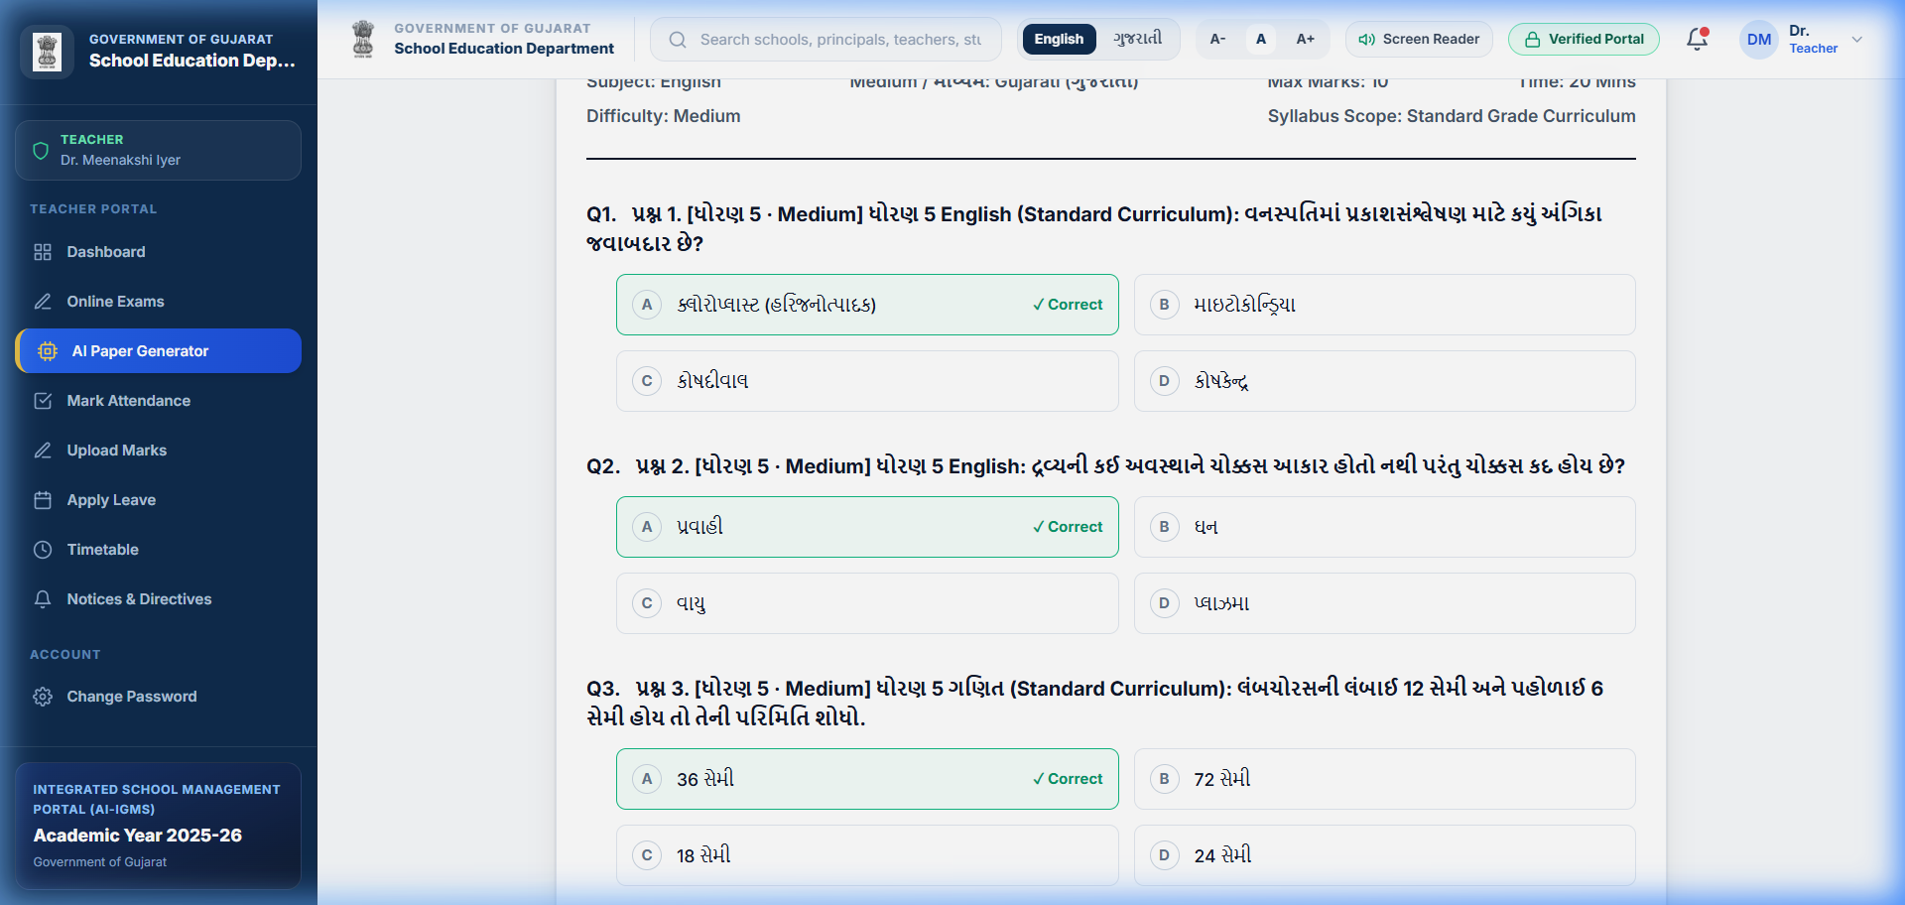
06 | LIVE ARTIFICIAL INTELLIGENCE ENGINE
Multilingual Live AI Paper Generator (Groq Cloud LLM)
GROQ CLOUD LPU INFERENCE ENGINE
✨ Multilingual Generation
Native support for English, Gujarati (ગુજરાતી), and Hindi (हिन्दी) with 100% language fidelity.
✨ Sub-2 Second Generation
Powered by Groq LPU Llama-3.3 hardware acceleration, delivering 10-question papers in < 2.0s without server lag.
✨ Syllabus & Difficulty Matching
Generates age-appropriate questions aligned to Class 1–12 with custom difficulty sliders (Easy / Medium / Hard).
✨ Strict JSON Schema Output
Enforces rigid JSON schema validation: question title, 4 options, and correct answer key for instant zero-error database publication.
✨ Fail-Safe Circuit Breaker
Embedded fallback question cache ensures the teacher never faces timeouts even if internet drops.
LIVE GUJARATI AI PAPER GENERATED IN TEACHER PORTAL

Slide 8
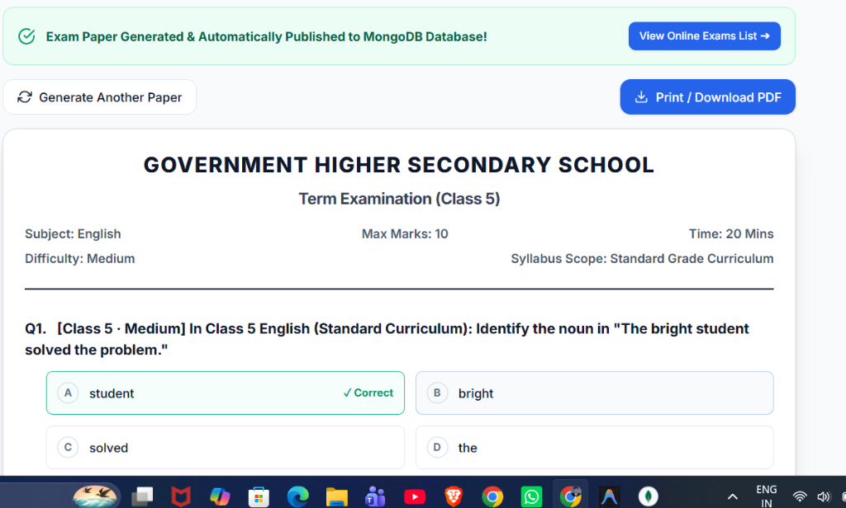
07 | ASSESSMENT & AUTO-GRADING ENGINE
Automated Online Examination & Zero-Latency Scoring
AUTOMATED EXAM EVALUATION LIFECYCLE
⚙️ Step 1: One-Click Publishing
AI-generated papers are immediately saved into the Exams collection with status 'Published' and allocated to specific classes.
⚙️ Step 2: Timed Student Assessment
Students take the test inside a clean, distraction-free interface with countdown timer and randomized option presentation.
⚙️ Step 3: 0-Second Auto-Grading
Upon submission, answers are instantly matched against MongoDB answer keys on the server—zero human evaluation required.
⚙️ Step 4: Real-Time Report Card
Students and teachers receive immediate score breakdowns, correct answer reviews, and percentage rankings.
⚙️ Step 5: PDF Export & Archive
Teachers can print official PDF question papers with school header and answer keys with a single click.
LIVE EXAM AUTO-PUBLISHED TO MONGODB DATABASE

Slide 9
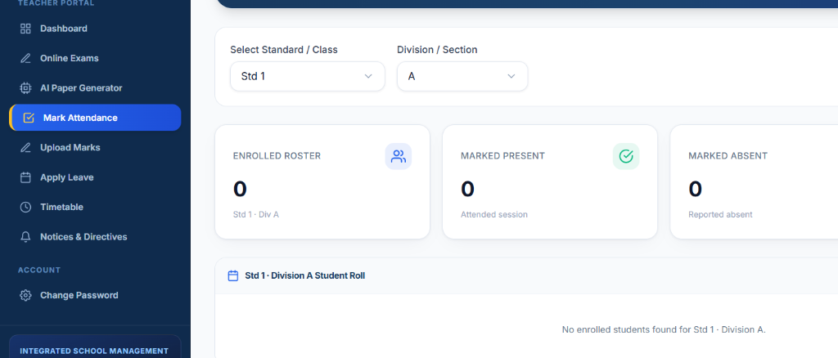
08 | CORE ACADEMIC MODULES
Daily Attendance, Marksheet Entry & Timetable Scheduling
ACADEMIC OPERATIONS INFRASTRUCTURE
📋 Daily Attendance Roster
Teachers select Standard & Division, then mark students Present or Absent with single clicks. Aggregates update automatically with date indexing.
📋 Student Marks Management
Direct marks upload interface with automated grade bands (A+, A, B, C, F), class averages, and permanent MongoDB persistence.
📋 Weekly Timetable Matrix
Dynamic 6-period daily timetable schedule mapping subject, teacher, and classroom allocations without double-booking conflicts.
📋 Leave & Notice Circulars
Teachers apply for leave directly to the Principal, and official school circulars broadcast instantly across portals.
LIVE ATTENDANCE ROSTER MODULE IN TEACHER PORTAL

Slide 10
09 | SECURITY & SYSTEM RELIABILITY
Enterprise Security & Fault-Tolerant Architecture
🛡️ STATELESS JWT AUTHENTICATION
Cryptographic Token Verification
Every authenticated session receives a signed JWT token containing userId and role. Sent via HTTP Bearer headers and validated by server middleware on every request.
🛡️ BCRYPT PASSWORD SALTING
10-Round Cryptographic Hashing
All user passwords across all 5 roles are hashed using Bcrypt with 10 salt rounds before database persistence. Plain-text passwords are never stored or logged.
🛡️ GRANULAR ROUTE GUARDS
Role-Based Endpoint Protection
Client routes and Express endpoints enforce role authorization checks. A student or teacher cannot access admin endpoints or mutate other students' records.
🛡️ CIRCUIT BREAKER & FAILOVER
2.5s Timeout Guard & Dual Cluster
Groq AI requests enforce a strict 2.5-second circuit breaker with automatic local fallback. Database connection features automatic retry between Atlas Cloud and local cluster.

Slide 11
10 | IMPLEMENTATION SPECIFICATIONS
Full-Stack Technology Stack & Developer Tooling
FRONTEND SPA
React 18 & Vite 5
Modular component architecture, React Hooks, React Router 6, instant Hot Module Replacement (HMR).
UI & STYLING
Tailwind CSS & Lucide Icons
Utility-first responsive styling, accessible government color palette, rich interactive iconography.
BACKEND RUNTIME
Node.js & Express.js
High-throughput asynchronous event-driven RESTful API server with custom route middlewares.
DATABASE LAYER
MongoDB Atlas & Mongoose
Scalable document store, schema validations, indexed relational foreign references (ObjectId).
AI ENGINE
Groq Cloud LPU (Llama-3.3)
Low-latency tensor processor inference with prompt engineering and strict JSON schema output.
SECURITY & DEVOPS
JWT, Bcrypt & Git
Stateless bearer authentication, 10-salt password hashing, Git version management.

Slide 12
11 | PROJECT MILESTONES & PROGRESS
SGP Review 2 Deliverables & Review 3 Roadmap
PHASE 1 (COMPLETED)
Review 1 Foundation
✅ Problem definition & literature review
✅ UI wireframing for all 5 roles
✅ Baseline MongoDB schema architecture
✅ REST API endpoint design
PHASE 2 (LIVE & WORKING)
Review 2 Deliverables (100% Done)
✅ 5 Role-Based Portals fully functional
✅ Live Multilingual AI Paper Generator (English, Gujarati, Hindi)
✅ 18 MongoDB collections modeled & live
✅ Online exam taking & 0s auto-grading
✅ Attendance, marks & timetable modules
PHASE 3 (NEXT MILESTONE)
Review 3 & Final Scope
🚀 Automated Parent SMS / WhatsApp alerts
🚀 AI Student Weak-Topic Diagnostic Tutor
🚀 Progressive Web App (PWA) offline sync for remote rural schools
🚀 Final performance benchmarking & viva
CHARUSAT UNIVERSITY · CSE DEPARTMENT · SGP REVIEW 2 EVALUATION
Thank You! Questions & Live System Demonstration Open for Faculty Reviewers.

