Slide 1
STUDENT NAME: Mahalakshmi K
REGISTER NO AND NMID:2422K1842/7AD92442ADBB00E84584BE60F94F7A6B
DEPARTMENT: CS
COLLEGE: AKSHAYA COLLEGE OF ARTS AND SCIENCE

Slide 2
Temperature converter

Slide 3


AGENDA
Problem Statement
Project Overview
End Users
Tools and Technologies
Temperature conventor design and Layout
Features and Functionality
Results and Screenshots
Conclusion
Github Link
3/21/2024 Annual Review

Slide 4

PROBLEM STATEMENT
Many professionals struggle to showcase their skills online due to a lack
of customizable and user-friendly portfolio templates. This project solves that by creating a simple, responsive, and personalized portfolio website.

Slide 5

PROJECT OVERVIEW
This project is a personal portfolio website designed to highlight my skills, projects, experience, and contact information in a clean and modern layout. It aims to serve as a digital resume and an online presence for potential employers or clients.

Slide 6

WHO ARE THE END USERS?
Clients or collaborators
Visitors wanting to learn more about my work
General audience interested in my skills and projects
Recruiters and hiring managers

Slide 7

TOOLS AND TECHNIQUES
Frameworks/Libraries: React.js (or plain HTML/CSS/JS if applicable)
Frontend: HTML, CSS, JavaScript
Design: Figma / Canva / Adobe XD (optional)
Version Control: Git & GitHub
Deployment: GitHub Pages / Netlify / Vercel

Slide 8
TEMPERATURE CONVENTOR DESIGN AND LAYOUT
About Section: Personal information, background, and skills
Projects Section: Showcase of selected projects with descriptions and links
Contact Section: Contact form and social media links
Responsive Design: Optimized for mobile, tablet, and desktop screens
Homepage: Introduction and navigation to other sections
8

Slide 9
FEATURES AND FUNCTIONALITY
Interactive UI with smooth scrolling
Fully responsive design
Hover effects and animations
Project cards with live links and GitHub repositories
Contact form with validation
Downloadable resume option (if included)

Slide 10
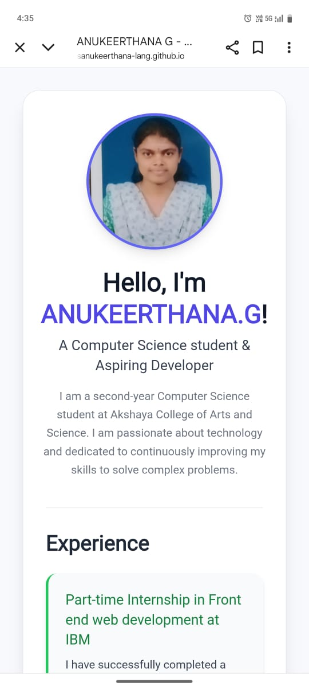

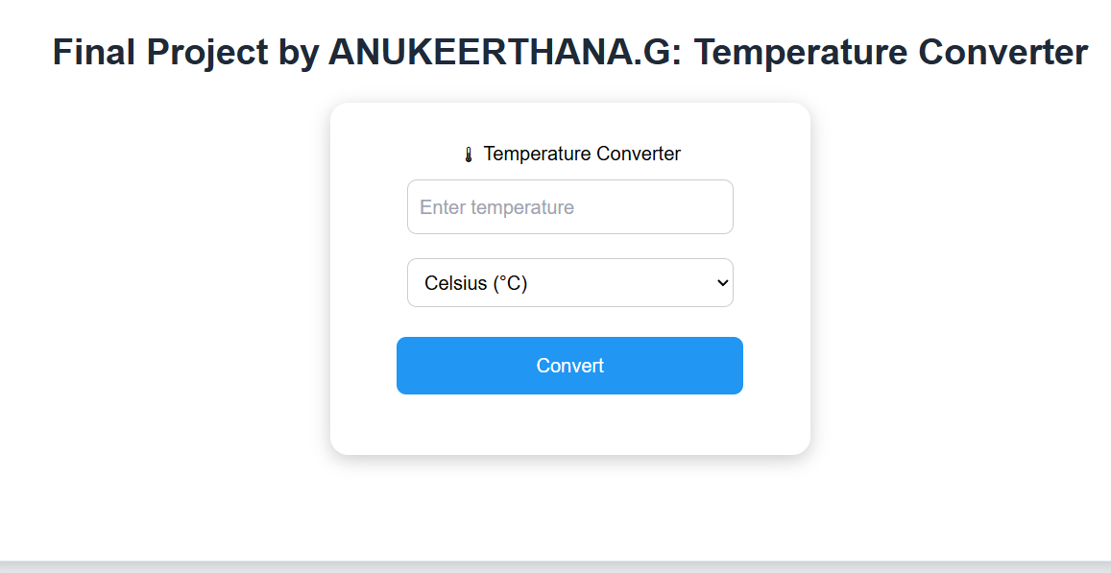
RESULTS AND SCREENSHOTS
Screenshot 1: Homepage with navigation bar
Screenshot 2: Project section with interactive cards
Screenshot 3: Contact form with social icons
3/21/2024 Annual Review
10

Slide 11
CONCLUSION
Built a simple and functional Temperature Converter.
Ensures accurate and quick conversions (Celsius, Fahrenheit, Kelvin).
Designed with a user-friendly layout.
Learned key concepts: math logic, UI design, and input handling.
Future scope: Add more features like history, themes, etc.
11

Slide 12
GITGUB LINK
https://24csanukeerthana-lang.github.io/Anukeerthana-/
12

