Slide 1
Digital Portfolio
STUDENT NAME: VIVINRICHARD.N
REGISTER NO AND NMID: 2422k1855 AND 9D458DC4811F73D8DF24E9EA27125F63
DEPARTMENT: B.Sc.COMPUTER SCIENCE
COLLEGE: COLLEGE/ UNIVERSITY: AKSHAYA COLLEGE OF ARTS AND SCIENCE/ BHARATHIAR UNIVERSITY - COIMBATORE

Slide 2
PROJECT TITLE
DIGITAL DYNAMIC PORTFOLIO

Slide 3


AGENDA
Problem Statement
Project Overview
End Users
Tools and Technologies
Portfolio design and Layout
Features and Functionality
Results and Screenshots
Conclusion
Github Link
3/21/2024 Annual Review

Slide 4

PROBLEM STATEMENT
This project involves creating a one-page personal portfolio using HTML, CSS, and JavaScript. The page includes personal details such as name, contact info, education, and skills. As a demonstration of frontend development skills, the page also features an active calculator capable of performing basic arithmetic operations (addition, subtraction, multiplication, division). The calculator is embedded directly on the page, making the site both informative and interactive.
Personal Information Section
Embedded Calculator Project
Fully Functional & User-Friendly Design
Single-page Structure for Simplicity

Slide 5

PROJECT OVERVIEW
This project is a single-page website built using HTML, CSS, and JavaScript, designed to showcase personal information along with an interactive calculator as a featured project.
The webpage includes key personal details such as name, contact information, educational background, and technical skills. The calculator, embedded within the same page, allows users to perform basic arithmetic operations (addition, subtraction, multiplication, division), demonstrating the developer's ability to create functional and interactive web elements

Slide 6

WHO ARE THE END USERS?
Hackathon & Project Collaborators : To understand my skill set for potential team formations.
Myself : A living document of my learning progress and achievements in academics
Recruiters & Companies : To assess technical skills and project experience for internships and entry-level positions.
University Professors & Peers : For academic collaboration, project reviews, and networking.

Slide 7

TOOLS AND TECHNIQUES
FRONTEND : HTML5,CSS3,JavaScript (ES6+)
STYLING : Custom CSS with Flexbox & Grid for layout
ICONS & UI : Font Awesome Icons
DESIGN PRINCIPLES : Mobile-First Responsive Design.
VERSION CONTROL : Git & GitHub.
CODE EDITOR : Codepen

Slide 8
POTFOLIO DESIGN AND LAYOUT
Navigation Bar : Fixed header with links to all sections.
Hero : Personal introduction with call-to-action buttons.
About : Personal information.
Education : Timeline of academic qualifications.
Projects : Scientific Calculator and Weather app .
Skills : C , C++ , Java , Python .
Interests : Programming, Communication, Sports and Dance .
Contact : Contact details and functional form .
Footer : Copyrights .
8

Slide 9
FEATURES AND FUNCTIONALITY
🔹 Personal Information Section
Displays name, photo, and contact information
Includes educational background and technical skills
Optional short biography or career objective
Clean and structured layout using HTML and CSS
🔹 Integrated Calculator Project
Fully functional calculator using HTML, CSS, and JavaScript
Supports basic arithmetic operations:
Addition (+)
Subtraction (−)
Multiplication (×)
Division (÷)
Responsive buttons and real-time display updates
User-friendly and intuitive interface
Embedded seamlessly into the same webpage

Slide 10
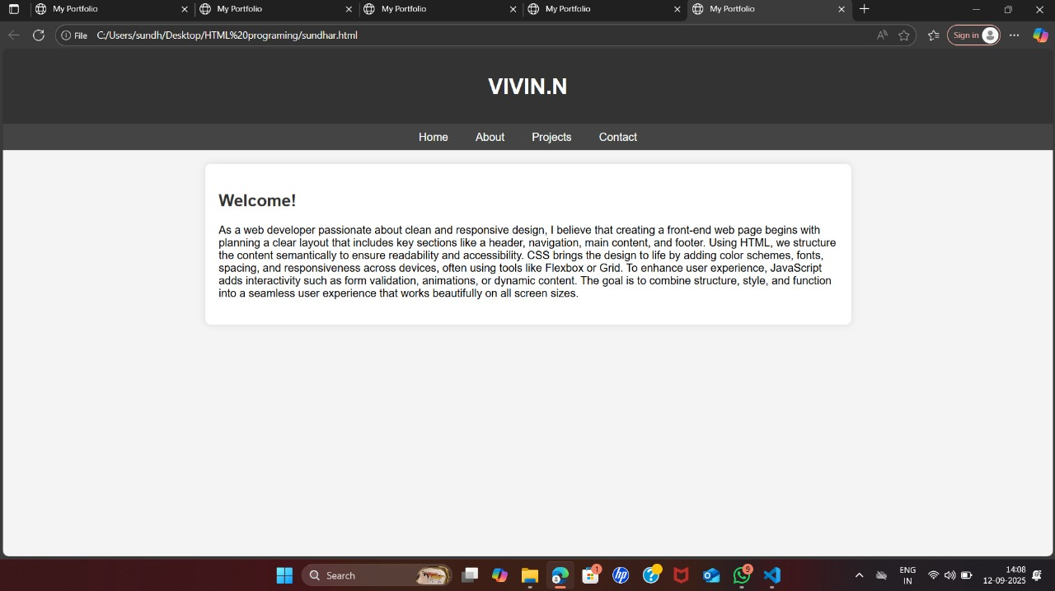

Slide 11
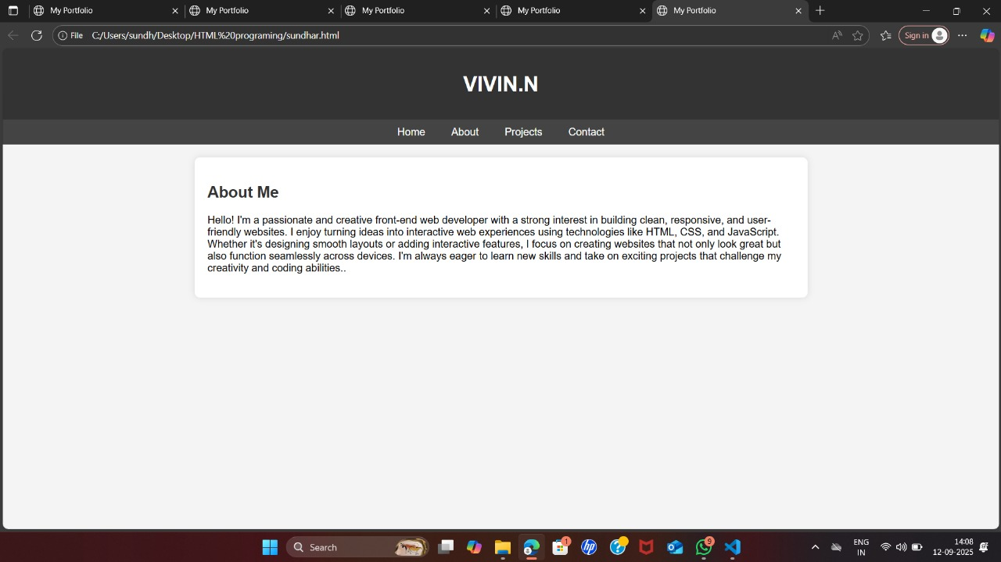

Slide 12
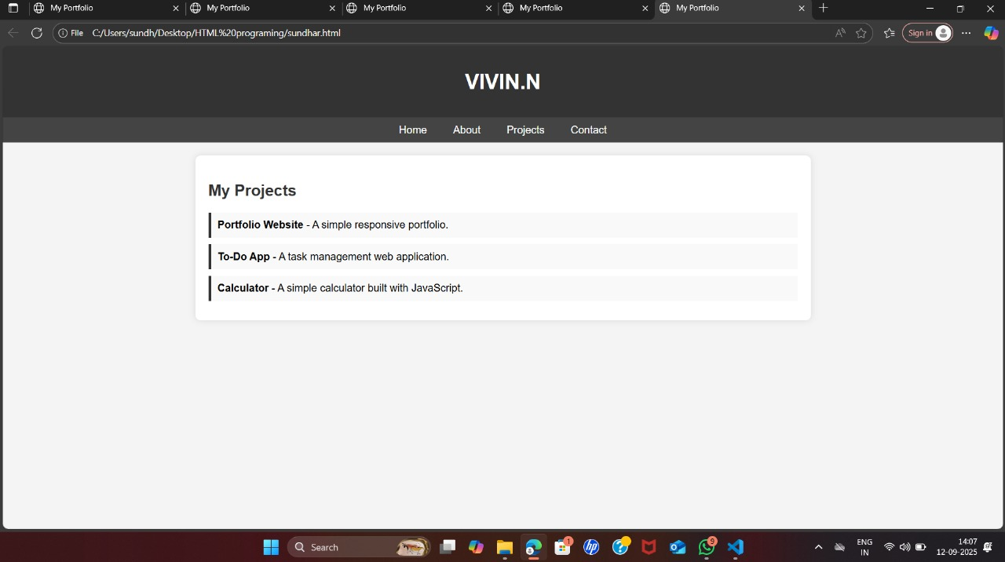

Slide 13
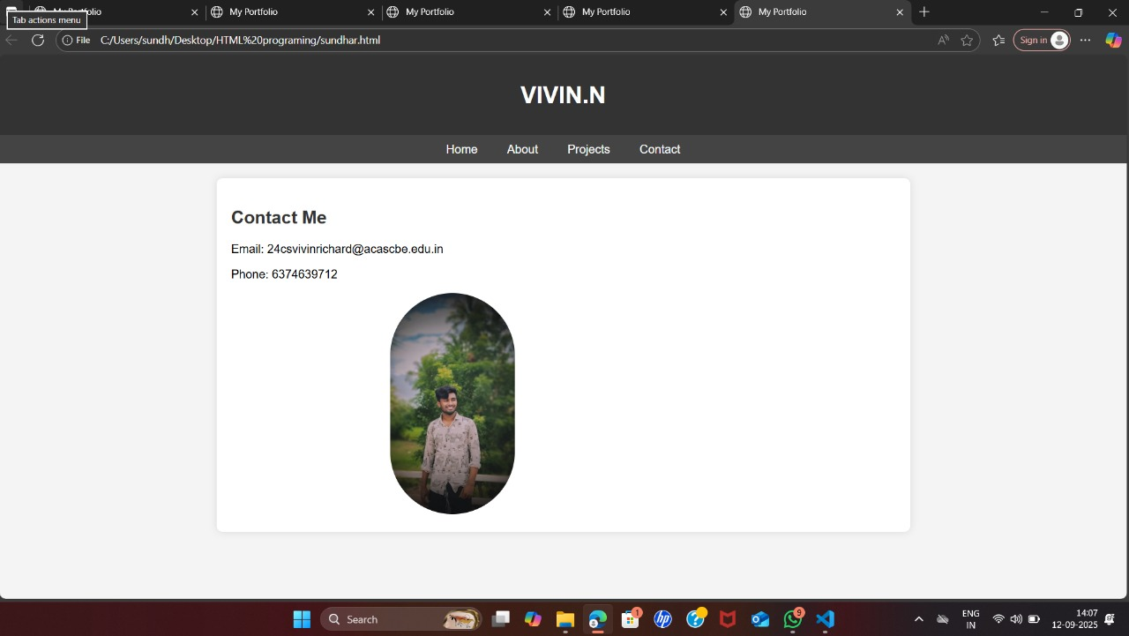

Slide 14
CONCLUSION
The Digital Dynamic Portfolio is an effective way to showcase achievements, skills, and projects in a modern and interactive format. It is easy to update, accessible on any device, and more engaging than traditional resumes. This project helps students and professionals present themselves better for academic and career opportunities.
THANK YOU !!!
14

