Slide 1
UNIT 3
CSUE301 · BIG DATA ANALYTICS
Parallel & Distributed
Data Processing
Parallel and Distributed Data Processing
3.1
Parallelism & its Types
3.2
Data Partitioning
3.3
Data Processing Ops
Partitioning
Joins & Aggregation
Query Optimization
3.4
Query Optimization
Scheduling
Load Balancing
Fault Tolerance
3.5
Cluster Resource Mgmt
3.6
Load Balancing
3.7
Fault Tolerance
3.8
Case Studies
3.9
Summary & Review
1

Slide 2

UNIT 3
Parallel & Distributed
Data Processing
Why Parallel & Distributed Processing Matters
3.1
Parallelism & its Types
3.2
Data Partitioning
3.3
Data Processing Ops
3.4
Query Optimization
3.5
Cluster Resource Mgmt
3.6
Load Balancing
3.7
Fault Tolerance
A single machine cannot store or process modern data volumes. This unit builds the mental model — from CPU-level parallelism to cluster-wide fault tolerance — used inside Hadoop, Spark, and every major cloud data platform.
3.8
Case Studies
3.9
Summary & Review
2

Slide 3
UNIT 3
3.1 PARALLELISM
Parallel & Distributed
Data Processing
What Is Parallelism — and Flynn's Taxonomy
3.1
Parallelism & its Types
Parallel processing uses multiple compute resources simultaneously so a task finishes faster than on one resource alone.
Clusters are MIMD systems: every node runs its own instructions over its own data.
3.2
Data Partitioning
The Four Classifications: -
3.3
Data Processing Ops
3.4
Query Optimization
SISD
SIMD
MISD
MIMD
1 instr · 1 data
1 instr · many data
many instr · 1 data
many instr · many data
Single Instruction Stream, Single Data Stream
3.5
Cluster Resource Mgmt
Single Instruction Stream, Multiple Data Stream
Multiple Instruction Stream, Single Data Stream
Multiple Instruction Stream, Multiple Data Stream
3.6
Load Balancing
Single-threaded script
GPU vector ops
Redundant flight control
Hadoop / Spark cluster
3.7
Fault Tolerance
Distributed clusters = MIMD at scale
3.8
Case Studies
Rule of thumb: a 200-node cluster scanning a 10 TB dataset in parallel finishes in minutes; the same scan on one machine (~150 MB/s) takes over 14 hours. This is the core economic case for distributed processing.
3.9
Summary & Review
3

Slide 4
UNIT 3
3.1 PARALLELISM
Parallel & Distributed
Data Processing
What Is Parallelism — and Flynn's Taxonomy
MIMD Architecture in Distributed Frameworks
Modern big data frameworks operate fundamentally as distributed MIMD architectures:
Apache Hadoop (MapReduce): Different worker nodes execute completely different mapping or reducing tasks across unique splits of data distributed across the HDFS network.
Apache Spark: Worker nodes execute distinct tasks within a complex execution graph (DAG) on localized partitions of a Resilient Distributed Dataset (RDD).
Massively Parallel Processing (MPP) Databases: Systems like Snowflake, Amazon Redshift, or Google BigQuery use clusters of independent compute nodes running isolated queries across segmented data storage.
3.1
Parallelism & its Types
3.2
Data Partitioning
3.3
Data Processing Ops
3.4
Query Optimization
3.5
Cluster Resource Mgmt
3.6
Load Balancing
3.7
Fault Tolerance
3.8
Case Studies
3.9
Summary & Review
3

Slide 5
UNIT 3
3.1 PARALLELISM
Parallel & Distributed
Data Processing
Five Types of Parallelism
1. Bit-Level Parallelism
Concept: Increasing the processor word size so the CPU can process larger numbers or operations in a single cycle.
Mechanism: Moving from 8-bit to 16-bit, 32-bit, and currently 64-bit architectures.
Big Data Context: Enables high-precision mathematical operations and massive direct memory addressing (RAM) on individual cluster nodes.
2. Instruction-Level Parallelism (ILP)
Concept: Executing multiple instructions from a single instruction stream simultaneously within a single CPU core.
Mechanism: Achieved using hardware techniques like pipelining, superscalar execution, and out-of-order execution.
Big Data Context: Speeds up the raw execution of serialized data processing functions at the lowest silicon layer.
3. Data Parallelism
Concept: Distributing independent chunks of data across multiple computing nodes or cores to run the same operation simultaneously.
Mechanism: Data is partitioned into subsets, and each subset is processed in parallel by identical code blocks.
Big Data Context: The foundational paradigm of modern big data systems. It drives frameworks like Apache Spark RDD partitions, Hadoop MapReduce splits, and GPU-accelerated computing.
3.1
Parallelism & its Types
3.2
Data Partitioning
3.3
Data Processing Ops
3.4
Query Optimization
3.5
Cluster Resource Mgmt
3.6
Load Balancing
3.7
Fault Tolerance
3.8
Case Studies
3.9
Summary & Review
4

Slide 6
UNIT 3
3.1 PARALLELISM
Parallel & Distributed
Data Processing
Five Types of Parallelism
4. Task Parallelism (Functional Parallelism)
Concept: Executing completely different operations or tasks concurrently on either the same or different data sets.
Mechanism: Threads or nodes perform unrelated functions at the same time.
Big Data Context: Heavily used in multi-stage workflows and complex orchestration pipelines (e.g., executing a data ingestion task, a data cleaning job, and an ML model training job concurrently via Apache Airflow).
5. Loop-Level Parallelism
Concept: Optimizing loops so that individual iterations can run concurrently instead of waiting for the previous iteration to finish.
Mechanism: Compiler optimization or manual directives (like OpenMP) that parallelize independent loop execution paths.
Big Data Context: Critical for optimizing repetitive mathematical operations inside data analysis scripts, matrix transformations, and machine learning algorithms.
3.1
Parallelism & its Types
3.2
Data Partitioning
3.3
Data Processing Ops
3.4
Query Optimization
3.5
Cluster Resource Mgmt
3.6
Load Balancing
3.7
Fault Tolerance
3.8
Case Studies
3.9
Summary & Review
CSUE301 · Big Data Analytics · CHARUSAT
4

Slide 7
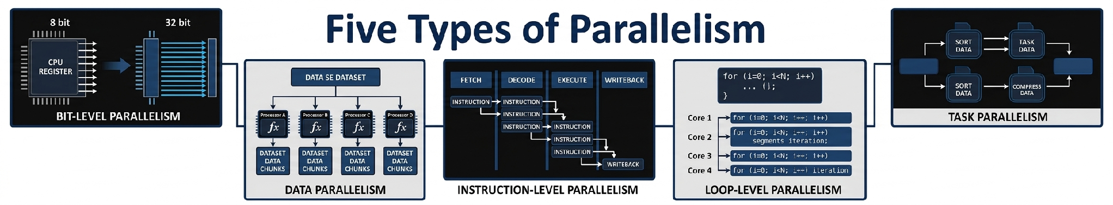
UNIT 3
3.1 PARALLELISM
Parallel & Distributed
Data Processing
Five Types of Parallelism
3.1
Parallelism & its Types
3.2
Data Partitioning
3.3
Data Processing Ops
3.4
Query Optimization
3.5
Cluster Resource Mgmt
3.6
Load Balancing
3.7
Fault Tolerance
3.8
Case Studies
3.9
Summary & Review
CSUE301 · Big Data Analytics · CHARUSAT
4

Slide 8
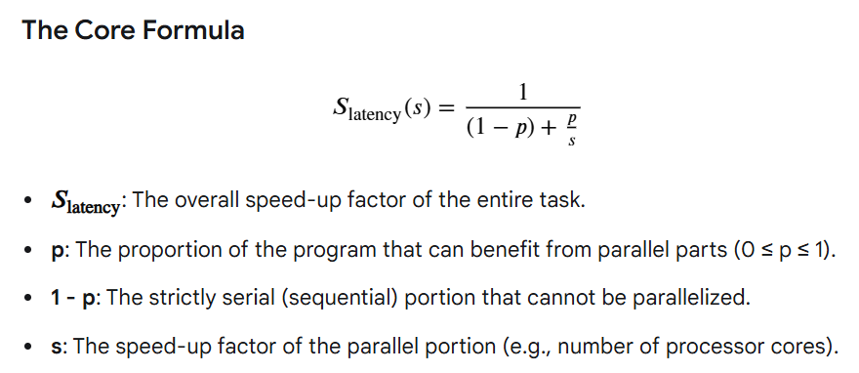
UNIT 3
3.1 PARALLELISM
Parallel & Distributed
Data Processing
Amdahl's Law — the Limit of Speed-Up
3.1
Parallelism & its Types
Amdahl's Law predicts the theoretical maximum speed-up of a program when only a part of it is parallelized.
It proves that the non-parallel portion of a program always creates a hard performance bottleneck.
3.2
Data Partitioning
3.3
Data Processing Ops
3.4
Query Optimization
3.5
Cluster Resource Mgmt
3.6
Load Balancing
3.7
Fault Tolerance
3.8
Case Studies
3.9
Summary & Review
CSUE301 · Big Data Analytics · CHARUSAT
5

Slide 9
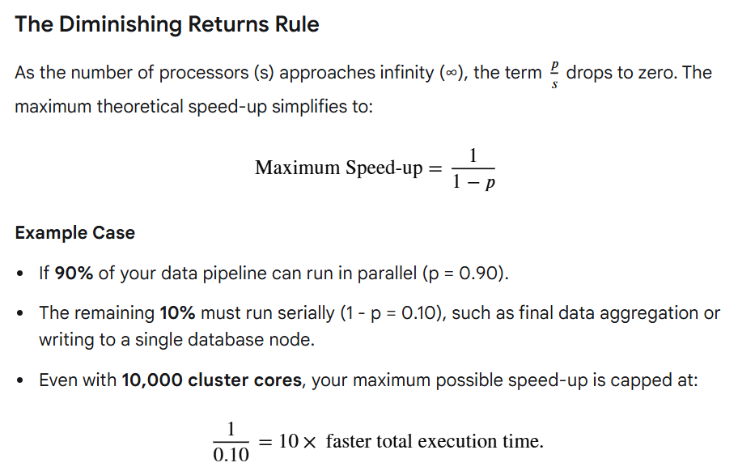
UNIT 3
3.1 PARALLELISM
Parallel & Distributed
Data Processing
Amdahl's Law — the Limit of Speed-Up
3.1
Parallelism & its Types
3.2
Data Partitioning
3.3
Data Processing Ops
3.4
Query Optimization
3.5
Cluster Resource Mgmt
3.6
Load Balancing
3.7
Fault Tolerance
3.8
Case Studies
3.9
Summary & Review
5

Slide 10
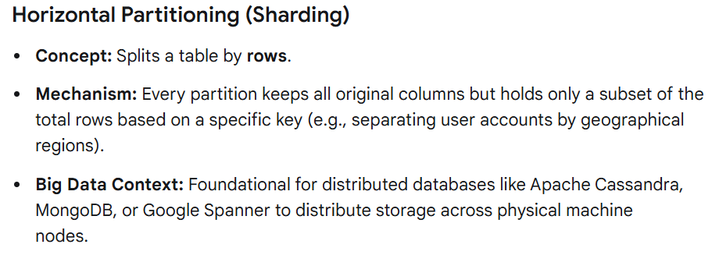
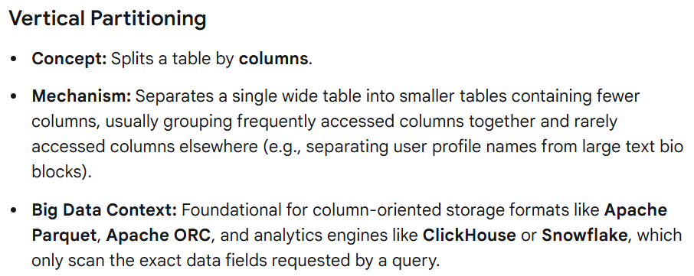
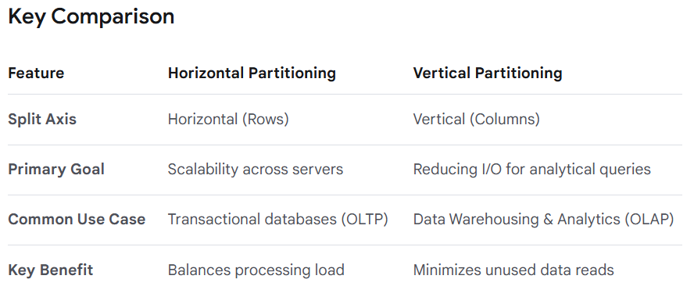
UNIT 3
3.2 DATA PARTITIONING
Parallel & Distributed
Data Processing
Horizontal vs Vertical Partitioning
3.1
Parallelism & its Types
3.2
Data Partitioning
3.3
Data Processing Ops
3.4
Query Optimization
3.5
Cluster Resource Mgmt
3.6
Load Balancing
3.7
Fault Tolerance
3.8
Case Studies
3.9
Summary & Review
6

Slide 11
UNIT 3
3.2 DATA PARTITIONING
Parallel & Distributed
Data Processing
Horizontal vs Vertical Partitioning
3.1
Parallelism & its Types
Horizontal Partitioning (Sharding)
Vertical Partitioning
3.2
Data Partitioning
Splits by ROWS — each shard holds full records for a subset of keys
Splits by COLUMNS — hot vs cold columns stored separately (basis of Parquet/ORC)
Shard 1: id 1–1M (all cols)
customers_core
(id, name, email)
3.3
Data Processing Ops
Shard 2: id 1M–2M (all cols)
3.4
Query Optimization
customers_history
(address, purchase_blob)
Shard 3: id 2M–3M (all cols)
3.5
Cluster Resource Mgmt
3.6
Load Balancing
Horizontal: fast range scans; risk of hot shards from skewed keys
Vertical: analytical queries skip unread columns entirely — the reason columnar formats (Parquet/ORC) are fast
3.7
Fault Tolerance
3.8
Case Studies
3.9
Summary & Review
6

Slide 12
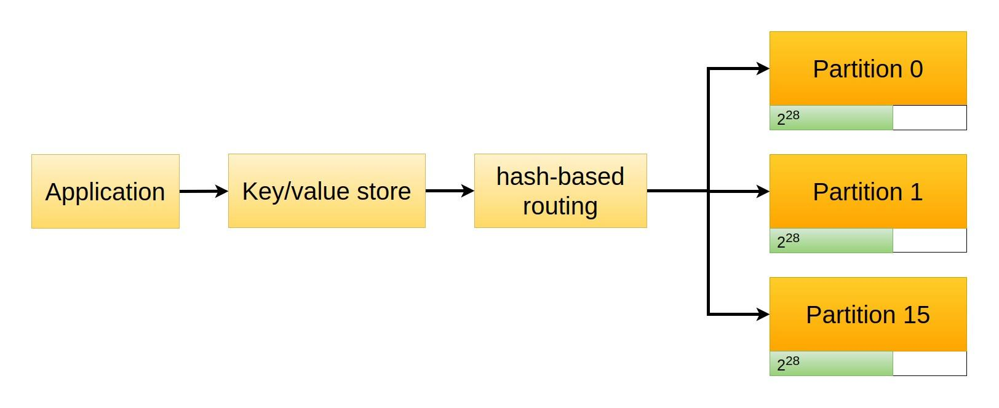
UNIT 3
3.2 DATA PARTITIONING
Parallel & Distributed
Data Processing
Hash Partitioning & Data Locality
3.1
Parallelism & its Types
Hash Partitioning and Data Locality are two foundational principles that dictate how modern big data systems distribute data and optimize computation across massive clusters.
3.2
Data Partitioning
Hash Partitioning
3.3
Data Processing Ops
partition_id = hash(key) % num_partitions
3.4
Query Optimization
3.5
Cluster Resource Mgmt
3.6
Load Balancing
3.7
Fault Tolerance
3.8
Case Studies
Hash Partitioning: Balancing the Load
Hash partitioning uses a mathematical formula to determine exactly which node stores a specific record.
Data Locality: Moving Code, Not Data
Data Locality is the practice of scheduling data processing tasks on the exact physical machines that already hold the targeted data chunks on their local disks.
3.9
Summary & Review

Slide 13
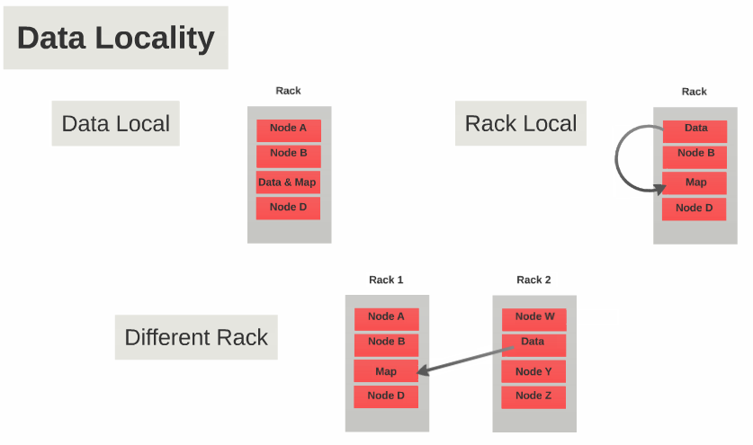
UNIT 3
3.2 DATA PARTITIONING
Parallel & Distributed
Data Processing
Hash Partitioning & Data Locality
3.1
Parallelism & its Types
Hash Partitioning and Data Locality are two foundational principles that dictate how modern big data systems distribute data and optimize computation across massive clusters.
3.2
Data Partitioning
Data Locality — "move computation to data"
3.3
Data Processing Ops
PROCESS_LOCAL
NODE_LOCAL
RACK_LOCAL
ANY
3.4
Query Optimization
Same JVM/executor
Same physical node
Same network rack
Across racks / core switch
3.5
Cluster Resource Mgmt
increasing cost →
3.6
Load Balancing
3.7
Fault Tolerance
3.8
Case Studies
3.9
Summary & Review

Slide 14
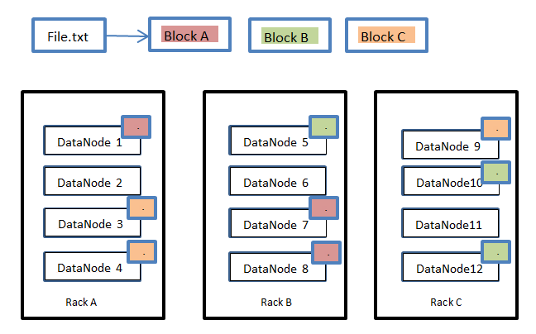
UNIT 3
3.2 DATA PARTITIONING
Parallel & Distributed
Data Processing
Partition Placement — HDFS Rack Awareness
3.1
Parallelism & its Types
HDFS Rack Awareness is the algorithmic policy used by the Hadoop Distributed File System (HDFS) to intelligently distribute data blocks across physical hardware server racks.
It perfectly balances two conflicting engineering priorities in a data center:
Data Reliability (surviving hardware failures) and
Network Performance (maximizing write speeds).
3.2
Data Partitioning
3.3
Data Processing Ops
3.4
Query Optimization
3.5
Cluster Resource Mgmt
3.6
Load Balancing
3.7
Fault Tolerance
3.8
Case Studies
3.9
Summary & Review
8

Slide 15
UNIT 3
3.2 DATA PARTITIONING
Parallel & Distributed
Data Processing
Partition Placement — HDFS Rack Awareness
Default replication factor = 3
3.1
Parallelism & its Types
3.2
Data Partitioning
RACK A
RACK B
Node 1
Replica 1 (writer)
Node 3
Replica 2
3.3
Data Processing Ops
3.4
Query Optimization
Node 2
(no replica)
Node 4
Replica 3
3.5
Cluster Resource Mgmt
3.6
Load Balancing
Replica 2 goes to a different rack — survives a rack-level failure (power/switch outage)
Replica 3 stays in that same rack (with Replica 2) — keeps inter-replica write traffic cheap while still tolerating one node failure
Cloud object stores generalize this to "availability zones" — spreading data across zones so one data-centre failure never causes data loss
3.7
Fault Tolerance
3.8
Case Studies
3.9
Summary & Review
CSUE301 · Big Data Analytics · CHARUSAT
8

Slide 16
UNIT 3
Parallel & Distributed
Data Processing
3.3 DATA PROCESSING OPERATIONS
Data processing operations represent the foundational transformations applied to raw data to convert it into meaningful information. In distributed big data environments, these operations are carefully structured to optimize processing efficiency, cluster memory usage, and network traffic.
3.1
Parallelism & its Types
3.2
Data Partitioning
3.3
Data Processing Ops
1. Validation and Cleaning
3.4
Query Optimization
2. Transformation (Mapping)
3.5
Cluster Resource Mgmt
3. Filtering
3.6
Load Balancing
4. Aggregation and Reduction
3.7
Fault Tolerance
5. Joining
3.8
Case Studies
3.9
Summary & Review

Slide 17
UNIT 3
3.3 DATA PROCESSING OPERATIONS
Parallel & Distributed
Data Processing
Parallel Aggregation & Reduction
In distributed big data processing, Parallel Aggregation and Reduction is the mechanism used to compute global metrics (like SUM, COUNT, MAX, MIN, or AVERAGE) across billions of rows scattered across a cluster without bottlenecking the system.
3.1
Parallelism & its Types
3.2
Data Partitioning
3.3
Data Processing Ops
The Challenge: The Centralization Bottleneck
If a cluster has 1,000 worker nodes holding pieces of a massive dataset, you cannot simply send all raw data rows to a single master node to calculate a total. The master node would immediately run out of memory (OOM error) and choke on network bandwidth.
3.4
Query Optimization
3.5
Cluster Resource Mgmt
The Strategy: Two-Phase Reduction
To bypass this bottleneck, frameworks like Apache Spark and Hadoop MapReduce use a divide-and-conquer strategy divided into two main stages:
3.6
Load Balancing
3.7
Fault Tolerance
1. Local Pre-Aggregation (Map-Side Combine)
The Action: Each individual worker node runs the aggregation function natively on only the data blocks stored in its local memory or disk.
Example: If a node has a column of numbers, it adds them up locally to produce a single subtotal.
The Benefit: This compresses millions of raws down to a single numeric value directly on the worker node.
2. Global Reduction (Reduce-Side Collapse)
The Action: The lightweight local subtotals are sent across the network (shuffled) to a single reducer node or a small set of target nodes.
The Execution: The reducer node performs the final math operation on just those 1,000 incoming subtotal numbers.
3.8
Case Studies
3.9
Summary & Review
9

Slide 18
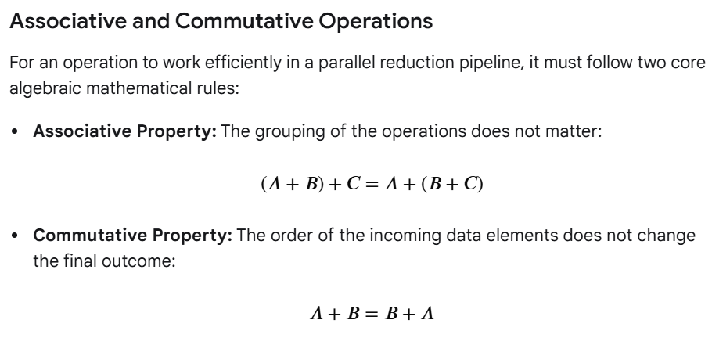
UNIT 3
3.3 DATA PROCESSING OPERATIONS
Parallel & Distributed
Data Processing
Parallel Aggregation & Reduction
3.1
Parallelism & its Types
reduceByKey
sums locally first (combiner), then shuffles only partial sums.
groupByKey
ships every raw record across the network before summing — far more shuffle traffic.
3.2
Data Partitioning
3.3
Data Processing Ops
3.4
Query Optimization
3.5
Cluster Resource Mgmt
3.6
Load Balancing
3.7
Fault Tolerance
3.8
Case Studies
3.9
Summary & Review
CSUE301 · Big Data Analytics · CHARUSAT
9

Slide 19
UNIT 3
3.3 DATA PROCESSING OPERATIONS
Parallel & Distributed
Data Processing
Filtering, Transformation & Distributed Joins
3.1
Parallelism & its Types
Filtering (Narrowing Scope)
Filtering selectively discards data rows that fail a specific boolean evaluation condition.
3.2
Data Partitioning
2. Transformation (Reshaping Structure)
Transformation modifies or augments existing fields into new computational representations.
Narrow Transformations: Operations where each input partition contributes to exactly one output partition (e.g., map, flatMap).
Wide Transformations: Operations that require data to be reorganized across multiple
cluster nodes (e.g., sort, repartition).
3.3
Data Processing Ops
3.4
Query Optimization
3.5
Cluster Resource Mgmt
3.6
Load Balancing
3. Distributed Joins (Merging Data)
    Distributed joins combine separate data sets based on a shared key. Because matching data rows may sit on completely different physical servers, systems rely on two main execution architectures:
3.7
Fault Tolerance
3.8
Case Studies
Shuffle / Sort-Merge Join
Broadcast Join
3.9
Summary & Review
Both sides re-partitioned by key, then joined
Distributed Join Strategies
Small side copied to every node; large side untouched
Both tables large & unsorted
One side small enough for memory
10

Slide 20
UNIT 3
3.4 DISTRIBUTED QUERY OPTIMIZATION
Parallel & Distributed
Data Processing
Distributed Query Optimization is the mechanism that translates high-level logical code (like SQL or Spark DataFrame APIs) into a physical execution plan optimized for a distributed cluster. Its primary goal is to minimize network shuffles and disk I/O.
3.1
Parallelism & its Types
3.2
Data Partitioning
Minimizing Communication Cost
Network I/O — not CPU — dominates distributed query cost. Optimizers rewrite plans to move as few bytes as possible.
3.3
Data Processing Ops
Predicate pushdown
WHERE filters pushed to the storage layer
Fewer rows read & shuffled
3.4
Query Optimization
Projection pushdown
Only SELECTed columns read from Parquet/ORC(Optimized Row Columnar)
Fewer bytes read from disk
3.5
Cluster Resource Mgmt
Partition pruning
Entire non-matching partitions skipped
Whole files never opened
3.6
Load Balancing
Map-side combine
Partial aggregation before shuffle
Smaller shuffle payload
3.7
Fault Tolerance
Broadcast selection
Small table copied instead of shuffled
Shuffle eliminated for large side
3.8
Case Studies
SELECT customer_name, amount FROM sales s JOIN customers c ON s.customer_id=c.id
WHERE s.sale_date = '2026-08-01' → prune to 1 partition, read 3 columns, broadcast customers
3.9
Summary & Review
11

Slide 21
UNIT 3
3.4 DISTRIBUTED QUERY OPTIMIZATION
Parallel & Distributed
Data Processing
Broadcast Joins vs Shuffle Operations
3.1
Parallelism & its Types
BROADCAST JOIN
SHUFFLE (SORT-MERGE) JOIN
3.2
Data Partitioning
Only the small table travels (once, to every executor)
Small table must fit in executor memory
Automatic when small side < threshold (Spark default 10MB, often tuned higher)
Risk: executor Out Of Memory if size was under-estimated
BOTH large tables are re-partitioned and moved across the network
Lower per-executor memory pressure
Default fallback when both sides are large
Risk: long shuffle stage; stragglers from data skew
3.3
Data Processing Ops
3.4
Query Optimization
3.5
Cluster Resource Mgmt
3.6
Load Balancing
3.7
Fault Tolerance
3.8
Case Studies
Re-optimizing and modifying the execution plan dynamically at runtime based on real-time data statistics gathered during intermediate stages.
3.9
Summary & Review
CSUE301 · Big Data Analytics · CHARUSAT
12

Slide 22
UNIT 3
3.5 CLUSTER RESOURCE MANAGEMENT
Parallel & Distributed
Data Processing
Job Scheduling: Fair vs Capacity
3.1
Parallelism & its Types
FAIR SCHEDULER
CAPACITY SCHEDULER
3.2
Data Partitioning
Every job gets, on average, an equal resource share over time
New jobs immediately claim a share from running jobs
Highly elastic — idle capacity redistributed instantly
Best for: ad-hoc, mixed, interactive + batch workloads
Cluster split into hierarchical QUEUES with guaranteed minimum capacity
New jobs wait in queue once its capacity is exhausted
Queues can borrow idle capacity, within configured limits
Best for: predictable multi-department SLAs (banks, telecoms)
3.3
Data Processing Ops
3.4
Query Optimization
3.5
Cluster Resource Mgmt
3.6
Load Balancing
3.7
Fault Tolerance
Classroom analogy: Capacity Scheduler = fixed lab-slot quotas per department each semester (guaranteed, rigid). Fair Scheduler = a shared walk-in lab where every present student gets an equal turn, and turns shrink automatically as more students arrive.
3.8
Case Studies
3.9
Summary & Review
CSUE301 · Big Data Analytics · CHARUSAT
13

Slide 23
UNIT 3
3.5 CLUSTER RESOURCE MANAGEMENT
Parallel & Distributed
Data Processing
Resource Allocation Strategies
3.1
Parallelism & its Types
Static Allocation
Fixed executors/containers reserved for the job's whole lifetime
Simple & predictable; wastes idle resources
●
3.2
Data Partitioning
3.3
Data Processing Ops
Dynamic Allocation
Executors added/removed at runtime based on pending-task backlog
Better utilization; adds scheduling overhead
●
3.4
Query Optimization
3.5
Cluster Resource Mgmt
Container-Based (YARN/K8s)
Resources granted as discrete containers/pods with fixed bounds
Strong isolation; needs accurate sizing
3.6
Load Balancing
●
3.7
Fault Tolerance
Preemption
Scheduler reclaims resources from low- to satisfy high-priority jobs
Better SLA compliance; wastes unprogressed/uncheckpointed work
3.8
Case Studies
●
3.9
Summary & Review
CSUE301 · Big Data Analytics · CHARUSAT
14

Slide 24
UNIT 3
3.6 LOAD BALANCING
Parallel & Distributed
Data Processing
Static vs Dynamic Load Balancing
3.1
Parallelism & its Types
STATIC
DYNAMIC
3.2
Data Partitioning
Work assigned BEFORE execution, per a fixed plan
Cannot react to skew or slow nodes
Zero runtime overhead
Work assigned/reassigned DURING execution
Reacts in real time to skew & stragglers
Continuous monitoring overhead
3.3
Data Processing Ops
3.4
Query Optimization
Speculative Execution — dynamic balancing in action
3.5
Cluster Resource Mgmt
Task on
Node A
(slow)
Duplicate
launched on
Node B
First to finish
WINS; other
killed
3.6
Load Balancing
3.7
Fault Tolerance
spark.speculation = true
spark.speculation.multiplier = 1.5 // flag if 1.5x slower than peers
spark.speculation.quantile = 0.75 // ...after 75% of stage tasks finish
3.8
Case Studies
3.9
Summary & Review
CSUE301 · Big Data Analytics · CHARUSAT
15

Slide 25
UNIT 3
3.6 LOAD BALANCING
Parallel & Distributed
Data Processing
Data Skew — Mitigation Strategies
3.1
Parallelism & its Types
Skew: one key (e.g., a celebrity user_id) dominates a partition, making its task a straggler the whole stage waits for.
3.2
Data Partitioning
Salting: append a random suffix (key#0..key#9) to spread a hot key across partitions, then aggregate in two phases
Broadcast join for skewed joins: removes the shuffle entirely when skew comes from a small dimension table
AQE skew-join optimization: Spark 3.x auto-detects oversized shuffle partitions and splits them at runtime
Custom/range-aware partitioners: isolate known hot keys into their own dedicated partitions
3.3
Data Processing Ops
3.4
Query Optimization
3.5
Cluster Resource Mgmt
// Salting technique
val salted = df.withColumn("salted_key",
concat(col("user_id"), lit("_"), (rand()*10).cast("int")))
val partial = salted.groupBy("salted_key").agg(sum("amount").as("p_sum"))
val finalAgg = partial
.withColumn("user_id", split(col("salted_key"),"_")(0))
.groupBy("user_id").agg(sum("p_sum").as("total"))
3.6
Load Balancing
3.7
Fault Tolerance
3.8
Case Studies
3.9
Summary & Review
CSUE301 · Big Data Analytics · CHARUSAT
16

Slide 26
UNIT 3
3.7 FAULT TOLERANCE
Parallel & Distributed
Data Processing
The Fault-Tolerance Stack
3.1
Parallelism & its Types
Layer 4 — Cluster Coordination Recovery
ZooKeeper leader election, HA NameNode
3.2
Data Partitioning
Layer 3 — Job / Stage Recovery
Driver restart, DAG re-submission
3.3
Data Processing Ops
3.4
Query Optimization
Layer 2 — Task Recovery
Re-execution via lineage, task retry
3.5
Cluster Resource Mgmt
3.6
Load Balancing
Layer 1 — Data Durability
Replication (3.2) + checkpointing
3.7
Fault Tolerance
3.8
Case Studies
A failure at any layer is contained and recovered WITHOUT cascading upward — provided each layer's assumptions hold. Section 3.8 shows real 2025 incidents where a failure crossed layers unexpectedly.
3.9
Summary & Review
CSUE301 · Big Data Analytics · CHARUSAT
17

Slide 27
UNIT 3
3.7 FAULT TOLERANCE
Parallel & Distributed
Data Processing
Checkpoints, Re-execution & Recovery
3.1
Parallelism & its Types
Checkpointing
Re-execution
Recovery
3.2
Data Partitioning
Persist state/data to durable storage so recovery is bounded, not lineage-dependent
Recompute ONLY the lost partition by replaying recorded transformations (lineage)
Cluster coordination layer itself survives failure via standby + consensus
3.3
Data Processing Ops
3.4
Query Optimization
HDFS block replication; Spark RDD.checkpoint(); Structured Streaming checkpoints
Spark RDD lineage graph; idempotent MapReduce task retry
HDFS HA NameNode, YARN RM HA, ZooKeeper leader election
3.5
Cluster Resource Mgmt
3.6
Load Balancing
3.7
Fault Tolerance
3.8
Case Studies
Trade-off: lineage-based re-execution costs nothing until a failure happens, but recovery time grows with lineage depth. Checkpointing costs I/O continuously but guarantees bounded, fast recovery.
3.9
Summary & Review
CSUE301 · Big Data Analytics · CHARUSAT
18

Slide 28
UNIT 3
3.8 CASE STUDIES
Parallel & Distributed
Data Processing
Case Study — AWS us-east-1 Outage (20 Oct 2025)
3.1
Parallelism & its Types
Root cause: DNS-resolution fault in the internal DynamoDB endpoint, us-east-1 (N. Virginia)
3.2
Data Partitioning
DynamoDB
DNS failure
Cascades into
EC2 / Lambda / SQS
Dependent apps
disrupted worldwide
3.3
Data Processing Ops
3.4
Query Optimization
Visible impact: widespread disruption to Pinterest, Snapchat, Duolingo, and many other platforms.
3.5
Cluster Resource Mgmt
Classroom connection to Section 3.7
3.6
Load Balancing
A region is a fault-isolation boundary for the DATA plane, but often NOT for the CONTROL plane
Services in every region can depend on us-east-1's control-plane components — "multi-region" did not fully protect dependents
This is a real Layer-1 (data-service) failure cascading upward into Layer-3/4 coordination failures — exactly what checkpointing/recovery design must anticipate
3.7
Fault Tolerance
3.8
Case Studies
3.9
Summary & Review
CSUE301 · Big Data Analytics · CHARUSAT
19

Slide 29
UNIT 3
3.8 CASE STUDIES
Parallel & Distributed
Data Processing
More 2025 Outages & Industry Figures
3.1
Parallelism & its Types
Azure Front Door — 29 Oct 2025
Google Cloud IAM — 12 Jun 2025
3.2
Data Partitioning
Shared global edge/routing layer degraded. Every app behind Front Door was affected simultaneously — regardless of backend distribution.
180+ minutes of disruption after an IAM failure blocked credential issuance — hit Spotify, Discord, Shopify, OpenAI, and GitHub.
3.3
Data Processing Ops
3.4
Query Optimization
3.5
Cluster Resource Mgmt
Industry Figures, 2025–2026
18,700+ companies run Apache Spark in production worldwide (2026)
100% of surveyed enterprises reported an outage-related revenue loss in 2025 (Cockroach Labs)
Yet <33% perform regular failover testing — theory/practice gap
3.6
Load Balancing
3.7
Fault Tolerance
3.8
Case Studies
3.9
Summary & Review
CSUE301 · Big Data Analytics · CHARUSAT
20

Slide 30
UNIT 3
3.9 SUMMARY
Parallel & Distributed
Data Processing
Unit 3 Recap
3.1
Parallelism & its Types
3.1
Parallelism
Bit/ILP/Data/Task/Pipeline; Amdahl's Law bounds speed-up
3.2
Data Partitioning
3.2
Partitioning
Horizontal/Vertical/Hash + data-locality-aware placement
3.3
Data Processing Ops
3.3
Processing Ops
Combiners for aggregation; broadcast/shuffle/bucketed joins
3.4
Query Optimization
3.4
Query Optimization
Pushdown, pruning, cost-based + adaptive (AQE) planning
3.5
Resource Mgmt
Fair vs Capacity scheduling; static vs dynamic allocation
3.5
Cluster Resource Mgmt
3.6
Load Balancing
Static vs dynamic; speculative execution; skew mitigation
3.6
Load Balancing
3.7
Fault Tolerance
Checkpointing, lineage re-execution, coordination recovery
3.7
Fault Tolerance
3.8
Case Studies
Golden thread: every technique in this unit exists to minimize network communication and to survive the failures that WILL happen at cluster scale.
3.9
Summary & Review
CSUE301 · Big Data Analytics · CHARUSAT
21

Slide 31

UNIT 3
Parallel & Distributed
Data Processing
3.1
Parallelism & its Types
Thanks
3.2
Data Partitioning
3.3
Data Processing Ops
3.4
Query Optimization
3.5
Cluster Resource Mgmt
3.6
Load Balancing
Prof. Pinal M. Hansora
Department of Computer Science & Engineering
CSPIT, CHARUSAT University
3.7
Fault Tolerance
3.8
Case Studies
3.9
Summary & Review
CSUE301 · Big Data Analytics · CHARUSAT
22

