Slide 1
HYDERABAD INSTITUTE OF TECHNOLOGY AND MANAGEMENT
MASTERHUB
IMPLEMENTATION REVIEW
INTERNSHIP PROJECT REVIEW
S NOUSHITH – 24E51A0451
BCI / IoT / Desktop / Embedded Mobility / Media
CURRENT IMPLEMENTATION / SEPTEMBER 2026
1
Notes:
Original cover artwork and presenter identity preserved from noushith_IOT_ppt.pptx. Current implementation as of 26 September 2026.

Slide 2
PRESENTATION OVERVIEW
Project background and current implementation scope
Architecture, state machine and gesture navigation
Desktop, IoT, mobility and media workflows
Cortex BCI connection and temporal control
Current dashboard, connectivity and diagnostics
Implemented outputs, test coverage and next steps
2
Notes:
Sources: README.md
Repository snapshot: 26 September 2026. Implementation describes code and mappings. Screenshots show the current local application, with external hardware disconnected.

Slide 3
ABSTRACT AND PROJECT SCOPE
One control hub for multiple execution domains
MasterHub accepts browser controls, arrow keys, API commands and classified mental commands from EMOTIV Cortex.
The Flask application maintains context, resolves command mappings and dispatches actions through dedicated handlers.
The current project connects desktop applications, IoT relay devices, mobility hardware and desktop or mobile media workflows.
The original IoT work remains part of the wider SynaptiMesh project.
3
Notes:
Sources: README.md
Repository snapshot: 26 September 2026. Implementation describes code and mappings. Screenshots show the current local application, with external hardware disconnected.

Slide 4
ORIGINAL PROJECT AND CURRENT MASTERHUB
Previous presentation
Current repository
ESP32 gateway and Arduino Nano sensing
LoRa communication and relay control
Light, fan, pump and audio outputs
MQTT integration and command acknowledgements
Four control domains in one dashboard
17 FSM modes and 98 command routes
Cortex profiles, streaming and mental control
Remote PC, UART and mobile media integration
The previous deck records earlier hardware work. Current screenshots document the software interface.
4
Notes:
Sources: Original PPT slides 3, 7–9; mappings/*.json; README.md
Repository snapshot: 26 September 2026. Implementation describes code and mappings. Screenshots show the current local application, with external hardware disconnected.

Slide 5
MOTIVATION AND OBJECTIVES
A consistent workflow across different targets
Reduce separate control interfaces for desktop applications and physical devices.
Reuse a small mental-command vocabulary through context-sensitive menus.
Expose the active domain, device, target and pending command before execution.
Track connection state and command feedback for troubleshooting.
Keep hardware transport, command mappings and application actions modular.
5
Notes:
Sources: README.md
Repository snapshot: 26 September 2026. Implementation describes code and mappings. Screenshots show the current local application, with external hardware disconnected.

Slide 6
CURRENT IMPLEMENTATION INVENTORY
4
11
17
98
Control domains
Workflow targets
FSM modes
Command routes
23 IoT payload mappings include relay actions and firmware maintenance commands.
JSON definitions drive domain navigation and command choices.
Counts describe implemented mappings, not the number of physically connected devices.
6
Notes:
Sources: mappings/mode_map.json; command_map.json; workflow_map.json; iot_map.json
Repository snapshot: 26 September 2026. Implementation describes code and mappings. Screenshots show the current local application, with external hardware disconnected.

Slide 7
OVERALL SOFTWARE ARCHITECTURE
Input, decision and execution layers
Input: dashboard, keyboard, REST clients and Cortex mental-command stream.
Decision: input normalization, FSM context, temporal framing and command validation.
Routing: command_map.json selects the execution domain and action identifier.
Execution: application handlers, hardware MQTT, USB serial and mobile MQTT.
Feedback: state snapshots, command outcomes, metrics, logs and device presence.
7
Notes:
Sources: app.py; core/engine.py; core/router.py; services/; actions/
Repository snapshot: 26 September 2026. Implementation describes code and mappings. Screenshots show the current local application, with external hardware disconnected.

Slide 8
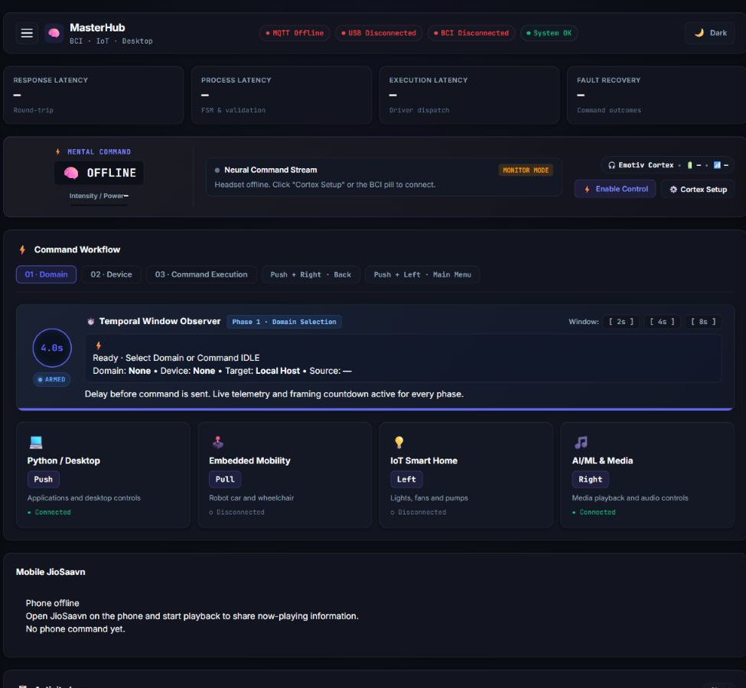
CURRENT DASHBOARD: MAIN CONSOLE
Current local capture. MQTT, USB and BCI show their actual disconnected state.
8
Notes:
Sources: templates/dashboard.html; static/masterhub.js; current screenshot
Repository snapshot: 26 September 2026. Implementation describes code and mappings. Screenshots show the current local application, with external hardware disconnected.

Slide 9
DOMAIN, DEVICE AND COMMAND WORKFLOW
Three phases share the same state machine
Domain selection: Desktop, Embedded Mobility, IoT Smart Home or AI/ML & Media.
Device selection: an application, smart-home output, mobility device or media target.
Command execution: choose an action and supply any required parameters.
Push + Right returns to the previous menu. Push + Left returns to the main menu.
The same gesture has different meanings in different modes.
9
Notes:
Sources: mappings/workflow_map.json; services/workflow_service.py
Repository snapshot: 26 September 2026. Implementation describes code and mappings. Screenshots show the current local application, with external hardware disconnected.

Slide 10
GESTURE VOCABULARY AND TIMING
Navigation
Timing behavior
Push: Desktop at the main menu
Pull: Embedded Mobility
Left: IoT Smart Home
Right: AI/ML & Media
Ordered pairs provide additional commands
Default window: 4 seconds
Configuration range: 2–10 seconds
Dashboard actions: preview and countdown
Manual command pairs: immediate dispatch
Live BCI pairs: original deadline
Direct /api/command requests do not automatically use the browser framing delay.
10
Notes:
Sources: README.md; static/masterhub.js; cortex/control.py
Repository snapshot: 26 September 2026. Implementation describes code and mappings. Screenshots show the current local application, with external hardware disconnected.

Slide 11
DESKTOP DOMAIN: APPLICATION WORKFLOWS
Four application workflows
YouTube: previous video, next video, play/pause and search/play.
Chrome: open an article, scroll up or down and Google search.
Notepad: open the application and save a file through mapped commands.
Gmail: compose with recipient, subject and body, then send through a separate command.
Application handlers use the selected Local Host or compatible remote target.
11
Notes:
Sources: mappings/workflow_map.json; actions/desktop/
Repository snapshot: 26 September 2026. Implementation describes code and mappings. Screenshots show the current local application, with external hardware disconnected.

Slide 12
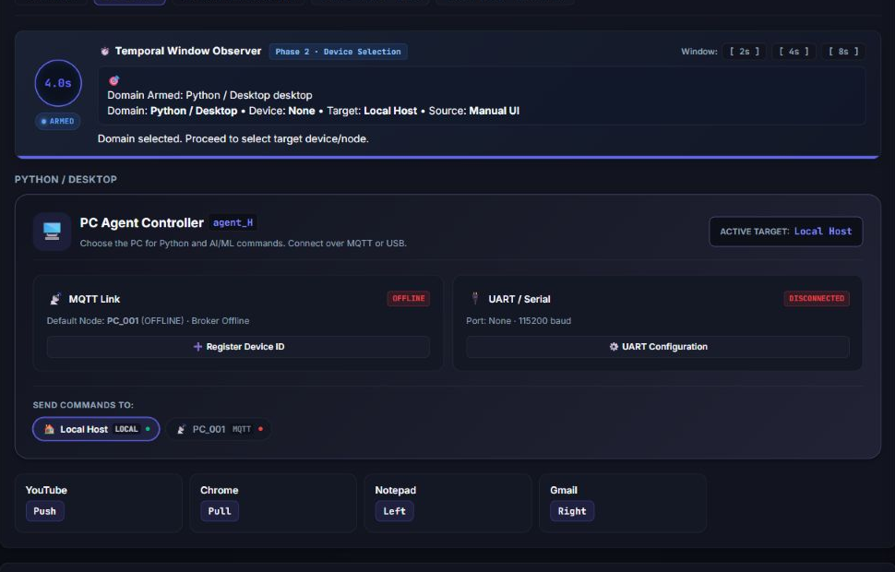
CURRENT DESKTOP AND TARGET SELECTION
The PC Agent Controller separates target selection from the application menu.
12
Notes:
Sources: Current dashboard screenshot; core/devices.py
Repository snapshot: 26 September 2026. Implementation describes code and mappings. Screenshots show the current local application, with external hardware disconnected.

Slide 13
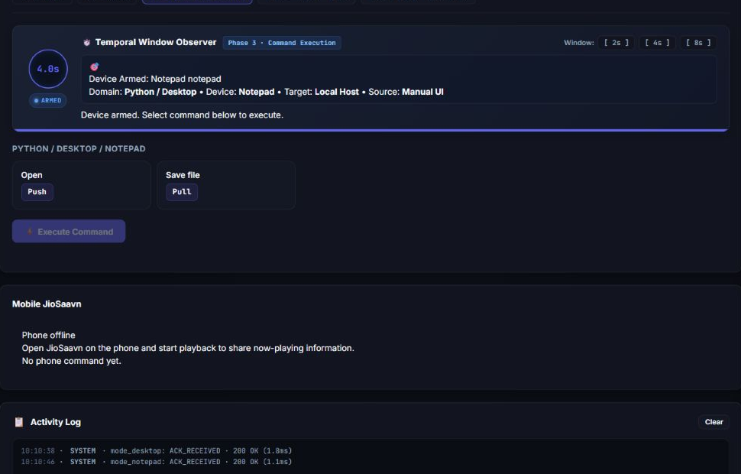
CURRENT COMMAND EXECUTION SCREEN
Notepad mode exposes Open and Save file. This capture shows navigation only.
13
Notes:
Sources: Current dashboard screenshot; mappings/workflow_map.json
Repository snapshot: 26 September 2026. Implementation describes code and mappings. Screenshots show the current local application, with external hardware disconnected.

Slide 14
IOT HARDWARE IMPLEMENTATION
Hardware foundation documented in the original project
ESP32 gateway connects MQTT commands to relay outputs.
Arduino Nano handles ultrasonic distance and float-switch sensing.
LoRa links the sensor node and gateway through SPI modules.
DFPlayer provides audio status output through a UART connection.
Original relay assignments: pump GPIO 25, light GPIO 21 and fan GPIO 32.
Hardware details come from the supplied earlier presentation.
14
Notes:
Sources: Original PPT slides 7, 9, 10
Repository snapshot: 26 September 2026. Implementation describes code and mappings. Screenshots show the current local application, with external hardware disconnected.

Slide 15
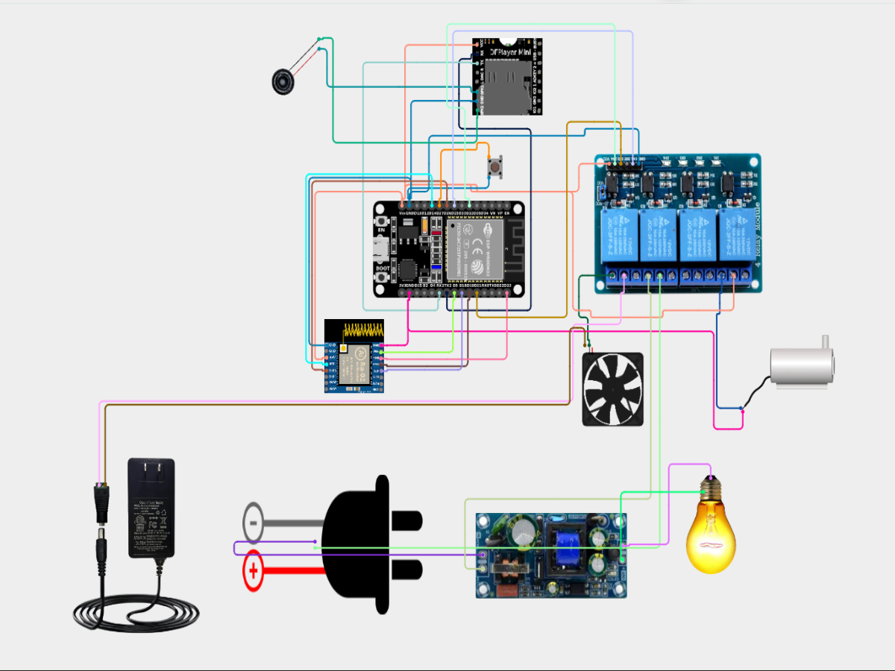
ORIGINAL IOT WIRING REFERENCE
Retained project wiring reference from your earlier PPT.
15
Notes:
Sources: Original PPT slide 10
Repository snapshot: 26 September 2026. Implementation describes code and mappings. Screenshots show the current local application, with external hardware disconnected.

Slide 16
CURRENT IOT COMMAND INTEGRATION
Relay control plus device maintenance commands
Light, fan and pump workflows expose On and Off choices.
The IoT map translates action names into firmware command strings.
Additional mappings include all_on, all_off, PING and self-test.
OTA_UPDATE and relay-polarity commands exist in the payload map.
MasterHub publishes to the configured broker and reads device status separately.
A mapped command requires compatible firmware support on the receiving device.
16
Notes:
Sources: mappings/iot_map.json; actions/iot/handler.py; services/mqtt_service.py
Repository snapshot: 26 September 2026. Implementation describes code and mappings. Screenshots show the current local application, with external hardware disconnected.

Slide 17
EMBEDDED MOBILITY IMPLEMENTATION
Robot car and wheelchair use separate control topics
Both device menus provide forward, backward, left, right and stop.
Additional mappings support left and right 360-degree rotation.
Handlers translate action identifiers into device-specific payload strings.
Readiness checks combine broker state, matching device identity and fresh status.
BCI motion checks the active direction at dispatch and requests stop after neutral.
These are software control capabilities. Physical motion requires connected, verified hardware.
17
Notes:
Sources: actions/embedded/handler.py; mappings/embedded_map.json; services/workflow_service.py
Repository snapshot: 26 September 2026. Implementation describes code and mappings. Screenshots show the current local application, with external hardware disconnected.

Slide 18
DESKTOP AND MOBILE MEDIA
Desktop JioSaavn
Mobile JioSaavn
Browser-based JioSaavn workflow
Next track and previous track
Play/pause and search
Ordered pairs for volume up/down
Dedicated Android companion path
Next, previous and play/pause
Android home, search and launch
Phone presence and now-playing feedback
18
Notes:
Sources: mappings/workflow_map.json; actions/media_jiosaavn_mobile.py
Repository snapshot: 26 September 2026. Implementation describes code and mappings. Screenshots show the current local application, with external hardware disconnected.

Slide 19
MOBILE MQTT AND ACKNOWLEDGEMENT
The phone uses an independent MQTT service
Separate topics carry commands, status, heartbeat, media, acknowledgements and errors.
Dispatch requires a fresh phone heartbeat and remote control enabled on the phone.
Each command carries a unique ID, issue time and expiry time.
The service tracks PENDING, EXECUTED, FAILED, REJECTED, UNCONFIRMED and TIMEOUT results.
Retained online messages cannot establish fresh liveness.
Defaults in code: 8-second acknowledgement timeout and 35-second heartbeat timeout.
19
Notes:
Sources: services/mobile_mqtt_service.py; api/jiosaavn.py
Repository snapshot: 26 September 2026. Implementation describes code and mappings. Screenshots show the current local application, with external hardware disconnected.

Slide 20
CORTEX CONNECTION AND TRAINED PROFILES
EMOTIV supplies the classified mental commands
EMOTIV Launcher and the local Cortex service provide headset access.
MasterHub requests authorization, discovers the headset and opens a session.
The user selects and loads an existing trained mental-command profile.
The com stream provides the detected action and detector power.
MasterHub routes predictions into its controller. It does not train a raw EEG model.
20
Notes:
Sources: cortex/service.py; cortex/auth.py; cortex/session.py; cortex/profile.py
Repository snapshot: 26 September 2026. Implementation describes code and mappings. Screenshots show the current local application, with external hardware disconnected.

Slide 21
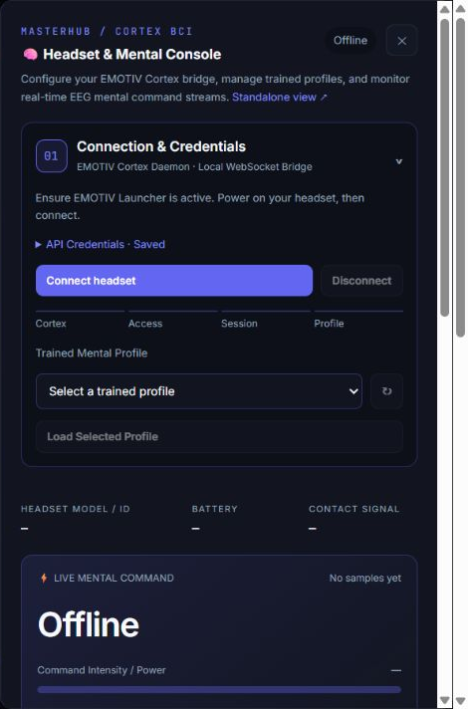
CURRENT BCI HEADSET CONSOLE
Connection and control
Connection-stage feedback
Trained-profile selector
Headset, battery and signal fields
Live mental command and power
Monitor mode and control toggle
The screenshot preserves the offline state. Credentials remain collapsed.
21
Notes:
Sources: templates/bci_panel.html; current screenshot
Repository snapshot: 26 September 2026. Implementation describes code and mappings. Screenshots show the current local application, with external hardware disconnected.

Slide 22
LIVE BCI TEMPORAL CONTROLLER
One frame captures one single or ordered pair
A neutral sample rearms control. A qualifying active sample starts the frame.
The default detector-power threshold is 0.20, subject to configuration.
A distinct second gesture joins the first only when that pair exists in the current mode.
Repeated packets of the same held gesture do not create repeated commands.
Singles and valid pairs execute at the original deadline when a new prediction arrives.
Detector power is not a measured intention-accuracy percentage.
22
Notes:
Sources: cortex/control.py; simulator/config.py
Repository snapshot: 26 September 2026. Implementation describes code and mappings. Screenshots show the current local application, with external hardware disconnected.

Slide 23
BCI CONTEXT AND COMMAND INPUTS
The controller keeps intent tied to the active workflow
Mode or target changes reset pending context. Control-generation checks prevent stale dispatch.
An unassigned qualifying gesture pair cancels its frame.
Search, compose and save operations use prepared parameter fields.
Neutral does not cancel a pending nonmotion action. Stop Control cancels BCI actuation.
Motion requires matching direction at dispatch and neutral requests a stop afterwards.
23
Notes:
Sources: cortex/control.py; templates/bci_panel.html; static/bci-panel.js
Repository snapshot: 26 September 2026. Implementation describes code and mappings. Screenshots show the current local application, with external hardware disconnected.

Slide 24
REMOTE PC AGENTS AND USB SERIAL
Target selection supports local and external execution
Local Host executes supported desktop actions on the MasterHub computer.
Remote PCs register a device ID and use a compatible agent over MQTT or serial.
Agent startup helpers and configuration artifacts support deployment setup.
USB configuration selects a COM port and uses JSON-line messages at 115200 baud by default.
A registered target still needs a running agent, a working transport and fresh presence.
24
Notes:
Sources: core/devices.py; services/usb_service.py; artifacts/start_agent.py; README.md
Repository snapshot: 26 September 2026. Implementation describes code and mappings. Screenshots show the current local application, with external hardware disconnected.

Slide 25
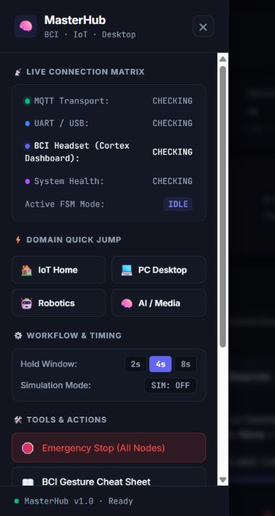
CURRENT SIDEBAR AND OPERATOR TOOLS
Built-in tools
Connection matrix and domain shortcuts
Temporal-window presets
Gesture cheat sheet and user guide
Target registration and UART setup
Reset state and software E-Stop
The sidebar exposes configuration and diagnostic controls within the main console.
25
Notes:
Sources: templates/dashboard.html; current screenshot
Repository snapshot: 26 September 2026. Implementation describes code and mappings. Screenshots show the current local application, with external hardware disconnected.

Slide 26
STATUS, TELEMETRY AND ACTIVITY RECORDS
Feedback supports diagnosis at each layer
Metrics record response, processing and execution latency with up to 100 recent samples.
Counters track total, successful and failed commands.
The Fault Recovery label derives from command outcomes. It is not a physical recovery-time measurement.
Manual and BCI activity records help trace command source and execution result.
The dashboard offers LOG, JSON and CSV telemetry export.
26
Notes:
Sources: core/metrics.py; services/manual_logger_service.py; services/bci_logger_service.py
Repository snapshot: 26 September 2026. Implementation describes code and mappings. Screenshots show the current local application, with external hardware disconnected.

Slide 27
API AND CONFIGURATION SURFACE
The browser and external clients share the backend
POST /api/command accepts supported command and gesture inputs.
State and workflow endpoints expose current context and available choices.
Health, metrics and device-status endpoints support monitoring.
Hardware configuration stores broker and topic settings for subsequent use.
Cortex endpoints manage connection, profile, stream status and control mode.
27
Notes:
Sources: api/routes.py; api/jiosaavn.py; cortex/dashboard.py
Repository snapshot: 26 September 2026. Implementation describes code and mappings. Screenshots show the current local application, with external hardware disconnected.

Slide 28
SAFETY CONTROLS AND OPERATING BOUNDARIES
Software safeguards support controlled testing
Command validation rejects unsupported routes and checks required parameters.
The BCI interface begins in monitor mode and requires explicit control enablement.
Dashboard countdowns support cancellation before dispatch.
Software E-Stop requests stops. A device acknowledgement and independent hardware stop remain essential.
Simulation Mode changes UI state and logs. It does not isolate real actions.
28
Notes:
Sources: README.md; cortex/control.py; static/masterhub.js
Repository snapshot: 26 September 2026. Implementation describes code and mappings. Screenshots show the current local application, with external hardware disconnected.

Slide 29
TEST COVERAGE AND REPLAY TOOLS
Tests cover control behavior and service integration
BCI tests cover framing, neutral rearm, ordered pairs, context changes and motion handling.
Workflow tests cover state transitions, mappings and command updates.
Other modules test hardware status, mobile media and separate logging paths.
Recorded-prediction replay sends requests through the command API.
Replay filtering differs from the live controller. Hardware results need a connected-device test.
This deck describes the test coverage present in the repository, not a new full-suite test result.
29
Notes:
Sources: tests/test_cortex_control.py; tests/; simulator/README.md
Repository snapshot: 26 September 2026. Implementation describes code and mappings. Screenshots show the current local application, with external hardware disconnected.

Slide 30
IMPLEMENTATION STATUS AND DEPENDENCIES
Implemented in MasterHub
Needed for live operation
Four-domain dashboard and workflow builder
Mapped state machine and command router
Cortex stream and temporal controller
MQTT, USB and remote-target services
Mobile acknowledgements and telemetry
Broker and compatible device firmware
Connected and safe mobility hardware
Running remote PC or Android agent
EMOTIV access and trained profile
Application sessions and desktop access
30
Notes:
Sources: README.md; services/; cortex/; actions/
Repository snapshot: 26 September 2026. Implementation describes code and mappings. Screenshots show the current local application, with external hardware disconnected.

Slide 31
FUTURE DEVELOPMENT PRIORITIES
Next work builds on the current modules
Complete connected-device validation for each transport and command family.
Add device-side watchdogs and verify stop acknowledgements under link failure.
Create a dry-run backend that cannot dispatch physical or desktop actions.
Expand repeatable integration tests and remote-agent packaging.
Improve user-specific BCI calibration and deployment authentication.
Proposed next steps, separate from implemented features.
31
Notes:
Sources: README.md
Repository snapshot: 26 September 2026. Implementation describes code and mappings. Screenshots show the current local application, with external hardware disconnected.

Slide 32
CONCLUSION
MasterHub now provides a common control workflow
The project combines the earlier IoT hardware work with desktop, mobility and media control.
A shared state machine and mapping layer reuse manual and mental-command inputs.
The current dashboard exposes workflow context, connection status and command feedback.
The next milestone is repeatable end-to-end validation with the complete hardware setup.
32
Notes:
Sources: README.md
Repository snapshot: 26 September 2026. Implementation describes code and mappings. Screenshots show the current local application, with external hardware disconnected.

Slide 33
THANK YOU
33

