Slide 1
HYDERABAD INSTITUTE OF TECHNOLOGY
AND MANAGEMENT
HITAM
MASTERHUB
BCI, IoT, Desktop and Mobility Control Platform
IMPLEMENTATION REVIEW
Current system architecture, dashboard and completed modules
NOUSHITH | 2451A051
Project status deck · September 2026
Notes:
Template style based on the user-supplied noushith_IOT_ppt.pptx. Project facts sourced from the current MasterHub repository and live dashboard.

Slide 2
LIST OF CONTENTS
HITAM
MASTERHUB
Project scope and implementation status
MasterHub architecture and command lifecycle
Four control domains and supported targets
EMOTIV Cortex BCI workflow
MQTT, USB and remote-agent connectivity
Current dashboard and observability
Safety controls, validation and testing
Current limitations and future work
02
Notes:
Contents reflect the current repository implementation.

Slide 3
MASTERHUB PROJECT OVERVIEW
HITAM
MASTERHUB
A single control layer translates manual input or EMOTIV mental commands into actions across software and physical devices.
INPUT
CONTROL CORE
Dashboard controls, arrow keys, HTTP requests, recorded predictions and live Cortex mental-command samples.
Input normalization, mode state, temporal framing, command validation and domain routing.
OUTPUTS
OPERATING MODEL
Desktop applications, smart-home nodes, robot car, wheelchair and media controls.
Manual-only use works locally. Hardware, broker and headset services are connected only when needed.
03
Notes:
Source: README.md and current project structure.

Slide 4
IMPLEMENTATION PROGRESS
HITAM
MASTERHUB
The project has evolved from a single IoT prototype into a modular control hub.
01
IoT prototype
ESP32 relay actions, sensor telemetry and MQTT command delivery
02
Unified routing
JSON mappings, validation, FSM modes and reusable domain handlers
03
Desktop and media
Chrome, YouTube, Notepad, Gmail and JioSaavn workflows
04
Mobility
Robot car and wheelchair commands through configurable MQTT topics
05
BCI integration
Cortex authentication, profile loading, live mental stream and temporal framing
06
Operational dashboard
Live status, metrics, activity records, device setup and telemetry export
04
Notes:
Implementation sequence summarized from repository history reflected in current modules and documentation.

Slide 5
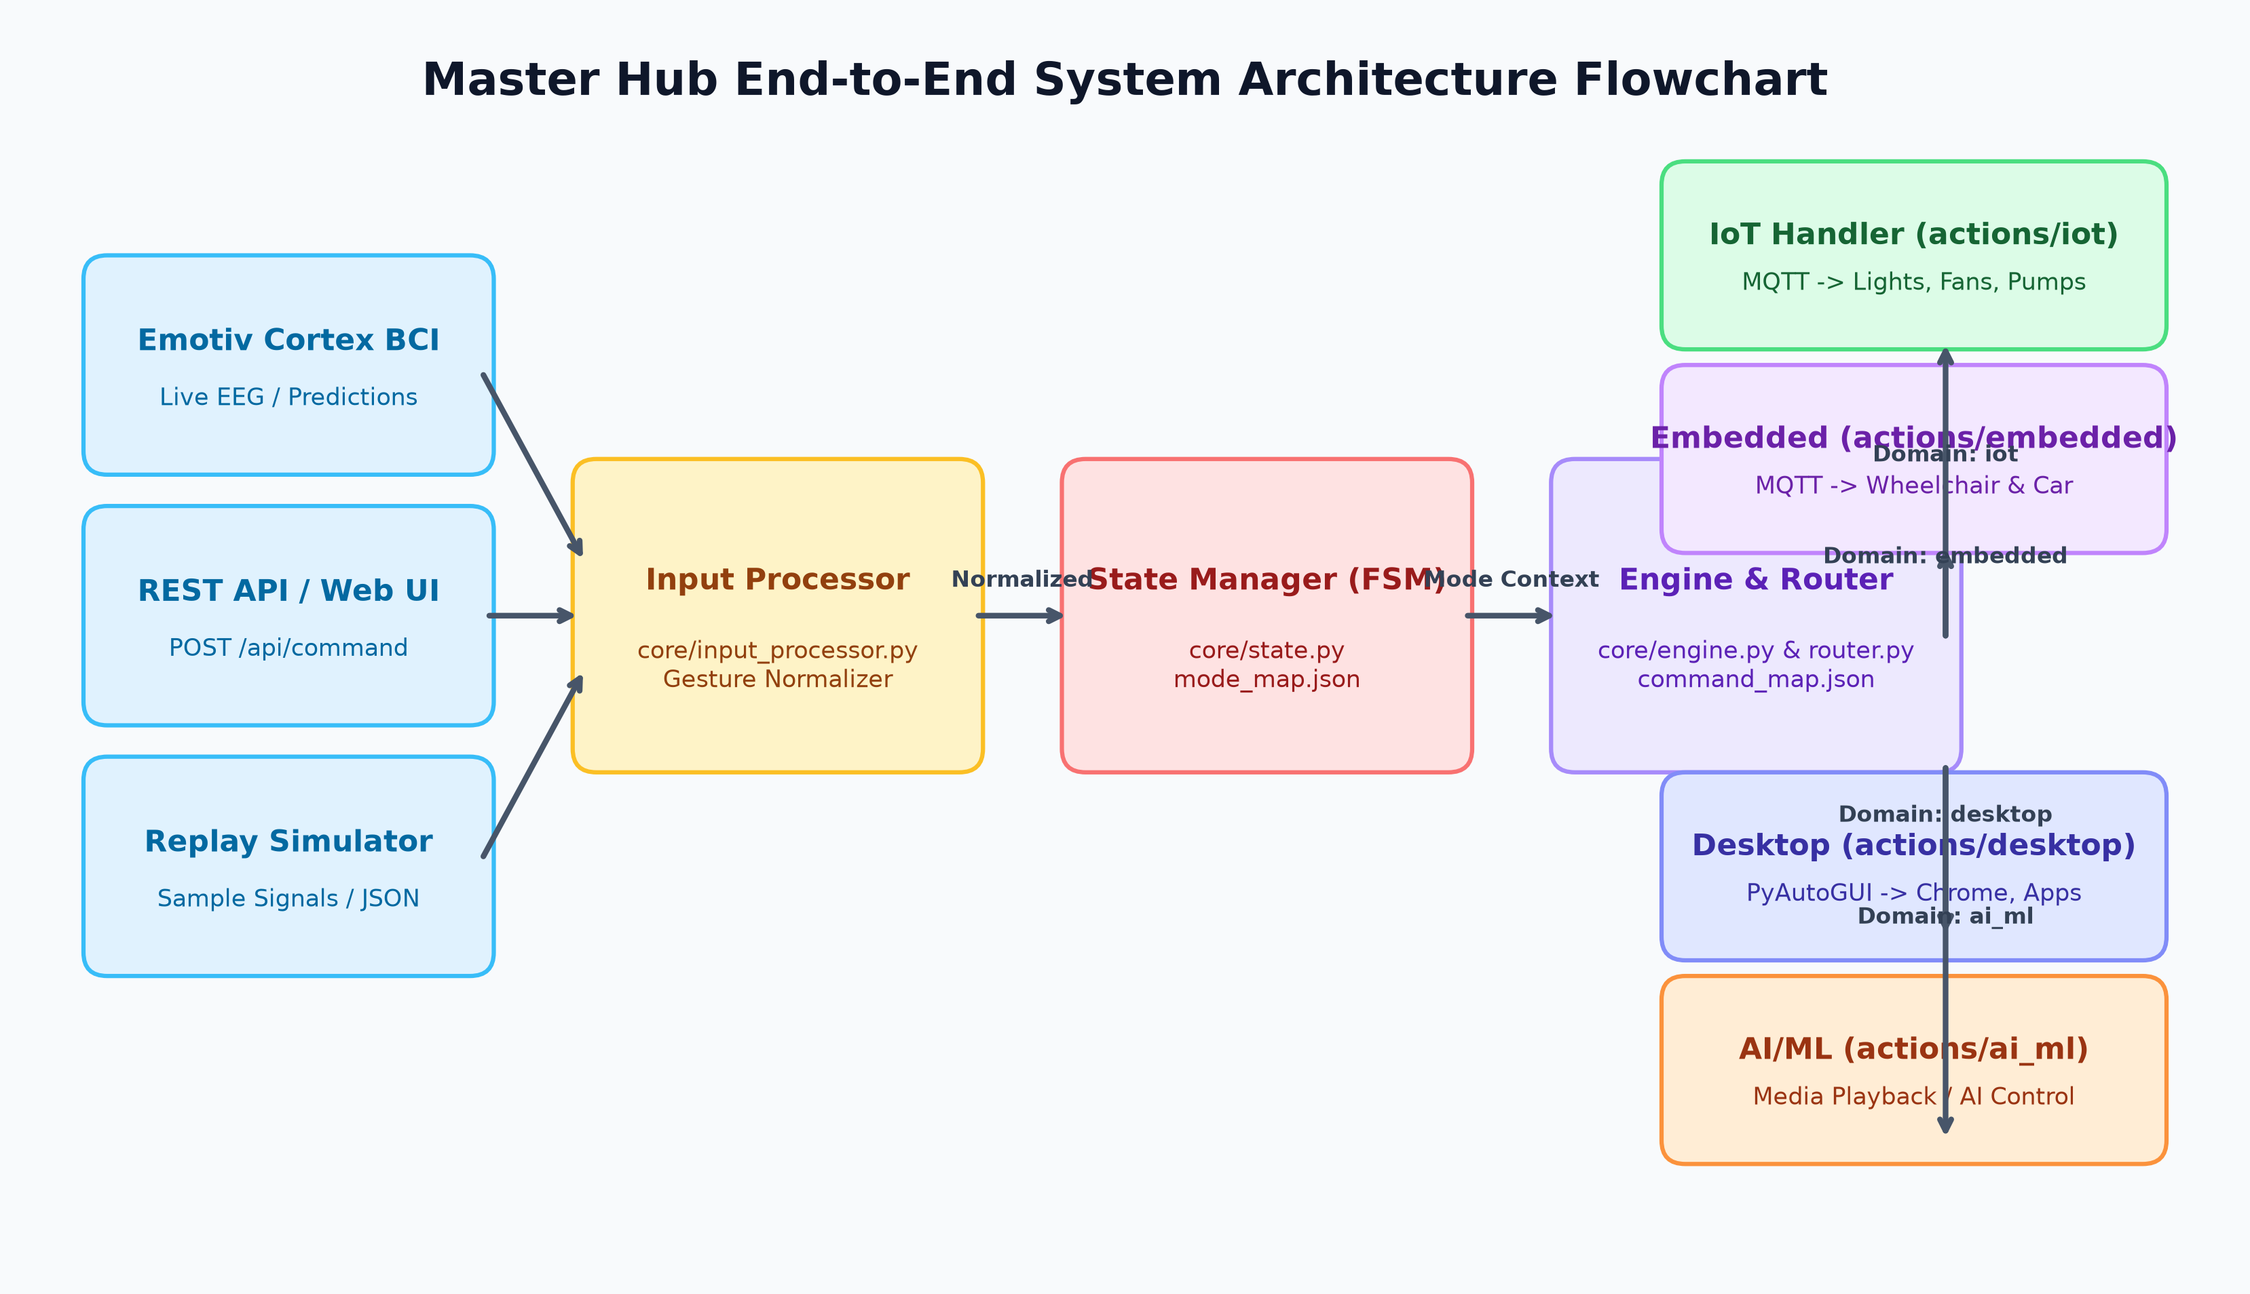
SYSTEM ARCHITECTURE
HITAM
MASTERHUB
Inputs enter one stateful routing core, then dispatch through domain-specific handlers and transport services.
05
Notes:
Visual source: docs/diagrams/arch_flowchart.png.

Slide 6
COMMAND LIFECYCLE
HITAM
MASTERHUB
1
2
3
4
5
6
7
Capture
Normalize
Frame
Resolve
Validate
Dispatch
Observe
Manual, API or Cortex input
Gesture and command vocabulary
Single or paired gesture window
Mode-specific command mapping
Allowed command and required inputs
Desktop, MQTT, USB or media handler
Result, latency and activity record
Mode state changes the meaning of the same gesture. Push selects Desktop at the main menu, then selects a desktop application, then triggers an application command.
TEMPORAL BEHAVIOR
Dashboard actions show a countdown and support Cancel or Execute Now. Live BCI keeps the original deadline even when a second gesture arrives.
06
Notes:
Sources: core/input_processor.py, core/engine.py, core/router.py, static/masterhub.js and cortex/control.py.

Slide 7
FOUR CONTROL DOMAINS
HITAM
MASTERHUB
PUSH
PULL
PYTHON / DESKTOP
EMBEDDED MOBILITY
Chrome, YouTube, Notepad and Gmail workflows
Robot car and wheelchair control
LEFT
RIGHT
IoT SMART HOME
AI/ML & MEDIA
Light, fan and pump actions
JioSaavn playback and audio control
07
Notes:
Source: README.md, mappings/mode_map.json and dashboard domain cards.

Slide 8
IMPLEMENTED DOMAIN CAPABILITIES
HITAM
MASTERHUB
DESKTOP
IOT AND MOBILITY
Application-specific handlers open and control Chrome, YouTube, Notepad and Gmail. Local Host runs on the MasterHub PC. Remote targets require a compatible agent.
MQTT publishes smart-home payloads and configurable robot or wheelchair commands. Status and acknowledgements provide separate readiness signals.
MEDIA
MAPPINGS
Desktop and mobile JioSaavn paths expose playback, search and audio controls. The mobile path reports phone presence and now-playing state.
JSON files define modes, gestures, workflows and command routes. This keeps navigation and action vocabulary separate from transport code.
Current startup report: 17 modes · 98 command routes · 23 IoT action payloads
08
Notes:
Runtime counts observed when the current Flask application started for this deck.

Slide 9
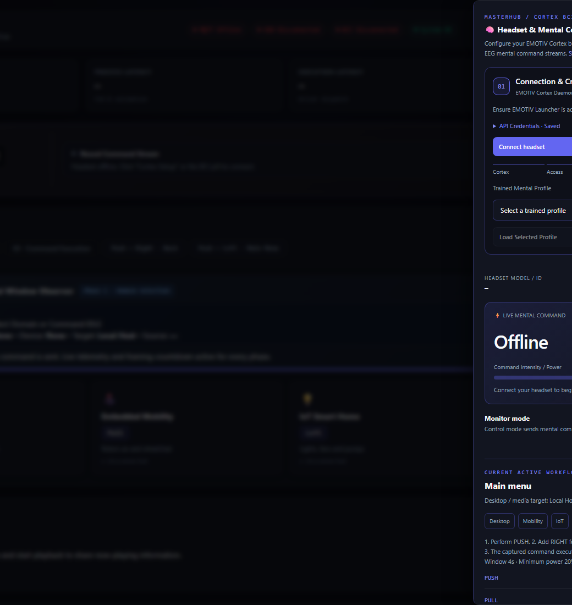
EMOTIV CORTEX BCI IMPLEMENTATION
HITAM
MASTERHUB
Local WebSocket connection to the Cortex service
Credential storage, access authorization and session creation
Headset discovery and trained profile loading
Live com stream with action and detector power
Monitor mode before explicit control enablement
Neutral rearm and duplicate suppression
Single or paired gestures resolved in the current FSM mode
Default minimum detector power: 0.20
Default temporal window: 4 seconds
09
Notes:
Sources: cortex/service.py, cortex/control.py, templates/bci_panel.html and live dashboard screenshot.

Slide 10
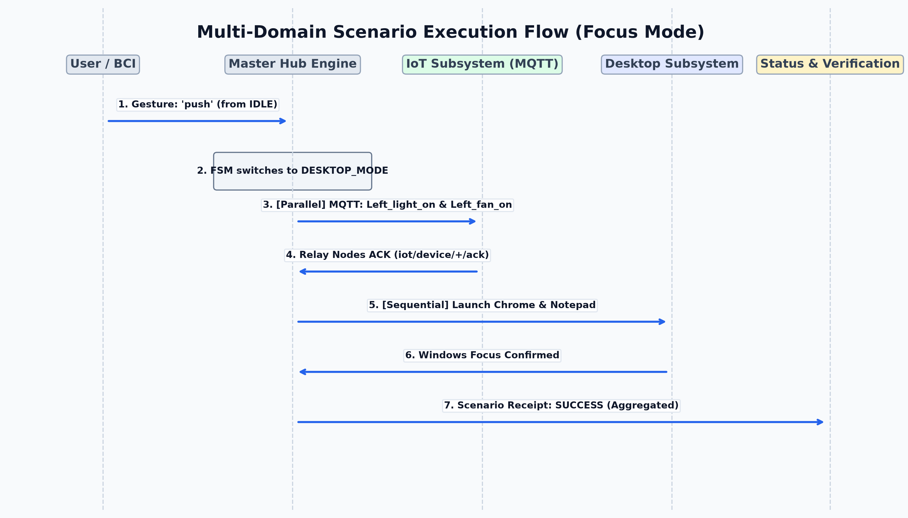
BCI TEMPORAL FRAMING AND SAFETY
HITAM
MASTERHUB
FRAME START
RESOLUTION
A qualifying active mental command starts one timing window. Repeated packets of the held gesture do not create repeated commands.
A mapped second gesture can form a pair. Live BCI waits until the original deadline, then validates the current direction before motion dispatch.
10
Notes:
Sources: cortex/control.py, tests/test_cortex_control.py and docs/diagrams/scenario_sequence.png.

Slide 11
HARDWARE AND CONNECTIVITY LAYER
HITAM
MASTERHUB
MQTT
USB SERIAL
Broker host and port can come from the environment or saved hardware settings. IoT and mobility topics remain independently configurable.
UART configuration discovers ports and uses a JSON-line envelope. The default baud rate is 115200 when pyserial is installed.
REMOTE PC AGENTS
CORTEX BRIDGE
The dashboard registers target IDs and transports, but each remote computer still requires its compatible agent and heartbeat.
EMOTIV Launcher and the local Cortex service provide headset access, authorization, profile data and the live command stream.
Connection state is separated from device readiness. Broker online, device heartbeat and command acknowledgement are different signals.
11
Notes:
Sources: services/mqtt_service.py, services/usb_service.py, services/hardware_config.py and README.md.

Slide 12
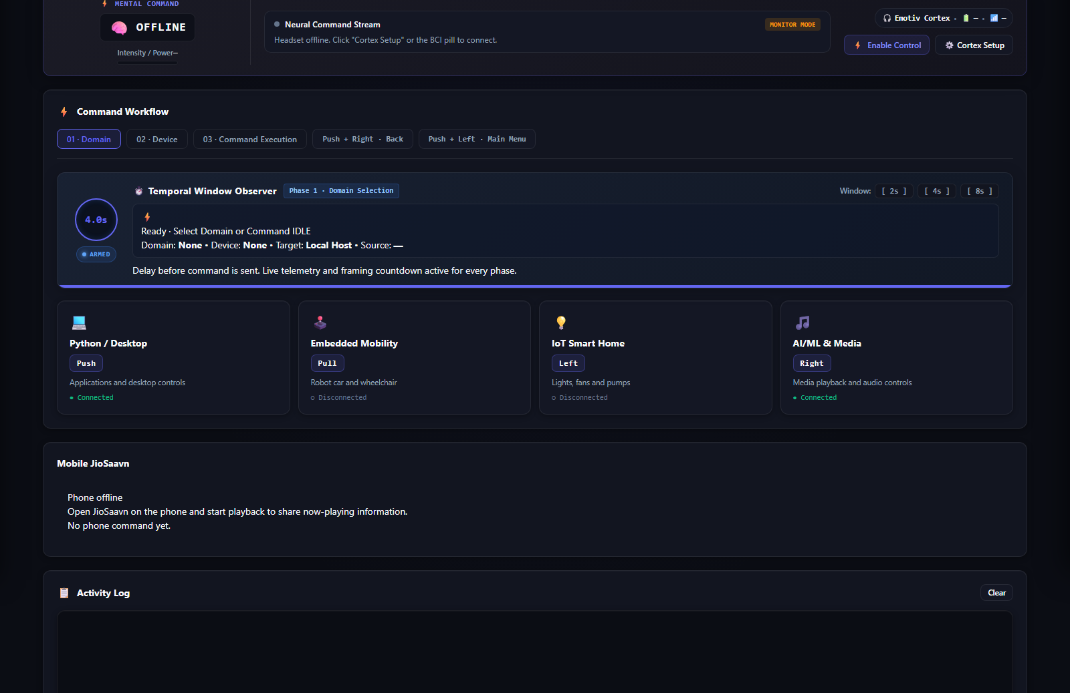
CURRENT MASTERHUB DASHBOARD
HITAM
MASTERHUB
Live console showing connection state, BCI status, temporal observer and the four control domains.
12
Notes:
Screenshot captured from the current local application at /dashboard on 26 September 2026. Offline hardware indicators reflect the capture environment, not missing implementation.

Slide 13
DASHBOARD CONTROLS AND OBSERVABILITY
HITAM
MASTERHUB
Connection matrix
Latency HUD
MQTT, USB, BCI and system status
Response, processing, execution and recovery indicators
Temporal observer
Workflow navigation
Current phase, countdown, target and input source
Domain, device and command phases with back and main-menu gestures
Activity log
Telemetry export
Command outcomes and operator-visible feedback
Log, JSON and CSV output for analysis
Hardware setup
Safety controls
Broker settings, UART configuration and target registration
Monitor mode, cancel, Execute Now, FSM reset and E-Stop request
13
Notes:
Source: templates/dashboard.html and static/masterhub.js.

Slide 14
SAFETY, VALIDATION AND FAULT HANDLING
HITAM
MASTERHUB
Command validator rejects unknown routes before handler execution
Mode-aware mappings prevent gestures from bypassing workflow context
BCI starts in monitor mode and requires control enablement
Pending dashboard commands can be cancelled before dispatch
Software E-Stop sends stop requests and clears pending work
Motion dispatch checks the current active direction
Activity and BCI logs record outcomes for diagnosis
Hardware still requires an independent physical stop and watchdog
IMPORTANT BOUNDARY
Simulation Mode changes dashboard state and logging. It does not guarantee that hardware actions are isolated.
PHYSICAL SAFETY
A successful HTTP or MQTT response does not prove that an actuator stopped. Device acknowledgements and independent safety hardware remain necessary.
14
Notes:
Source: README.md safety notes and current service behavior.

Slide 15
SOFTWARE IMPLEMENTATION STRUCTURE
HITAM
MASTERHUB
core/
Input processor, engine, router, state and metrics
actions/
Desktop, IoT, embedded and media handlers
cortex/
Authentication, session, profile, stream and BCI control
services/
MQTT, USB, logging, validation, workflow and hardware settings
mappings/
Command, gesture, mode and workflow JSON definitions
templates/ + static/
Dashboard UI, BCI drawer, scripts and styles
simulator/
Recorded-prediction replay and filtering tools
tests/
BCI, workflow, mappings, hardware and logging tests
15
Notes:
Source: current repository structure.

Slide 16
VERIFICATION AND TEST COVERAGE
HITAM
MASTERHUB
BCI CONTROLLER TESTS
WORKFLOW TESTS
Temporal window behavior, gesture pairs, neutral handling, retry paths and motion stability.
State transitions, mappings, command updates, embedded routes and dashboard behavior.
SERVICE TESTS
REPLAY TOOLS
Hardware status, logging, media integration and manual-versus-BCI command records.
Recorded predictions can exercise HTTP command paths, while focused controller tests verify live BCI framing.
Verification must distinguish software dispatch from physical execution. Hardware tests require isolated devices, acknowledgements and safe movement constraints.
16
Notes:
Source: tests/ directory and README.md testing guidance.

Slide 17
ACHIEVED OUTPUTS AND CURRENT LIMITS
HITAM
MASTERHUB
ACHIEVED
CURRENT LIMITS
Unified dashboard and API
Four routed control domains
Live Cortex mental-command path
Temporal single and paired gestures
MQTT, serial and remote-target setup
Activity logs and telemetry export
External broker and firmware remain required
Remote target registration does not install an agent
Simulation Mode is not an execution sandbox
Cortex depends on trained profiles and vendor access
Physical E-Stop and watchdog remain external
Some actions depend on an unlocked Windows desktop
The current implementation provides a working orchestration layer. Deployment readiness depends on the connected hardware, credentials and safety system.
17
Notes:
Source: current repository and README.md limitations.

Slide 18
CONCLUSION AND FUTURE SCOPE
HITAM
MASTERHUB
CONCLUSION
FUTURE SCOPE
MasterHub now combines the original IoT work with desktop automation, embedded mobility, media control and EMOTIV BCI. A single stateful workflow translates multiple input sources into validated domain actions.
Add device-side watchdogs and signed acknowledgements
Package and document the remote PC agent
Create a true dry-run execution backend
Calibrate BCI thresholds per user and profile
Add automated end-to-end hardware test rigs
Improve deployment packaging and secret management
The project has moved from hardware control experiments to a reusable human-to-device orchestration platform.
18
Notes:
Future work is based on gaps documented in the current repository.

Slide 19
HITAM
THANK YOU
MASTERHUB IMPLEMENTATION REVIEW
Notes:
Closing slide.

