Slide 1

TRACECROP: CROP TRACEABILITY AND SUPPLY CHAIN MANAGEMENT PLATFORM
Adabala Pushkaran B.Tech (Computer Science & Engineering) Hall Ticket: 24EG105R65
Project Guide Name Designation
Department of Computer Science and Engineering
1

Slide 2
Index
1. Introduction
2. Problem Statement
3. Objectives
4. Scope of the Project
5. Existing System
6. Proposed System
7. Software & Hardware Requirements
8. System Design
9. Flowchart & Algorithm
10. Modules Description
11. Results / Output Screens
12. Advantages & Limitations
13. Future Enhancements
14. Conclusion
15. References
Department of Computer Science and Engineering
2

Slide 3
1. Introduction
Modern Cloud-Based Solution:
TraceCrop is a web-based agricultural crop traceability and supply chain management system.
Addresses transparency, trust, and accountability in agricultural transactions.
Connected Stakeholder Ecosystem:
Dynamically links farmers, quality auditors, distributors, government authorities, and consumers.
Replaces isolated workflows with a unified database structure.
Advanced Serverless Backend:
Built with a serverless architecture using Firebase Authentication and Cloud Firestore.
Real-time synchronization ensures that all updates are immediately visible to authorized stakeholders.
Department of Computer Science and Engineering
3

Slide 4
2. Problem Statement
Paper-Based & Disconnected Records:
Supply chain data is often fragmented across physical logs, verbal agreements, or isolated local software.
Manual recording increases data errors, delays, and exposes records to physical damage or tampering.
Lack of Consumer Transparency:
End consumers have no reliable means to verify the crop origin, quality grades, or logistics timeline.
Inability to verify authenticity leads to product counterfeit risks and lower consumer trust.
Inefficient Stakeholder Communication:
Farmers, distributors, and auditors work in silos, relying on manual check-ins and separate databases.
Technical barriers, such as exposing complex database document IDs, reduce system adoption.
Department of Computer Science and Engineering
4

Slide 5
3. Objectives
Centralized Ledger Database:
Implement a centralized Cloud Firestore database that stores real-time records for all crops and users.
Secure Role-Based Access Control:
Implement secure signup and authentication to redirect stakeholders to customized role dashboards.
Friendly Identifiers & Usability:
Generate readable user public IDs (e.g. FARM-AB12) and crop batch codes (e.g. TRC-2026-M7X2) to improve data searching and communication.
Public Crop Traceability:
Allow public consumers to search crop batch codes and trace the product journey, quality grades, and logistics status instantly.
Department of Computer Science and Engineering
5

Slide 6
4. Scope of the Project
In-Scope Features:
Authentication: User registration, Google Sign-in, and role-based routing.
Farmer Module: Crop registration, batch code generation, and crop transfer.
Auditor Module: Crop inspection, grading, notes, and laboratory report linking.
Distributor Module: Transfer acceptance, transit status, and current location tracking.
Government Module: Centralized oversight, National Registry table, and high-level crop metrics.
Consumer View: Public lookup page retrieving complete crop journey timeline.
Out-of-Scope (Future Enhancements):
Blockchain network integration, IoT sensor tracking, automated QR code generation, mobile apps.
Department of Computer Science and Engineering
6

Slide 7
5. Existing System
Manual Ledgers & Disconnected Apps:
Existing systems rely heavily on manual paper-based logs or disconnected local database apps.
Highly vulnerable to data loss, physical damage, and unauthorized record modification.
Zero Visibility & Fragmented Communication:
Minimal data sharing between farmers, auditors, and distributors leads to delayed updates.
Consumers have no access to product journeys, causing lack of market trust.
Comparison Table:
Feature | Existing Systems | Proposed TraceCrop System
Record-Keeping | Paper-based or isolated digital databases | Centralized, real-time Cloud Firestore database
Consumer View | No public access to product information | Public trace portal using crop batch codes
Identifiers | Long, complex technical database UIDs | Short, readable public IDs and batch codes
Security | Weak access controls, susceptible to tampering | Firebase Auth & strict role-based Firestore rules
Notifications | Manual communication (calls/texts/emails) | Animated toast notifications for instant UX feedback
Department of Computer Science and Engineering
7

Slide 8
6. Proposed System
Centralized Cloud Ledger Architecture:
Integrates all participants (Farmers, Auditors, Distributors, Govt, Consumers) into a single database.
Ensures single-source of truth via real-time Cloud Firestore listeners.
Decoupled and Rationalized Workflows:
Crop registration and distributor transfer are separated to match natural agricultural processes.
Farmers register crops first; distributor IDs are validated and assigned subsequently.
Security and Access Boundaries:
Stakeholder operations restricted using server-side security rules matching user roles.
Hides database keys, using public IDs to simplify searches and transfer transactions.
Department of Computer Science and Engineering
8

Slide 9
7. Software & Hardware Requirements
System Requirements Table:
Category | System Requirement Spec
Frontend UI | HTML5, CSS3, JavaScript (ES Modules), Tailwind CSS CDN, Google Material Symbols
Cloud Backend | Firebase Authentication, Cloud Firestore NoSQL Database, Firebase Hosting config
Development Tools | Visual Studio Code, Git, Browser Developer Tools, PowerShell CLI
Browser | Chrome, Edge, Firefox, Safari or any modern browser with ES module support
Minimum Hardware | Intel/AMD Dual-Core Processor, 4 GB RAM, active Internet Connection
Operating System | Windows 10/11, macOS, or Linux distributions
Department of Computer Science and Engineering
9

Slide 10
8. System Design
Client-Server Architecture (BaaS):
Presentation Layer: HTML5 structures styled with responsive Tailwind CSS components.
Logic Layer: Event handlers, UI controllers, and Firebase modules imported in JS scripts.
Database & Security: Cloud Firestore storing data; Firestore Security Rules restricting writes.
Data Model Schema (Firestore):
users Collection: {fullName, email, role, publicId, createdAt}
crops Collection: {batchCode, name, variety, sowingDate, location, fertilizers, farmerId, farmerPublicId, distributorId, distributorPublicId, status, qualityGrade, auditNotes, reportUrl, auditedAt, imageUrl, createdAt, lastUpdated}
Department of Computer Science and Engineering
10

Slide 11
9. Flowchart & Algorithm
Lifecycle Flow of Crop Batch Document:
1. SOWING: Farmer registers crop details -> System generates batch code -> Status set to 'Unassigned'.
2. ASSIGNMENT: Farmer enters distributor public ID -> App validates ID -> Document assigned to distributor.
3. INSPECTION: Auditor searches crop -> Submits quality grade, notes, and report -> Status updated.
4. TRANSIT: Distributor accepts shipment -> Updates location and status ('In Transit', 'Stored', 'Delivered').
5. TRACE: Consumer searches batch code -> Retrieves timeline of cultivation, audit, and transit logs.
Farmer
Crop Registration
Transfer
Assign Distributor ID
Auditor
Quality Audit & Grading
Distributor
Shipment & Transit Updates
Consumer
Public Trace Journey
Department of Computer Science and Engineering
11

Slide 12
10. Modules Description
Farmer Module:
Allows digital crop registration, crop list viewing, crop deletion, and post-registration transfer.
Quality Auditor Module:
Features crop batch search by ID/name/variety; enables grading (Grade A, B, Rejected) and remarks.
Distributor Module:
Displays transfer requests; allows distributors to accept ownership and update transit status/location.
Government Module:
Centralized monitoring dashboard displaying global crop counts, audit grades, and national crop registry.
Consumer Module & Notifications:
Consumer View allows public search and journey lookup. Notifications module provides toast alerts.
Department of Computer Science and Engineering
12

Slide 13
11. Results / Output Screens
Signup & Login Pages:
Responsive forms allowing users to sign up with roles (Farmer, Auditor, etc.) or log in via Google.
Farmer Dashboard:
Features crop list cards showing batch codes and a dedicated post-registration transfer modal.
Quality Auditor Dashboard:
Contains real-time search filters, quality checkboxes, and a form to submit audit certificates.
Distributor & Government Dashboards:
Distributor: Table for incoming shipments; Government: Summary analytics cards and national database registry.
Consumer Trace View:
Displays crop images, detailed origin information, audit grades, and an interactive journey timeline.
Department of Computer Science and Engineering
13

Slide 14
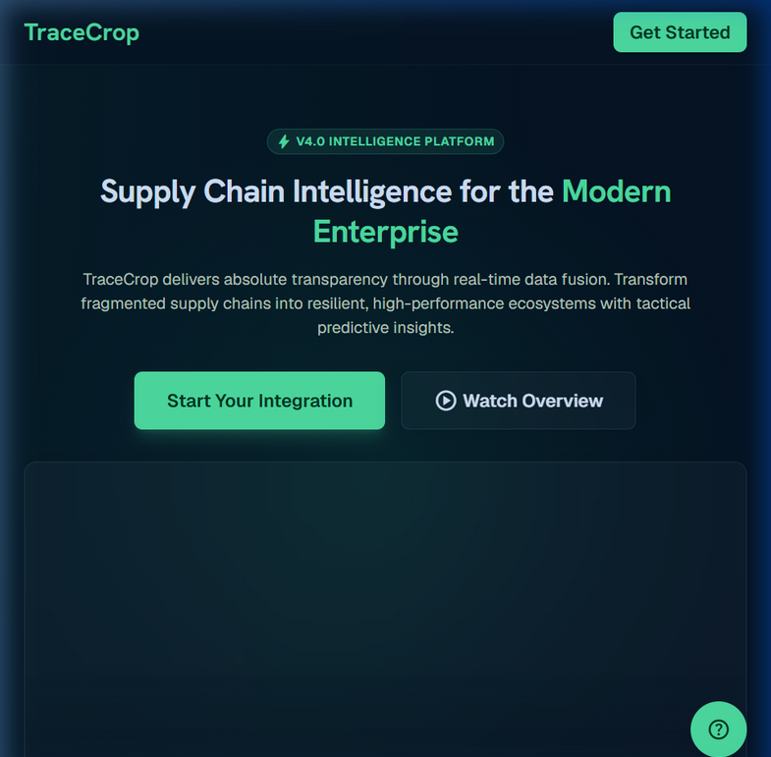
System UI: Landing Page
Department of Computer Science and Engineering
14

Slide 15
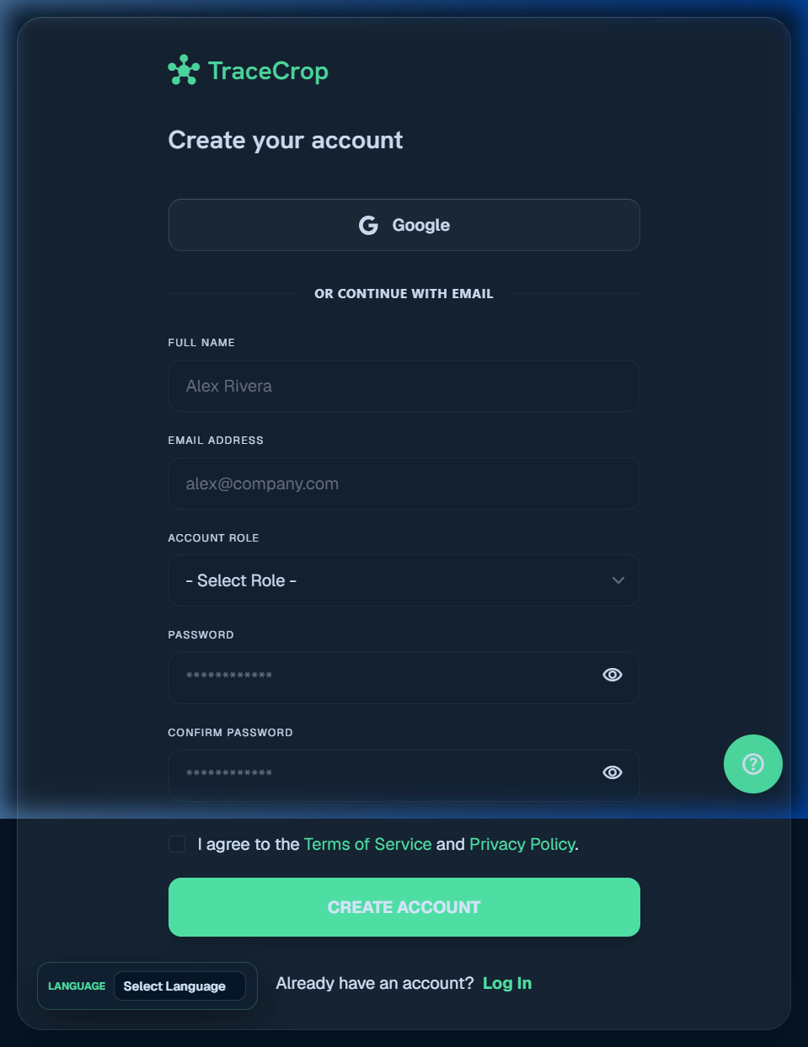
System UI: User Signup
Department of Computer Science and Engineering
15

Slide 16
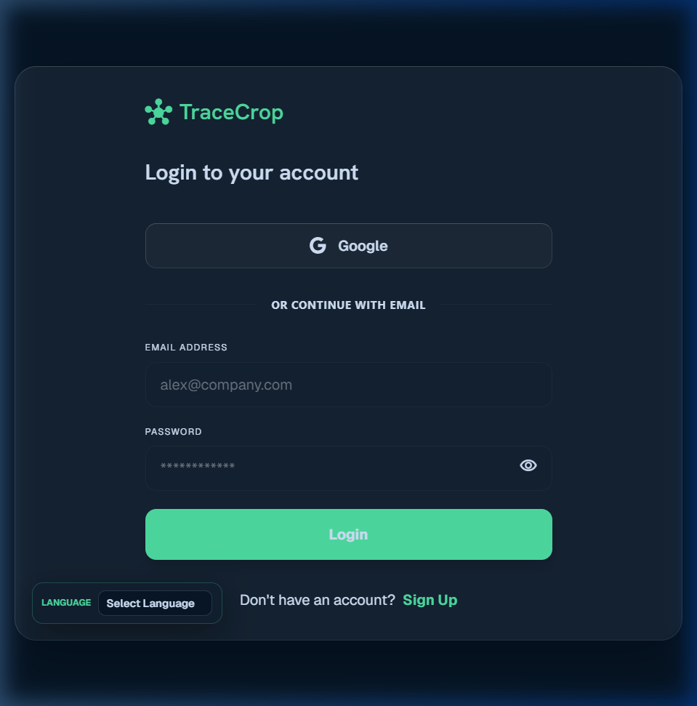
System UI: User Login
Department of Computer Science and Engineering
16

Slide 17
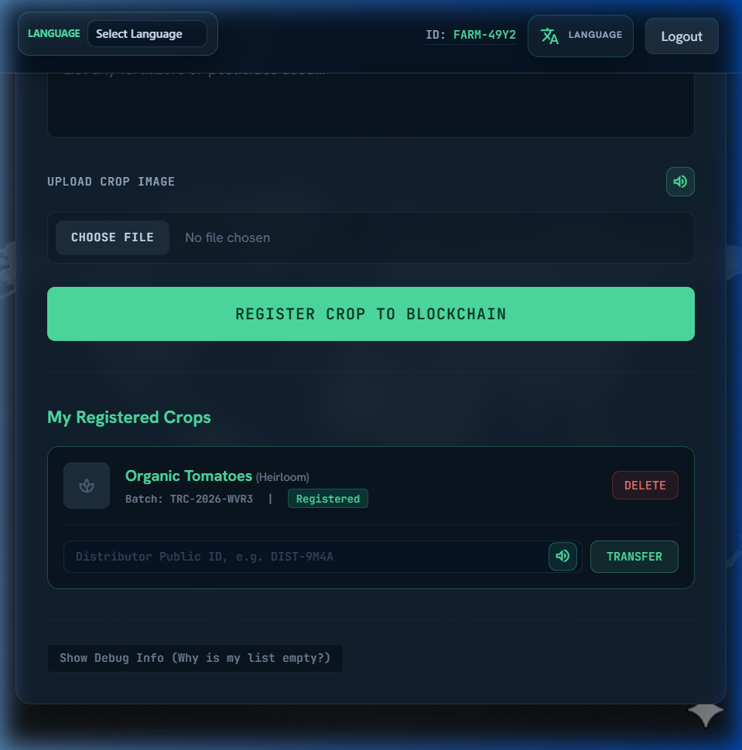
System UI: Farmer Dashboard (Crop Registration)
Department of Computer Science and Engineering
17

Slide 18
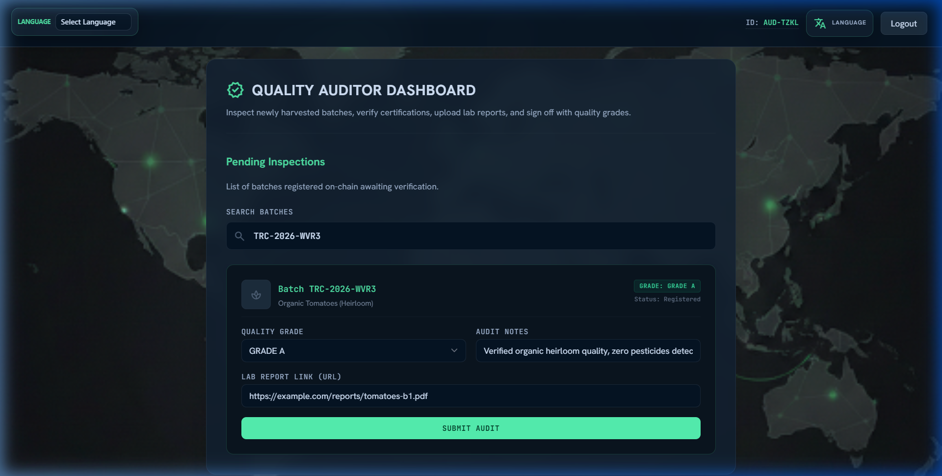
System UI: Quality Auditor Dashboard (Grading)
Department of Computer Science and Engineering
18

Slide 19
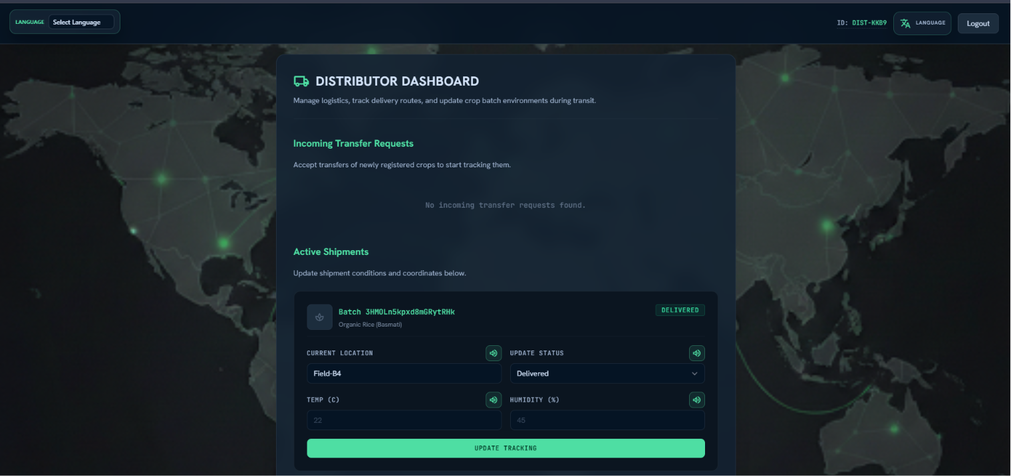
System UI: Distributor Dashboard (Logistics & Tracking)
Department of Computer Science and Engineering
19

Slide 20
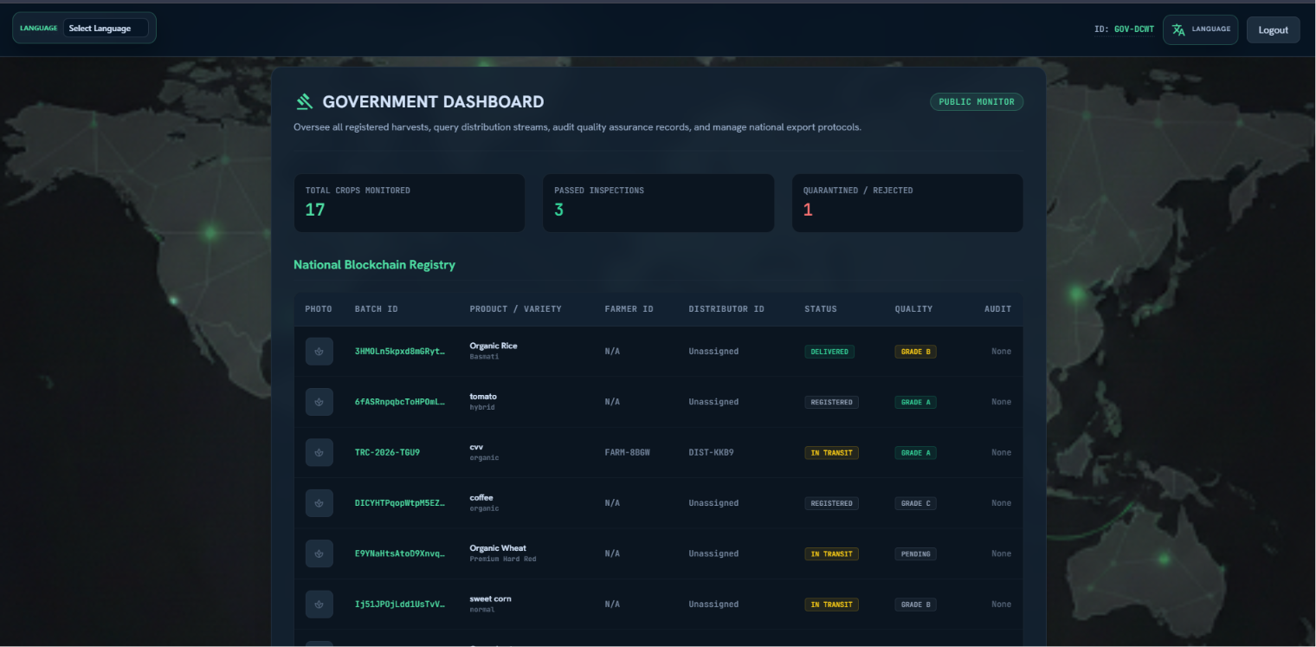
System UI: Government Dashboard (Oversight)
Department of Computer Science and Engineering
20

Slide 21
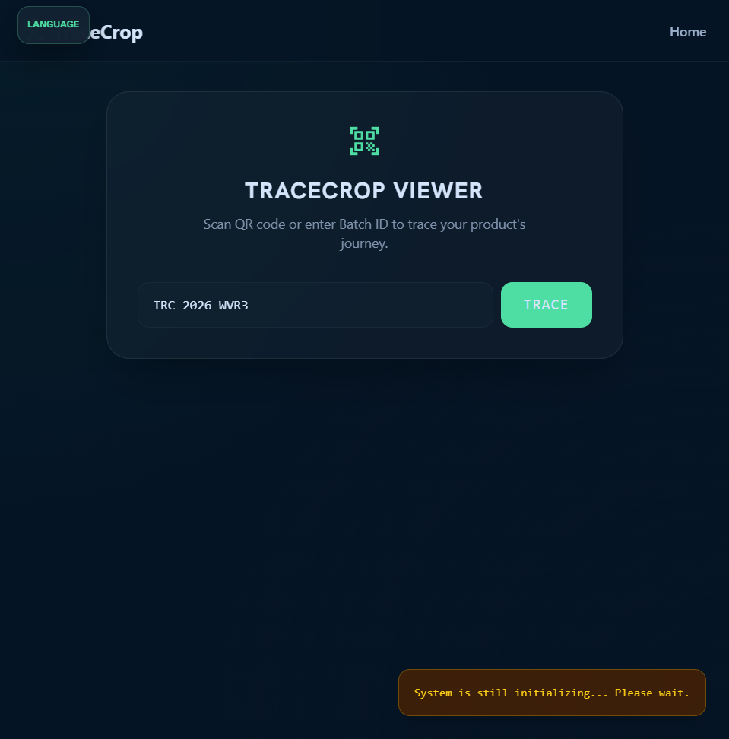
System UI: Consumer Trace View (Public Journey)
Department of Computer Science and Engineering
21

Slide 22
12. Advantages & Limitations
Project Advantages:
Real-Time Supply Chain Tracking: Instant database synchronization across all dashboard users.
Role-Specific Dashboards: Personalized interfaces match exact user responsibilities, reducing clutter.
User-Friendly Identifiers: Readable batch codes and public IDs hide long, confusing database UIDs.
Premium UX Elements: Responsive CSS layouts and animated toast notifications improve feedback.
Project Limitations:
Sandbox/Prototype Database: Uses centralized Firestore; does not run on a physical blockchain network.
Static QR-Codes: QR code generation and direct mobile camera scanning are not yet implemented.
Basic Analytics: Advanced trend charts and exportable PDF audit files are left for future work.
Department of Computer Science and Engineering
22

Slide 23
13. Future Enhancements
Blockchain Anchoring for Tamper-Evidence:
Hash quality reports and transaction logs onto a public ledger (e.g. Ethereum/Hyperledger) for absolute trust.
Automated QR Code Generation:
Render QR codes for each crop batch, enabling quick scanning via smartphones to retrieve trace pages.
Progressive Web App (PWA) Offline Support:
Allow farmers to log data offline in farms with poor connectivity and sync once they go online.
Advanced Government & Distributor Analytics:
Implement analytical charts showing crop yield distribution, quality trends, and logistics efficiency.
Department of Computer Science and Engineering
23

Slide 24
14. Conclusion
Successful Cloud-Based Prototype:
TraceCrop successfully connects all key supply chain actors in a unified, role-based cloud system.
Usability & Accountability:
Separating registration from transfer matches real-world workflows, and public IDs improve usability.
Quality inspections are permanently recorded and visible to consumers, promoting accountability.
Strong Foundation for Production:
Demonstrates how modern web technologies (HTML5, CSS3, JS) and cloud backends (Firebase) can be combined to solve trust challenges in agricultural supply chains. Ready for future blockchain/IoT scaling.
Department of Computer Science and Engineering
24

Slide 25
15. References
Firebase Documentation:
Google Cloud Firestore documentation, Real-time Sync listeners, and Firebase Security Rules.
MDN Web Docs:
HTML5 structure definitions, CSS3 properties, and modern JavaScript ES Module specifications.
Tailwind CSS CDN Reference:
Utility-first CSS classes and responsive layout structure rules.
Google Material Symbols Icon Registry:
Icon library utilized for dashboard navigation and status representation.
Project Source Code & Configuration Files:
TraceCrop database schemas, firebase-config.js, firestore.rules, and dashboard html scripts.
Department of Computer Science and Engineering
25

