Slide 1
AIMHIGH - CAREER MENTOR PORTAL
AimHigh — Find the Right Mentor. Build Your Future.
Java • Spring Boot • Thymeleaf • Spring Security • Spring Data MongoDB • MongoDB
Prepared By: Sonakshi Bohra
Batch No: TECFJ01
Registeration No: CL2026070301170648
A web platform connecting students with the right mentors
based on their career interests.

Slide 2
Introduction
What the Career Mentor Portal does
Java
AimHigh is a web-based application designed to connect students with suitable mentors based on their career interests.
Students can register, log in, select their interests, view recommended mentors, connect with a mentor, and provide feedback.
The admin manages mentor information end-to-end.
Spring Boot
Thymeleaf
Spring Security
Spring Data MongoDB
MongoDB
AimHigh — Career Mentor Portal
2

Slide 3
Objectives
Goals the platform is built to achieve
1
2
3
Develop a platform for career mentoring
Allow students to register and log in securely
Collect student career interests
4
5
6
Recommend suitable mentors
Allow students to connect with mentors
Provide a feedback and rating feature
7
8
9
Allow admin to manage mentor information
Store application data in MongoDB
Provide a simple, user-friendly interface
AimHigh — Career Mentor Portal
3

Slide 4
Technology Used
Stack powering the Career Mentor Portal
Frontend
Backend
Database
Dev Tools
• HTML
• Java
• MongoDB
• VS Code
• CSS
• Spring Boot
• Maven
• Thymeleaf
• Spring Data MongoDB
• Git / GitHub
• Spring Security
• MongoDB Compass
AimHigh — Career Mentor Portal
4

Slide 5
System Architecture
Layered architecture from UI to database
Frontend Layer
HTML, CSS, Thymeleaf — Registration, Login, Dashboards, Mentor pages
Backend Layer
Java + Spring Boot — registration, login, interests, recommendation, feedback, admin ops
Repository Layer
Spring Data MongoDB — save, retrieve, update, delete data
Database Layer
MongoDB — students, interests, mentors, assignments, feedback
AimHigh — Career Mentor Portal
5

Slide 6
Main Modules — Student
Registration, login, and the student dashboard
1
2
3
Student Registration
Student Login
Student Dashboard
Students create an account using name, email, and password. Information is stored in MongoDB.
Verifies the student's email and password. Correct credentials redirect to the dashboard; incorrect ones show an error.
Displays student information, selected interests, assigned mentor, and mentor details.
AimHigh — Career Mentor Portal
6

Slide 7
Main Modules — Matching
Interests, recommendation, and assignment
1
2
3
Career Interests
Mentor Recommendation
Mentor Assignment
Students select preferred career areas — Data Science, Machine Learning, Web Development, Java, AI. Stored in MongoDB.
The system compares student interests with mentor expertise and displays suitable mentors.
Student selects a mentor via Connect & Assign. Mentor ID is stored in the student's record and shown on the dashboard.
AimHigh — Career Mentor Portal
7

Slide 8
Main Modules — Administration
Admin management and feedback
1
2
3
Admin Module
Feedback Module
Data Storage
Admin manages mentor information: add mentor, view mentors, delete mentors, manage mentor details (name, email, expertise, experience).
Students provide feedback on their assigned mentor — rating, message, and suggestions — stored in MongoDB.
All application data — students, mentors, interests, feedback — is persisted centrally in MongoDB collections.
AimHigh — Career Mentor Portal
8

Slide 9
Database Design
MongoDB collections used by the application
Student Collection
Mentor Collection
Feedback Collection
ID
ID
Student
Name
Name
Mentor
Email
Email
Rating
Password
Expertise
Feedback message
Interests
Experience
Mentor ID
AimHigh — Career Mentor Portal
9

Slide 10
Security & User Interface
Protecting access, and how it looks & feels
Security — Spring Security
User Interface
Student authentication
HTML — Page structure
Login management
CSS — Styling and design
Password protection
Thymeleaf — Dynamic content
Access control
Navigation links — Page navigation
Session-based tracking of the logged-in student
Cards & Buttons — Mentors and actions
The interface is simple, attractive, and user-friendly.
AimHigh — Career Mentor Portal
11

Slide 11
Functional Features
Everything the platform delivers, end to end
01
02
03
04
Student Registration
Student Login
Session Management
Career Interest Selection
05
06
07
08
Mentor Recommendation
Student Dashboard
Mentor Details
Mentor Assignment
09
10
11
12
Admin Mentor Management
MongoDB Data Storage
Dynamic Thymeleaf Pages
Application Security
AimHigh — Career Mentor Portal
13

Slide 12
Product Screens
A walkthrough of the AimHigh Career Mentor Portal
AimHigh — Career Mentor Portal
14

Slide 13
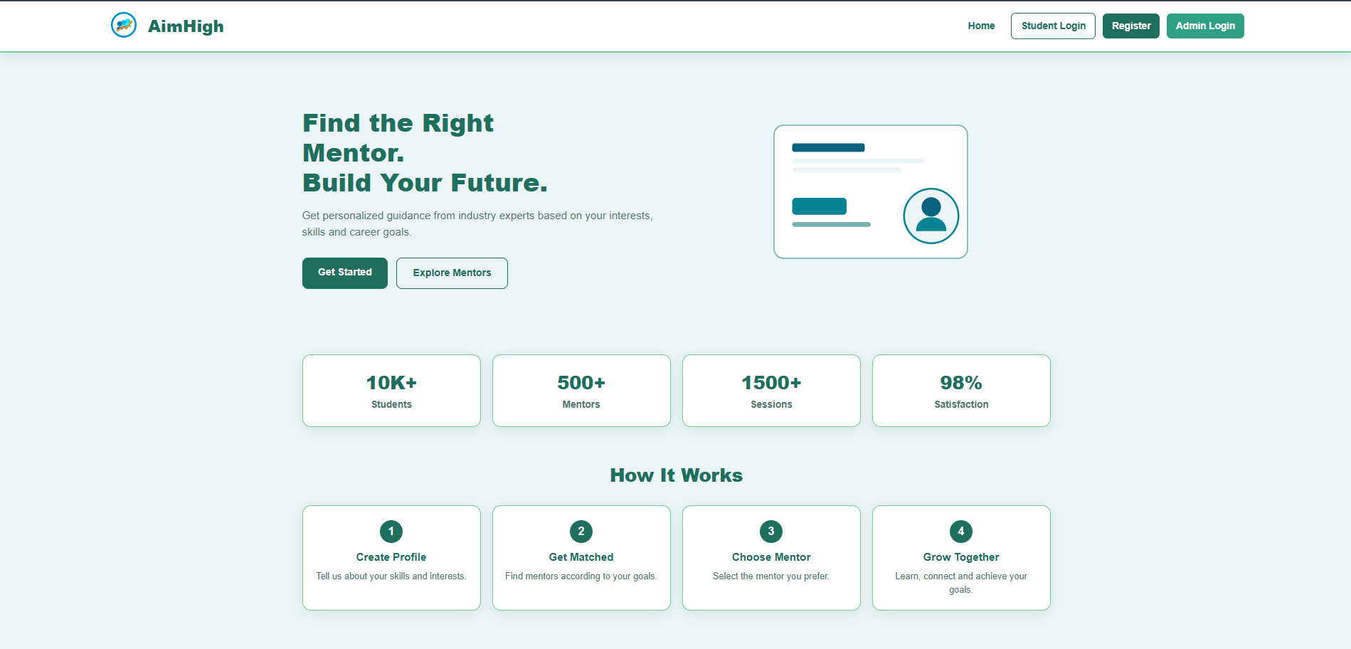
Home Page
First impression — value proposition, stats, and how it works
AimHigh — Career Mentor Portal
15

Slide 14
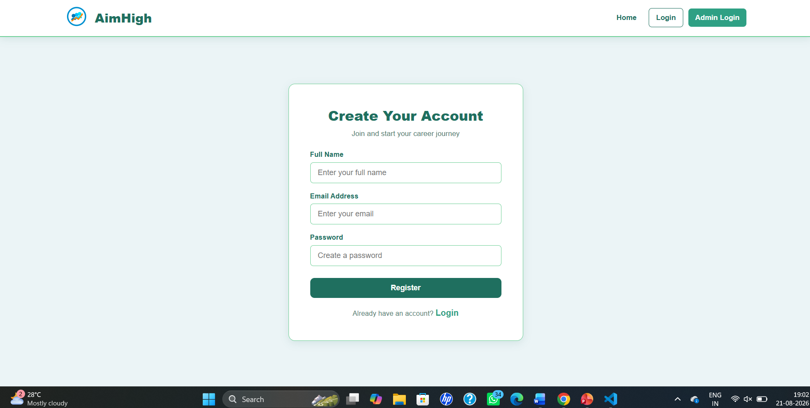
Student Registration
Students create an account with name, email, and password
AimHigh — Career Mentor Portal
16

Slide 15
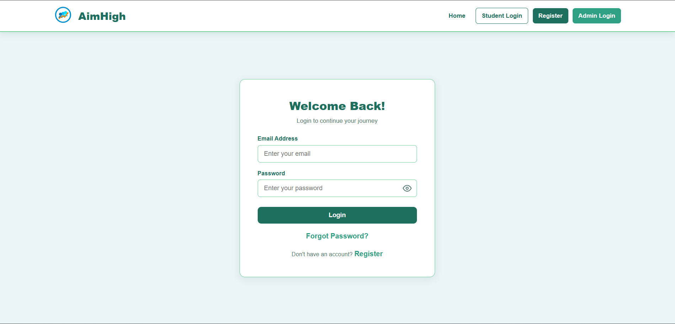
Student Login
Secure sign-in for returning students
AimHigh — Career Mentor Portal
17

Slide 16
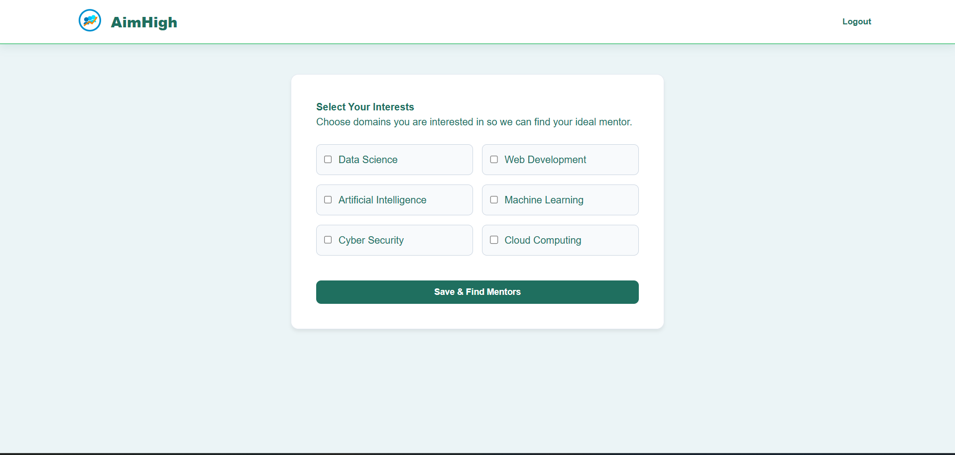
Select Your Interests
Students choose career domains to find their ideal mentor
AimHigh — Career Mentor Portal
18

Slide 17
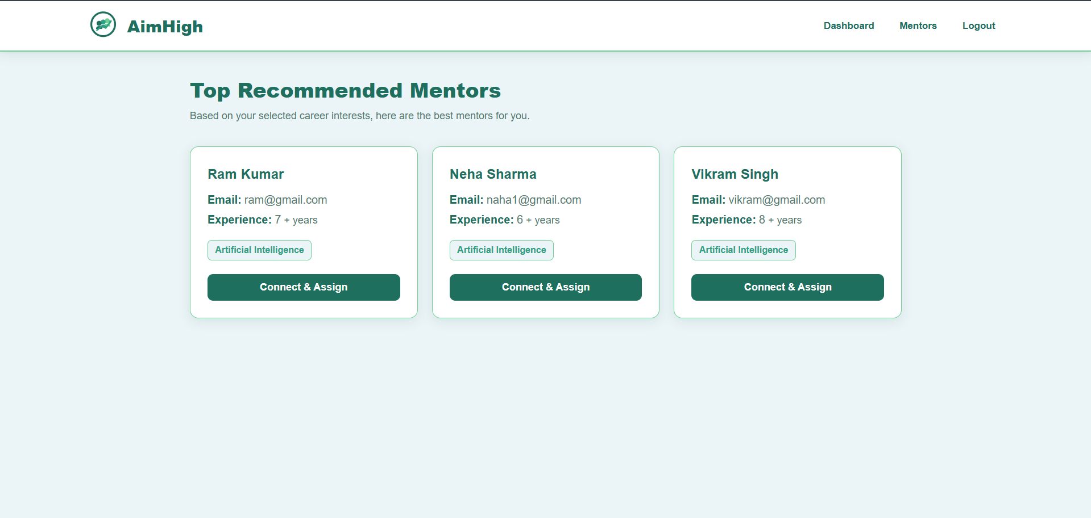
Top Recommended Mentors
Matched to the student's selected interests
AimHigh — Career Mentor Portal
27

Slide 18
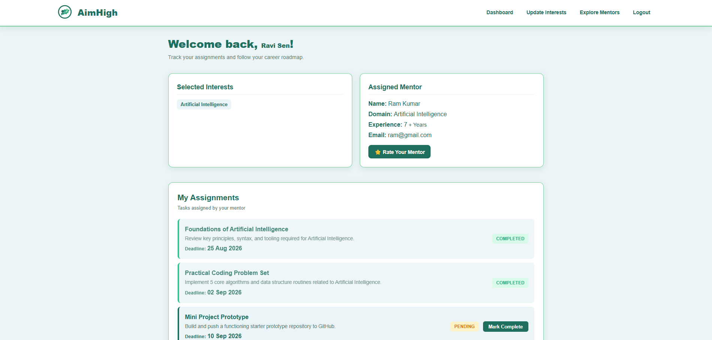
Student Dashboard
Assigned mentor, assignments, and progress at a glance
AimHigh — Career Mentor Portal
19

Slide 19
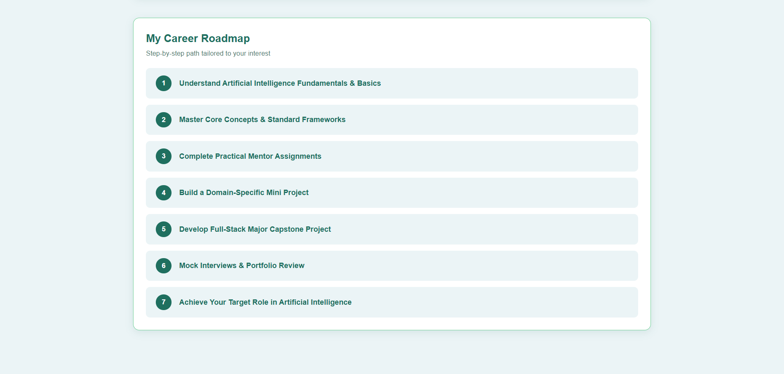
My Career Roadmap
A step-by-step path tailored to the student's interest
AimHigh — Career Mentor Portal
20

Slide 20
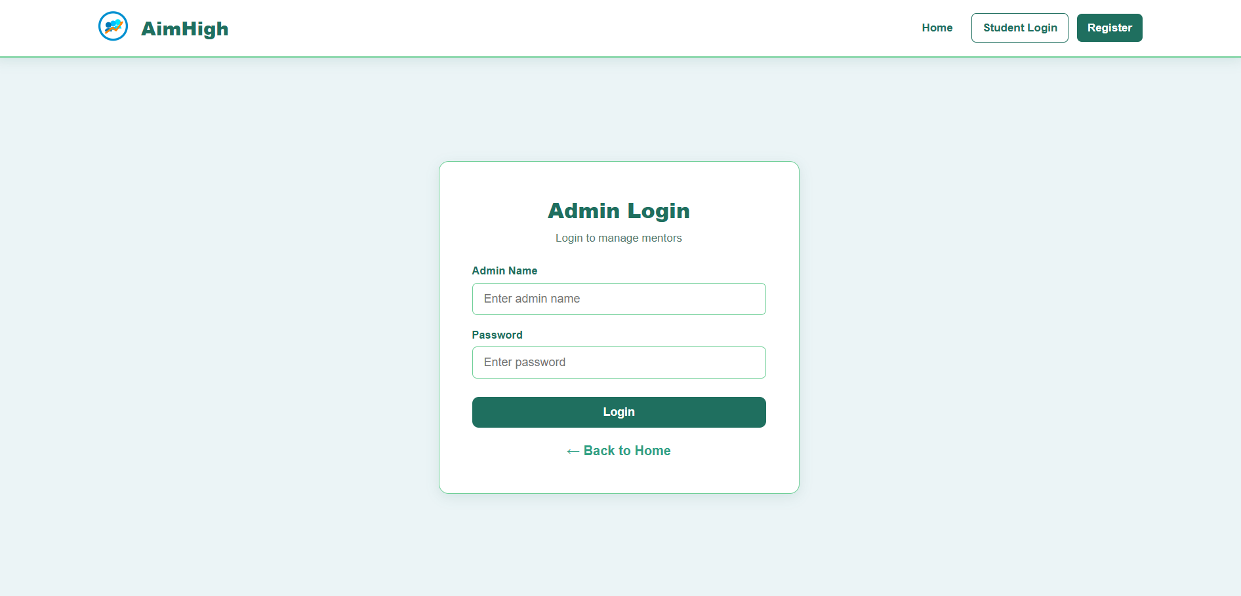
Admin Login
Secure, dedicated entry point for admins
AimHigh — Career Mentor Portal
21

Slide 21
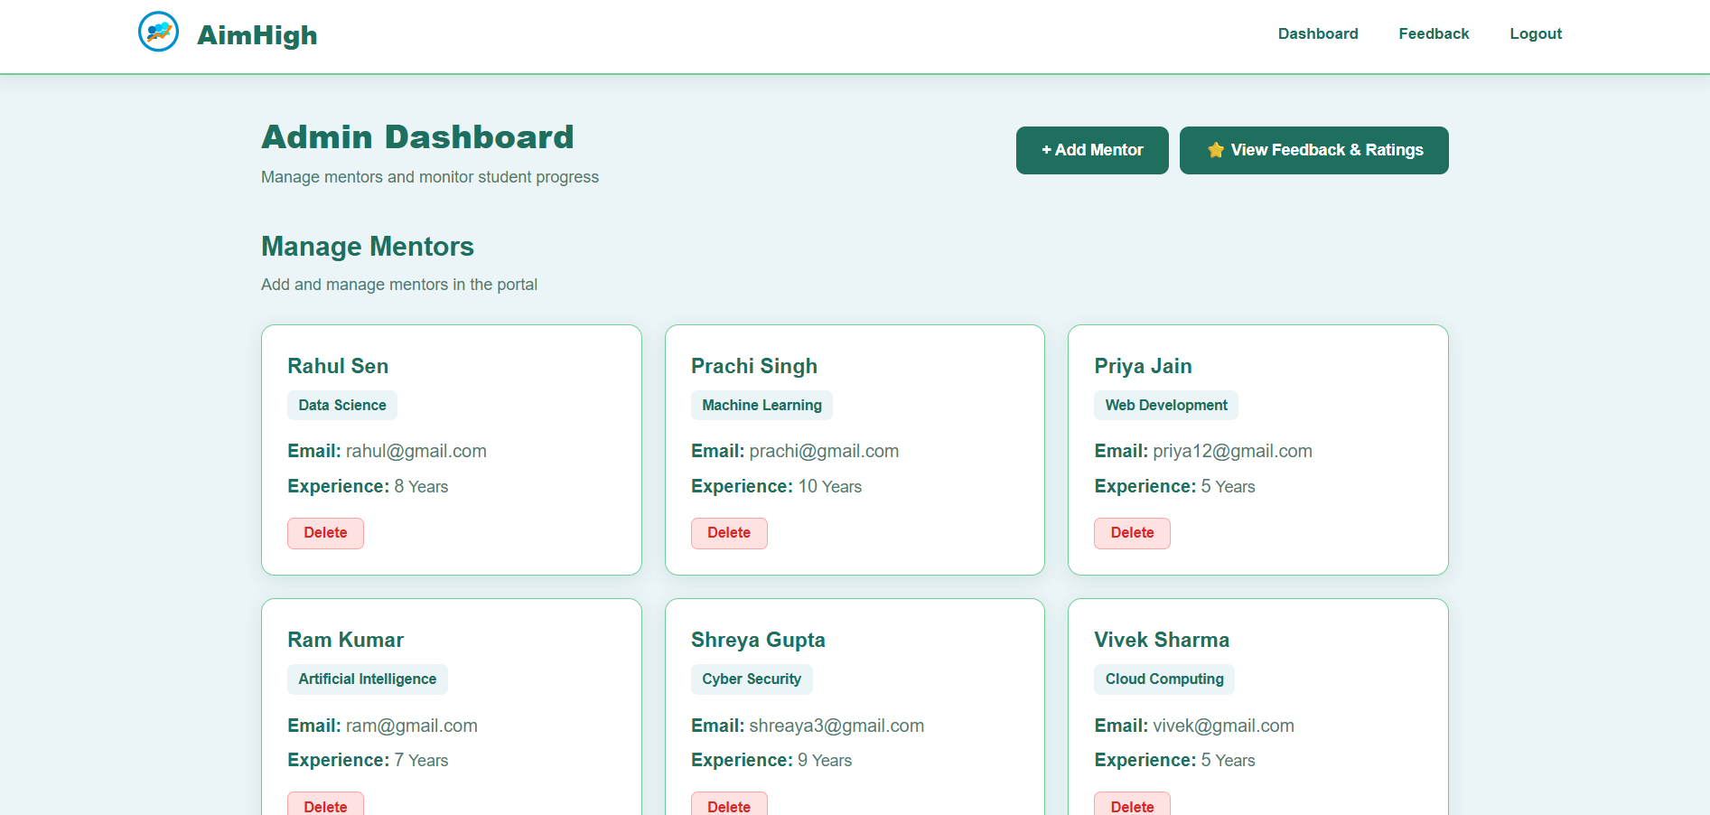
Admin Dashboard
Manage all mentors from a single screen
AimHigh — Career Mentor Portal
22

Slide 22
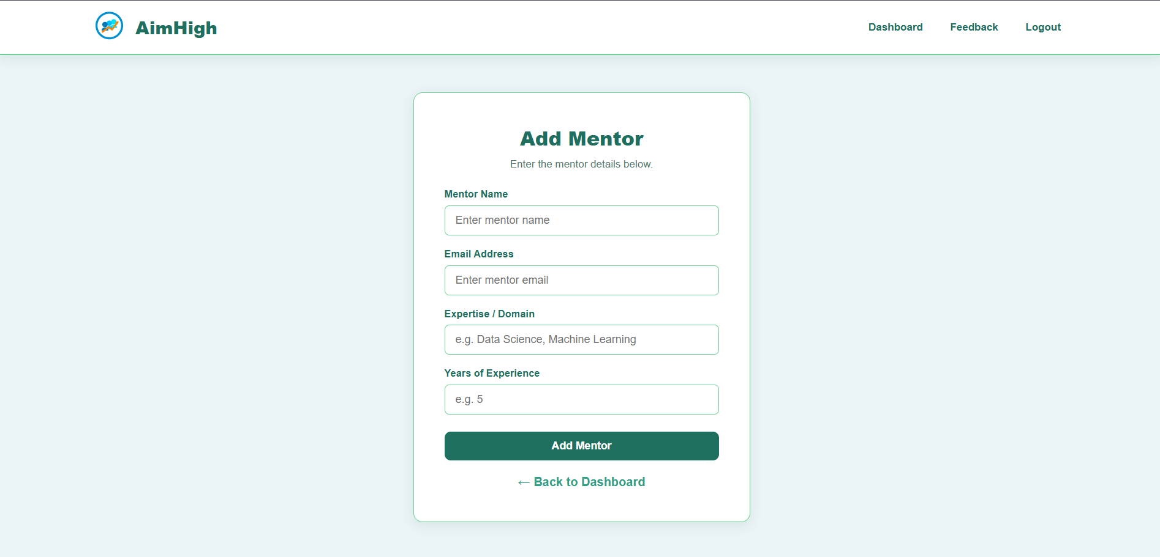
Add Mentor
Admins onboard mentors with expertise and experience
AimHigh — Career Mentor Portal
23

Slide 23
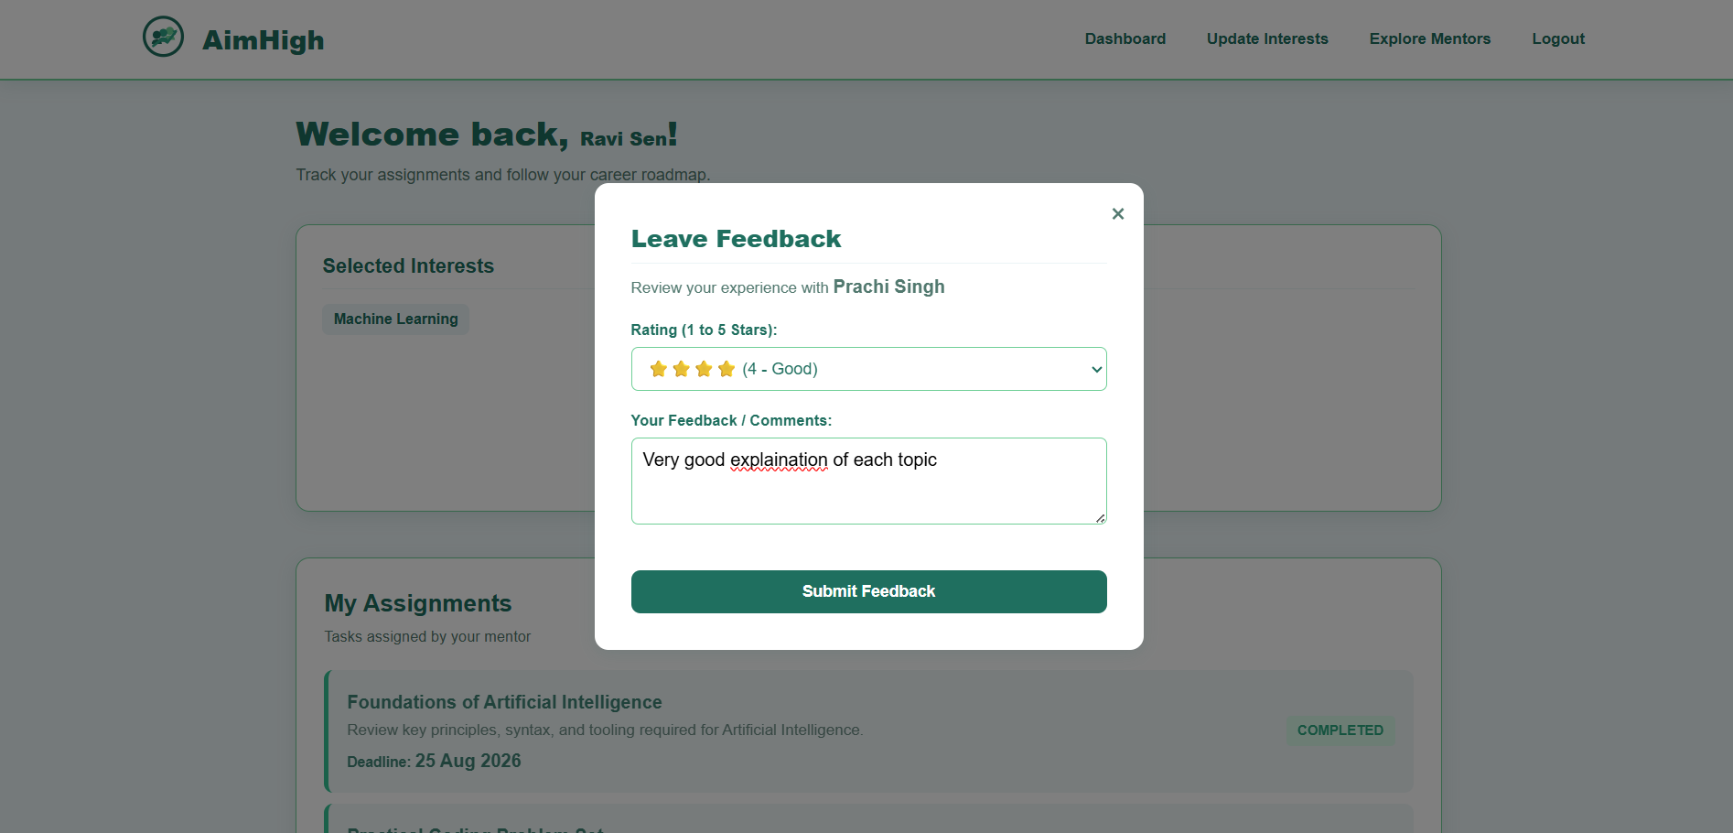
Leave Feedback — Comments
Written feedback captured alongside the star rating
AimHigh — Career Mentor Portal
25

Slide 24
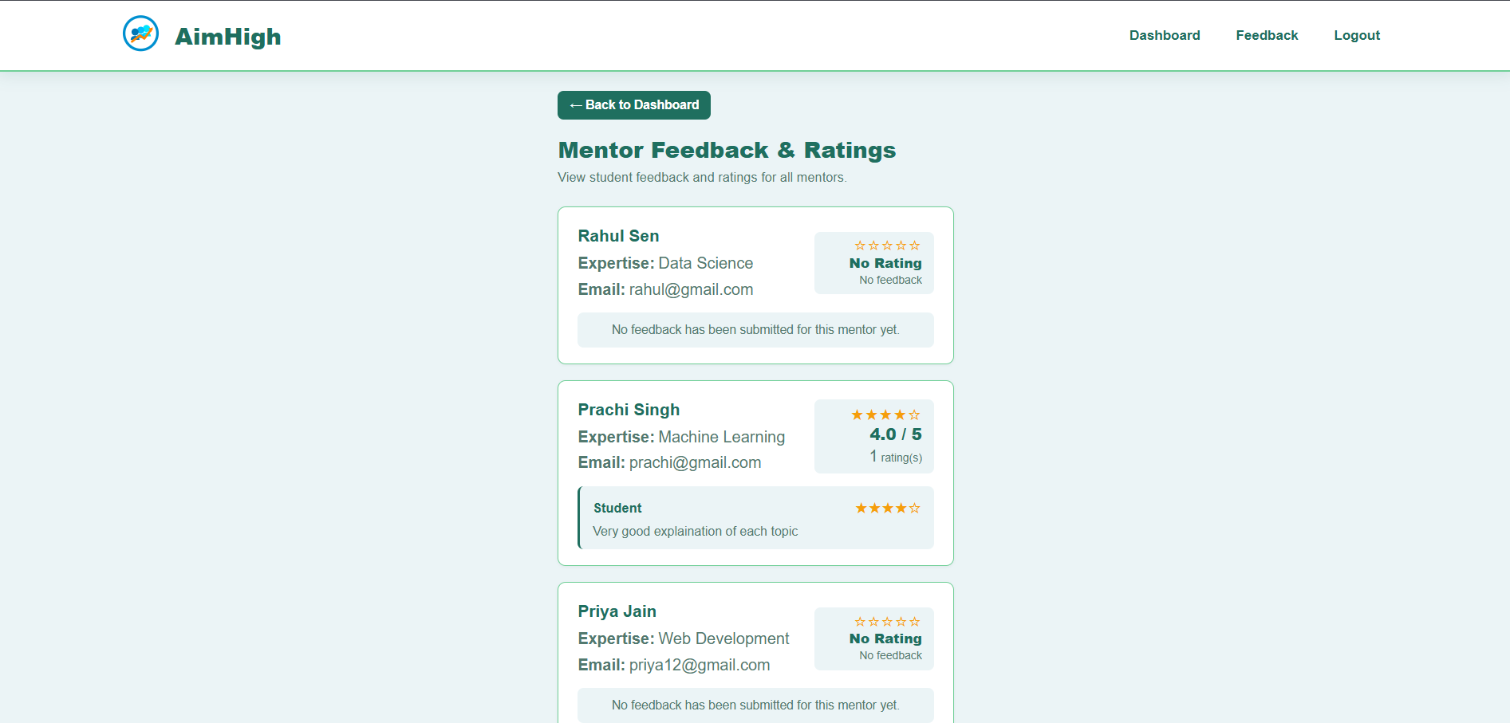
Mentor Feedback & Ratings
Admin view of every mentor's feedback and average rating
AimHigh — Career Mentor Portal
26

Slide 25
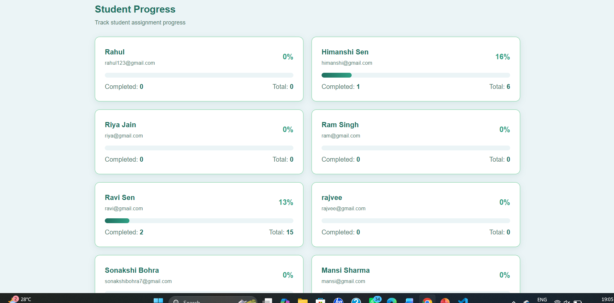
Student Progress
Admin view of assignment completion per student
AimHigh — Career Mentor Portal
28

Slide 26
Advantages
Why the Career Mentor Portal works
Easy mentor discovery
Personalized mentor recommendations
Simple mentor assignment
Student feedback & rating system
Centralized mentor management
Flexible MongoDB database
Simple, user-friendly interface
Easy to maintain and extend
AimHigh — Career Mentor Portal
29

Slide 27
Thank You
AimHigh — Career Mentor Portal
Java · Spring Boot · Thymeleaf · Spring Security · MongoDB

