Slide 1








Sales Performance and Product Demand Analysis for Improved Inventory Planning in a Retail Garments Store
Presented by:
Name: Sumaiya Afroz
Roll number: 24f1000754
A presentation slide for BDM Capstone Project
IITM Online BS Degree Program, Indian Institute of Technology, Madras, Chennai Tamil Nadu, India, 600036

Slide 2






Organization Background &
Business Problems
Organization Details
01 — Reducing Locked Working Capital
Slow-moving inventory → Capital remains tied up
      Lack of structured product-wise inventory analysis
      Slow-moving stock remains on shelves
      Working capital gets locked in inventory
02 — Minimising Total Inventory Cost
Demand uncertainty → Overstock + Stockout
      Procurement relies heavily on intuition
      Low-demand products may be overstocked
      High-demand products may face stockouts
      Results in higher holding costs / lost sales
  Matching Point — B2C retail garment and matching-accessories store
  Located at Powerhouse Road, Maripur, Muzaffarpur, Bihar
  Owned by Md. Tarique Anwar
  Established in 2014, operating for 10+ years
  Sells sarees, suit pieces, dupattas, blouse materials, lungi, undergarments and other matching accessories
  Serves local walk-in (B2C) customers
  Currently maintains all sales and inventory records manually through registers and bill books — no digital tracking system

Slide 3



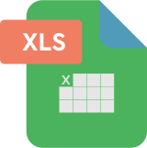

METHODS LINKED TO PROBLEMS
Data Collection & Analytical Methodology
PROBLEM 1
Reducing Locked Working Capital
ABC Analysis
→ Revenue contribution & inventory priority
Inventory Turnover
→ Identify slow / fast stock movement
⬇️
Identify where capital is tied up
Primary Data
Jan–Apr 2026
699 valid sales transactions
56 SKU/product records
Sources
      Sales registers
      Customer bill books
      Physical stock verification
      Owner discussions
      Excel Workbook
      Item Master
      Daily Sales
      Inventory Summary
      Current Stock
Key Variable
      Quantity Sold Selling Price
      Cost Price
      Opening Stock
      Closing Stock
PROBLEM 2
Minimising Total Inventory Cost
Descriptive Statistics
→ Understand sales pattern & variability
7-Day Moving Average
→ Smooth recent demand fluctuations
⬇️
Support demand-based replenishment
TOOL: MICROSOFT EXCEL
Pivot Tables • Excel Formulas • Charts
Click here for sheet

Slide 4


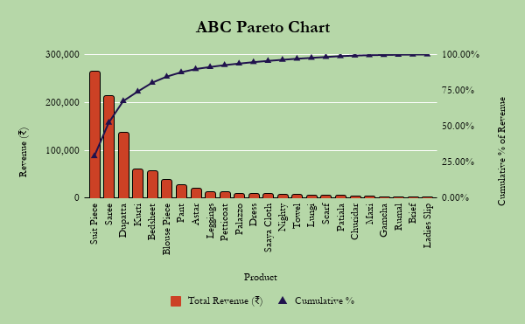



PROBLEM 1: ABC Analysis — Revenue Contribution
₹9,07,565 analysed revenue
Visual:
56 SKU records → 30 unique products → 24 products with sales
Then:
Class A — 3 products → 67.56%
Class B — 5 products → 22.30%
Class C — 16 products → 10.14%
Highlight:
A-Class: Suit Piece | Saree | Dupatta
Bottom insight:
3 products contribute 67.56% of analysed revenue
ABC Analysis — Revenue Contribution
Margin check: Class A products show ~29.19% avg margin vs 33.92% for Class C — revenue and profitability [align / partially align]

Slide 5



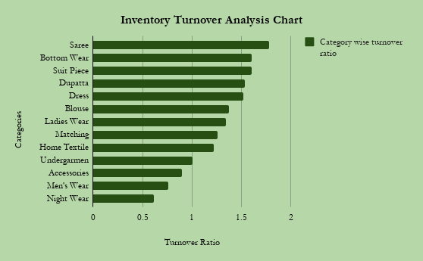


Stock Movement
PROBLEM 1: Inventory Turnover —
Slow < 1 | Moderate 1–1.5 | Fast > 1.5
Highlight:
      Highest: Saree ≈ 1.78
      Lowest: Night Wear ≈ 0.61
      Slow-moving categories:
      Night Wear • Men's Wear • Accessories
Small clarification:
Quantity-based stock movement
measure
Turnover shown as quantity-based stock movement: Quantity Sold ÷ Average Inventory Quantity

Slide 6

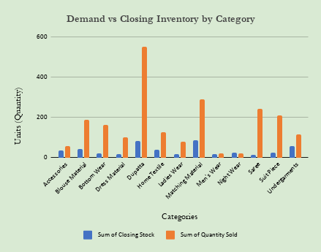
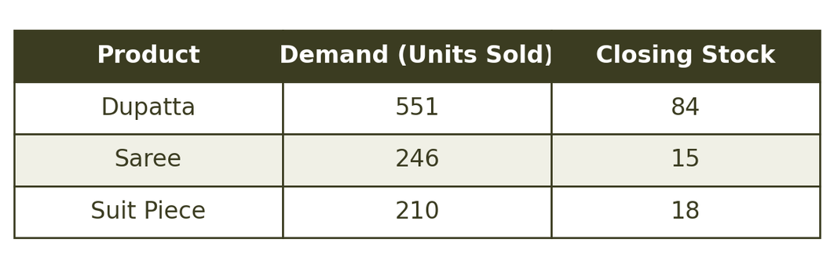

PROBLEM 2: DEMAND VS CLOSING STOCK
Focus: Class-A products require closer stock monitoring and replenishment planning.
Key Finding:
Demand is highly concentrated in Class-A products, while closing stock varies considerably across them. Dupatta has the highest demand but also carries the highest closing stock, indicating the need for demand-based replenishment rather than uniform stocking.
24 products (42.86%) Near Stockout, 28 products (50%) Normal,
4 products (7.14%) Overstock.
Demand vs Closing Inventory by Category/Product

Slide 7

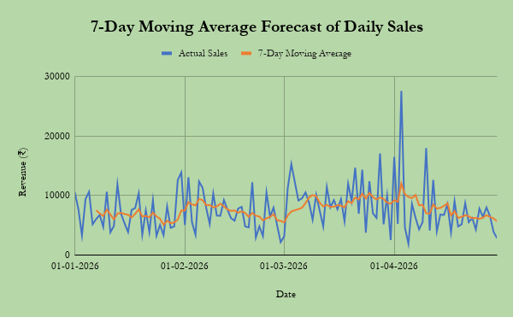

PROBLEM 2: 7-Day Moving Average — Demand Forecast
MAE: ₹2,664
RMSE: ₹3,529
MAPE: 44.21%
Key takeaway:
7-day MA smooths short-term fluctuations but has limited accuracy during demand spikes.
Integrated Finding:
Sales are concentrated in a few high-demand products, while inventory movement varies across categories. Therefore, inventory planning should combine ABC classification + stock movement + recent demand forecasting.
At the end of April, the moving
average was approximately ₹5,669 per day.
7-Day Moving Average Forecast of Daily Sales

Slide 8



Interpretation of Results
PROBLEM 2 — Minimising Total Inventory Cost
What the analysis tells us:
      Demand and available closing stock are not always aligned.
      24 of 56 products (42.86%) are Near Stockout, while 4 (7.14%) are Overstock.
      The 7-day moving average smooths daily fluctuations and provides a more stable short-term demand signal.
      This creates two opposite risks: stockouts in high-demand products and excess stock in slower-moving products.
PROBLEM 1 — Reducing Locked Working Capital
What the analysis tells us:
      Revenue is highly concentrated: 3 Class-A products generate 67.56% of analysed revenue.
      Saree (1.78) has the highest turnover, while Night Wear (0.61) has the lowest.
      485 units remain in closing stock, with approximately ₹1,02,600 capital locked.
      Slow-moving and high-value stock therefore needs tighter monitoring.
Interpretation:
Replenishment should be demand-based, using recent sales, current stock status and product priority.
Interpretation:
Inventory priority should be based on both revenue contribution and stock movement, rather than treating all products equally.
Overall Insight
Move from intuition-based purchasing to a simple data-driven inventory system using ABC priority, turnover, current stock status and recent demand.

Slide 9


RECOMMENDATIONS
1. Purchasing & Inventory Priorities
2. Demand-Based Replenishment
      Class-A products: highest priority; review weekly
      Class-B products: periodic review
      Class-C products: purchase cautiously
      Reduce purchases of slow-moving / Overstock products.
      Use discounts or bundle offers to clear prolonged slow stock.
      Review Near Stockout products weekly
      Use recent sales + 7-day Moving Average for replenishment decisions.
      Maintain a defined minimum stock level for high-demand products.
      Reorder when stock approaches the required level.

Slide 10

Reorder Point (ROP) & Conclusions
ROP & Safety Stock
Conclusions:
Reorder Point
ROP = Average Daily Demand × Lead Time + Safety Stock
Safety Stock
SS = Z × σd × √L
  Analysis shifts Matching Point from intuition-based to data-driven inventory decisions
  Class-A products (Suit Piece, Saree, Dupatta) identified as highest priority — 67.56% of revenue
  Slow-moving categories (Night Wear, Men's Wear, Accessories) identified for capital release
  Expected impact: faster clearance of ~₹1,02,600 locked capital, reduced stockouts in 24 near-stockout products, better demand-supply alignment via 7-day MA + ROP
Where:
Z = service-level factor
σd = standard deviation of daily demand
L = supplier lead time
Important: Actual supplier lead time was not available in the study data, so the ROP should be calculated after obtaining the actual lead time from the supplier/business.

Slide 11




Shift from intuition-based purchasing to simple,
data-driven inventory planning.
Implementation Roadmap
WEEKLY
📌 Review A-class & Near Stockout products
↓
MONTHLY
📌 Review slow-moving & Overstock products
↓
EACH PURCHASE CYCLE
📌 Apply ABC + demand-based ROP

