Slide 1

BLUESTOCK FINTECH
Mutual Fund Analytics Platform
End-to-End Data Engineering · ETL Pipeline · Interactive Dashboard
Anish Abhyankar
Data Analyst Intern · June 2026
40
46K+
55K+
4.5
Schemes Tracked
NAV Rows
Transactions
Years of Data
Notes:
Title slide. Introduce project, company, and scope.

Slide 2
Problem Statement
Why does this platform need to exist?
P1
Data Fragmentation
P4
Investor Behaviour Blind Spot
NAV, AUM, SIP and portfolio data scattered across AMFI, NSE, BSE in different formats. No unified database exists.
AMCs have limited visibility into how demographics and geography influence SIP amounts and redemptions.
P2
No Risk-Adjusted Comparison
P5
Slow Static Reporting
Investors cannot compare funds on Sharpe ratio, Alpha or Beta. Raw NAV requires complex transformation.
Monthly MF reports are PDFs taking days to prepare. Stakeholders need live, self-service dashboards.
P3
No Benchmark Tracking
Retail investors don't know if their fund beats the index. Tracking error requires both NAV and benchmark data.
Notes:
Five core problems this platform solves.

Slide 3
Data Sources & Datasets
10
40
87K+
4.5 Yrs
Datasets
Fund Schemes
Total Rows
NAV History
# | Dataset | Rows | Description
01 | fund_master.csv | 40 | Master list of 40 schemes — AMFI codes, AMC, category, expense ratio
02 | nav_history.csv | ~46,000 | Daily NAV Jan 2022–May 2026, anchored to real mfapi.in values
03 | aum_by_fund_house.csv | 90 | Quarterly AUM for top 10 fund houses, 2022–2025
04 | monthly_sip_inflows.csv | 48 | Month-wise SIP inflows — real AMFI Monthly Note data
07 | scheme_performance.csv | 40 | Sharpe, Sortino, Alpha, Beta, Max Drawdown per scheme
08 | investor_transactions.csv | 55,000+ | SIP/Lumpsum/Redemption records across 5,000 investors
10 | benchmark_indices.csv | ~8,000 | Daily Nifty 50, Nifty 100, BSE SmallCap closing values
Notes:
10 datasets from AMFI India, mfapi.in, NSE/BSE.

Slide 4
System Architecture & ETL Pipeline
Extract → Transform → Load → Analyse → Visualise
1
2
3
4
5
EXTRACT
TRANSFORM
LOAD
ANALYSE
VISUALISE
AMFI Daily NAV TXT
Pandas Cleaning Pipeline
SQLite (development)
Jupyter Notebooks
Power BI Dashboard
mfapi.in REST API
Forward-fill weekends/holidays
5-table Star Schema
Sharpe · Sortino · Alpha · Beta
4 Interactive Pages
NSE / BSE Bhavcopy CSV
Compute daily returns & CAGR
dim_fund · fact_nav
VaR · CVaR · Max Drawdown
Slicers & Drill-through
Pre-packaged CSV Datasets
Normalise fund names
fact_transactions · fact_performance
Fund Scorecard & HHI
Export PDF / PNG
Star Schema: dim_fund · dim_date · fact_nav · fact_transactions · fact_performance · fact_aum · fact_sip_industry
Notes:
Five-layer architecture. SQLite star schema at the core.

Slide 5
EDA Findings
SIP Inflow — India's Savings Revolution
Rs. 31,002 Cr
SIP Inflow — Dec 2025
All-Time High
9.35 Cr
Active SIP Accounts
as of Dec 2025
3×
Growth in monthly
inflows 2022–2025
Notes:
SIP inflows grew 3x in 4 years. Rs.31,002 Cr all-time high in Dec 2025.

Slide 6
EDA Findings
AUM Dominance & Investor Demographics
Key Insights
SBI leads with Rs. 12.5 lakh crore AUM
Top 3 AMCs control ~40% of industry AUM
26–35 age group drives majority of SIPs
T30 cities: ~65% of total investment volume
Notes:
AUM bar chart and age group demographics.

Slide 7
Fund Performance Analytics
Computing every metric that professional analysts use — from scratch using NAV history
CAGR
Sharpe
Sortino
Compound Annual Growth Rate
Risk-Adjusted Return
Downside Risk Penalised Return
(NAV_end / NAV_start)^(1/n) − 1
(Rp − Rf) / σ × √252
(Rp − Rf) / σ_downside × √252
Alpha
Beta
Max DD
Excess Return vs Benchmark
Market Sensitivity
Worst Peak-to-Trough Loss
OLS intercept × 252
Cov(Rp, Rm) / Var(Rm)
min(NAV / running_max − 1)
Notes:
Six metrics computed from scratch using NAV history and OLS regression.

Slide 8
Fund Scorecard — Composite Ranking
Score = 30% × 3yr CAGR rank + 25% × Sharpe rank + 20% × Alpha rank + 15% × Expense ratio rank⁻¹ + 10% × Max Drawdown rank⁻¹
Metric | Weight | Why It Matters
3-Year CAGR | 30% | Primary measure of long-term return generation
Sharpe Ratio | 25% | Rewards return per unit of total risk taken
Alpha vs Benchmark | 20% | Measures active fund manager's skill
Expense Ratio (inv) | 15% | Lower cost = more return passes to investor
Max Drawdown (inv) | 10% | Penalises funds with severe peak-to-trough losses
Notes:
Composite scorecard ranks all 40 funds 0-100.

Slide 9
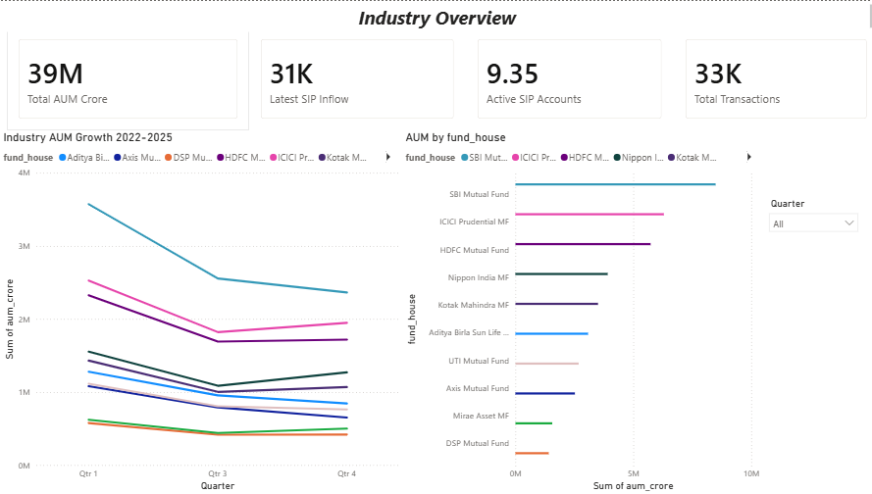
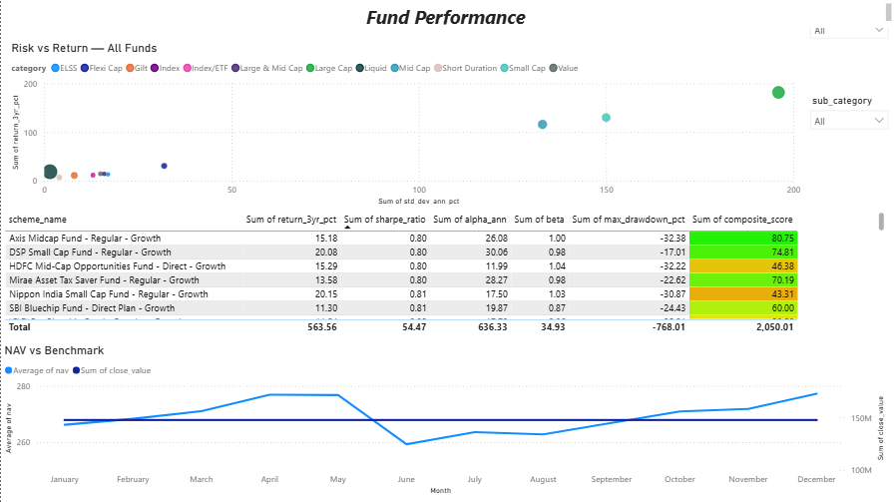
Interactive Dashboard — Power BI
4 pages · Slicers on every page · Drill-through capability
Page 1 — Industry Overview
Page 2 — Fund Performance
KPI Cards: AUM, SIP Inflow, Folios, Schemes
Line chart: Industry AUM 2022–2025
Bar chart: AUM by Fund House
Slicer: Year / Quarter
Scatter: Risk vs Return (bubble = AUM)
Sortable Fund Scorecard table
Line: NAV vs Nifty 50 benchmark
Slicer: Fund House, Category
Notes:
Dashboard pages 1 and 2.

Slide 10
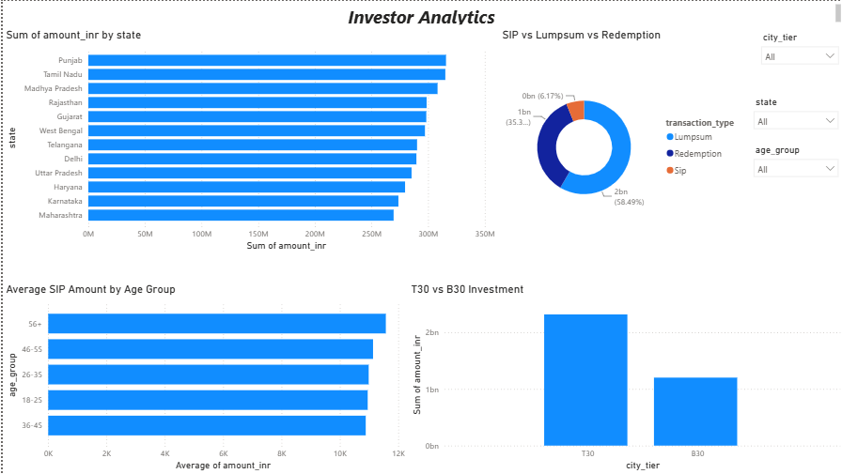
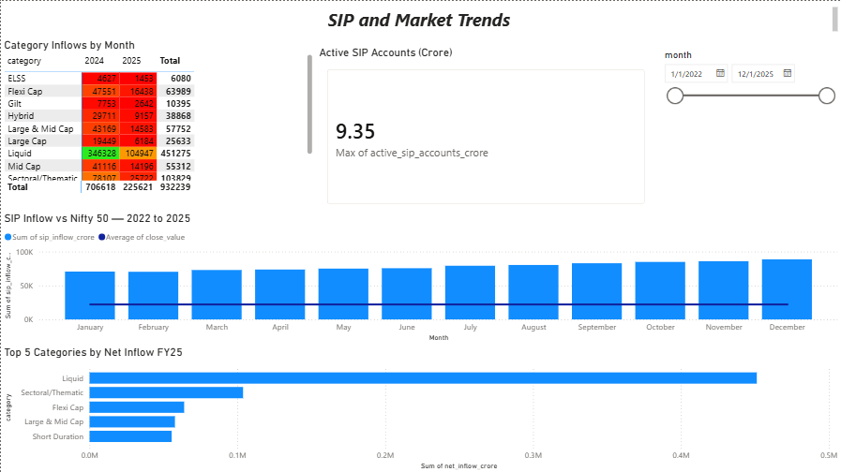
Interactive Dashboard — Power BI
Investor behaviour and market trend analysis
Page 3 — Investor Analytics
Page 4 — SIP & Market Trends
Map: Investment amount by state
Donut: SIP vs Lumpsum vs Redemption split
Bar: Average SIP amount by age group
Slicer: State, Age Group, City Tier
Dual-axis: SIP Inflow (bar) + Nifty 50 (line)
Matrix heatmap: Category inflows by month
Bar: Top 5 categories by net inflow FY25
Slicer: Date range slider
Notes:
Dashboard pages 3 and 4.

Slide 11
Key Findings
01
SIP Inflows Hit All-Time High
02
SBI Dominates AUM
Rs. 31,002 Cr in Dec 2025. Monthly inflows grew 3× in 4 years reflecting deepening retail participation.
Rs. 12.5 lakh crore AUM — largest AMC in India. Top 3 AMCs control ~40% of total industry assets.
03
30% of SIP Investors Are At-Risk
04
Large Cap Funds vs Nifty 100
Irregular payment gaps exceeding 35 days flagged via SIP continuity analysis. Maharashtra leads at-risk count.
Most actively managed Large Cap funds underperform the Nifty 100 index net of expenses over 3 years.
05
Small Cap: High Return, High VaR
06
26–35 Age Group Drives SIPs
Highest 5yr CAGR but 95% VaR exceeds -2% daily. Suitable only for High risk investors with 5+ year horizon.
Largest segment of investors. 2024 cohort starts with higher average SIP amounts than 2022 cohort.
Notes:
Six key findings from the full analysis.

Slide 12
Thank You
Mutual Fund Analytics Platform — Complete
✓ ETL Pipeline (Python)
✓ SQLite Star Schema
✓ EDA Notebook (15+ charts)
✓ Performance Analytics
✓ Advanced Analytics + VaR
✓ Power BI Dashboard (4 pages)
✓ Fund Recommender
✓ Final Report + Slides
Anish Abhyankar
Data Analyst Intern · Bluestock Fintech · June 2026
Notes:
Closing slide. All 8 objectives met.

