Slide 1
Student Performance Intelligence System
Presented by
Anirban

Slide 2
Content
1
Problem Statement
2
Dataset & Structure
3
Key Assumptions (QB & Dip)
4
Objectives
5
Methodology / Approach
6
Expected Outcomes
2026r

Slide 3
Problem Statement
We have student marks data…
but we don’t really use it.
No tracking of performance over time
No way to predict who might struggle
No clear insights from the data
Company Name
Quarter Month
Year

Slide 4
2. Dataset
For now I have used a randomly A.I generated data set
- Batches: 2018 to 2025
- Around 25–30 students per batch
- Each student → 8 semesters
Data includes:
Mid marks, internals, end term, attendance, SGPA

Slide 5
Data Structure
Each row = one student in one semester
So same student appears multiple times
→ because we track them over time
- Students usually dip in Sem 4–5
- Then they recover later
- In 2022, Question Bank (QB) started
After QB:
More toppers
Less gap between weak and average students

Slide 6
3. Key Assumptions (QB & Dip)
- See how students perform over time
- Check if QB actually helped
- Identify different types of students
- Try predicting performance

Slide 7

Possible Things We Can Achieve
Understand how student performance changes over semesters
Analyze the effect of the Question Bank (QB) introduced in 2022
Identify different types of students (topper, average, low, late bloomer)
Detect students who might struggle early (early warning system)
Compare performance across different batches (cohort analysis)
Build models to predict SGPA or performance
Group students based on similar performance patterns (clustering)
Explore “what-if” scenarios (e.g., attendance improvement impact)
Generate useful insights from data instead of just storing marks
OBJECTIVE

Slide 8
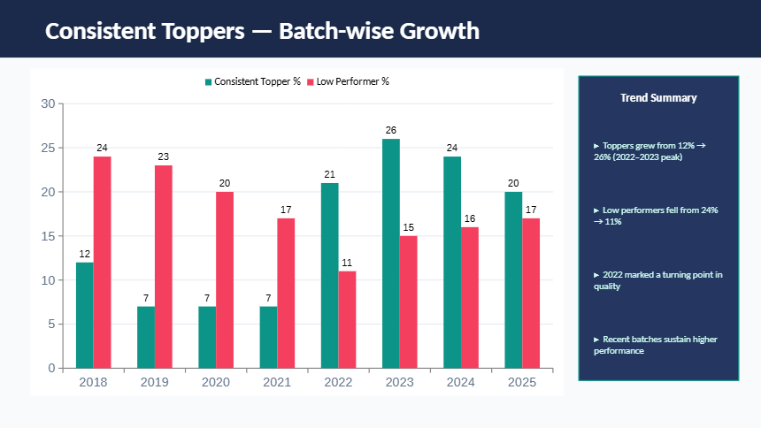
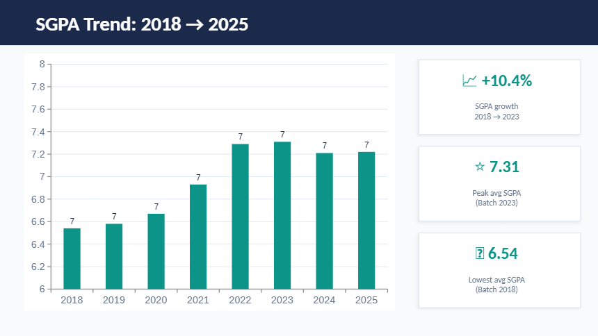
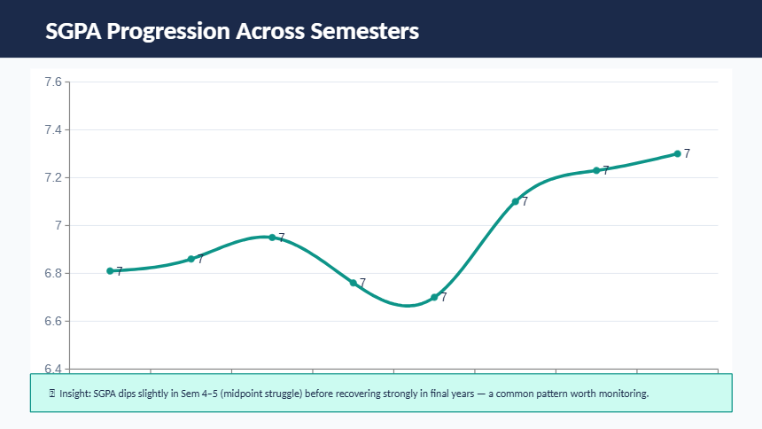
Now that we understand the objectives…
Let’s look at what insights we can actually
extract from the data.
What This Data Shows

