Slide 1
High-Availability Multi-City ISP Backbone
Architecture with Redundancy and Secure Routing

Slide 2
Table Contents:
Introduction
Problem Statement
Network Elements
Topology
Architecture
Protocols
Configuration
Conclusion & Future Scope

Slide 3
Introduction:
This project designs a multi-city ISP backbone network
Internet usage is increasing, so fast and reliable networks are needed
ISPs provide internet connectivity to users across different locations
Uses redundancy and routing protocols for high availability
Ensures secure, scalable, and efficient network performance

Slide 4
Problem Statement:
Suboptimal Path Selection and Latency Issues
Routing Misconfiguration and Traffic Blackholing
Insufficient Load Balancing During Failures
Route Leaks and Security Risks
Scalability and Policy Management Challenges

Slide 5
Network Elements:
Switches
Routers
Access – points
Computer, Laptops, Smart phones
Servers
Connecting Cables

Slide 6
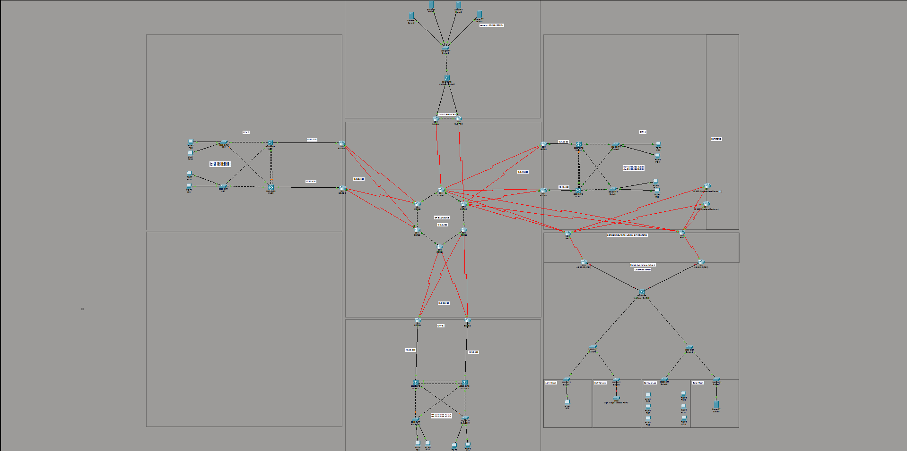
Topology:

Slide 7
Architecture:
Central ISP backbone connects all cities and networks
Each city has its own local network with switches and routers
Redundant paths are used to avoid network failure
Cloud and external services are connected through the backbone
Users access the network through organized VLAN-based connections

Slide 8
Protocols:
OSPF
BGP
HSRP
VLANs
Inter-Vlan Routing

Slide 9
VLAN(Virtual Local Area Network)
Definition:
Used to logically divide a physical network into multiple smaller networks.
It improves security, reduces broadcast traffic, and organizes departments efficiently.
Commands:
vlan 10
name ADMIN
interface fa0/1
switchport mode access
switchport access vlan 10

Slide 10
Inter-VLAN Routing
Definition: Inter-VLAN Routing allows communication between different VLANs using a router or Layer-3 switch.
Without this, devices in different VLANs cannot communicate.
Commands:
interface g0/0.10
encapsulation dot1Q 10
ip address 192.168.10.1 255.255.255.0
no shutdown

Slide 11
DHCP (Dynamic Host Configuration Protocol)
Definition: DHCP automatically assigns IP addresses and network configuration (subnet mask, gateway) to devices, reducing manual work and errors.
Commands:
ip dhcp excluded-address 192.168.1.1 192.168.1.10
ip dhcp pool VLAN10
network 192.168.1.0 255.255.255.0
default-router 192.168.1.1

Slide 12
OSPF (Open Shortest Path First)
Definition: OSPF is a dynamic routing protocol that automatically finds the best path for data transmission using the shortest path algorithm.
Commands:
router ospf 1
network 192.168.1.0 0.0.0.255 area 0

Slide 13
HSRP (Hot Standby Router Protocol)
Definition: HSRP provides redundancy by using two routers. One router is active and the other is standby. If the active router fails, the standby takes over automatically.
Commands:
standby 1 ip 192.168.1.1
standby 1 priority 110
standby 1 preempt

Slide 14
eBGP(External Border Gateway Protocol)
Definition: eBGP (External Border Gateway Protocol) is used to exchange routing information between different Autonomous Systems (AS).
Commands:
router bgp 65000 neighbor 192.168.1.2 remote-as 65010 network 10.10.10.0 mask 255.255.255.0 exit

Slide 15
Conclusion & Future Scope
The project successfully designs a scalable and high-availability multi-city ISP backbone with optimized routing, redundancy, and secure policy-controlled peering.
The implemented architecture ensures low latency, stable traffic flow, fast failover, and protection against routing leaks and misconfigurations.
The network can be expanded to new cities with enhanced automation, centralized policy management, and improved traffic engineering.

Slide 16
THANK YOU

