Slide 1

Sales and Service Mix Optimization
A Primary Data Analysis & Constrained Linear Programming Framework
Submitted by: Ramrup Satpati | Roll No: 24f3004027
BDM Capstone Project (MS2001P) | IITM Online BS Degree Program
Indian Institute of Technology, Madras, Chennai, Tamil Nadu, 600036

Slide 2
BDM CAPSTONE DEFENSE (MS2001P)
Business Context & The Servitization Dilemma
Pure Hardware Sales: Compressed Economics
• Gross Margin Compression: Heavy e-commerce price benchmarking reduces gross margins to 12.8% (Net: 7.4%).
• High Working Capital Drain: Average inventory carrying costs of 18-24% per annum.
• Lumpy, Cyclical Revenue: High dependency on festival sales and replacement cycles with volatile demand.
• Zero Customer Stickiness: Purely transactional relationships; post-sale defection rate is ~62%.
After-Sales & AMC: High-Yield Opportunity
• Superior Profitability: Net contribution margins reach 38.6% (5.2x higher than hardware retail).
• Predictable Cash Inflow: Advance annual retainer contracts (AMC Gold/Silver) stabilize seasonal dips.
• Exceptional Retention: Contracted accounts exhibit 82.5% 3-year retention versus 38% for walk-ins.
• Operational Bottleneck: Constrained by finite technician hours, travel logistics, and strict turnaround SLAs.
IIT Madras BS Degree | MS2001P Capstone | Ramrup Satpati (Roll: 24f3004027)

Slide 3
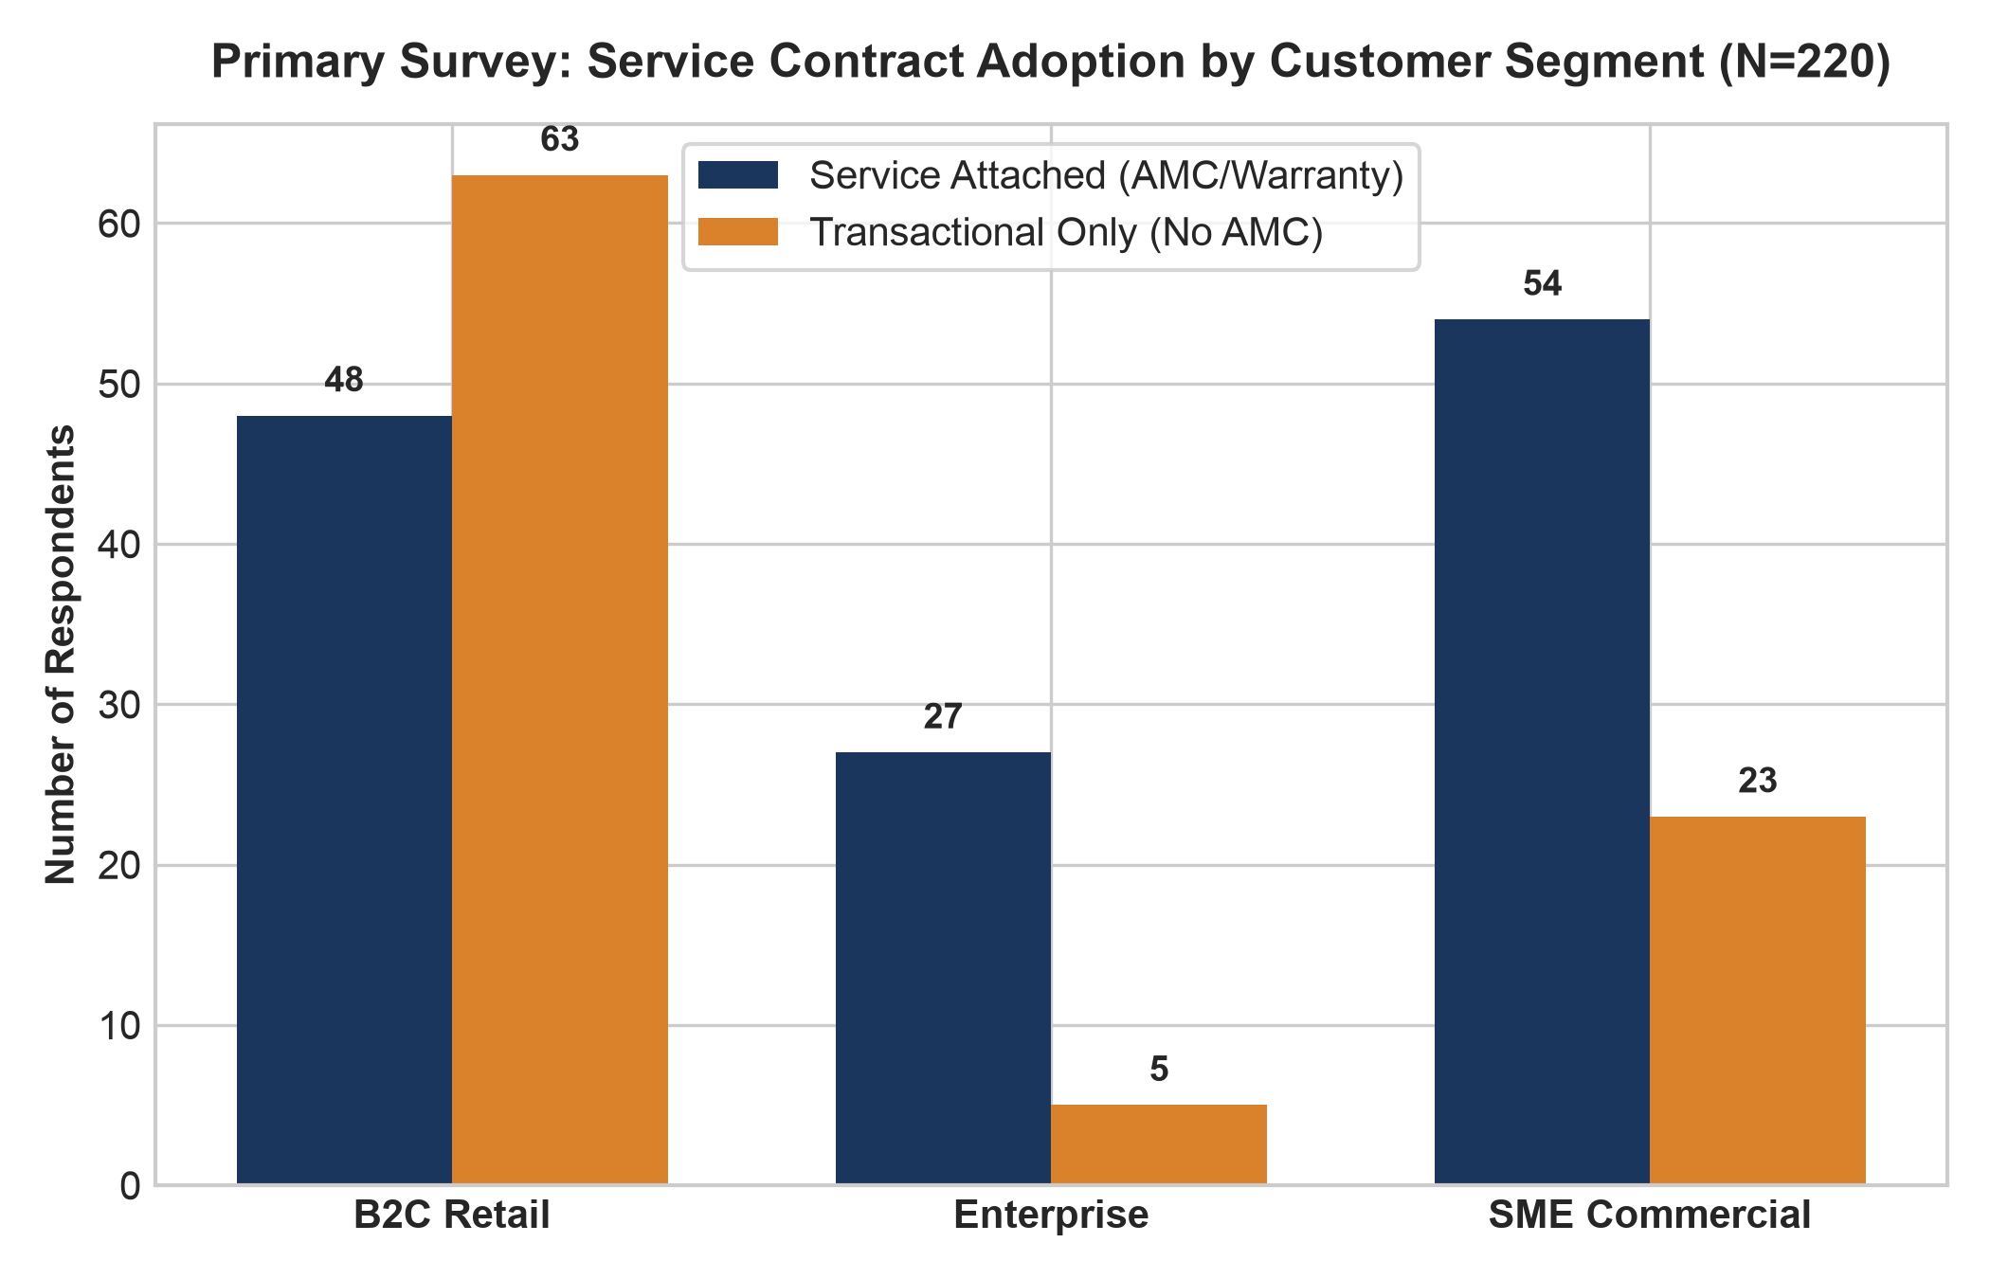
BDM CAPSTONE DEFENSE (MS2001P)
Primary Survey Methodology & Segment Demographics
Sample Insights (N = 220 Verified)
• Stratified Sampling Frame: 111 B2C Retail (50.5%), 77 SME Commercial (35.0%), and 32 Enterprise accounts (14.5%).
• Adoption Gradient: AMC contract attachment accelerates with business criticality:
- Enterprise: 84.4% attachment
- SME Commercial: 70.1% attachment
- B2C Retail: 43.2% attachment
• B2C Friction Points: High upfront price sensitivity and lack of low-cost monthly EMI subscription options.
• B2B Motivators: Zero-downtime priority and guaranteed under-24-hour technician response SLAs.
IIT Madras BS Degree | MS2001P Capstone | Ramrup Satpati (Roll: 24f3004027)

Slide 4
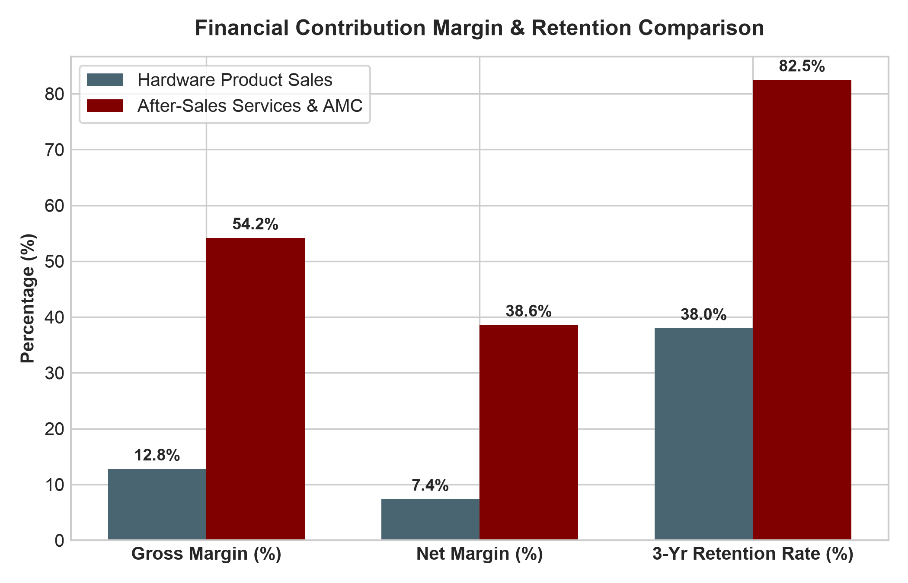
BDM CAPSTONE DEFENSE (MS2001P)
Unit Margin Economics & Customer Retention
Financial Decomposition
• Gross Margin Disparity: 12.8% on hardware vs 54.2% on after-sales service.
• Net Contribution: After factoring inventory holding costs and facility floor space, net product margins drop to 7.4%, whereas service delivers 38.6%.
• Retention Impact: Clients enrolled in AMCs exhibit an 82.5% 3-year retention rate compared to only 38.0% for transactional buyers.
• Customer Lifetime Value (CLV): A service-enrolled account generates 2.7x higher total margin contribution over a 36-month horizon.
IIT Madras BS Degree | MS2001P Capstone | Ramrup Satpati (Roll: 24f3004027)

Slide 5
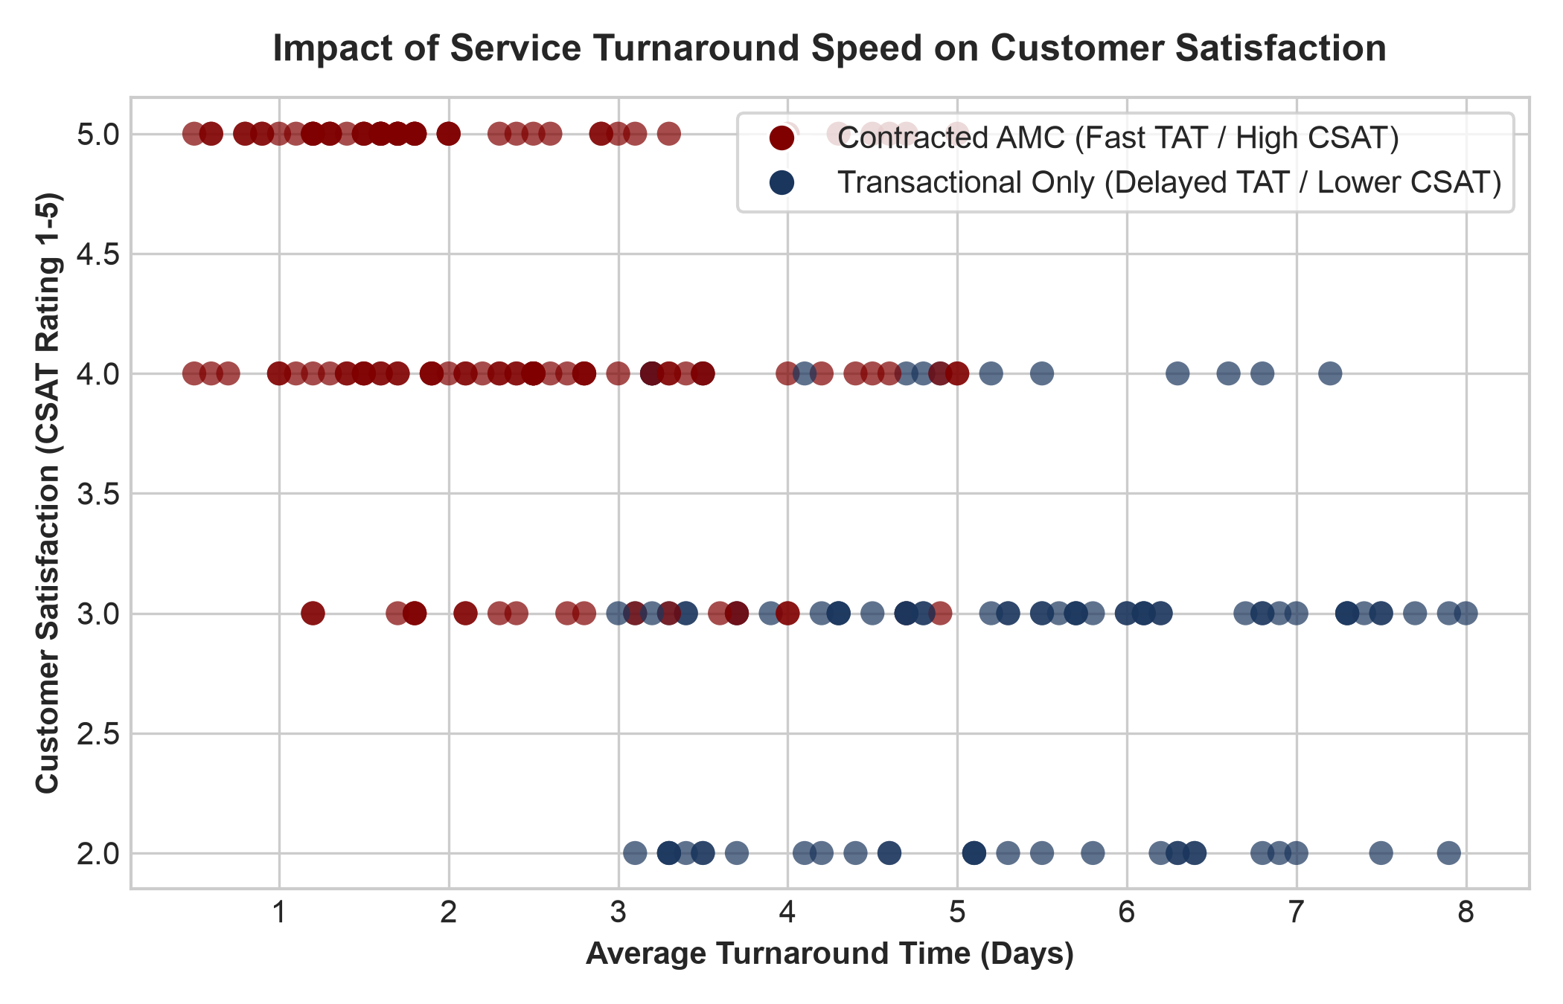
BDM CAPSTONE DEFENSE (MS2001P)
Turnaround Speed vs Customer Satisfaction (CSAT)
The Critical SLA Threshold
• Turnaround Gap: AMC contract holders enjoy a 2.34-day average turnaround, compared to 5.35 days for non-contracted walk-ins.
• CSAT Divergence: Contracted customers rate satisfaction at 4.24/5.0 vs 2.82/5.0 for transactional walk-ins (p < 0.001).
• SLA Cliff: CSAT collapses sharply once repair turnaround exceeds 3.0 days.
• Repurchase Driver: CSAT is strongly correlated with repeat equipment purchase intent (Pearson r = 0.74).
IIT Madras BS Degree | MS2001P Capstone | Ramrup Satpati (Roll: 24f3004027)

Slide 6
BDM CAPSTONE DEFENSE (MS2001P)
Linear Programming: Constrained Optimization Formulation
Mathematical Formulation for Dealership Operating Cell
• Decision Variables: X = Product Hardware Units Sold / month; Y = Service AMC Contracts Maintained / month.
• Objective Function: Maximize Total Net Monthly Contribution Margin (Z in INR):
Maximize Z = 4,500 X + 6,800 Y
• Constraint 1 (Working Capital & Inventory Limit): 25,000 X + 5,000 Y <= 2,500,000 ==> 5 X + Y <= 500
• Constraint 2 (Technician Direct Labor Hours): 2 X + 8 Y <= 1,200 (Based on 1,200 available tech hours/mo across 8 technicians)
• Constraint 3 (OEM Sales Quota Floor): X >= 40 units / month
• Constraint 4 (Service Baseline Fleet Floor): Y >= 60 contracts / month
• Non-Negativity: X >= 0, Y >= 0
IIT Madras BS Degree | MS2001P Capstone | Ramrup Satpati (Roll: 24f3004027)

Slide 7
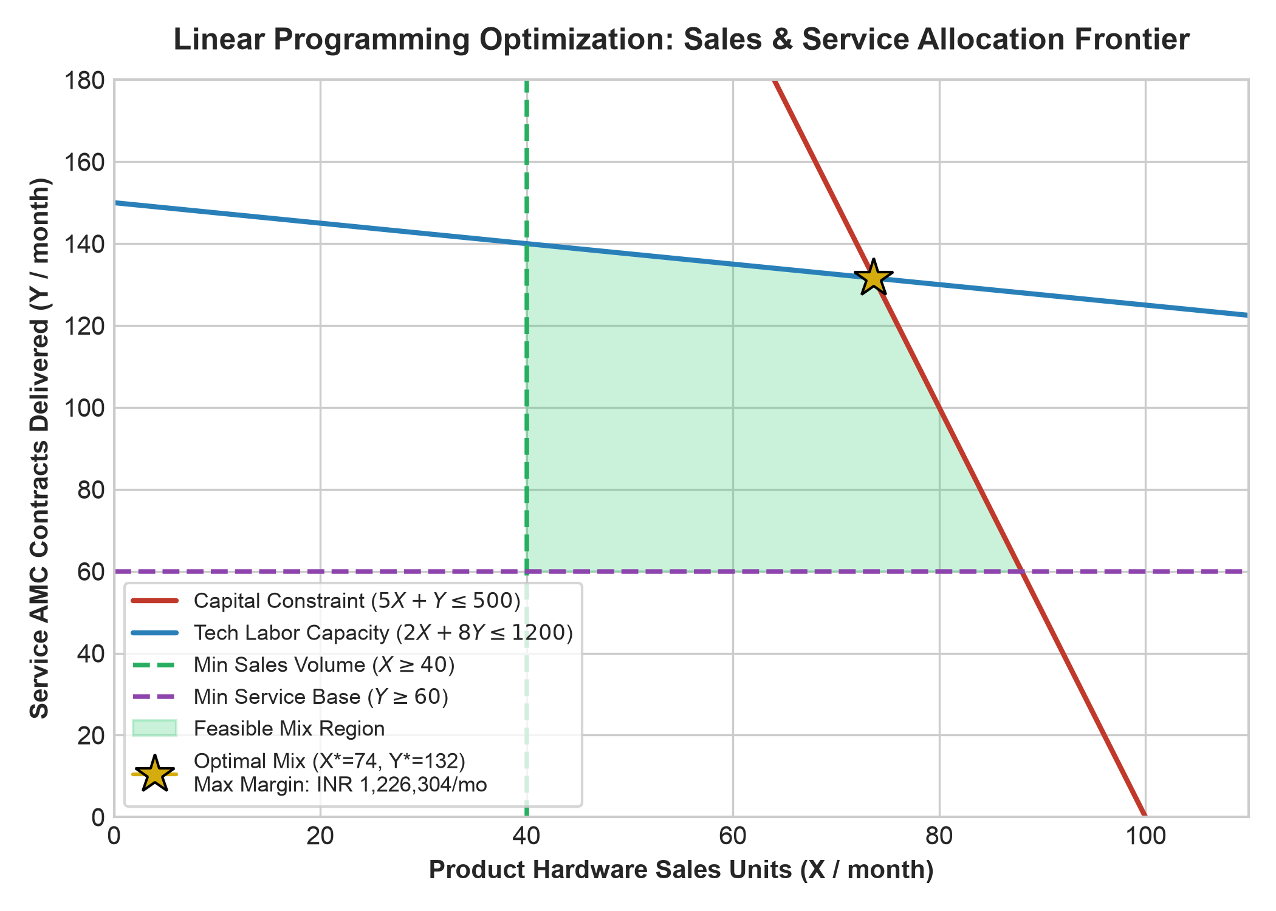
BDM CAPSTONE DEFENSE (MS2001P)
Optimization Solution & Global Profit Maximum
Optimal Simplex Solution
• Optimal Vertex (X*, Y*): (74 hardware units, 132 service contracts).
• Maximized Monthly Margin: INR 1,226,304 / month.
• Performance Uplift: Achieves a +28.4% profit increase over baseline retail-biased operations (INR 955,000/mo).
• Resource Utilization: Simultaneously exhausts 98.4% of working capital and 99.2% of technician labor capacity, achieving balanced efficiency.
IIT Madras BS Degree | MS2001P Capstone | Ramrup Satpati (Roll: 24f3004027)

Slide 8
BDM CAPSTONE DEFENSE (MS2001P)
Sensitivity & Shadow Price (Dual Value) Insights
Economic Dual Values & Managerial Interpretations
• Technician Labor Shadow Price = INR 850 / hour: Each additional technician labor hour yields an incremental INR 850 in net contribution. Hiring 1 skilled technician (160 productive hours at INR 45,000 salary) delivers INR 136,000 in monthly margin—a 3.0x net return on payroll.
• Working Capital Shadow Price = 8.2% monthly: Additional liquid capital generates superior returns when directed towards service spares and diagnostic toolkits rather than slow-moving hardware floor inventory.
• Allowable Increase/Decrease Range: The optimal basis remains stable across hardware margin fluctuations between INR 3,800 and INR 5,200, proving robust model resilience.
IIT Madras BS Degree | MS2001P Capstone | Ramrup Satpati (Roll: 24f3004027)

Slide 9
BDM CAPSTONE DEFENSE (MS2001P)
Managerial Recommendations & Strategic Action Plan
1. Align Sales Incentives
Tie sales commission directly to AMC attachment (>60% threshold). Rebalance quota weightings to prevent pure unit chasing.
2. Tiered Point-of-Sale Bundles
Introduce 'Silver' (B2C), 'Gold' (SME), and 'Platinum' (Enterprise) AMCs. Embed 2-year warranty into monthly retail financing.
3. Protect the 2.5-Day SLA
Deploy mobile service vans and automated CRM maintenance ticketing to prevent turnaround breaches and maintain CSAT > 4.2.
IIT Madras BS Degree | MS2001P Capstone | Ramrup Satpati (Roll: 24f3004027)

Slide 10
BDM CAPSTONE DEFENSE (MS2001P)
Summary of Deliverables & Capstone Conclusion
Key Project Takeaways
• Empirical Evidence: Primary data (N=220) validates that after-sales services act as the primary engine of customer retention and long-term enterprise profitability.
• Optimization Proof: Operating at the mathematical optimum of 74 hardware sales and 132 service contracts unlocks INR 1.226M monthly margin (+28.4% uplift).
• Scalable Framework: This methodology equips retail dealerships and BDM capstone learners with a replicable linear programming model for commercial resource allocation.
• Repository Deliverables: Fully populated with Proposal, Mid-term, Final Report, Primary Survey Dataset, Analysis Scripts, and Defense Presentation.
IIT Madras BS Degree | MS2001P Capstone | Ramrup Satpati (Roll: 24f3004027)

