Slide 1
Digital Portfolio
STUDENT NAME: V.Devipriya
REGISTER NO AND NMID: 212402340/asunm1301212402340
DEPARTMENT: BCA
COLLEGE: COLLEGE/ UNIVERSITY: AM Jain College/Madras University

Slide 2
DIGITAL PORTFOLIO

Slide 3


AGENDA
Problem Statement
Project Overview
End Users
Tools and Technologies
Portfolio design and Layout
Features and Functionality
Results and Screenshots
Conclusion
Github Link
3/21/2024 Annual Review

Slide 4

PROBLEM STATEMENT
Many students lack a proper platform to showcase their skills.
Traditional resumes fail to display creativity effectively.
Recruiters find it difficult to evaluate projects without visuals.
Lack of personal branding reduces opportunities.
A digital portfolio solves these issues with an interactive format.

Slide 5

PROJECT OVERVIEW
The project is about creating a personal digital portfolio.
It highlights academic achievements, skills, and projects.
The portfolio serves as a professional identity online.
It is user-friendly and visually appealing.
The aim is to provide a complete overview of the creator.

Slide 6

WHO ARE THE END USERS?
Students who want to display their work.
Recruiters searching for talented candidates.
Teachers evaluating student projects.
Peers collaborating and sharing knowledge.
Anyone interested in learning about the portfolio creator

Slide 7

TOOLS AND TECHNIQUES
HTML for structure and layout.
JavaScript for interactivity and functionality.
GitHub for version control and hosting.
Optional frameworks like Bootstrap for faster design.

Slide 8
Portfolio Design and Layout
Simple, clean, and professional interface.
Organized sections for easy navigation.
Consistent color scheme and typography.
Responsive design for all devices.
Visual elements like images and icons for better appeal.

Slide 9
FEATURES AND FUNCTIONALITY
Interactive navigation bar.
Sections for About Me, Skills, Projects, and Contact.
Integration of images, certificates, and videos.
External links to GitHub and LinkedIn.
Downloadable resume option.

Slide 10
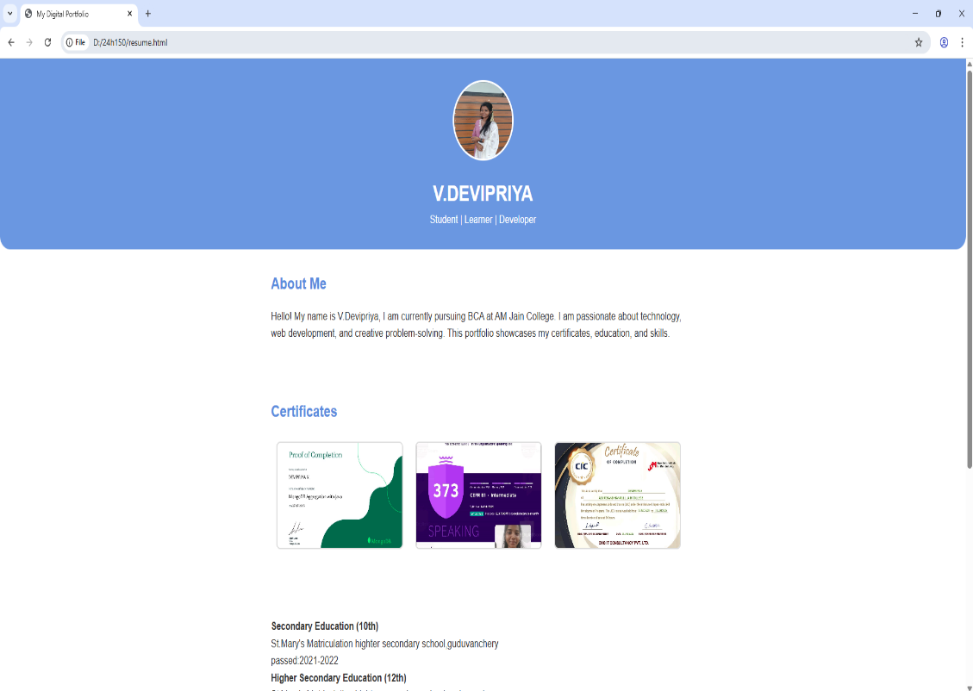
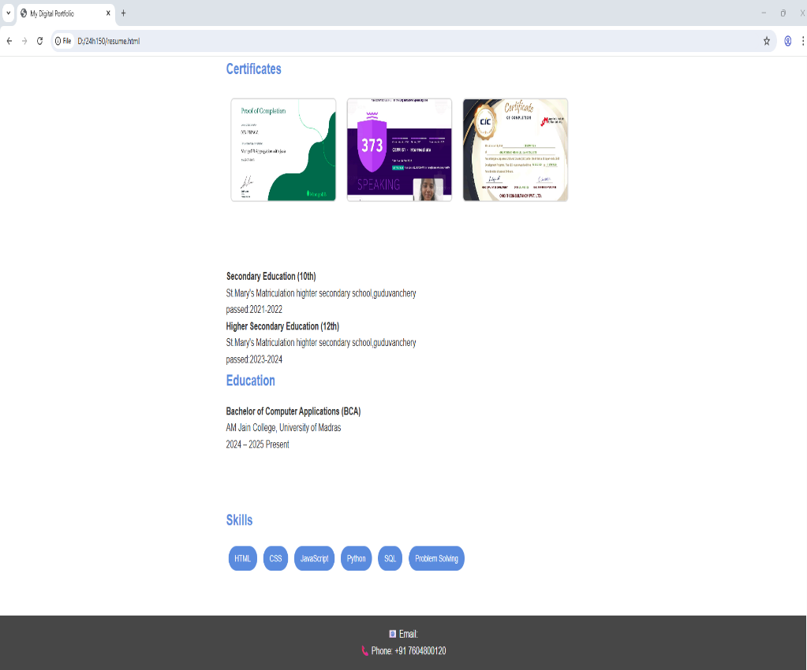

RESULTS AND SCREENSHOTS
3/21/2024 Annual Review
10

Slide 11
CONCLUSION
Digital portfolios are essential in today’s competitive world.
This project showcases technical and creative skills.
It improves personal branding and visibility.
Provides recruiters with a better candidate evaluation tool.
Future scope includes adding blogs and AI-driven features.
11

