Slide 1
Digital Portfolio
STUDENT NAME: SURENDAR
REGISTER NO : 24H211
DEPARTMENT: BCA
COLLEGE: AGURCHAND MANMULL JAIN COLLEGE

Slide 2
PROJECT TITLE
INTREACTIVE DIGITAL PORTFOLIO USING FRONT END DEVELOPMENT

Slide 3


AGENDA
Problem Statement
Project Overview
End Users
Tools and Technologies
Portfolio design and Layout
Features and Functionality
Results and Screenshots
Conclusion
Github Link
3/21/2024 Annual Review

Slide 4

PROBLEM STATEMENT
Traditional resumes and static portfolios often fail to engage viewers and effectively showcase an individual’s skills. There is a need for an interactive digital portfolio built using front-end technologies (HTML, CSS, JavaScript) that is responsive, visually appealing, and user-friendly, allowing individuals to present their skills, projects, and contact information in a more engaging way.

Slide 5

PROJECT OVERVIEW The project “Interactive Digital Portfolio using Front-End Development” focuses on creating a responsive and user-friendly web-based portfolio to showcase an individual’s profile, skills, projects, and contact details. Using front-end technologies like HTML, CSS, and JavaScript, the portfolio will provide an engaging interface with smooth navigation and interactive features. It aims to replace traditional static resumes with a modern, digital platform that enhances personal branding and accessibility across devices.

Slide 6

WHO ARE THE END USERS? 1. Students & Job Seekers – who use the portfolio to showcase their skills, projects, and achievements to recruiters. 2. Recruiters & Employers – who view the portfolio to evaluate the candidate’s abilities, creativity, and technical expertise. 3. Freelancers & Professionals – who present their work to potential clients or collaborators. 4. Educators & Peers – who may review the portfolio for academic, mentoring, or networking purposes.

Slide 7

TOOLS AND TECHNIQUES TOOLS: HTML5 – for structuring the web pages and content. CSS3 – for styling, layout design, and responsiveness. JavaScript – for adding interactivity and dynamic features. Code Editor (VS Code / Sublime Text) – for writing and managing code. Version Control (Git) – for managing code versions and hosting the portfolio online. TECHNIQUES: Responsive Web Design– to ensure compatibility across devices (desktop, tablet, mobile). Flexbox and Grid Layouts – for modern, flexible page structuring. DOM Manipulation with JavaScript – to make the site interactive. Form Handling – for creating a functional contact section. Smooth Navigation & Animations – to improve user experience and engagement.

Slide 8
POTFOLIO DESIGN AND LAYOUT
POTFOLIO:
Header/Nav Bar – links to Home, About, Skills, Projects, Contact.
Home – introduction with name, tagline, and banner.
About – personal details, education, and profile photo.Skills – technical skills shown using progress bars or cards.
Projects – sample projects in a grid layout with descriptions.
Contact – form and social media links.
Footer – copyright and quick links.
LAYOUT STYLE:
Grid and Flexbox for responsive structuring.
Consistent color scheme (2–3 main colors for branding).
Readable typography with hierarchy (headings, subheadings, body text).
Interactive elements (hover effects, smooth scrolling, animations).

Slide 9
FEATURES AND FUNCTIONALITY Responsive Design – Works smoothly on desktop, tablet, and mobile. Navigation Bar – Easy movement between Home, About, Skills, Projects, and Contact. Interactive UI – Hover effects, smooth scrolling, and animations. Skills Section – Visual display of coding and technical skills. Projects Showcase – Grid layout with descriptions and links. Contact Form – Allows users to send queries directly. Social Media Integration – Links to GitHub, LinkedIn, etc. Clean Layout – Simple, modern, and user-friendly design.

Slide 10
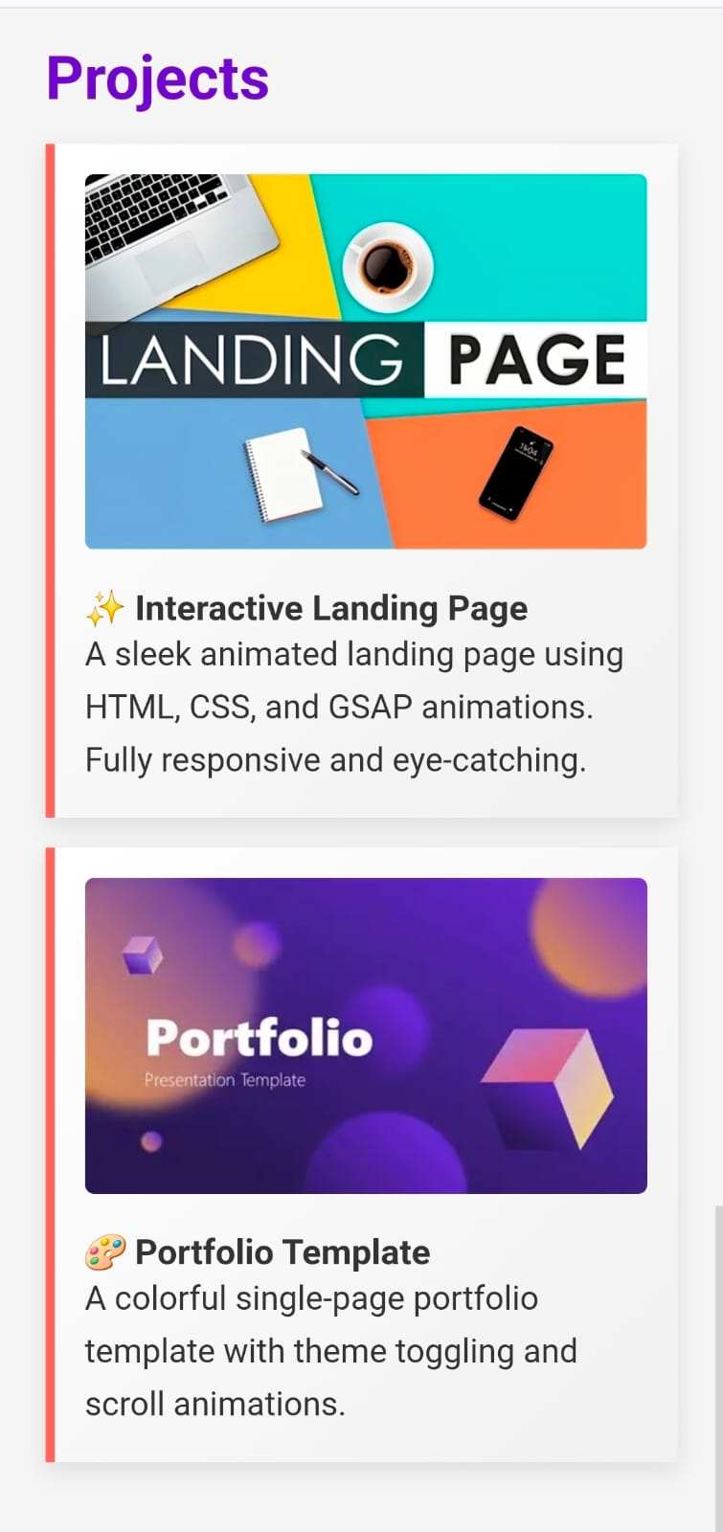
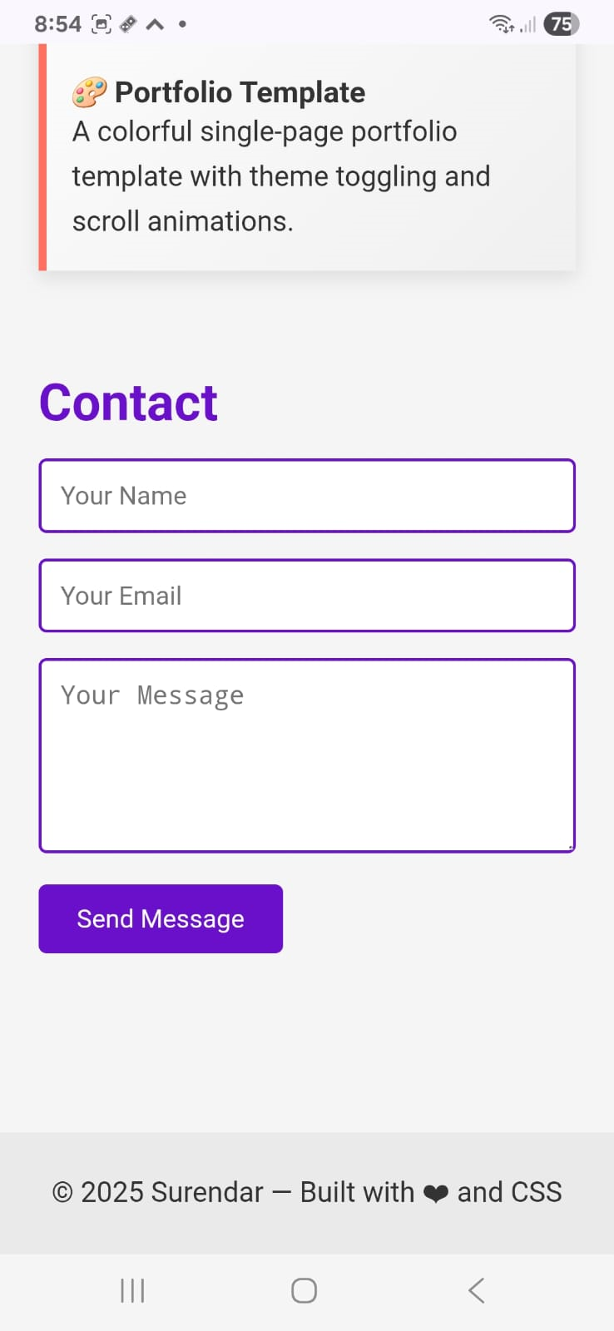
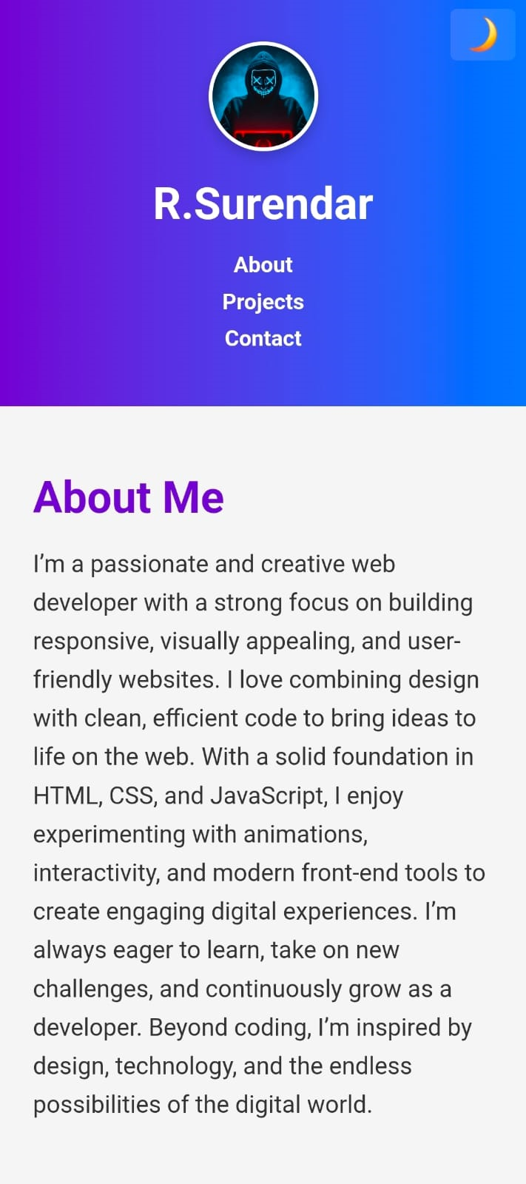

RESULTS AND SCREENSHOTS
3/21/2024 Annual Review

Slide 11
CONCLUSION The project “Interactive Digital Portfolio using Front-End Development” successfully demonstrates how modern web technologies like HTML, CSS, and JavaScript can be used to build a responsive, user-friendly, and engaging portfolio. Unlike traditional resumes, this portfolio provides an interactive platform to showcase personal details, skills, and projects in a professional manner. It enhances personal branding, improves accessibility across devices, and serves as an effective tool for students, job seekers, and professionals to present their capabilities to recruiters and clients.

