Slide 1

Digital Portfolio
STUDENT NAME: GOKULA KRISHANAN
REGISTER NO:212402352
NMID: B58CEC87FD08F599D1442C10A5B7FD95
ROLL NO:24H206
DEPARTMENT: BCA
COLLEGE: AM JAIN COLLEGE
UNIVERSITY OF MADRAS
1

Slide 2

PROJECT TITLE
Digital Portfolio Website
Personal Portfolio Website
Web Developer Portfolio
Online Portfolio Showcase
2

Slide 3



AGENDA
Problem Statement
Project Overview
End Users
Tools and Technologies
Portfolio design and Layout
Features and Functionality
Results and Screenshots
Conclusion
Github Link
3/21/2024 Annual Review
3

Slide 4

PROBLEM STATEMENT
"In today’s competitive job market, students and entry-level developers often lack a professional online presence to effectively showcase their technical skills, certifications, and academic achievements. Traditional resumes are limited in interactivity and visual appeal. This project aims to solve that by developing a responsive digital portfolio website that allows users to highlight their skills, display certifications, and provide easy access to contact information — all in one personalized platform."
4

Slide 5

PROJECT OVERVIEW
"The Digital Portfolio Website is a personal web-based platform designed to present an individual's professional profile in an interactive and visually appealing manner. Built using HTML, CSS, and JavaScript, the site includes sections such as About Me, Education, Skills, Certificates, and Contact Information. This project aims to help students and aspiring developers showcase their technical skills, academic background, and achievements online, making it easier for recruiters and collaborators to discover their capabilities."
5

Slide 6

WHO ARE THE END USERS?
"The primary end users of the Digital Portfolio Website are students, fresh graduates, and entry-level developers who want to showcase their technical skills, projects, and academic achievements online. Additionally, recruiters, hiring managers, and potential collaborators are secondary users who visit these portfolios to evaluate candidates for internships, jobs, or project opportunities."
6

Slide 7

TOOLS AND TECHNIQUES
Visual Studio Code – Code editor for development
HTML5 – For webpage structure
CSS3 – For styling and layout
JavaScript – For interactivity (e.g., smooth scrolling)
Chrome Developer Tools – For testing and debugging
W3Schools & MDN – Reference materials for web technologies
7

Slide 8
POTFOLIO DESIGN AND LAYOUT
Clean, minimalistic, and user-friendly design with a consistent purple color palette
Rounded corners and soft shadows for a modern, professional appearance
Clear typography hierarchy to enhance readability
Header with profile picture, name, and role prominently displayed
Navigation bar with easy access to key sections (About, Education, Skills, Certificates, Contact)
Well-organized content sections with white backgrounds, padding, and rounded corners
Simple footer with centered copyright information
8

Slide 9
FEATURES AND FUNCTIONALITY
Personal profile display with profile picture, name, and professional role
Organized sections for About Me, Education, Skills, Certificates, and Contact
User-friendly navigation bar with smooth scrolling between sections
Responsive design ensuring compatibility across desktop, tablet, and mobile devices
Clean, modern UI with consistent color scheme and typography for better readability
Interactive elements like clickable links and smooth transitions enhance user experience
Easy access to contact details including phone, email, and address
Option for downloadable resume or certificates (if included)

Slide 10
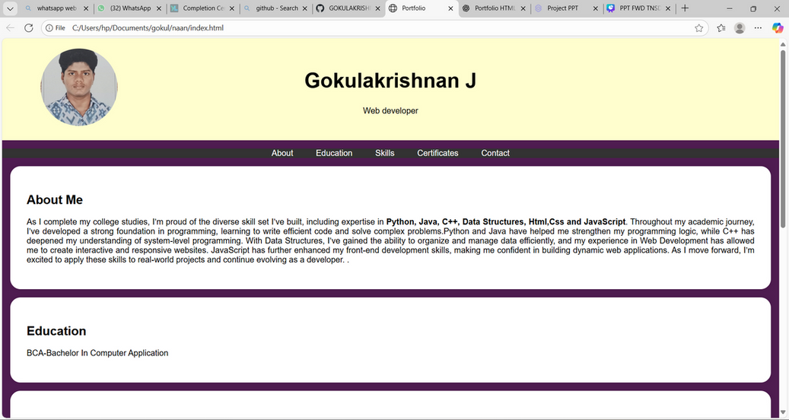

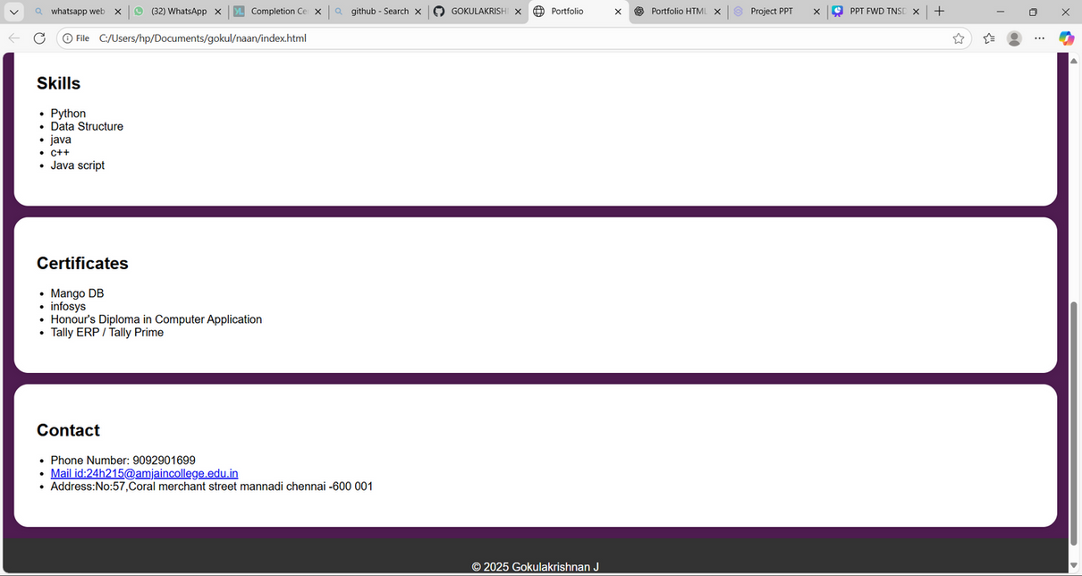
RESULTS AND SCREENSHOTS
3/21/2024 Annual Review
10

Slide 11
CONCLUSION
The Digital Portfolio Website effectively showcases personal skills, education, and achievements in a clean and professional format.
It provides an intuitive user experience through smooth navigation and responsive design, ensuring accessibility on all devices.
This project highlights my web development skills using HTML, CSS, and JavaScript, reflecting my ability to build modern and functional websites.
Moving forward, I aim to enhance the portfolio by adding more interactive features and improving mobile responsiveness.
Overall, the portfolio serves as a strong foundation for presenting myself to recruiters and potential collaborators.
11

Slide 12
SERVER LINK :https://github.com/24h215-lgtm/GOKUL.git
DPELOYMENT LINK: https://24h215-lgtm.github.io/GOKUL/

