Slide 1

Digital Portfolio
STUDENT NAME: S.BHARATH
REGISTER NO: 212402335
NMID:F8A25DF9959CA5A92FC415B7A9757B1A
DEPARTMENT: BCA
COLLEGE: AM JAIN COLLEGE
1

Slide 2

PROJECT TITLE: DIGITAL PORTFOLIO
2

Slide 3



AGENDA
Problem Statement
Project Overview
End Users
Tools and Technologies
Portfolio design and Layout
Features and Functionality
Results and Screenshots
Conclusion
Github Link
3/21/2024 Annual Review
3

Slide 4

PROBLEM STATEMENT
Many aspiring developers face challenges in showcasing their skills and projects effectively to potential employers or collaborators. A personal portfolio website provides a professional platform to highlight technical expertise, creativity, and accomplishments in a visually engaging manner.
4

Slide 5

PROJECT OVERVIEW
This project is a personal developer portfolio website designed for S. Bharath. The portfolio highlights skills, projects, and contact details while maintaining a modern, responsive design. It acts as a digital resume and a showcase for frontend development expertise.
5

Slide 6

WHO ARE THE END USERS?
Recruiters & Hiring Managers looking for frontend developers.
Peers & Collaborators interested in project work or networking.
General Visitors who want to explore the developer’s skills and achievements.
6

Slide 7

TOOLS AND TECHNIQUES
HTML5 – Semantic and accessible markup.
CSS3 – Styling, responsiveness, animations, and layout with Flexbox/Grid.
JavaScript – Interactive elements (navigation, animations).
Font Awesome – Icons for skills and contact section.
Unsplash Images – High-quality placeholder images.
7

Slide 8
POTFOLIO DESIGN AND LAYOUT
Header & Navigation – Sticky navbar with smooth scrolling.
Hero Section – Introduction with a highlighted name and profile image.
About Section – Developer’s background, experience, and interests.
Skills Section – Grid-based cards for technical skills.
Projects Section – Card-style project showcase with hover effects.
Contact Section – Email, phone, location, and contact form.
Footer – Social links and copyright.
8

Slide 9
FEATURES AND FUNCTIONALITY
Smooth scrolling and responsive navigation (hamburger menu on mobile).
Animated floating profile image.
Interactive hover effects on skills and projects.
Contact form for user input.
Professional branding with custom theme colors.

Slide 10
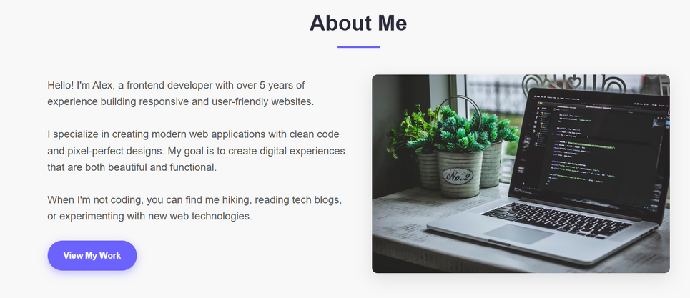
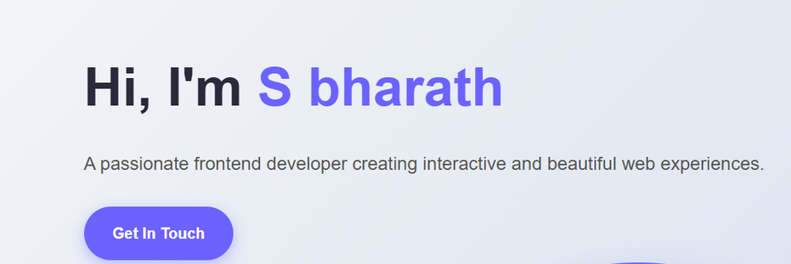
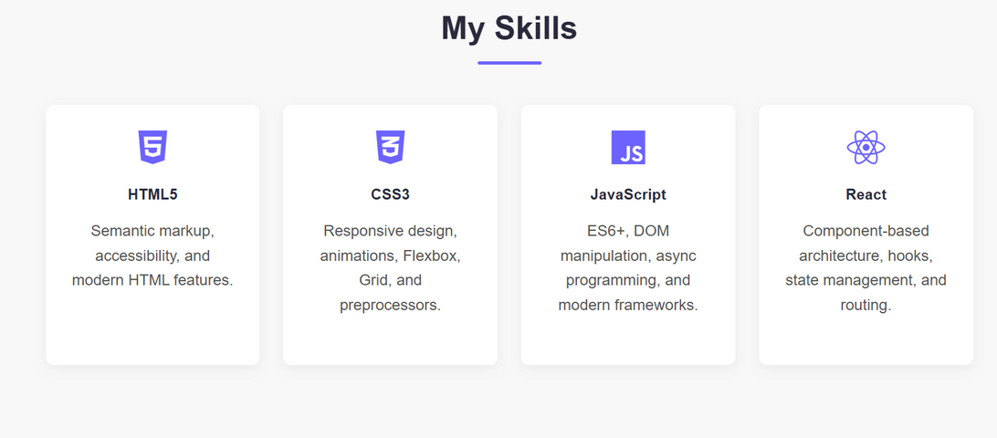
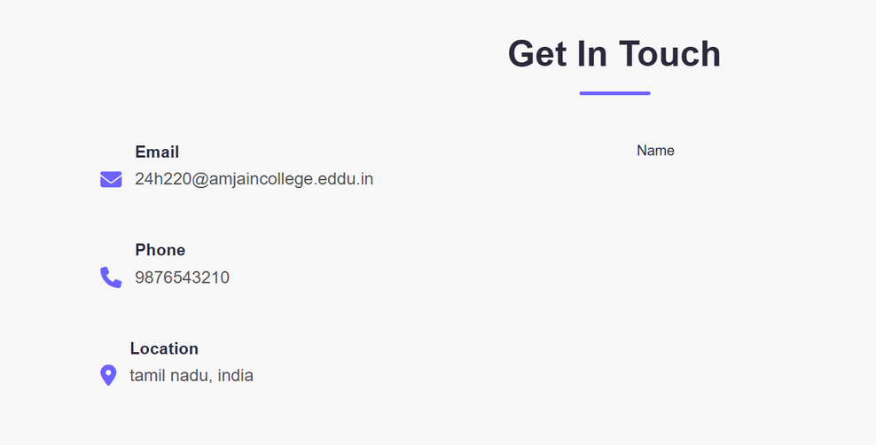
RESULTS AND SCREENSHOTS
3/21/2024 Annual Review
10

Slide 11
CONCLUSION
The portfolio project effectively demonstrates frontend development skills while providing a professional digital presence for S. Bharath. It serves as a strong personal brand asset and can be extended further with features like a blog, downloadable resume, or project demos.
11

