Slide 1

Digital Portfolio
STUDENT NAME: Monish Kumar.V
REGISTER NO :212402387
NMID: AFADDFFCD465D3CBEB84148C84CEAEC33 DEPARTMENT: BCA
COLLEGE: A.M.Jain College

Slide 2


project title
Digital Portfolio

Slide 3

AGENDA
1.Problem Statement 2.Project Overview 3.End Users 4.Tools and Technologies 5.Portfolio design and Layout 6.Features and Functionality 7.Results and Screenshots 8. Conclusion 9.Github Link

Slide 4

Problem Statement
In the digital era, professionals and students need a personal platform to showcase their skills, projects, and achievements. Traditional resumes are static and lack interactivity. A digital portfolio solves this problem by presenting skills and projects in an engaging, accessible, and interactive format.

Slide 5

PROJECT OVERVIEW
This project is a personal portfolio website for Monish Kumar, designed to highlight his background, skills, and projects. It is responsive, interactive, and visually appealing with smooth animations, a typewriter effect, and Lottie integration. The portfolio also includes a contact form for collaborations and networking.

Slide 6

WHO ARE THE END USERS?
Students & Recruiters – to view academic and technical background. Hiring Managers / Clients – to evaluate skills and project work. Peers & Collaborators – for networking and partnerships. General Audience – to explore Monish’s creativity and expertise.

Slide 7
TOOLS AND TECHNIQUES
Frontend: HTML5, CSS3, JavaScript (Vanilla JS) Animations: Lottie, CSS Keyframes, Intersection Observer Icons: Font Awesome Design: Google Fonts (Inter), UI/UX best practices Version Control: Git & GitHub

Slide 8



POTFOLIO DESIGN AND LAYOUT
Dark Theme: Modern carbon-black background for a sleek look. Header Section: Animated intro with gradient text and typewriter effect. About Section: Short introduction with focus on user-centric design. Projects Section: 3D hover effects for showcasing work. Skills Section: Badge-style skill listing with bounce animation. Contact Section: Simple form with validation and demo alert. Footer: Copyright info. Back to Top Button: Smooth scrolling for better navigation.

Slide 9

FEATURES AND FUNCTIONALITY
✔
Responsive design for mobile and desktop.
✔
Animated header with gradient text.
✔
Smooth section reveal using Intersection
Observer.
✔
Project cards with 3D hover animations.
✔
Animated skill badges.
✔
Lottie animation for visual appeal.
✔
Contact form with form handling.
✔
Back-to-top button with scroll detection.

Slide 10



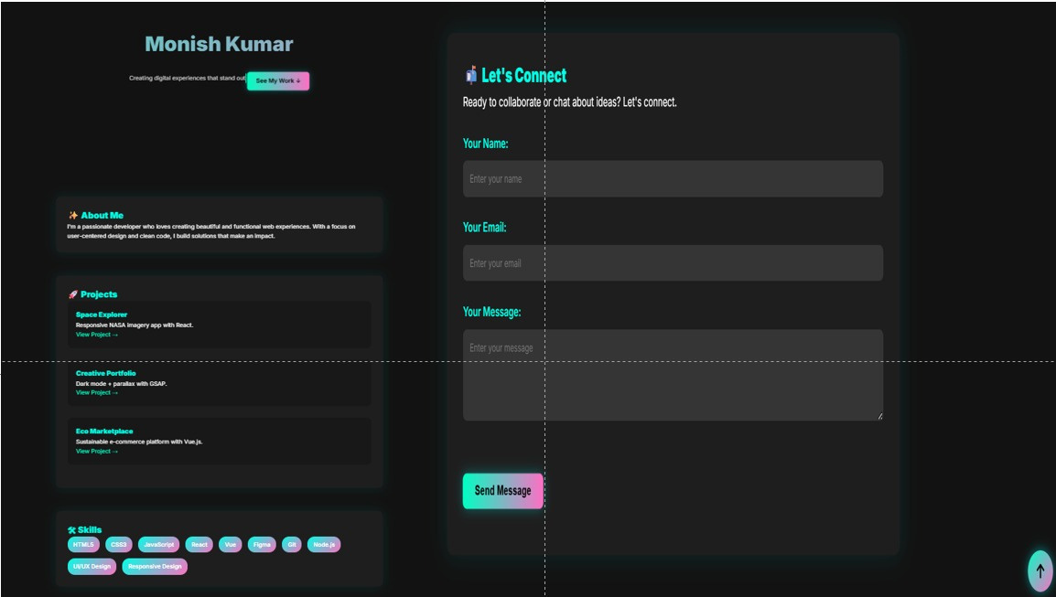



RESULTS AND SCREENSHOTS

Slide 11



Conclusion
This portfolio successfully demonstrates Monish Kumar’s skills as a developer and designer. It combines clean UI/UX design with interactive animations, providing a professional platform to showcase projects and connect with potential recruiters or collaborators. It is scalable and can be extended with blogs, project case studies, or API integrations in the future.

Slide 12
Github Link
server link :
https://github.com/24h222-droid/TNSDC-FWD-DigitalPortfolio.git
deployment link :
https://24h222-droid.github.io/TNSDC-FWD-DigitalPortfolio/

