Slide 1


Digital Portfolio
STUDENT NAME: S.ABHISHEK
REGISTER No:212402316
NMID:1D80E54A08832E19508433F3C13BD62C
DEPARTMENT: BCA
COLLEGE: AM JAIN COLLEGE
1

Slide 2

PROJECT TITLE:Digital Portfolio
2

Slide 3




AGENDA
Problem Statement
Project Overview
End Users
Tools and Technologies
Portfolio design and Layout
Features and Functionality
Results and Screenshots
Conclusion
Github Link
3/21/2024 Annual Review
3

Slide 4

PROBLEM STATEMENT
Showcasing skills, projects, and professional identity online is often scattered and unorganized. A centralized, visually appealing, and responsive portfolio is needed to present abilities effectively.
4

Slide 5

PROJECT OVERVIEW
This project is a digital portfolio website for Abhishek, designed with a modern animated background, smooth navigation, and interactive elements. It highlights personal details, technical skills, and project showcases while including a contact form for communication.
5

Slide 6

WHO ARE THE END USERS?
Recruiters and hiring managers evaluating skills.
Clients looking for freelance or project-based collaboration.
Peers, mentors, and collaborators interested in Abhishek’s work.
6

Slide 7

TOOLS AND TECHNIQUES
Frontend: HTML5, CSS3, JavaScript (ES6+).
Styling & Frameworks: Tailwind CSS, Figma (design mockups).
Libraries: Particles.js for background animation.
Version Control: Git & GitHub.
7

Slide 8
POTFOLIO DESIGN AND LAYOUT
Animated gradient background with particle effects.
Sticky header with smooth scrolling navigation.
Hero section with introduction and call-to-action button.
About section with image and description.
Skills section using styled tags for technologies.
Projects section with interactive project cards and GitHub links.
Contact section with a functional form.
Responsive design for mobile and desktop.
8

Slide 9
FEATURES AND FUNCTIONALITY
Responsive navigation bar with hover and click effects.
Interactive skills and project cards with hover animations.
Particle.js background for an engaging UI.
Contact form with client-side validation.
Smooth scroll to different sections.
Links to GitHub repositories of projects.

Slide 10
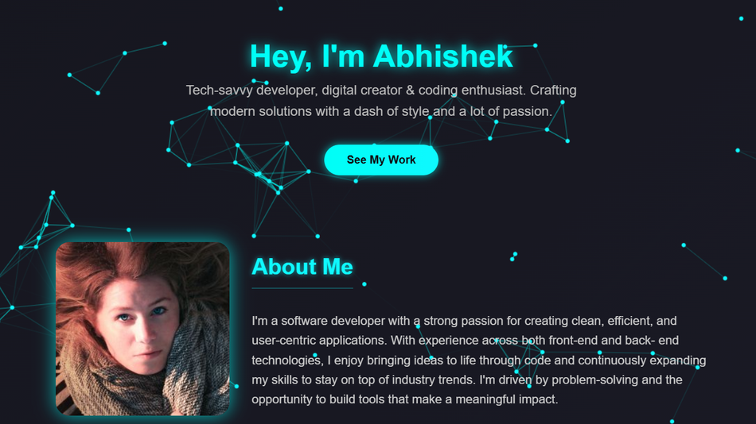
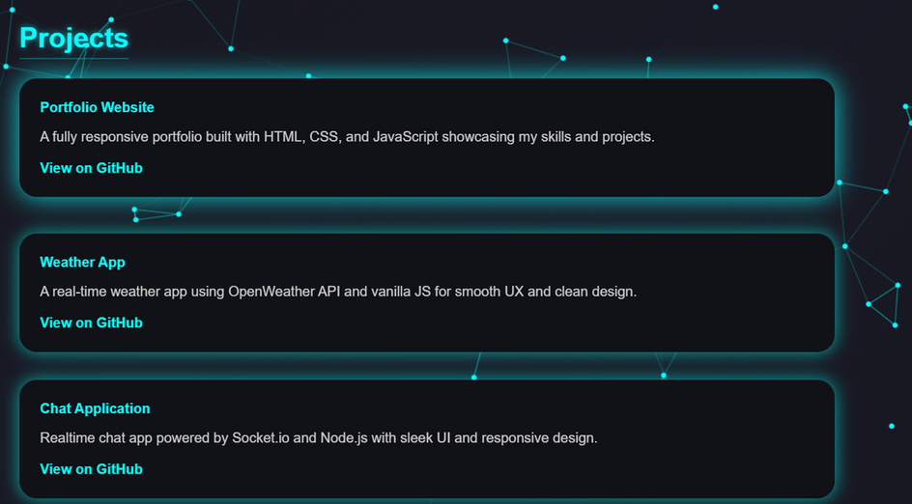
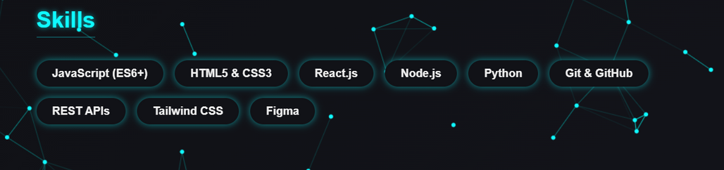
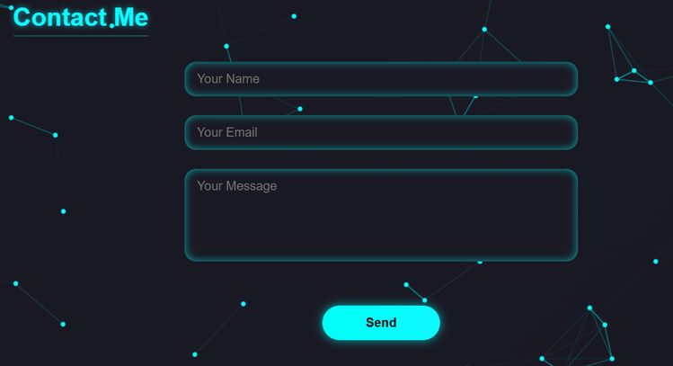
RESULTS AND SCREENSHOTS
3/21/2024 Annual Review
10

Slide 11
CONCLUSION
The portfolio successfully serves as a digital identity for Abhishek. It highlights skills, showcases real projects, and provides an accessible way for potential employers or collaborators to connect. Its modern design and responsiveness make it both visually appealing and practical.
11

Slide 12
SERVER LINK
https://github.com/24h225-sketch/abi.git
DEPLOYMENT LINK
https://24h225-sketch.github.io/abi/

