Slide 1

Digital Portfolio
STUDENT NAME: SREEVARSHAN K
REGISTER NO:212402432
NMID:C55655B9164826186CA493DD87DF2FE1
ROLL NO: 24h231
DEPARTMENT: BCA
COLLEGE:AM JAIN COLLEGE
UNIVERSITY OF MADRAS
1

Slide 2

PROJECT TITLE: DIGITAL PORTFOLIO
2

Slide 3



AGENDA
Problem Statement
Project Overview
End Users
Tools and Technologies
Portfolio design and Layout
Features and Functionality
Results and Screenshots
Conclusion
Github Link
3/21/2024 Annual Review
3

Slide 4

PROBLEM STATEMENT
In today’s competitive digital world, having a personal portfolio is essential for showcasing technical skills, educational background, and certifications. Many students and fresh graduates lack a structured platform to highlight their capabilities, leading to missed opportunities in job placements, internships, and freelance projects.
4

Slide 5

PROJECT OVERVIEW
This project is a personal portfolio website developed using HTML, CSS, and JavaScript. It provides a structured digital resume that highlights the developer’s profile, education, skills, certifications, and contact information. The portfolio demonstrates web development skills and serves as a central hub to present personal achievements.
5

Slide 6

WHO ARE THE END USERS?
Students & Fresh Graduates – to showcase their skills and certifications.
Recruiters/Employers – to quickly evaluate a candidate’s technical expertise.
Freelancers – to display work samples and contact details.
Peers & Mentors – to view academic and professional growth.
📌 Tools and Technologies
6

Slide 7

TOOLS AND TECHNIQUES
Frontend: HTML5, CSS3, JavaScript
Styling: Custom CSS with layout, color scheme, and responsive design
Editor: VS Code (recommended)
Hosting Options: GitHub Pages, Netlify, or Vercel
7

Slide 8
POTFOLIO DESIGN AND LAYOUT
Header: Profile picture, name, and designation
Navigation Bar: Links to About, Education, Skills, Certificates, and Contact sections
About Section: Summary of skills and academic journey
Education Section: Degree information
Skills Section: Technical skills like Python, Java, C++, Data Structures, JavaScript
Certificates Section: MongoDB, Infosys, HDCA, Tally ERP/Prime
Contact Section: Phone, email, and address
8

Slide 9
FEATURES AND FUNCTIONALITY
Smooth scrolling navigation
Responsive sections with clean layout
Downloadable CV option (future scope)
Certificates list to showcase achievements
Contact details for networking
Minimal yet professional design

Slide 10
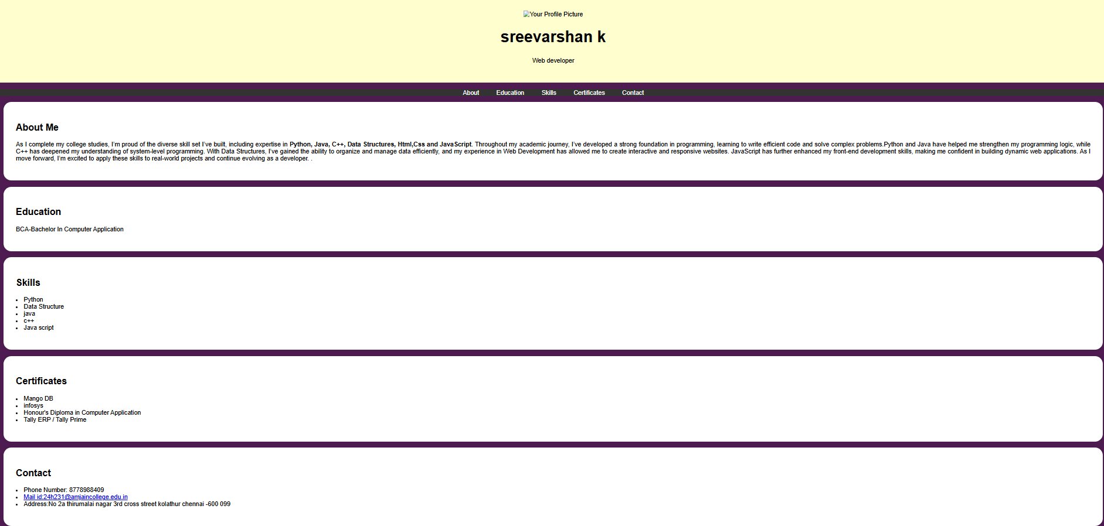

RESULTS AND SCREENSHOTS
3/21/2024 Annual Review
10

Slide 11
CONCLUSION
This project successfully delivers a professional personal portfolio website that demonstrates technical knowledge and design sense. It serves as a foundation that can be enhanced further by adding:
A projects section with live demos
A blog page
Responsive design for all devices
Integration with GitHub/LinkedIn
11

Slide 12
SERVER LINK :
https://github.com/24h231-hash/varshan.git
DIPLOYMENT LINK:
https://24h231hash.github.io/varshan/

