Slide 1


Digital Portfolio
STUDENT NAME: S.DEEPAK REGISTER NO AND NMID: 2 12402338 & D263E64ED1ACF3DB5414CE7B24C7C979
DEPARTMENT: BCA
COLLEGE: AM JAIN COLLEGE
1

Slide 2

DIGITAL POTFOLIO
2

Slide 3
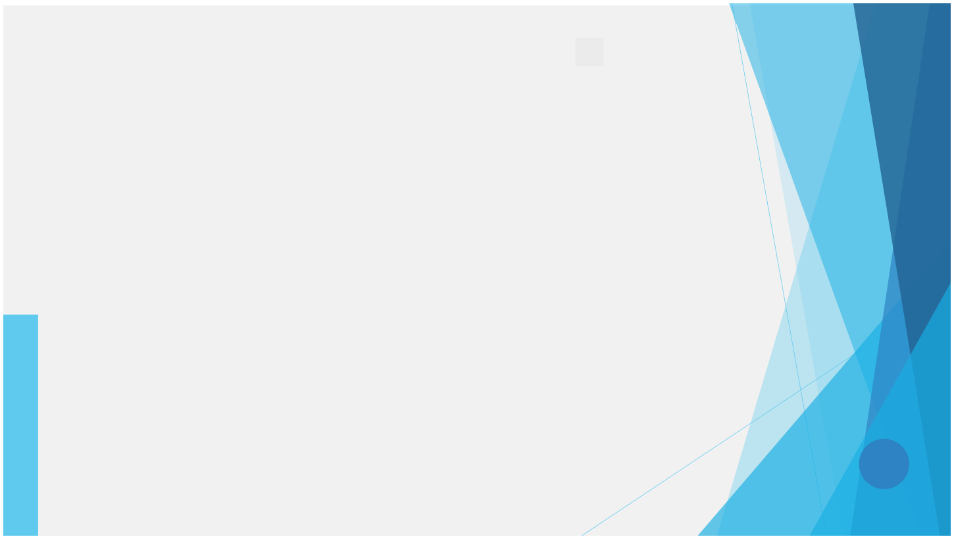



AGENDA
1.Problem Statement 2.Project Overview 3.End Users 4.Tools and Technologies 5.Portfolio design and Layout 6.Features and Functionality 7.Results and Screenshots 8. Conclusion 9.Github Link
3/21/2024 Annual Review
3

Slide 4


PROBLEM STATEMENT
Many portfolios fail to balance creativity with functionality, resulting in unengaging user experiences. There is a need for a modern, interactive, and visually appealing personal portfolio that highlights skills, projects, and contact information in a professional way.
4

Slide 5

PROJECT OVERVIEW
This project is a neon-themed digital portfolio website designed to showcase Deepak’s skills, projects, and professional identity. It uses modern web technologies, responsive design, and interactive elements like animations, glowing effects, and a hamburger navigation menu to create a futuristic and user-friendly experience.
5

Slide 6
WHO ARE THE END USERS?
Recruiters and hiring managers seeking to evaluate Deepak’s skills. Clients looking for web developers and UI/UX designers. Peers and collaborators interested in projects. General visitors exploring creative web designs.
6

Slide 7


TOOLS AND TECHNIQUES
Frontend Languages: HTML5, CSS3, JavaScript Styling & Effects: CSS animations, gradients, neon glow effects Icons & UI Support: Font Awesome Responsive Design: Media queries for mobile- friendliness
7

Slide 8

POTFOLIO DESIGN AND LAYOUT
Header & Navigation: Fixed header with neon-styled logo, smooth navigation, and hamburger menu for mobile. Hero Section: Introductory section with glowing elements and a call-to-action button. About Section: Personal introduction and career overview. Skills Section: Grid layout with animated skill cards (HTML, CSS, JavaScript, UI/UX Design). Projects Section: Interactive cards showcasing sample projects (website, mobile UI, browser game). Contact Section: Simple form to collect visitor details and messages. Footer: Social media links (GitHub, LinkedIn, Twitter, Instagram).
8

Slide 9
FEATURES AND FUNCTIONALITY
Interactive Navigation: Responsive hamburger menu with toggle effect. Neon Design Theme: Futuristic glowing background and UI elements. Skill Cards: Hover animations to highlight individual skills. Projects Showcase: Visual project cards with icons and descriptions. Contact Form: Allows visitors to send inquiries. Sparkle Button Effect: Animated sparkles on hover for buttons.

Slide 10

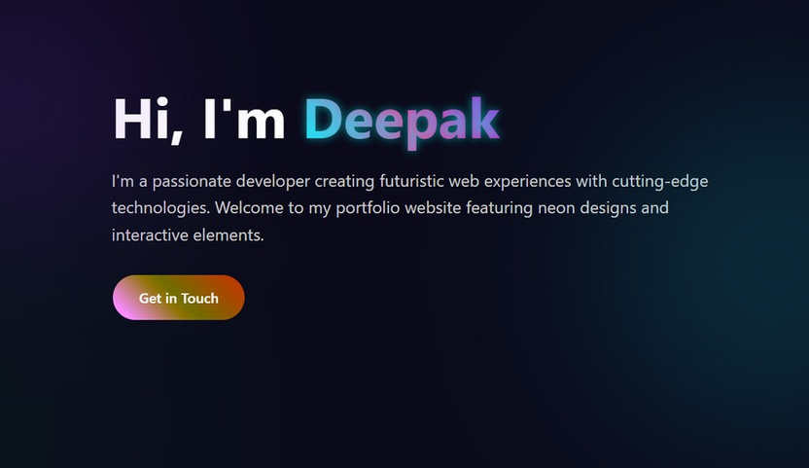
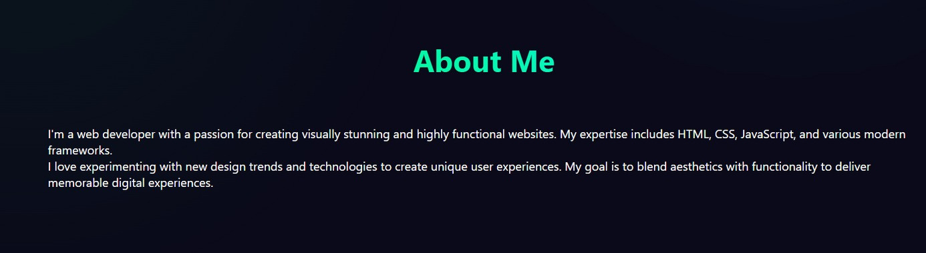
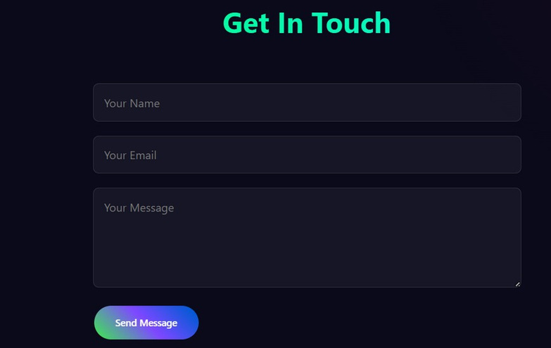
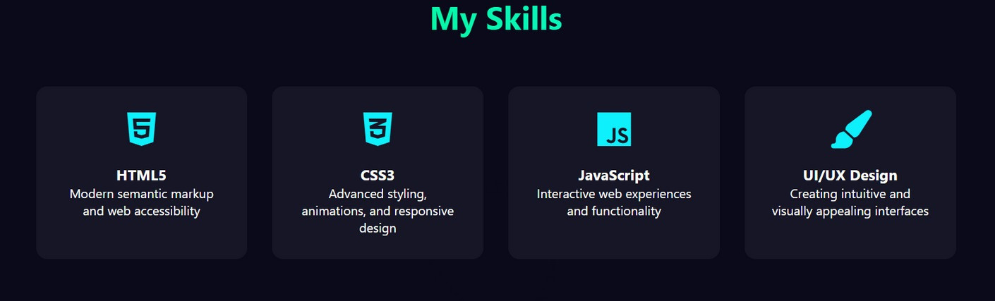
RESULTS AND SCREENSHOTS
3/21/2024 Annual Review
10

Slide 11

CONCLUSION
creativity, functionality, and responsiveness. It highlights Deepak’s technical and design skills while serving as a professional online identity. This portfolio can be further enhanced with backend integration (for contact form submissions) and real project deployment.
Theprojectdemonstrates a blend of
11

Slide 12
SERVER LINK
https://github.com/24h235-gif/TNSDC-FWD-DigitalPortfolio.git
DEPLOYMENT LINK
https://24h235-gif.github.io/TNSDC-FWD-DigitalPortfolio/

