Slide 1
Digital Portfolio
STUDENT NAME: SONALI . V
REGISTER NO AND NMID: 9387D9D0117A90A9FF84320D29386674
DEPARTMENT: COMPUTER APPLICATION
COLLEGE: AM JAIN COLLEGE

Slide 2
PROJECT TITLE
INTERACTIVE DIGITAL PORTFOLIO

Slide 3


AGENDA
Problem Statement
Project Overview
End Users
Tools and Technologies
Portfolio design and Layout
Features and Functionality
Results and Screenshots
Conclusion
Github Link
3/21/2024 Annual Review

Slide 4

PROBLEM STATEMENT
LACK OF PROFESSIONAL WAY TO SHOW THERIR RESUMES THEIR QULIFICATION,CERTIFICATES AND ETC.,.

Slide 5

PROJECT OVERVIEW
This project contains personal portfolio which contains details of student like their , skills , certificates, contact and etc.,.

Slide 6

WHO ARE THE END USERS?
Clients , hiring managers , faculty , general peoples , HR’s , general peoples and professional networkers likes LinkedIn and etc.,.

Slide 7

TOOLS AND TECHNIQUES
TOOL’s:
HTML
CSS
JAVA SCRIPT
VS CODE(visual studio)
BROWSER(chrome)
TECHNIQUES:
HTML(to structure the code)
CSS(to give it style)
JAVA SCRIPT(to give it buttons , handling)and etc.,.

Slide 8
POTFOLIO DESIGN AND LAYOUT
Clean and modern Ul
Navigation bar with smooth access
Sections: About, Skills, Certificates, Contact
Responsive grid layout for skills and certificates and etc.,.
8

Slide 9
FEATURES AND FUNCTIONALITY
FEATURES:
HOME SECTION
ABOUT ME
SKILLS
CERTIFICATES
CONTACT
FUNCTIONALITY:
NAVIGATION BAR
INTERACTIVE ELEMENTS-(BUTTONS,HOVER EFFECTS)
SOCIAL MEDIA AND ETC.,.

Slide 10
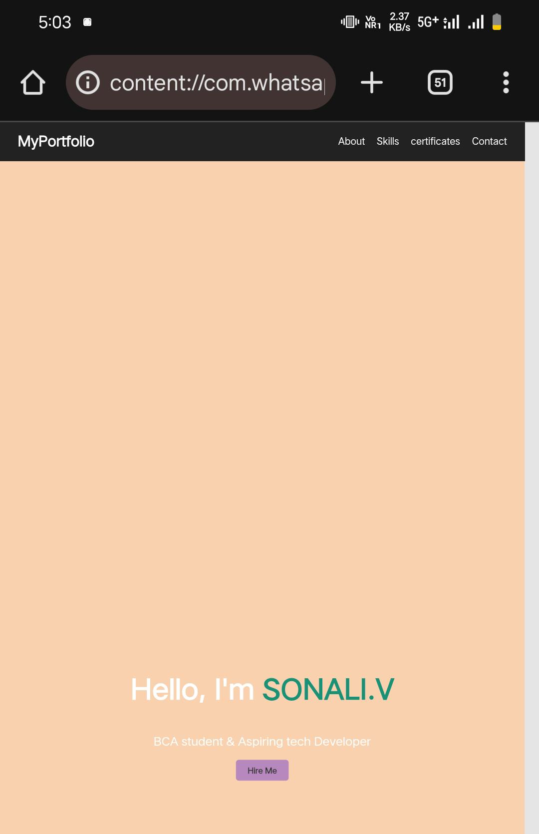
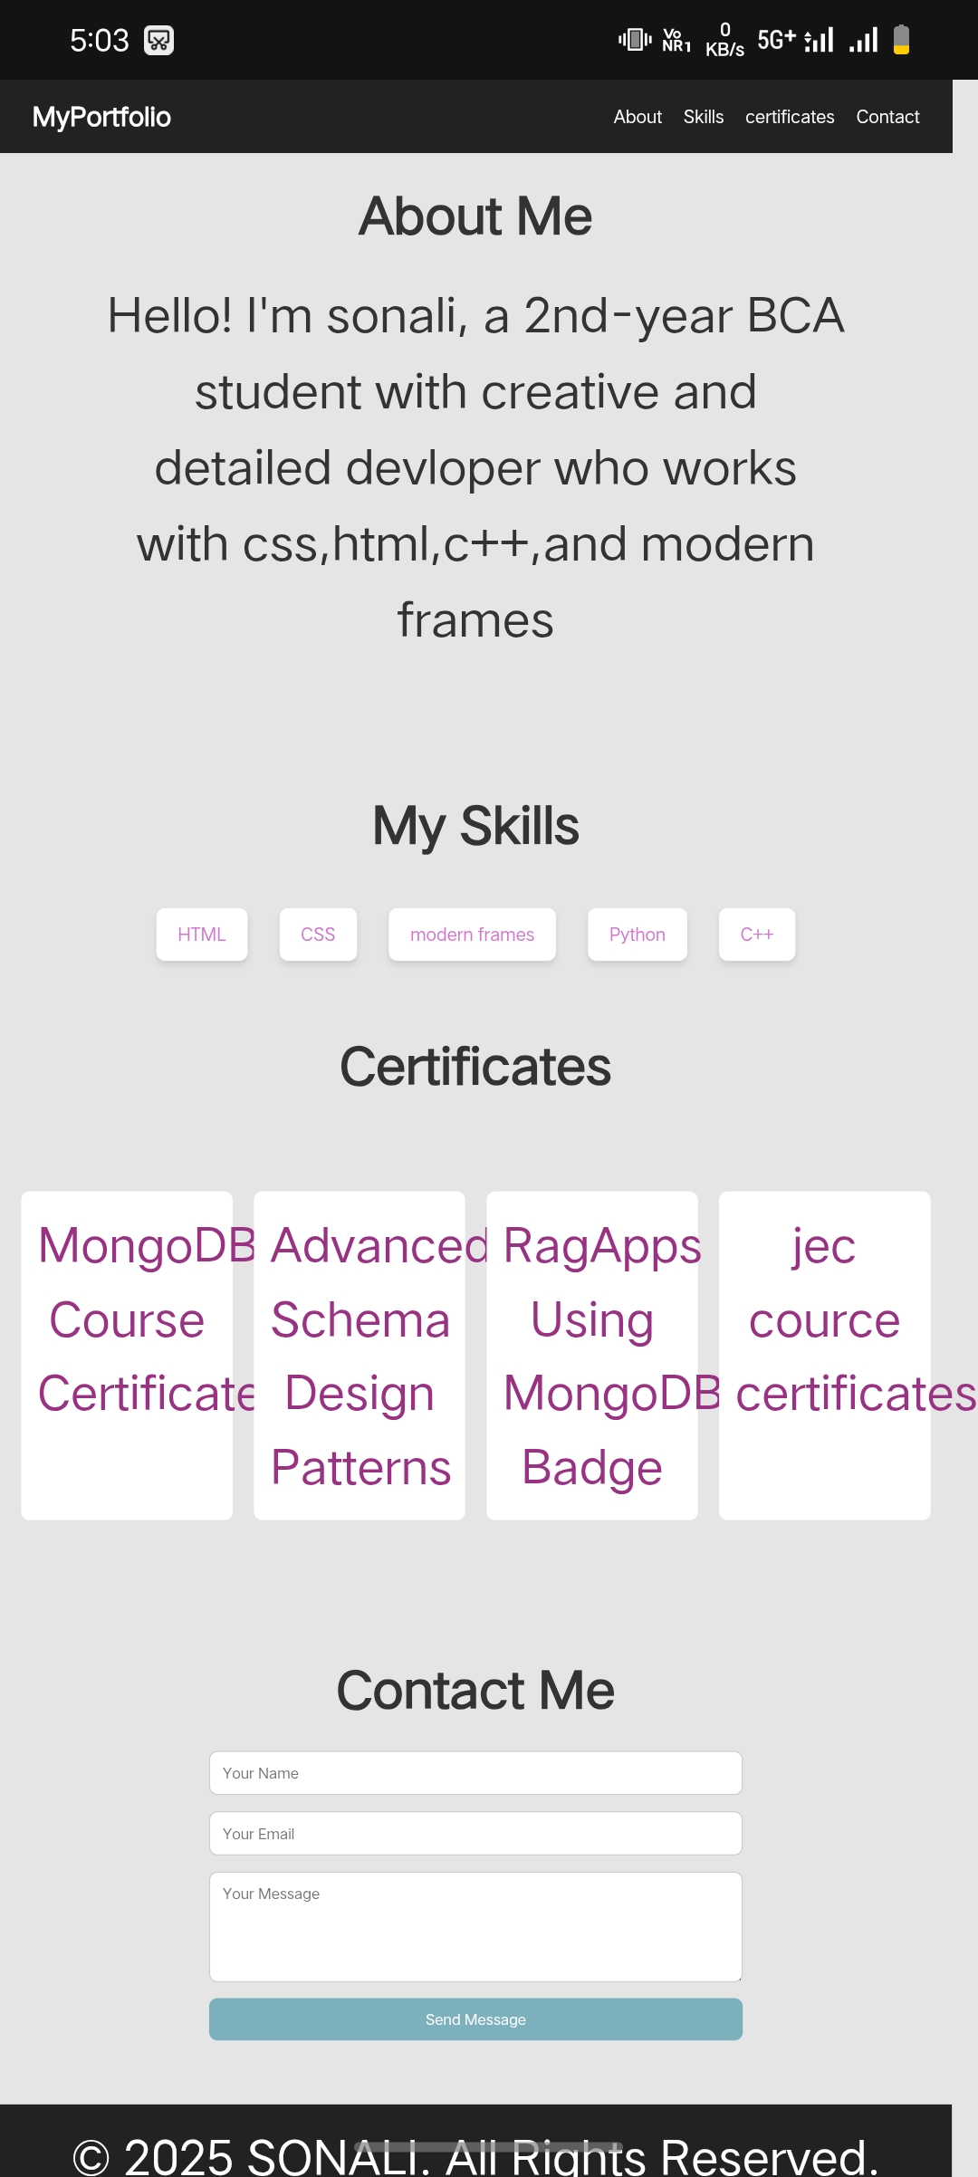

RESULTS AND SCREENSHOTS
MYPORTFOLIO SUCCESSFULLY DEMONSTRATES MY CODE:
3/21/2024 Annual Review
10

Slide 11
CONCLUSION
“This portfolio showcases my skills, certifications, and achievements as a student. I am eager to keep learning, improving, and applying my knowledge to future opportunities.”
11

Slide 12
Github Link: PROJECT LINK: https://24h322-cmd.github.io/Myserver/ GITHUB LINK: https://github.com/24h322-cmd/Myserver.git

