Slide 1
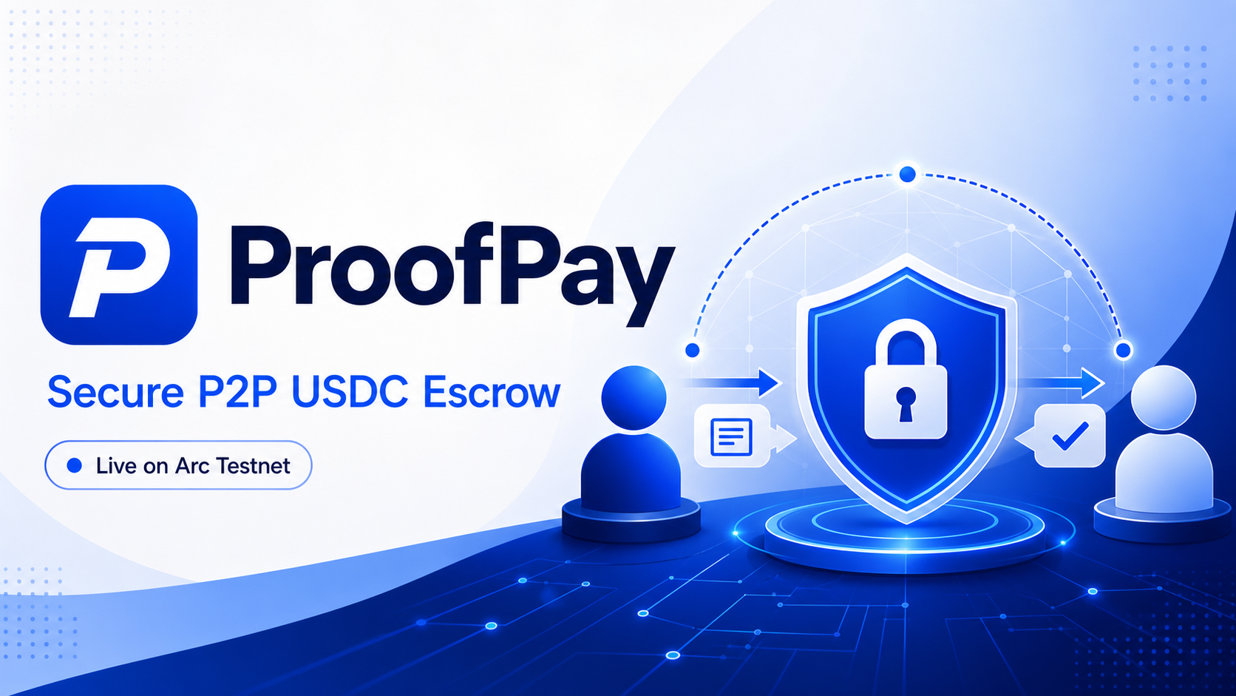
ARC HACKATHON · MID-SUBMISSION CHECKPOINT
proofpay.online
Notes:
Introduce ProofPay as a live public testnet MVP for trust-minimized peer-to-peer payments.
[Sources]
- https://proofpay.online
- https://github.com/24hlivepay/ProofPay
[/Sources]

Slide 2
THE PROBLEM
P2P commerce still asks one side to trust first
Payment-before-delivery exposes buyers; delivery-before-payment exposes sellers.
B
Buyer risk
↔
Trust gap
S
Seller risk
Pays first, then waits with limited proof or recourse.
Chat messages cannot enforce who delivers or who releases payment.
Delivers first, then depends on the buyer to pay.
PAYMENT RISK
NO SHARED STATE
DELIVERY RISK
Notes:
Frame the product around counterparty risk rather than crypto complexity.
[Sources]
- https://proofpay.online
- https://github.com/24hlivepay/ProofPay
[/Sources]

Slide 3
HOW IT WORKS
One shared escrow state from agreement to settlement
Every critical payment step is visible and participant-controlled.
1
2
3
4
5
Create deal
Seller verifies
Lock USDC
Confirm delivery
Release funds
Buyer defines the seller, item and amount.
Seller wallet reviews and accepts or rejects.
Buyer deposits Arc Testnet USDC.
Seller marks the delivery complete.
Buyer releases USDC to the seller.
BUYER
SELLER
SMART CONTRACT
SELLER
BUYER
Notes:
Walk through the live flow. The seller is wallet-bound before the buyer deposits.
[Sources]
- https://github.com/24hlivepay/ProofPay
- https://testnet.arcscan.app/address/0xCd0f43E573899809ff96C560439570A760698C9a
[/Sources]

Slide 4
CHECKPOINT EVIDENCE
A public, working testnet MVP—not a mockup
The core buyer-to-seller settlement loop is deployed and has been exercised across multiple wallets.
3
3
2
LIVE
proofpay.online
completed end-to-end escrows
wallets used in testing
supported browser wallets
Public Arc Testnet deployment
✓
Seller acceptance and rejection states
✓
USDC deposit, delivery confirmation and release
✓
Pending, active, completed and cancelled histories
✓
Persistent records in Neon Postgres
✓
Arcscan transaction links for onchain proof
✓
MetaMask and Rabby connection flows
Notes:
These are checkpoint test results, not production volume claims.
[Sources]
- https://proofpay.online
- https://github.com/24hlivepay/ProofPay
[/Sources]

Slide 5
ARCHITECTURE
Onchain settlement, off-chain product experience
A focused Web3 stack keeps escrow enforcement transparent while preserving usable order workflows.
Buyer + Seller
React frontend
Arc Testnet
MetaMask / Rabby
Vite · Tailwind · ethers.js
ProofPayEscrow + USDC
Order actions
Express API
Neon Postgres
Create · accept · deliver · release
Validation and status orchestration
Persistent order metadata
VERCEL SERVICES
Contract: 0xCd0f…98C9a
Notes:
Explain the separation between smart-contract settlement and database-backed UX metadata.
[Sources]
- https://github.com/24hlivepay/ProofPay
- https://testnet.arcscan.app/address/0xCd0f43E573899809ff96C560439570A760698C9a
[/Sources]

Slide 6
NEXT CHECKPOINT
From wallet-first testing to easier mainstream onboarding
The next major integration is Circle User-Controlled Wallets.
01
Circle wallets
02
Public testing
Integrate Circle User-Controlled Wallets for familiar, app-guided onboarding.
Collect feedback from Arc community testers across wallets, browsers and devices.
03
Flow hardening
04
Final demo
Expand automated coverage for rejection, expiry, refund, dispute and retry paths.
Polish mobile UX, document the architecture and publish a concise end-to-end demo.
LIVE MVP
proofpay.online
github.com/24hlivepay/ProofPay
Notes:
Be explicit that Circle User-Controlled Wallets are the next planned integration, not a completed checkpoint feature.
[Sources]
- https://developers.circle.com/w3s/user-controlled
- https://proofpay.online
- https://github.com/24hlivepay/ProofPay
[/Sources]

