Slide 1
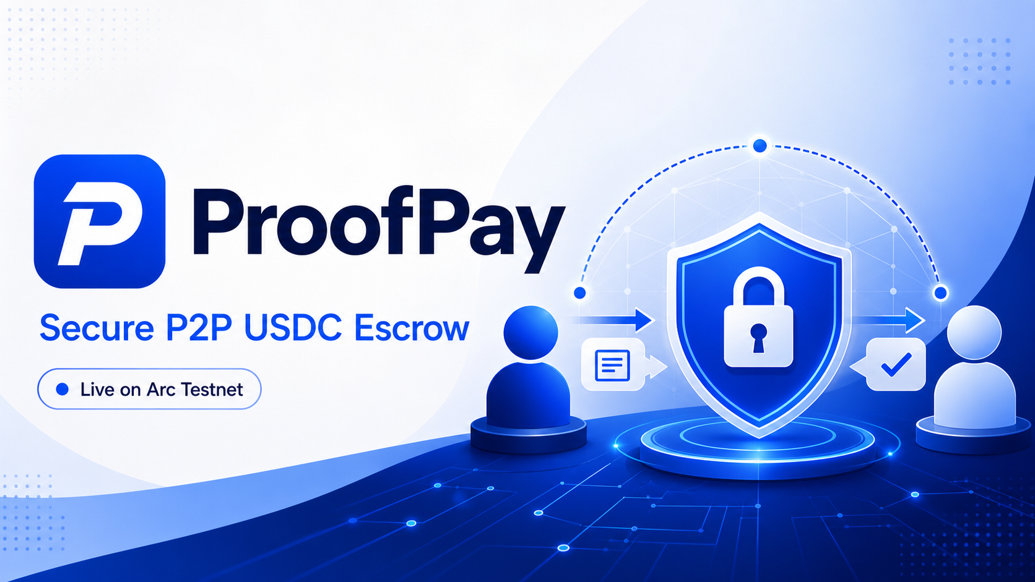
ARC HACKATHON · FINAL SUBMISSION
proofpay.online
Notes:
Introduce ProofPay as a live public testnet MVP for trust-minimized peer-to-peer payments.
[Sources]
- https://proofpay.online
- https://github.com/24hlivepay/ProofPay
[/Sources]

Slide 2
THE PROBLEM
P2P commerce still asks one side to trust first
Payment-before-delivery exposes buyers; delivery-before-payment exposes sellers.
B
Buyer risk
↔
Trust gap
S
Seller risk
Pays first, then waits with limited proof or recourse.
Chat messages cannot enforce who delivers or who releases payment.
Delivers first, then depends on the buyer to pay.
PAYMENT RISK
NO SHARED STATE
DELIVERY RISK
Notes:
Frame the product around counterparty risk rather than crypto complexity.
[Sources]
- https://proofpay.online
- https://github.com/24hlivepay/ProofPay
[/Sources]

Slide 3
HOW IT WORKS
One shared escrow state from agreement to settlement
Every critical payment step is visible and participant-controlled.
1
2
3
4
5
Create deal
Seller verifies
Lock asset
Confirm delivery
Release funds
Buyer defines the seller, item and amount.
Seller wallet reviews and accepts or rejects.
Buyer locks the selected Arc asset.
Seller marks the delivery complete.
Buyer releases the asset to the seller.
BUYER
SELLER
SMART CONTRACT
SELLER
BUYER
Notes:
Walk through the live flow. The seller is wallet-bound before the buyer deposits.
[Sources]
- https://github.com/24hlivepay/ProofPay
- https://testnet.arcscan.app/address/0xCd0f43E573899809ff96C560439570A760698C9a
[/Sources]

Slide 4
FINAL EVIDENCE
A tested, multi-asset MVP—not a mockup
The live product combines public testing, three escrow assets and reproducible contract validation.
3
3
12
LIVE
proofpay.online
supported escrow assets
wallet onboarding modes
escrow contract tests
Public Arc Testnet deployment
✓
Circle email + browser wallet onboarding
✓
USDC, EURC & cirBTC lock and release
✓
Buyer + seller lifecycle dashboards
✓
Persistent Neon Postgres records
✓
Arcscan transaction proof links
✓
Refund + dispute contract paths
Notes:
Final evidence reflects first-party repository state and automated test output generated on 2026-08-05. Public testing is ongoing; these are not production-volume claims.
[Sources]
- https://proofpay.online
- https://github.com/24hlivepay/ProofPay
[/Sources]

Slide 5
ARCHITECTURE
Onchain settlement, off-chain product experience
A focused Web3 stack keeps escrow enforcement transparent while preserving usable order workflows.
Buyer + Seller
React frontend
Arc Testnet
Circle / MetaMask / Rabby
Vite · Tailwind · ethers.js
3 escrow contracts + assets
Order actions
Express API
Neon Postgres
Create · accept · deliver · release
Validation and status orchestration
Persistent order metadata
VERCEL SERVICES
Contracts: USDC · EURC · cirBTC
Notes:
Explain the separation between on-chain asset custody and database-backed product metadata.
[Sources]
- https://github.com/24hlivepay/ProofPay
- https://testnet.arcscan.app/address/0xCd0f43E573899809ff96C560439570A760698C9a
[/Sources]

Slide 6
FINAL SUBMISSION
A tested escrow MVP, ready for Arc judges
Live product, multi-asset contracts and reproducible validation in one public build.
01
Multi-asset escrow
02
Public testing
Three dedicated contracts support USDC, EURC and cirBTC settlement.
Live Arc Testnet testing continues across wallets, browsers and devices.
03
Verified controls
04
Responsible next step
12 escrow tests cover settlement, refunds, disputes, permissions and invalid inputs.
Complete an independent audit and operational review before any mainnet use.
TESTNET
proofpay.online
github.com/24hlivepay/ProofPay
Notes:
Close with the demonstrated outcome and the explicit testnet-only safety boundary.
[Sources]
- https://proofpay.online
- https://github.com/24hlivepay/ProofPay
[/Sources]

