Slide 1





Digital Portfolio
STUDE NT NAM: n.dhanush
REGISTER NO AND NMID: 222404540/6C609D2336D394B95D34824ACC52A2AF
DEPARTMENT: Bsc.Software Application
COLLEGE: COLLEGE/ UNIVERSI TY: A. M Jain college

Slide 2


PROJECT TITLE
•
DIGITAL PORTFOLIO
/
/
/
/
/

Slide 3


AGENDA
I .Problem Statement
Project Overview
End Users
Tools and Technologies
Portfolio design and Layout
Features and Functionality
Results and Screenshots
8.Conclusion
9. Github Link
/
/
/

Slide 4


PROBLEM
STATEMENT
Building The structure
Giving Perfect Colors 3 ) Inserting pictures
•
'\
4) Making Scrolling smooth 5) Making it Responsive

Slide 5

PROJECToOVERVIEW
•
A Digital Portfolio fully attac hed about my skills in the software world and also it holds my project
i have linked my github , linkedin ,Twitter profile

Slide 6

WHO ARE THE END USERS?
•
The End Users are..
The Companies I go for Interview My Online Clients

Slide 7



TOOLS AND TECHNIQUES
•
HTML
css
JAVASCRI PT

Slide 8

POTFOLIO DESIGN AND LAYOUT
It has a maginificent Purple blended violet colors and it has my profile photo , My name in the Starting
after scrolling down you can find my projects , and what Skills do i have and lastly you got a information box
to fill up your details and get in touch with me...
- Thank you!!

Slide 9

FEATURES AND FUNCTIONALIT
Displays My Essential Details
Scrolls Smootly
it has a Arrow button in the left to scroll up from down

Slide 10
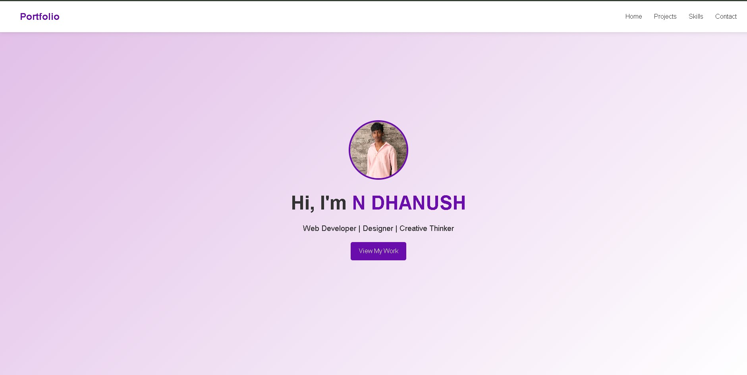
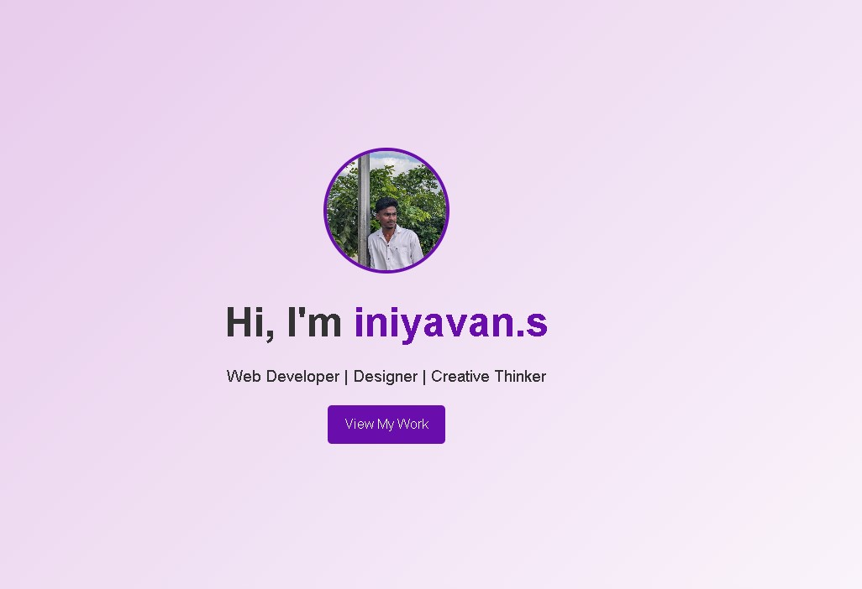
RESULTS AND SCREENSHOTS
'"l'""'' o.-_,u._
c
• ,
-.,
•
•
Portfolio
1 1,;.1,,..u"o •
•
Hi,I'm Vigneshwaran
<:
'
0 0 -
Portfolio
My Projects
:_ ::..= : --- .._
Prot&cll
SCr""$holl f/f HTMt
Projoct2
Projeca3
l;' "" "• \ • ... 'II' ·""' .i
0 -
•

Slide 11

CONCLUSION
•
I have created this Portfolio with my Hardwork and
Consistency
Github link:https://github.com/24j022-ux/TNSDC-FWD-DigitalPortfolio.git
Proifolio link:
https://24j022-ux.github.io/TNSDC-FWD-DigitalPortfolio/

