Slide 1






QUICKDOC
Book doctor’s
appointments online
By team:- CodeBreakers

Slide 2

Introduction
QuickDoc is an online platform for booking doctor appointments, allowing users to select doctors and hospitals based on their convenience and medical needs.
QuickDoc partners with hospitals across every state to connect you with the ideal doctor and hospital, tailored to your needs and proximity.

Slide 3

Vision
To revolutionize healthcare access by making doctor and hospital bookings seamless, personalized, and accessible to everyone, everywhere.
Mission
Our mission is to simplify healthcare by providing a user-friendly platform that connects patients with the best doctors and hospitals, ensuring convenience, quality, and accessibility for all.

Slide 4

Our Services
Online Doctor Appointments
Book consultations with doctors across various specialties, tailored to your medical needs.
Hospital Recommendations
Get matched with top hospitals near you, ensuring the best care based on your location and preferences.

Slide 5



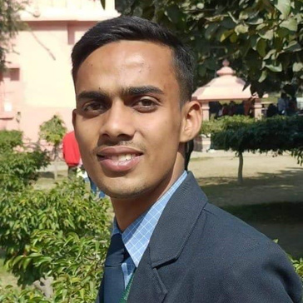

Our Team
Kaushik
Sarkar
Rajnish
Pandey
Abhiraj Chaubey
Abhishek
Vishwakarma

Slide 6

Our Facilities
24/7 Booking Access
Enjoy the flexibility of scheduling doctor appointments anytime, day or night, from the comfort of your home.
Distance-Based Matching
Get assigned to nearby hospitals and doctors for quicker and more convenient healthcare.

Slide 7


Business Aspects
Subscription Plans
Targeted Advertising
Offering premium membership plans for priority bookings and exclusive benefits.
Providing a platform for healthcare providers to promote their services to potential patients.
Hospital Partnerships
Data Insights
Offering analytics to hospitals for understanding patient preferences and improving services.
Collaborating with hospitals for commission-based referrals and services.

Slide 8
Future Aspects
AI Integration
Record Management
Implementing AI to suggest the best doctors and hospitals based on user history and preferences.
Enabling users to store and manage their medical records securely on the platform.
Telemedicine Integration
Multi-Language Support
Offering virtual consultations for faster and more accessible healthcare.
Expanding accessibility by providing services in multiple regional languages.

Slide 9





Contact Us
+91 6396731141
Quantum University, Roorkee
kaushik.s.contact@gmail.com
24kaushik.vercel.app

Slide 10

THANK
YOU

