Slide 1
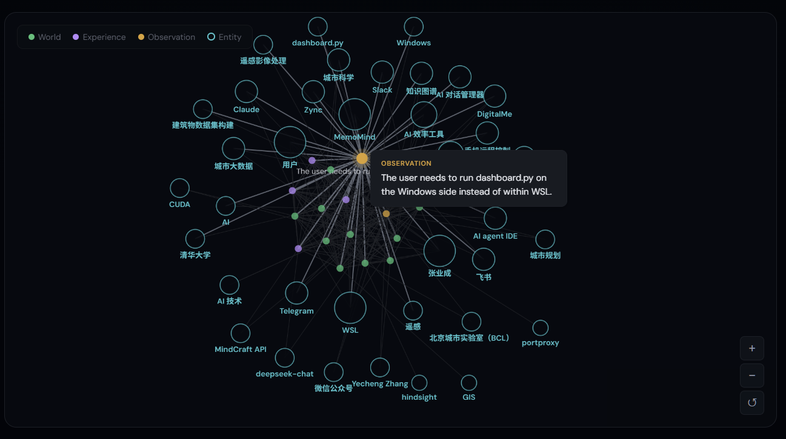
MemoMind
Give your AI a brain that remembers.
100% Local · GPU-Accelerated · Knowledge Graph Memory
github.com/24kchengYe/MemoMind

Slide 2
Your AI remembers nothing.
Every morning: a stranger
500 AI chats, zero value
Your life is invisible to AI
You spend 20 min explaining your project.
Session ends. Tomorrow?
"Hi, I'm Claude. How can I help?"
Start over. Again.
Research ideas in ChatGPT,
debug logs in Gemini,
architecture in Claude —
scattered, unsearchable, disconnected.
Your knowledge is decaying.
2,400+ days of activities in DayLife.
Your AI doesn't know when you last
worked on this topic, or how you
spend your time.
It knows nothing about you.
The problem isn't intelligence — it's amnesia. Models get smarter, memory stays at zero.
2 / 23

Slide 3
Existing solutions fall short.
 | CLAUDE.md | RAG | Long Context | MemoMind
Essence | Manual rules file | Doc retrieval | Bigger reading room | AI's Brain
Extraction | Manual | Pre-process docs | None — raw input | LLM auto-extract
Knowledge Links | None | None (isolated chunks) | None | Entity linking + graph
Cross-source | No | Per-document | Window limited | ChatGPT+Gemini+DayLife
Reasoning | None | None | Model-dependent | reflect: cross-memory
Time-aware | No | No | No | Temporal search + date
Cost | Free but token-wasteful | Varies | Expensive | ~$0.01/day
Scale | ~200 lines max | Depends | 100K token limit | 8,000+ memories verified
RAG is a library. Long context is a bigger reading room. MemoMind is a brain.
3 / 23

Slide 4
A living knowledge graph that gets smarter over time.
MemoMind is a 100% local, GPU-accelerated AI memory system.
It doesn't store chat logs — it extracts facts from every interaction
and builds a continuously growing knowledge graph.
8,456
556,672
4,666
Memory Nodes
Knowledge Links
Named Entities
Spanning 2017-01 to today · 3 Memory Banks · 484 MB local data
4 / 23

Slide 5
Under the Hood
MCP Protocol
Claude Code / Cursor → stdio
LLM
gpt-4o-mini · $0.01/day
Embedding
bge-m3 · RTX 3070 CUDA · 50ms
Reranker
ms-marco-MiniLM · local CUDA
Storage
PostgreSQL 17 + pgvector 0.8 + HNSW
Runtime
Windows native or WSL2/Linux · auto-start
5 / 23

Slide 6
retain · recall · reflect
retain
recall
reflect
Conversation → LLM extracts structured facts → vectorize → into graph
Query → 4-way parallel retrieval → reranker → most relevant memories
Synthesize multiple memories for cross-knowledge reasoning
Auto-detect entities, time, categories. Async — never blocks dialogue.
Keyword 20ms / Semantic 400ms. Returns only relevant fragments.
"Based on your past decisions, analyze the risks of this approach."
6 / 23

Slide 7
Not just vector search — 4-way hybrid retrieval
Semantic Similarity
BM25 Keywords
Knowledge Graph Traversal
Temporal Search
bge-m3 (1024-dim), 100+ languages
HNSW index, O(log n) query
Synonyms & cross-lingual
PostgreSQL GIN full-text index
Exact terms: code names, file paths
20ms response
470K entity links + 35K semantic links
Co-occurrence: 'FastAPI' → 'Express'
Discover hidden connections
48K temporal links
"Decisions this week" / "March 2024"
Time-decay weighting
Final reranking: cross-encoder/ms-marco-MiniLM ensures best results surface first
7 / 23

Slide 8
Bionic memory classification — organized like a human brain
World
Objective facts
7,546 (89%)
"User majors in Urban Planning" / "Project uses FastAPI"
Observation
Auto-inferred patterns
908 (11%)
"User often does research on Tuesdays" / "Prefers functional style"
Experience
Participated events
2 (<1%)
"Debugged the auth module last time"
Mental Model
Complex topic understanding
0 (—)
"This codebase follows hexagonal architecture"
Observations are auto-generated by the Consolidation Engine — AI discovers patterns, not you.
8 / 23

Slide 9
Memories don't pile up — they merge, update, and evolve
1
New fact enters → compare with existing memories
Real Example (life bank)
2
Duplicate? → Merge, increase confidence
5 raw facts:
"2024-03-25 attended global urbanization study"
"2024-03-26 global urbanization work"
"2024-04-01 merge urbanization data"
...
AI auto-inferred Observation:
"User has completed the paddleOCR pipeline work" (proof_count=3)
3
Contradiction? → Keep latest version
4
Multiple related facts → Auto-infer Observation
5
Observations refine over time, proof_count++
Currently 908 Observations, auto-inferred from 7,546 World facts
9 / 23

Slide 10
Three Banks, three dimensions of life
default
life
docs
AI Collaboration Memory
Life Trajectory
Technical Notes
2,050 nodes
6,361 nodes
45 nodes
Claude Code real-time: decisions, preferences, experience
541 ChatGPT + Gemini imports
Top entities: User, Python, BSAS, CIM, CityGML
Span: 2017-01 to now
5,490 DayLife daily events
Span: 2019-08-26 to 2026-03-26 (2,400+ days)
859 auto-inferred Observations
Top entities: Research, GhostCity, GitHub, English
API docs, framework tips, gotcha records
Accumulated during Claude Code sessions
Quick lookup for known pitfalls
10 / 23

Slide 11
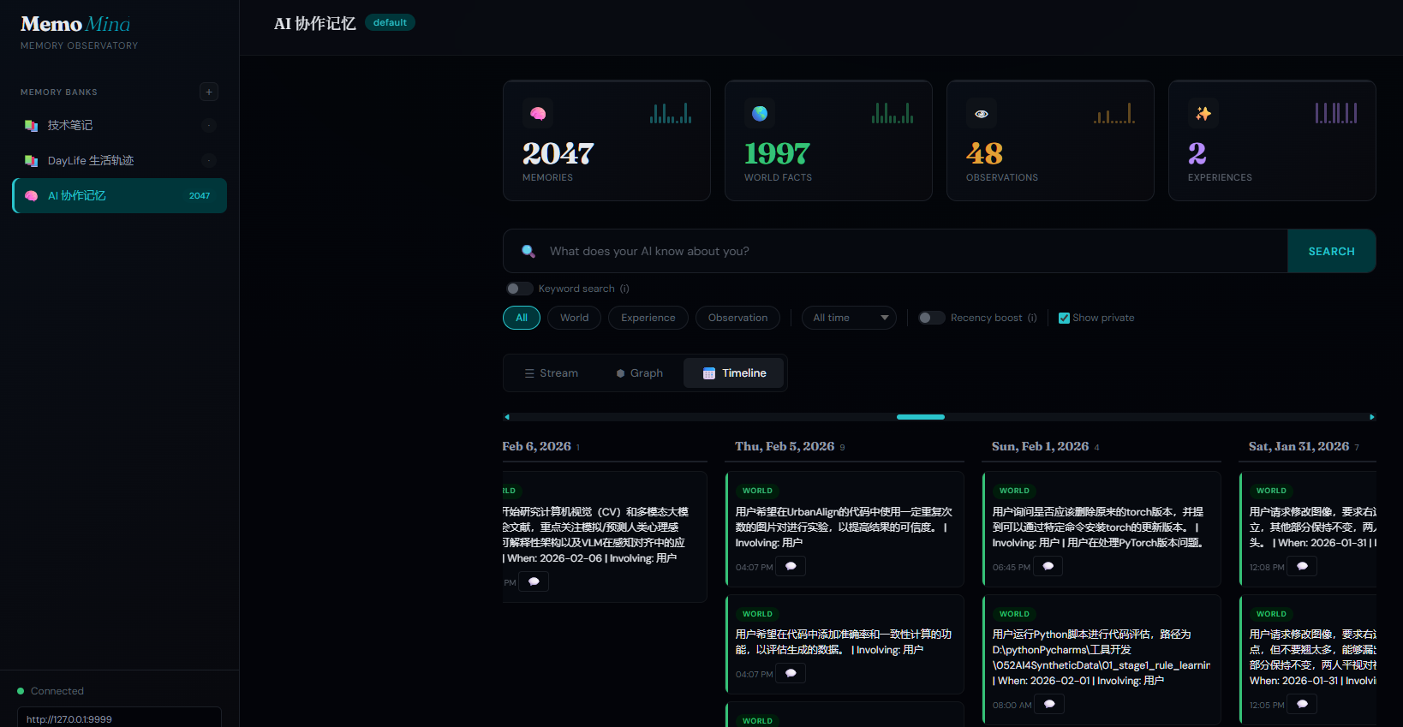
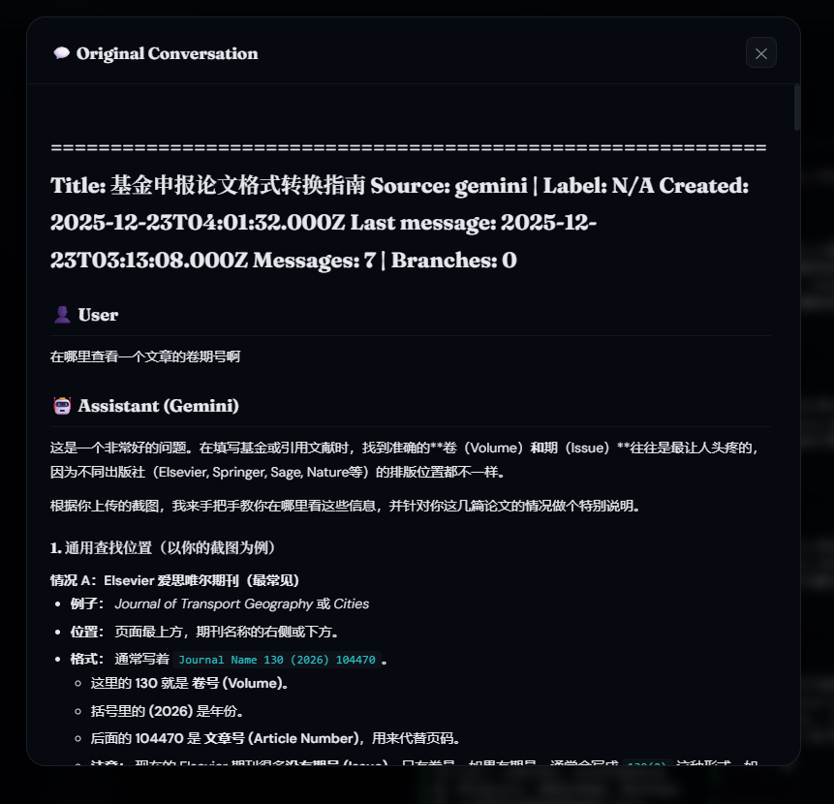
Your 500 AI chats: from graveyard to goldmine
ChatGPT → chatgpt-exporter → JSON
Gemini → gemini-exporter → JSON
↓
import_ai_chats.py
↓
MemoMind Knowledge Graph
541 conversations → 2,050 memory nodes → 2,093 entities → 144,426 links
Full traceability: every memory links back to its source conversation
Open-source tools:
github.com/24kchengYe/chatgpt-exporter
github.com/24kchengYe/gemini-exporter
11 / 23

Slide 12
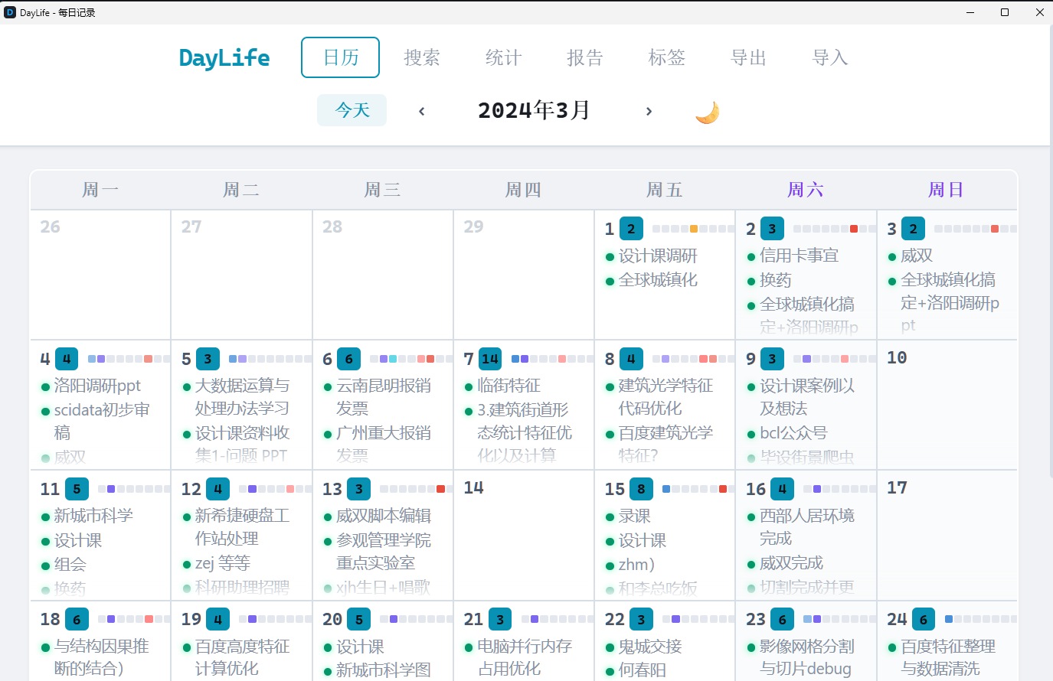
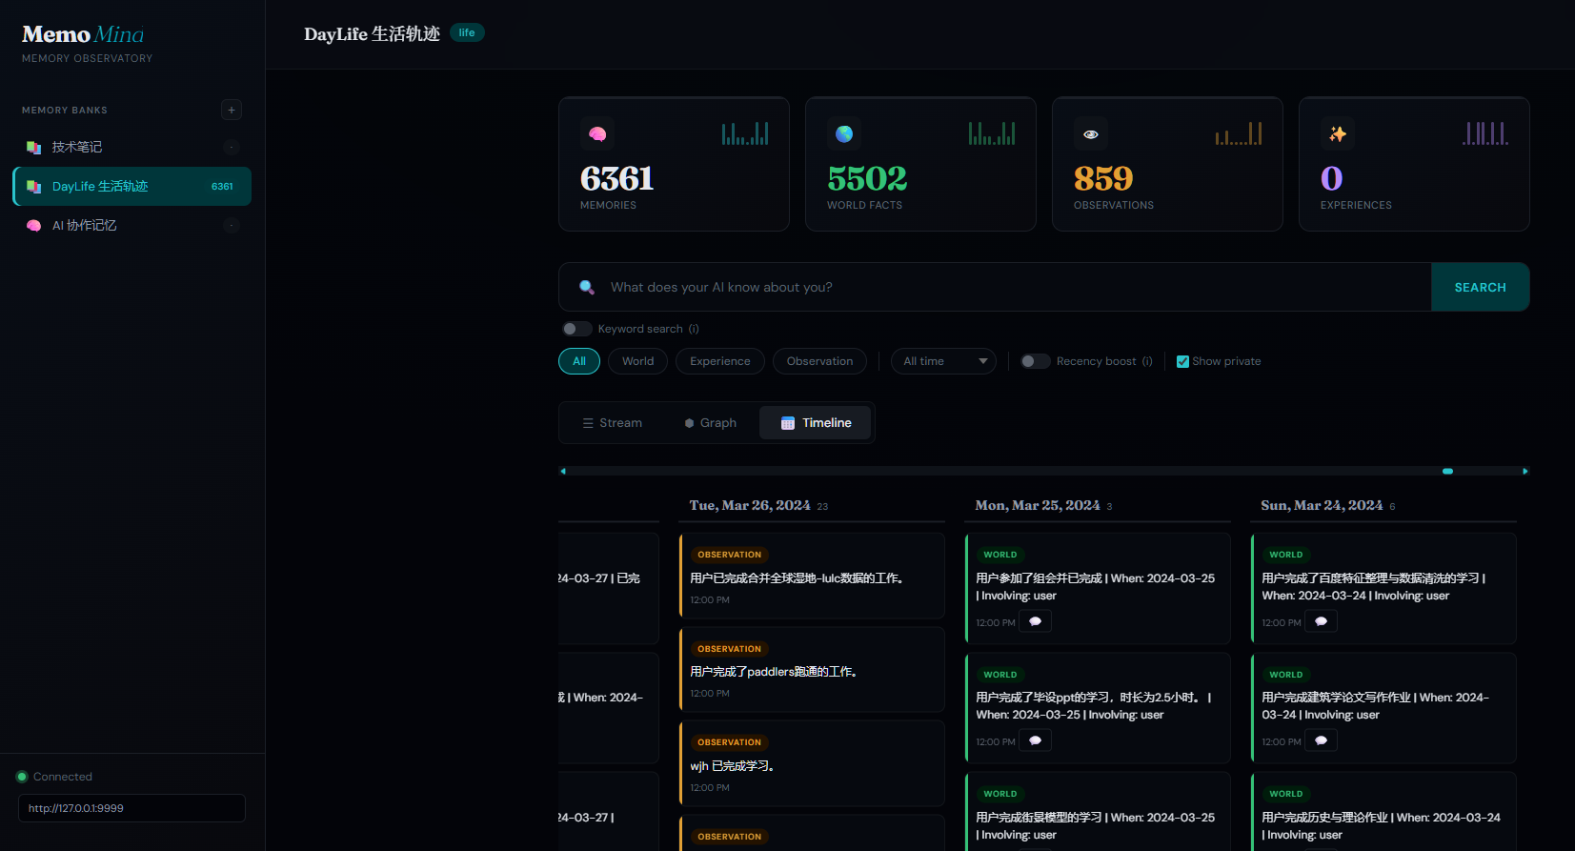
From 2019 to 2026 — your AI remembers every day
DayLife — Your daily planner
5,490 events → searchable memories
Smart Sync: Auto-sync daily at 3:00 AM (Windows Task Scheduler) · Marker file tracks last sync date · PC off for a week? Auto-backfills all missing days on reboot · No duplicates
12 / 23

Slide 13
Keyword instant search + Semantic deep recall
 | Keyword Search | Semantic Recall
Speed | 20-33ms | 235-430ms
How | PostgreSQL GIN full-text | bge-m3 vector + HNSW + reranker
Best for | Exact terms: filenames, tech words | Fuzzy concepts: "similar project I did"
Toggle | Dashboard one-click switch
Infinite Scroll
Stream view: 50 items per batch, IntersectionObserver triggers loading
Timeline view: 30 days per batch, scroll to load more
8,000+ memories browsed smoothly
13 / 23

Slide 14
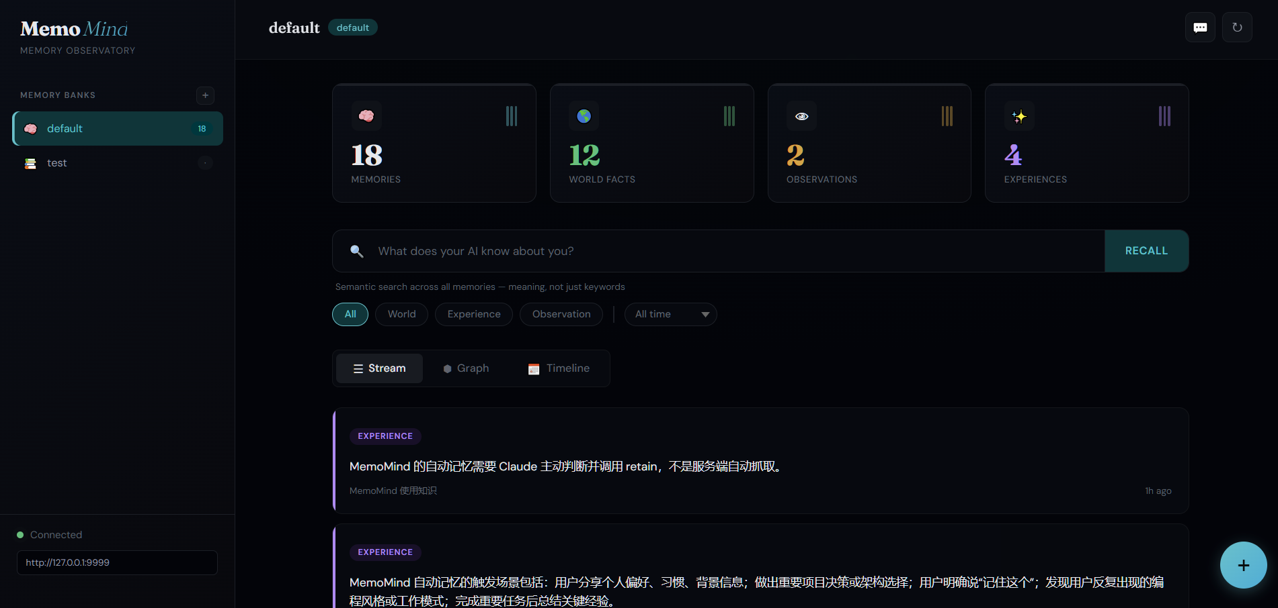
Your memories at a glance
Dashboard Overview
Knowledge Graph (WebGL)
Timeline View
Original Chat Tracing
Dark/Light theme · Type filter · Time filter · Recency boost · Privacy flags · JSON export · Bank management
14 / 23

Slide 15
How It Compares — The Full Landscape
 | MemoMind | Mem0 | Graphiti/Zep | Letta | Cognee | Hindsight
GitHub Stars | — | 51.2K | 24.3K / 4.3K | 21.8K | 14.7K | 6.5K
Funding | Self-funded | $24M (YC) | — | $10M | $7.5M | $3.5M
Architecture | KG + pgvector | Vector + Graph | Temporal KG | OS 3-tier | ECL + KG | 4-network
Retrieval | 4-way hybrid | Semantic + graph | Sem+BM25+graph | Agent-driven | 14 modes | 4 parallel
Knowledge Graph | pgvector + EL | Pro only $249 | Core (Neo4j) | No | Yes (all) | Yes
Temporal Model | Yes (native) | No | Yes (bi-temp) | No | Partial | Yes
Deployment | 100% local | Cloud / OSS | Cloud / OSS | Cloud / OSS | Local / Cloud | Local
Privacy | Never leaves | Cloud default | Cloud / BYOC | Self-host opt | Local default | Local
GPU Accel | Local CUDA | No | No | No | No | No
Chat Tracing | Full trace | No | No | No | No | No
Life Data | DayLife | No | No | No | No | No
LongMemEval | — | 49.0% | — | — | — | 91.4%
Cost | $0.01/day | Free~$249/mo | Free~$475/mo | Free~$200/mo | Free~$200/mo | Free (OSS)
License | MIT | Apache-2.0 | Apache-2.0 | Apache-2.0 | Apache-2.0 | MIT
Also evaluated: MemOS (7.9K stars), Memvid (13.6K), LangMem (1.4K, 59s P95 latency), MemoryLake (closed-source enterprise)
15 / 23

Slide 16
Key Competitive Insights
Mem0: Popular but shallow
Graphiti/Zep: Best temporal model
51K stars, $24M raised, AWS exclusive memory provider.
But: graph features paywalled ($249/mo), no temporal model,
independent LongMemEval accuracy only 49.0%.
Bi-temporal tracking (event time + ingestion time), hybrid retrieval.
But: requires Neo4j infra, Zep cloud-only for full platform,
credit-based pricing confusing ($475/mo for moderate use).
Hindsight: Highest benchmark accuracy
MemoMind's unique position
91.4% on LongMemEval (vs Mem0's 49%). Four-network architecture
(world/experience/entity/belief) mirrors MemoMind's memory types.
But: young project (6.5K stars), less production-proven.
Only system combining: 100% local + GPU-accelerated + knowledge graph
+ 4-way retrieval + AI chat tracing + life data integration + MCP native.
No competitor covers all six. Cost: $0.30/month vs $99-475/month.
16 / 23

Slide 17
Technical Deep Dive
Knowledge Graph, Not Flat Storage
Fact Extraction Engine
Consolidation Engine
556,672 links: entity (85%) + temporal (9%) + semantic (6%). Entity co-occurrence reasoning discovers hidden connections.
gpt-4o-mini auto-extracts entities, relations, time, categories. Async queue — never blocks conversations.
Auto-merge duplicates, infer Observations. 908 Observations from 7,546 World facts. Configurable mission control.
Local Embeddings
Time-Aware Memory
Original Chat Tracing
bge-m3: 1024-dim, 100+ languages. RTX 3070 CUDA, 50ms/item. Zero API calls, zero latency, zero cost.
Every memory has occurred_start/end. Engine patches auto-fallback to event date. Supports temporal range queries.
Engine patch saves original_document_id on retain. Dashboard: chunk_id → doc hash → index.json → .md file.
17 / 23

Slide 18
Less than $0.01 per day
Component | Resource Usage | Cost
LLM extraction (gpt-4o-mini via OpenRouter) | ~100 calls/day | ~$0.01/day
Embedding model (bge-m3 local CUDA) | ~500MB VRAM transient | $0
Reranker (ms-marco-MiniLM local) | ~200MB VRAM transient | $0
Storage (PostgreSQL) | 484MB disk | $0
Service process | ~2GB RAM | $0
Cost Comparison
MemoryLake: Enterprise pricing, undisclosed
Mem0 Pro: $99/month+
MemoMind: $0.30/month, everything local
18 / 23

Slide 19
Real Numbers, Real Usage
Total memory nodes
8,456
Time span covered
2017-01 to present (9 years)
Knowledge links
556,672
Database size
484 MB
Named entities
4,666
Daily LLM cost
< $0.01
AI chat imports
541 (ChatGPT 115 + Gemini 426)
Keyword search latency
20-33ms
Life events imported
5,490 (2019-08 to 2026-03)
Semantic recall latency
235-430ms
Auto-inferred Observations
908
This is not a lab demo — it's a production system used every day.
19 / 23

Slide 20
Memory is the new moat
Models commoditize, memory doesn't
GPT-5 is 97% cheaper than GPT-4. Models depreciate.
But your 8,000+ memories, 500+ entity relationships, 9-year life trajectory —
no model swap can replicate that.
Data is portable, no lock-in
Open JSON export with all memories, entities, tags, relations, sources.
Weekly auto-backup to GitHub.
Better system tomorrow? Take everything with you.
Digital twin — more valuable over time
Start accumulating today.
Your AI knows you better tomorrow than today, better next year than tomorrow.
That's compound interest.
20 / 23

Slide 21
What's Next
Completed
Next Up
Core engine: retain / recall / reflect
4-way hybrid retrieval + GPU acceleration
AI chat import + original chat tracing
DayLife life trajectory integration
Web Dashboard (Stream / Graph / Timeline)
Weekly auto-backup
Windows native support (no WSL needed)
Memory conflict detection & versioning
Multi-hop graph reasoning (2-3 hops)
Memory decay mechanism (time-weighted archival)
Docker install — one-command deployment
More MCP clients: Cursor, Windsurf, etc.
21 / 23

Slide 22
5 minutes: from amnesia to memory
# 1. Clone
git clone https://github.com/24kchengYe/MemoMind.git
# 2. Install — choose your platform:
# Windows: python -m venv memomind-env && pip install hindsight-api-slim
# Linux/WSL: sudo bash install.sh
# 3. Configure LLM API key in serve.py
# 4. Register MCP
# Windows: claude mcp add memomind -- python.exe mcp_stdio.py
# Linux: claude mcp add memomind -- /opt/.../mcp_stdio.py
# 5. Start chatting — AI auto-retains and recalls
GitHub: github.com/24kchengYe/MemoMind · MIT License
22 / 23

Slide 23
Start building your digital twin's memory today.
今天开始培养你的数字分身。
GitHub: github.com/24kchengYe/MemoMind
Dashboard: 127.0.0.1:9999
chatgpt-exporter: github.com/24kchengYe/chatgpt-exporter
gemini-exporter: github.com/24kchengYe/gemini-exporter
23 / 23

