Slide 1

BDA PROJECT REPORT · ACADEMIC YEAR 2026-27 · DEFENSE DECK
Smart City IoT
Sensor Analytics
on Cassandra & Spark.
THE DATASET
11,343
synthetic sensor readings — validated, stored and queried from Cassandra.
THE QUESTION
Can raw sensor readings alone drive city monitoring and flag unusual events?
An Apache Cassandra and Apache Spark pipeline over synthetic city sensor data — turning raw readings into traffic, environment, parking and waste insights.
SUBMITTED BY
UNDER GUIDANCE OF
Amaan Khan Pathan
Roll No. B1-B2-27
Ujwal Chikankar
Roll No. B1-B4-60
Prof. Sonam Chopade
Prof. Samiha Khan
School of Computer Science & Engineering · B.Tech CSE (AI & DS)
01 / 12 · COVER
Notes:
Cover: title, team members, guides, dataset size (11,343 synthetic readings) and the project question.

Slide 2
02 / 12 · WHAT THIS DEFENSE COVERS
PAGE 02
08
Eight moves,
over twelve slides.
Each move earns its place. Expect one finding per slide — a claim, a diagram, or a chart.
01
The sensor-data gap
Raw city readings vs. decisions — and the question behind this project.
05
The four tasks
Traffic, parking & waste, sensor health, anomaly detection.
02
Five objectives
What the system is built to do, from storing to anomaly review.
06
Results
Validation outcome on 11,343 readings — what was caught.
03
Why the data needs big-data tools
Six problems; one pipeline; the matching fix beside each.
07
Limits & future work
Seven honest caveats — and where the next version goes.
04
Dataset, architecture, pipeline
15 columns · four sensor types · five steps — visualised.
08
Conclusion
What was built, and what the demo shows.
ACADEMIC DEFENSE · 2026-27 · 12 SLIDES · ~20 MINUTES
Notes:
Agenda: eight moves over twelve slides, about twenty minutes.

Slide 3

03 / 12 · BACKGROUND · THE GAP BEHIND THE WORK
SENSORS · INSIGHTS
The answers a city needs are
buried in raw readings.
ON THE STREET
WHAT PLANNERS NEED
Four kinds of sensors
Decisions · not rows
Traffic counters, weather stations, parking lots and waste bins each report every few minutes.
“Which junction peaks at 08:30?” “Which bin is full?” — not millions of timestamped rows.
T
E
P
W
traffic · environment · parking · waste
1
2
3
4
raw → validated → stored → insight
THE PROJECT QUESTION
If readings are stored by query pattern in Cassandra and processed in Spark, then traffic, parking, waste and unusual events can be monitored from one dashboard.
The remaining slides report what was built — on synthetic data, not real city measurements.
Notes:
The gap: sensors produce raw rows; planners need answers. The project question frames the whole defense.

Slide 4
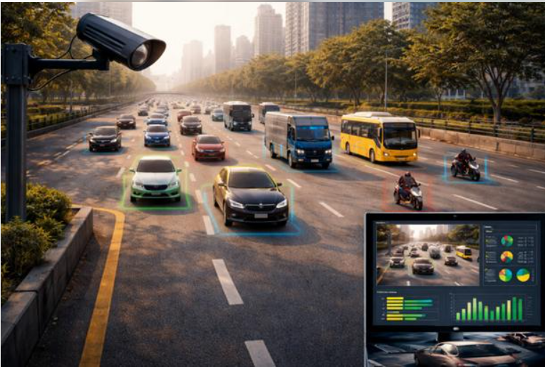
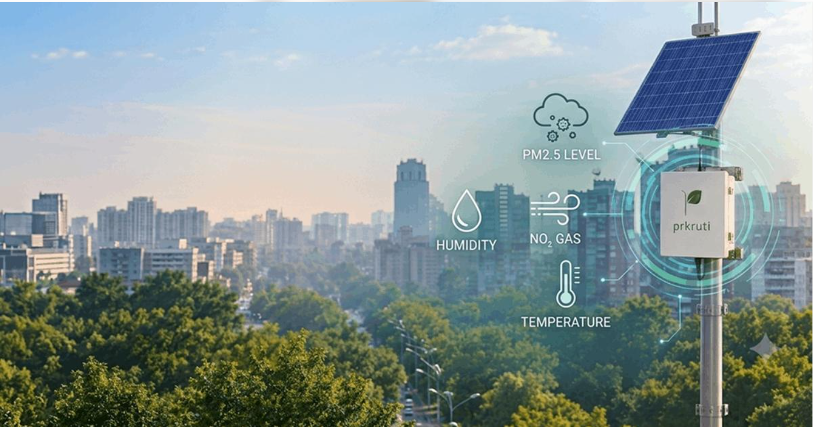
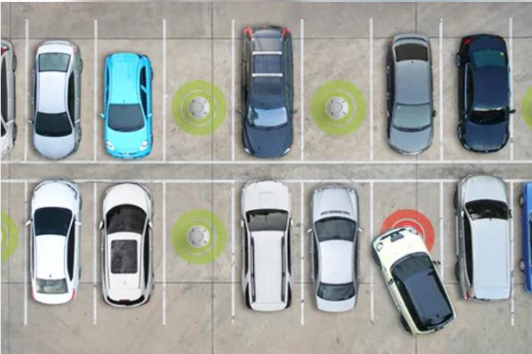
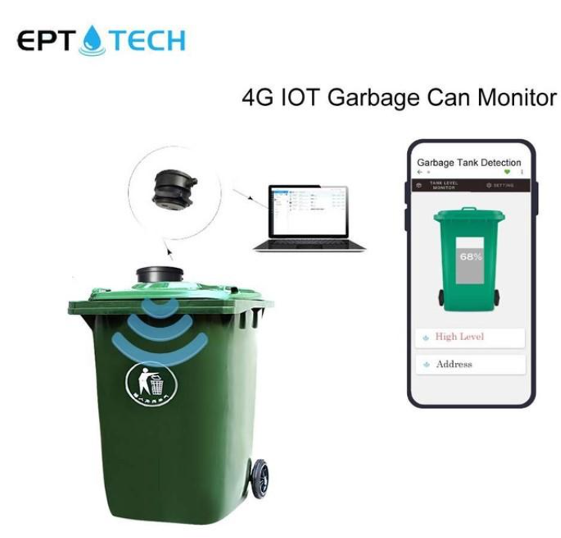

Slide 5
04 / 12 · FIVE OBJECTIVES
05 OF THEM
From a repeatable
pipeline to a dashboard.
ONE SHAPE, TWO MODES
Every step re-runs from the command line.
Spark 3.5.1 · Cassandra 4.1
seed 42 · batch + periodic mode
01
A repeatable Cassandra + Spark pipeline
Ingest with upserts — re-running never duplicates; same seed gives the same data.
04
Detect potential anomalies
Per-sensor Z-score; a person reviews each one on the dashboard.
02
Validate and clean every reading
Reject duplicates, missing and impossible values — and log the reason.
05
Monitor sensor health
Active, delayed, inactive or unknown — silence is not proof of a fault.
03
Analyse four sensor domains
Traffic, environment, parking and waste with PySpark aggregations.
Notes:
Five objectives, ranked from build to monitor.

Slide 6
05 / 12 · WHY THIS NEEDS BIG-DATA TOOLS
SIX PROBLEMS ↔ FIXES
Six problems. Six pipeline answers.
THE PROBLEM
HOW THE PIPELINE ANSWERS IT
Readings arrive in volume, all day long
Cassandra tables partitioned by (location, day) — writes spread out, partitions stay bounded.
Dirty data: gaps, duplicates, impossible values
A validation layer rejects them and logs the reason for every record.
Re-loading the same file must not duplicate
Primary-key upserts — a second run overwrites identical rows.
Dashboards must not scan whole tables
Bounded queries on the partition key; Spark reads date windows, no ALLOW FILTERING.
High traffic is not the same as congestion
Congestion needs speed: high volume AND speed below 60% of free-flow.
One global average would flag the wrong readings
Z-score per sensor, metric and 6-hour day-part — rush hour is compared with rush hour.
11,343 READINGS · 4 SENSOR TYPES · 4 CASSANDRA TABLES · SEED 42
Notes:
Each problem on the left has a matching design decision on the right.

Slide 7
06 / 12 · DATASET
SYNTHETIC DATA
A synthetic city catalogue.
11,343 readings · 15 columns · 4 sensor types.
THE SHAPE OF THE DATA
15 COLUMNS · AND WHERE EACH IS USED
11,343
KEY
KEY
KEY
sensor_id
location_id
sensor_type
KEY
GEO
GEO
readings in the sample CSV — 20 sensors, 5 locations, one reading every 15 minutes.
timestamp
latitude
longitude
TRAFFIC
TRAFFIC
ENVIRONMENT
−1.4%
vehicle_count
average_speed
temperature
ENVIRONMENT
ENVIRONMENT
PARKING
humidity
noise_level
parking_capacity
rows rejected by the validation rules on slide 8: 11,343 → 11,189.
PARKING
PARKING
WASTE
occupied_spaces
parking_occupancy
waste_fill_percentage
SYNTHETIC DATA · GENERATED WITH SEED 42 · NOT REAL-WORLD MEASUREMENTS
Notes:
Synthetic data with built-in rush-hour patterns, plus injected missing values, duplicates and unusual readings to test validation and anomaly detection.

Slide 8
07 / 12 · SYSTEM ARCHITECTURE
CASSANDRA + SPARK
Storage underneath,
processing on top.
APACHE CASSANDRA 4.1 — DISTRIBUTED STORAGE
keyspace smart_city · 4 tables · single node, RF 1 locally
TABLE
TABLE
TABLE
TABLE
sensor_readings_by_location
sensor_readings_by_type
latest_sensor_status
detected_anomalies
Readings for a location on a day, newest first.
Primary measurement of a sensor type per day.
Last known state of every sensor.
Potential anomalies + review status.
↓
SPARK CASSANDRA CONNECTOR 3.5.1 · PARTITION-KEY FILTERS
APACHE SPARK 3.5.1 — FIVE-STEP PROCESSING
PySpark · DataFrames · cache()
STEP · 01
STEP · 02
STEP · 03
STEP · 04
STEP · 05
Read
Clean
Aggregate
Detect
Publish
bounded date window from Cassandra.
ranges, dedupe, safe parking maths.
traffic, environment, parking, waste.
Z-score per sensor and day-part.
CSV results + anomalies → dashboard.
CASSANDRA STORES BY QUERY. SPARK SUPPLIES THE WORK. STREAMLIT SHOWS IT.
Notes:
Cassandra tables are designed around the queries. Spark reads bounded date windows through the connector, runs five steps, and publishes small results for the Streamlit dashboard.

Slide 9
08 / 12 · VALIDATION RULES & SPARK CONCEPTS
5 RULES · 6 CONCEPTS
Validate first, read in bounded windows,
then let every job reuse the result.
VALIDATION RULES
SPARK CONCEPTS USED
One check per rule.
PySpark + Cassandra connector
R1
Required columns and a valid UTC timestamp.
Rows without sensor, location, type or a parsable time are rejected.
SESSION
connector · UTC time zone
R2
Keep values inside physical ranges.
Humidity 0–100 %, temperature −50 to 60 °C, bin fill 0–100 %.
PRUNING
filter on location_id, day
DATAFRAME
groupBy · agg · join
R3
Handle missing values by sensor type.
Traffic needs a count, parking needs occupied spaces, waste needs fill %.
WINDOW
row_number · lag · percentile
R4
Reject duplicate (sensor, timestamp).
Only the first copy is kept — 51 found in the sample.
CACHE
persist once, reuse
R5
Check parking capacity.
Capacity must be > 0 and occupied ≤ capacity — no divide-by-zero.
ANOMALY
Z = (x − mean) / std
11,343 rows before → 11,189 after. validated once · reused by six Spark jobs.
Notes:
Five validation rules protect the database. Spark concepts: partition-key pruning, DataFrame aggregations, window functions, caching, Z-score.

Slide 10
09 / 12 · THE FOUR TASKS
FOUR QUESTIONS
Four questions, four Spark jobs,
four answers on the dashboard.
TASK 01
TASK 02 · MAIN
Traffic analytics
Anomaly detection
SPARK TOOL groupBy + window functions
MEASURES Volume by location and hour, peak hours, surges
ANSWER Which places peak — and when is it really congested? Volume alone is not congestion; speed is checked too.
SPARK TOOL Z-score per sensor, metric, day-part
MEASURES Threshold |Z| ≥ 3 · severity medium / high / critical
ANSWER Which readings are unusual? They are potential anomalies — a person reviews each one.
TASK 03
TASK 04
Parking, waste & environment
Sensor health
SPARK TOOL avg · max · latest-per-sensor
MEASURES Occupancy % · bins ≥ 80 / 90 % · temperature, humidity, noise
ANSWER Which lots are full, which bins need collecting? Thresholds are operational, not universal.
SPARK TOOL age of last reading vs. timeout
MEASURES Active ≤ 30 min · delayed ≤ 180 min · inactive · unknown
ANSWER Which sensors went quiet? A silent sensor is not automatically faulty.
ONE CLEANED DATAFRAME · SIX SPARK JOBS · FOUR QUESTIONS ANSWERED
Notes:
Traffic, anomaly detection (main task), parking/waste/environment, and sensor health.

Slide 11
10 / 12 · RESULTS · DATA QUALITY
VALIDATION OUTCOME
98.6% of readings pass validation;
154 are caught before storage.
Rejected readings by reason, out of 11,343. Traffic peaks, bin status and anomalies are shown live in the dashboard demo.
THE TAKEAWAY
154
of 11,343 readings rejected (1.4%) — each logged with its reason, none stored.
ACCEPTED
11,189
environment 2,982 · traffic 2,980 · waste 2,614 · parking 2,613
BARS SHARE ONE AXIS · REAL COUNTS FROM VALIDATING data/sample_sensor_data.csv · SYNTHETIC DATA
Notes:
These counts come from actually validating the sample CSV: 11,343 total, 11,189 accepted, 154 rejected (64 missing required value, 51 duplicates, 39 impossible values). Spark analytics results are demonstrated live on the dashboard.

Slide 12
11 / 12 · HONEST LIMITS & WHERE WE PUSH NEXT
TWO COLUMNS
Seven caveats on the left.
Five next-moves on the right.
WHAT THE PROJECT DOESN'T DO
WHERE THE NEXT VERSION GOES
L1
Synthetic. Data is generated, not measured — the patterns are built in.
F1
Live ingestion with Kafka or MQTT.
L2
Single node. One local Cassandra node shows the design, not fault tolerance.
F2
Spark Structured Streaming for continuous processing.
L3
Local Spark. local[*] on one machine — no cluster speed-ups claimed.
L4
Potential anomalies. Z-score outliers need human review; they are not incidents.
F3
Isolation Forest alongside the Z-score.
L5
No live ingestion. Periodic mode is simulated; no real MQTT/Kafka producer yet.
Multi-node Cassandra (NetworkTopologyStrategy).
F4
L6
No benchmark. We do not claim Spark or Cassandra beat other tools.
F5
Fair benchmarks on larger datasets.
L7
Scope. PM2.5/PM10 sensors and bin time-to-full forecasts are not implemented.
Notes:
Be upfront: synthetic data, single node, local Spark, potential anomalies, simulated live mode, no benchmark, limited scope.

Slide 13
12 / 12 · CONCLUSION · REPRODUCIBILITY · THANKS
END · THANK YOU
A pipeline that honestly reports
what it stores, and what it can't claim.
Cassandra stores by query, Spark validates-reads-aggregates, Streamlit shows. We built a working path from raw synthetic readings to traffic, parking, waste and anomaly insights — and measured what validation catches on the way in.
STORAGE
COMPUTE
HEADLINE
Cassandra 4.1
PySpark 3.5.1
98.6% valid
Four query-shaped tables; upserts make re-runs safe.
Five steps, one cleaned frame, six jobs.
154 of 11,343 readings caught before storage.
REPRODUCIBILITY
THANK YOU · QUESTIONS?
Docker + Cassandra 4.1 · PySpark 3.5.1 · Python 3.10/3.11 · seed 42. The same seed regenerates the same dataset.
Amaan Khan Pathan · Ujwal Chikankar
Guided by Prof. Chopade & Prof. Khan
REFERENCES · Apache Cassandra docs · Apache Spark docs · DataStax Spark Cassandra Connector · Streamlit docs · Standard score (Z-score) method
Notes:
Close: what was built, the headline validation result, reproducibility, thanks and questions.

