Slide 1
A Learning-Progression Knowledge Graph for Diagnosing Novice Code-Comprehension Reasoning
Pradhyumn Nair
Mid-term progress report, Directed Study (PhD)
Advisor: Dr. Vijayalakshmi Ramasamy, Department of Computer Science, Georgia Southern University
October 30, 2026

Slide 2
Problem and motivation
A correct answer to a code-tracing question is weak evidence of correct reasoning: a student can reach the right output with a wrong mental model.
  About one third of students on an online course could not explain their own working code (Lehtinen et al., ITiCSE 2021).
  Only 17% of first-year Java students held a sound model of reference assignment (Ma et al., SIGCSE 2007).
A wrong answer does not say which piece of understanding is missing. An instructor or tutor needs the missing concept, the student's level, and the root cause.
LLM graders can read free text, but their verdicts are hard to trace to a rule and can change from one run to the next.
Our scoping review of 240 studies found that code-comprehension assessment, learning progressions and LLM scoring have each been paired, but never joined.
This project makes a learning progression machine-readable as a knowledge graph, so that a system can reason along its edges and show why it reached each verdict.

Slide 3
Research questions
RQ1 Subgraph recovery (results today)
Can the code alone pick out the part of the graph an item is about, using patterns stored on the concept nodes?
RQ2 Traversal (planned)
Can a Think-on-Graph traversal match each sentence of the student's answer to the edge or misconception it uses? Measured with knowledge precision, recall and F1 (Hwang et al., 2025) and exact match (Think-on-Graph).
RQ3 Learning-progression logic (planned)
Do the level rules stored in the graph place the student at the right level, L0 to L4, for each concept, compared with expert labels?
RQ4 Value of the graph (planned)
Is an LLM that reasons over the graph more accurate and more consistent across reruns than the same LLM without the graph?

Slide 4
Related work (1): what novices get wrong, and scales of depth
Misconceptions and how they are catalogued
Pea (1986): language-independent "bugs": novices think lines run at the same time, or that the computer will work out what they meant.
du Boulay (1986): novices must learn five things at once, and the notional machine (what the computer does when code runs) gives the most trouble.
Qian and Lehman (2017, TOCE): review that sorts difficulties into syntactic, conceptual and strategic knowledge.
Kaczmarczyk et al. (2010, SIGCSE): formal interviews with students revealed four themes, including memory models and assignment.
Caceffo et al. (2019, ITiCSE): identified and validated Java misconceptions toward a CS1 concept inventory. ProgMiscon (Chiodini et al., 2021): an online inventory of 198 misconceptions.
Scales of depth for reading code
SOLO (Biggs and Collis, 1982): five levels from prestructural to extended abstract; applied to novice code-reading answers by Lister et al. (2006).
Block Model (Schulte, 2008): grades how much of the program is read (atoms to whole) and how deep (text, execution, purpose).
Clear et al. (2008): three raters agreed only moderately on SOLO levels. Knowledge tracing (Corbett and Anderson, 1994; Piech et al., 2015) models mastery of items, not reasoning.

Slide 5
Related work (2): learning progressions and LLM grading
Learning progressions in science education
Krajcik and Shin (2023): a progression orders the ways students reason about one idea, from simple to developed, built from real answers.
Wilson (2009, JRST): construct modeling ties each level to assessment items. Alonzo and Steedle (2009): force-and-motion progression with multiple-choice items whose options map to levels.
Jin et al. (2019): the evidence a progression needs to be valid. Jin, Lima and Wang (2025): machine scores on progression levels compared with researchers' scores.
Language models for grading and tutoring
Prather et al. (2023, ITiCSE working group): generative AI is now used for material, explanations and tutoring in computing courses.
Fowler et al. (2021, SIGCSE): graded 2,019 explain-in-plain-English answers at 87-89% accuracy, not statistically different from trained TAs.
Liffiton et al. (2023): CodeHelp gives LLM help with guardrails at course scale. Zhang et al. (2025, SIGCSE): an LLM classifies programming answers onto SOLO levels.
Zheng et al. (2023, NeurIPS): LLM judges show position, verbosity and self-enhancement bias, so they must be checked against people.

Slide 6
Related work: language models reasoning over graphs
Paper | What it does | What we take from it
Think-on-Graph (Sun et al., ICLR 2024) | An LLM walks a knowledge graph with beam search: it lists the edges at each node, keeps the useful ones, and checks whether it has enough to answer. No training. | The traversal for Stage 2; exact-match accuracy (Hits@1)
Reasoning on Graphs (Luo et al., ICLR 2024) | Uses only paths that really exist in the graph and answers with the path it used. | Every verdict must cite a real path
PathRAG (Chen et al., AAAI 2026) | Gives the LLM key paths as ordered text: node, edge description, node. | How to write paths in the prompt
Principal knowledge grounding (Hwang et al., Findings of EMNLP 2025) | Labels each required knowledge unit correct, incorrect or not applied; reports knowledge precision, recall and F1. | The result metric
Judging LLM-as-a-Judge (Zheng et al., NeurIPS 2023) | Validates LLM judges by agreement with humans; documents position, verbosity and self-enhancement bias. | How to validate an LLM judge

Slide 7
The gap this project fills
Misconception catalogues are flat lists. They say a misconception exists, but not which prerequisite it breaks or which level of understanding it means.
Depth scales (SOLO, Block Model) order answers, need trained raters, and were not built from the wrong ideas students actually hold.
Learning progressions exist in science, but none exists for code, and they are written as documents for human raters, not as structures a program can follow.
LLM graders put a general scale in a prompt. The verdict is not tied to a stated rule, can change between runs, and does not name the prerequisite that failed.
Graph-reasoning methods (Think-on-Graph, Reasoning on Graphs, PathRAG) answer factual questions over large general graphs. None has been used to diagnose a student's reasoning.
Principal knowledge grounding checks reasoning against knowledge units, but its units are a flat list with no prerequisite links.
Our scoping review of 240 studies found no study that joins all three: code-comprehension assessment, a validated ordered scale, and LLM scoring.
This project: a learning progression for Java Chapter 1 stored as a knowledge graph, and an LLM that reasons only along its edges, so each verdict comes with its path.

Slide 8
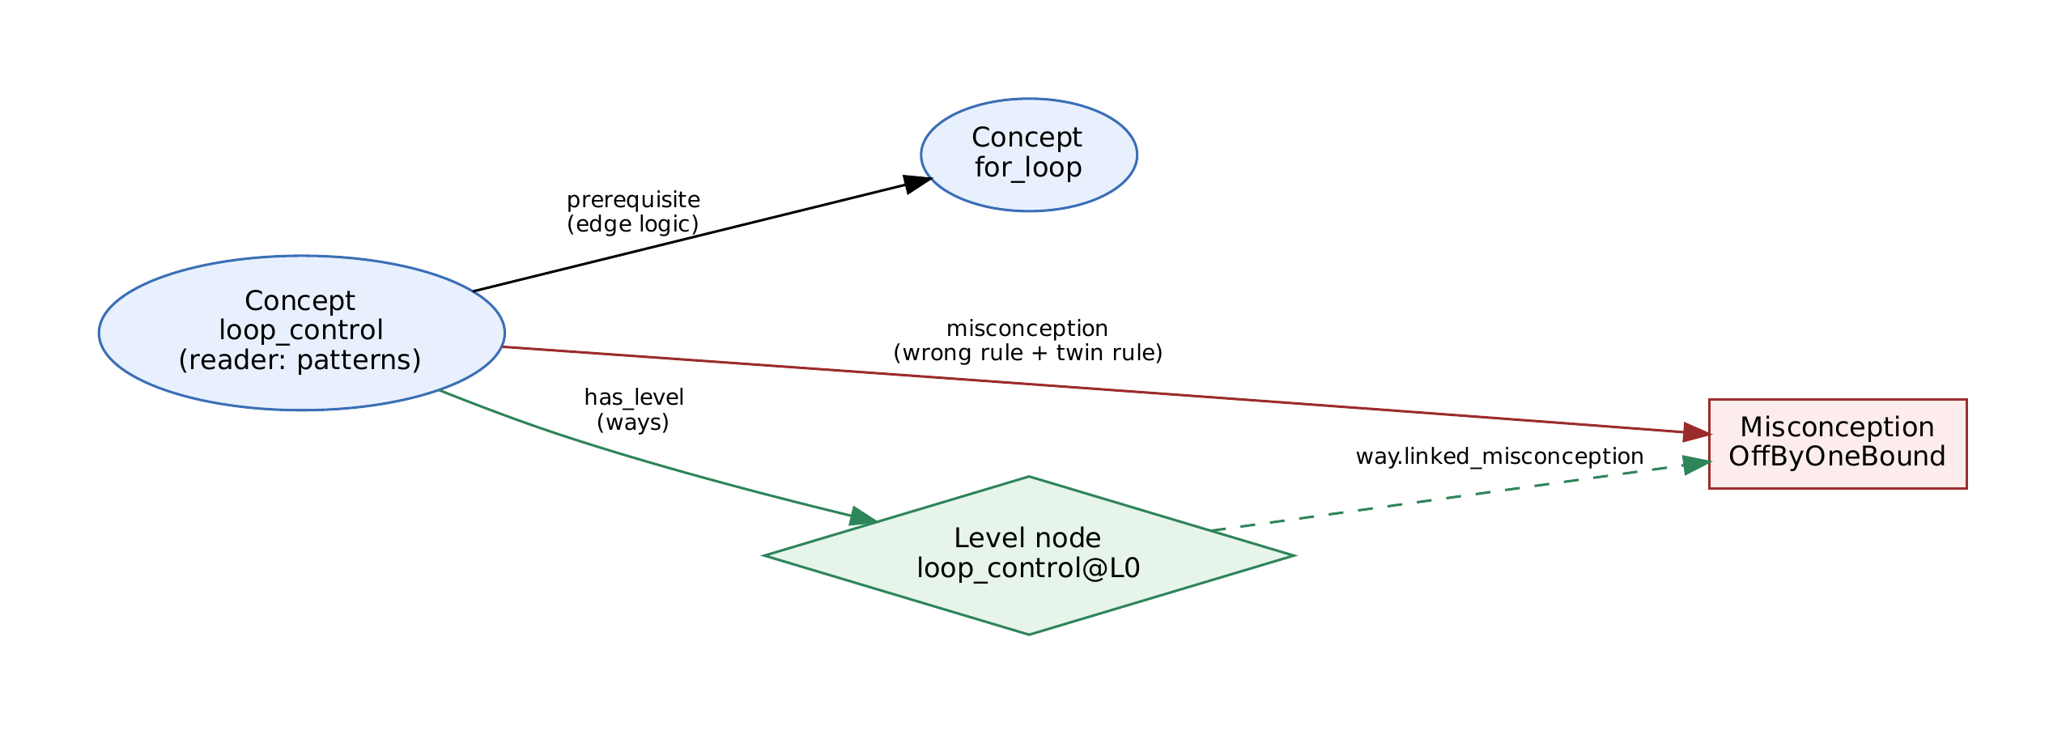
Dataset: the knowledge graph
Covers Chapter 1 of Sedgewick and Wayne, Introduction to Programming in Java: 6 sections, 36 topics, 173 concepts.
207 prerequisite and 34 parallel edges. Each edge carries its logic, a sentence saying why the relation holds.
296 misconceptions and errors on 569 edges. Each edge gives the wrong rule and the correct twin rule; 294 cite the literature or the textbook.
Five level nodes per concept, L0 to L4 (865 in total), with 3,079 ways that say what a student at that level says. 736 ways name a misconception, so a held misconception points straight to a level.
Each concept also stores its own code patterns: 166 concepts with 359 regular expressions.
A concept, a prerequisite edge, a misconception with its wrong and right rule, and the L0 level node that links to it.

Slide 9
Dataset: the scenarios
Taken from the repository file data/raw/scenarios_20.json: 10 scenarios plus one reference case (S000).
  S001, S007, S008, S021, S026, S047, S052, S057, S134, S137
Each scenario has Java code, a question about it, and a student's answer.
They are hard cases on purpose: answers that correct themselves, answers that are right by coincidence, and answers in non-native English.
The code of each scenario shows the concepts the question is about, so Stage 1 can be run on the code alone.
Stage 1 reads only the code. The question and the student's answer are the input to Stage 2.

Slide 10
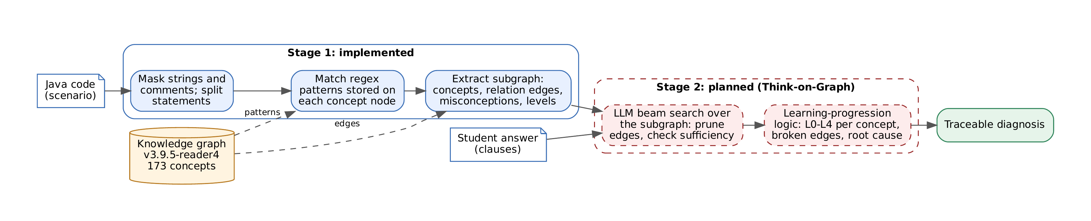
Methodology: two stages
Stage 1 (implemented): read the code, run each concept node's own patterns, and take the matching concepts with their edges, misconceptions and levels out of the graph. The result is a small subgraph for the item.
Stage 2 (planned): an LLM walks that subgraph in the Think-on-Graph way, keeping only the edges that the student's sentences use. Rules stored in the graph then turn the matched edges into a level per concept and a root cause.
No training is needed for either stage: Stage 1 uses stored patterns, and Stage 2 uses prompts with a few worked examples.

Slide 11
Stage 1: how the code works
mask.py
Blanks the text inside strings and comments so that words in them are not read as code, and splits the code into statements without cutting a for header apart.
tagger.py
Goes through the concept nodes and runs each node's own patterns on the code: regular expressions, structural signals such as a for inside another loop, operators, Java types and shell commands. A concept is tagged only by its own patterns.
extract.py
Keeps a generic concept such as statement only when an edge ties it to a specific one, then reads from the graph the edges between the concepts, their misconceptions, their level nodes and the links between levels and misconceptions.
report.py and results.py
Print one line of counts per scenario, and draw the figures and tables. The Python code contains no concept names: to change what is tagged, the graph is edited, not the program.

Slide 12
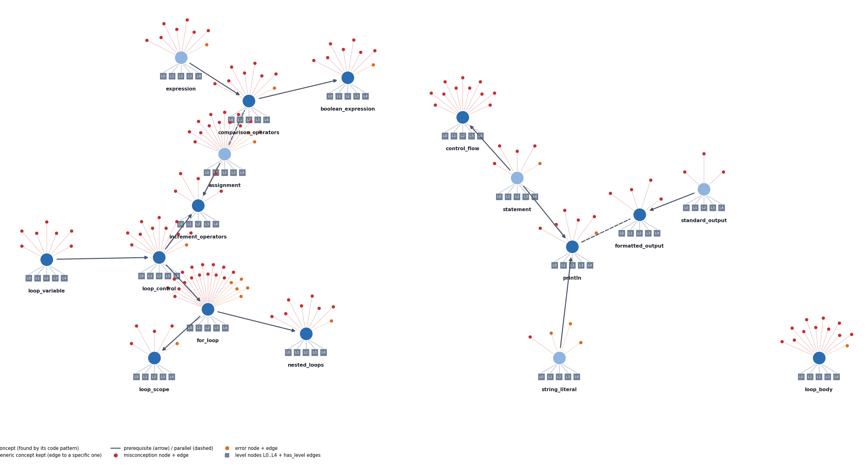
Example: scenario S007
for (int i = 3; i >= 0; i--) {
for (int j = i; j > 0; j--) {
System.out.printf("%d ", j);
}
System.out.println();
}
Student: "3 2 1 / 2 1 / 1 (no empty line at the end), because the loop stops at 1."
for_loop is tagged by the pattern "for (", loop_control by the for_header signal, and nested_loops by the nested_for signal.
println and formatted_output are tagged by System.out.println( and .printf(.
The subgraph has 17 concepts, 14 edges and 141 misconception edges in three pieces. It contains loop_control -> for_loop -> nested_loops and the misconception OffByOneBound.

Slide 13
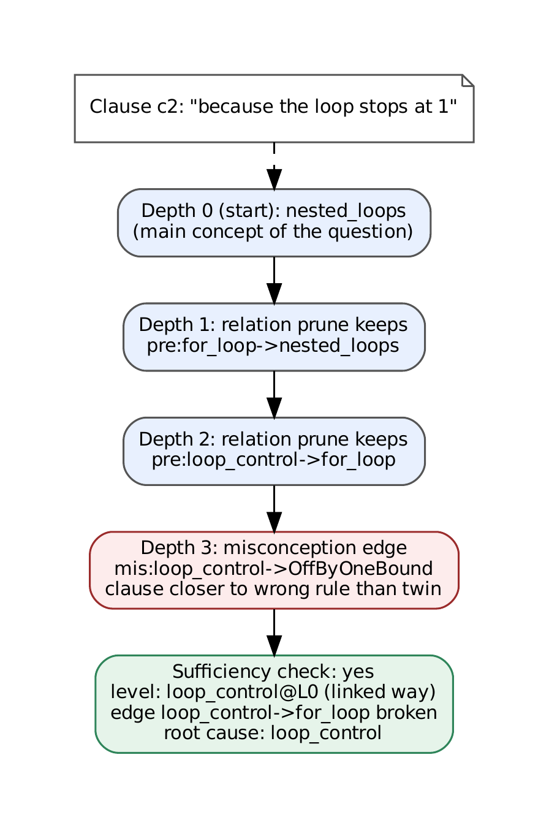
Stage 2 (planned): Think-on-Graph over the subgraph
Start at the item's main concepts. At each step the LLM looks at the edges of the subgraph around the current concepts and keeps the ones the student's sentence uses (beam width 3, up to 3 steps).
After each step it checks whether it has enough to judge the sentence. At most 22 LLM calls per sentence.
Paths are written as ordered text (node, edge logic, node), and only edges that exist in the graph are shown.
Rules from the graph turn the matches into levels:
  the sentence is closer to a misconception's wrong rule than to its right rule, and the code agrees: the misconception is held, and its linked way gives L0;
  the sentence states an edge's logic correctly: the edge is confirmed; an edge whose end holds a misconception is broken;
  the root cause is the first broken edge going up the prerequisites.

Slide 14
Evaluation plan: output, metric and validation
Output for each student answer
The overall level, a level per concept (L0-L4), the misconceptions held, the root-cause concept, and for each verdict the path in the graph that supports it.
Result metric: Hwang et al., Findings of EMNLP 2025
Each edge and misconception in the subgraph is labelled correct (confirmed edge), incorrect (broken edge or held misconception) or not applied (not used by the student). Knowledge precision, knowledge recall and F1 compare the system's labels with the expert's. Exact-match accuracy of the level, misconception and root cause is reported as in Think-on-Graph (Hits@1).
Validation: Zheng et al., NeurIPS 2023
Expert labels are the reference. If an LLM labels edges at scale, its agreement with the expert labels (percent agreement and Cohen's kappa) is reported first, and its known biases are reduced: edges are shown in shuffled order, temperature is 0, and a different model family judges than reasons.

Slide 15
Results so far: Stage 1 on the 10 scenarios
Scenario | Concepts | Concept edges | Misconception edges | Level nodes
S001 | 4 | 5 | 18 | 20
S007 | 17 | 14 | 141 | 85
S008 | 19 | 16 | 141 | 95
S021 | 12 | 10 | 87 | 60
S026 | 2 | 1 | 17 | 10
S047 | 2 | 1 | 7 | 10
S052 | 8 | 7 | 17 | 40
S057 | 26 | 22 | 167 | 130
S134 | 2 | 1 | 17 | 10
S137 | 4 | 5 | 18 | 20
Every scenario gets a subgraph; the repository report prints "fully covered: 10 / 10".
A subgraph has 2 to 26 concepts, 9.6 on average.
It holds 63 of the graph's 569 misconception edges on average, about 11%, so the reasoner checks a small set.
Five of the ten subgraphs split into 2 to 4 pieces, so the traversal needs several starting points.
All 208 tests pass in 2.3 seconds, including 372 snippets that must or must not tag each of the 166 code-visible concepts.

Slide 16
Findings and limitations
Findings
Limitations
The code alone is enough to build the subgraph for these items.
The subgraph narrows the search to about a tenth of the graph.
Longer code (loops, arrays, output) gives larger subgraphs that split into pieces.
The level-to-misconception links come with the subgraph, so Stage 2 needs no extra lookup.
10 hand-picked edge cases and one reference case, not a random sample: this shows feasibility, not accuracy.
The graph covers one chapter of one textbook.
Items whose concepts appear only in the student's answer are left to Stage 2.
The reasoning stage is not built yet, so RQ2 to RQ4 have no results.

Slide 17
Remaining work and timeline
Week | Work
Nov 2-8 | Split answers into sentences; write the Think-on-Graph prompts; run S007 end to end
Nov 9-15 | Run the traversal on all 10 scenarios; log paths and LLM calls
Nov 16-22 | Level rules and root cause; knowledge precision, recall, F1 and exact match
Nov 23-29 | Baselines: the same LLM without the graph, and a single-call version; ablations; five reruns
Nov 30-Dec 6 | Second annotator and agreement; check the LLM judge against expert labels; error analysis
Dec 7-13 | Final paper, slides and repository
Risks: limited LLM access (fall back to an open model), small data (report per scenario with bootstrap intervals), label validity (second annotator), non-determinism (temperature 0, five reruns).

Slide 18
References
Alonzo, Steedle. Developing and assessing a force and motion learning progression. Science Education 93(3), 2009.
Biggs, Collis. Evaluating the Quality of Learning: The SOLO Taxonomy. Academic Press, 1982.
Caceffo et al. Identifying and validating Java misconceptions toward a CS1 concept inventory. ITiCSE 2019.
Chen et al. PathRAG: Pruning graph-based RAG with relational paths. AAAI 2026.
Chiodini et al. A curated inventory of programming language misconceptions. ITiCSE 2021.
Clear et al. Reliably classifying novice programmer exam responses using the SOLO taxonomy. NACCQ 2008.
Corbett, Anderson. Knowledge tracing. User Modeling and User-Adapted Interaction 4(4), 1994.
du Boulay. Some difficulties of learning to program. J. Educational Computing Research 2(1), 1986.
Fowler et al. Autograding explain-in-plain-English questions using NLP. SIGCSE 2021.
Hwang et al. Assessing LLM reasoning steps via principal knowledge grounding. Findings of EMNLP 2025.
Jin et al. A validation framework for science learning progression research. IJSE 41(10), 2019.
Jin, Lima, Wang. Automated scoring in learning progression-based assessment. EM:IP 44(3), 2025.
Kaczmarczyk et al. Identifying student misconceptions of programming. SIGCSE 2010.
Krajcik, Shin. Student conceptions, conceptual change, and learning progressions. Handbook of Research on Science Education III, 2023.
Lehtinen et al. Students struggle to explain their own program code. ITiCSE 2021.
Liffiton et al. CodeHelp: LLMs with guardrails for scalable support. Koli Calling 2023.
Lister et al. A multi-national study of reading and tracing skills in novice programmers. SIGCSE Bulletin 36(4), 2004.
Lister et al. Not seeing the forest for the trees: novice programmers and the SOLO taxonomy. ITiCSE 2006.
Luo et al. Reasoning on Graphs: faithful and interpretable LLM reasoning. ICLR 2024.
Ma et al. Investigating the viability of mental models held by novice programmers. SIGCSE 2007.
Nair, Ramasamy. Learning progressions and LLMs for assessing code comprehension: a scoping review. Under review.
Pea. Language-independent conceptual bugs in novice programming. J. Educational Computing Research 2(1), 1986.
Piech et al. Deep knowledge tracing. NeurIPS 2015.
Prather et al. The robots are here: navigating the generative AI revolution in computing education. ITiCSE-WGR 2023.
Qian, Lehman. Students' misconceptions in introductory programming: a literature review. TOCE 18(1), 2017.
Schulte. Block Model: an educational model of program comprehension. ICER 2008.
Sedgewick, Wayne. Introduction to Programming in Java, 2nd ed. Addison-Wesley, 2017.
Sun et al. Think-on-Graph: deep and responsible reasoning of LLM on knowledge graph. ICLR 2024.
Wilson. Measuring progressions: assessment structures underlying a learning progression. JRST 46(6), 2009.
Zhang et al. An LLM-based framework for simulating, classifying, and correcting students' programming knowledge with the SOLO taxonomy. SIGCSE TS 2025.
Zheng et al. Judging LLM-as-a-judge with MT-Bench and Chatbot Arena. NeurIPS 2023.

