Slide 1
FLOOD MONITORING AND EARLY WARNING SYSTEM

Slide 2
INTRODUCTION
Flood monitoring and early warning systems are crucial components of disaster management, designed to mitigate the devastating impacts of floods. These systems involve the continuous surveillance of various environmental factors, such as rainfall, river levels, and weather conditions, to detect potential flood events. When certain thresholds are exceeded or specific patterns are identified, alerts are issued to authorities and communities at risk, enabling them to take proactive measures to protect lives and property. The effectiveness of flood monitoring and early warning systems relies on advanced technology, real-time data analysis, and efficient communication channels to provide timely and accurate information to those in harm's way, ultimately saving lives and reducing the socio-economic impact of flooding disasters

Slide 3
ABSTRACT
This. abstract explores the critical importance of flood monitoring and early warning systems in reducing the impact of these disasters.
Effective flood management relies on the integration of advanced technologies, including remote sensing, meteorological data, and real-time monitoring networks.
This paper delves into the key components of a comprehensive flood monitoring system, encompassing data collection, analysis, and dissemination. It highlights the significance of accurate and timely data in predicting flood events, allowing authorities to issue early warnings to at-risk populations. Furthermore, the paper discusses the role of community engagement and preparedness in ensuring the effectiveness of such systems.

Slide 4
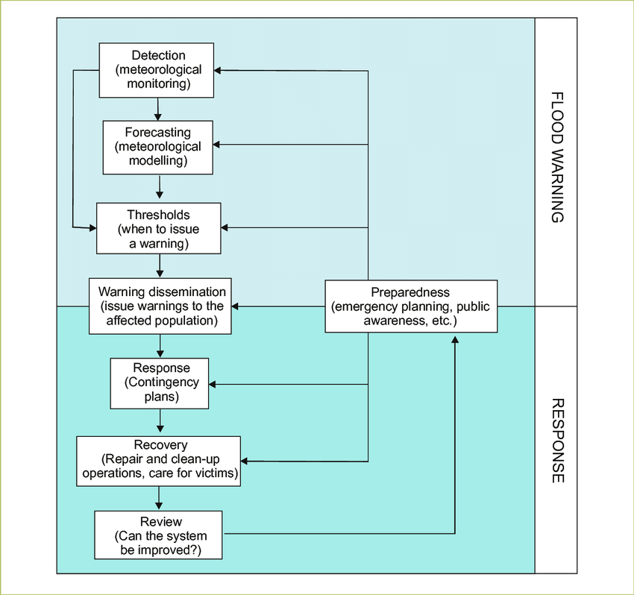
DESIGN

Slide 5
DETECTION FLOOD MONITORING
The flood monitoring and detection system are important to minimize flood damage costs because the cost of damaged caused by the floods is correlated closely with the period of warning given before the flood event occurred. Because of this, the purpose of this project is to design and develop a flood monitoring and detection system using the Internet of Thing (IoT).

Slide 6
FORECASTING IN FLOOD MONITORING
Flood monitoing forecasting typically involves the use of various data sources and models to predict potential floods.
Hydrological data
Weather data
Historical data
Hydraulic models
Remote sensing
Machine learning and AI

Slide 7
THERSHOLDS IN FLOOD MONITORING
Threshold flood monitoring involves setting specific water level threshold in rivers other water bodies
When the water level surpasses these threshold, it triggers alerts or action to mitigate potential dlooding.
This is often used in flood warning system to provide early warnings to communities at risk.

Slide 8
WARNING DISSEMINATION IN FLOOD MONITORING
Warning dissemination in flood monitoring is a crucial aspect of public safety it involves the timely and effective communication of flood related information to potentially affected individuals and communities.
Here are some key point related to warning dissemination in flood monitoring.
Early Warning System .Multiple communication channels
Localized alerts .Clear and actionable information
Community engagement .Regular testing

Slide 9
RESPONSE N FLOOD MONITORING
In flood monitoring it’s essential to have real time data from various sources such as weather stations river gauges and remote sensors.
Additionally, GIS(Geographic Information System) technology can help visualize flood prone areas and plan evacuation routes.
Regular communication with the public through emergency broadcasts and mobile apps is crucial for keeping people informed and safe during flood events.

Slide 10
RECOVERY IN FLOOD MONITORING
Recovery in flood monitoring typically involves assessing the damage, restoring monitoring equipment, and improving warning systems.
It may also include data analysis to better prepare for future floods.

Slide 11
REVIEW IN FLOOD MONITORING
Flood monitoring is a crucial component of disaster management and environmental protraction.
It involves the systematic observation , measurement and anslysis of various factors related to flooding.
Here’s abrief review of flood monitoring,

Slide 12
CONCLUSION
Flood monitoring is crucial for early warning and disaster management. It involves the use of various technologies like remote sensing, weather forecasts, and river gauges to assess flood risks.
Effective flood monitoring can save lives and reduce property damage by providing timely alerts and information to authorities and the public.
Continuous advancements in technology and data analysis are improving the accuracy and efficiency of flood monitoring systems, making them increasingly important in the face of climate change and growing urbanization.

Slide 13
THANK YOU

