Slide 1
COURSE MATERIALS
Week 7
Adaptive Learning Rate
Optimizers
OPT
From SGD to Adam, RMSprop, Adadelta and Adagrad
LECTURE + HANDS-ON CODE | TensorFlow / Keras
DEEP LEARNING FOUNDATIONS
01

Slide 2
01 · OUTCOMES
By the end, students will be able to…
Explain what a learning rate controls during training.
Distinguish standard SGD from per-parameter adaptive updates.
Replace ONE optimizer constructor in tf.keras code.
Compare ANN, MLP and CNN models using validation curves.
Report results without claiming every adaptive method must win.
DEEP LEARNING FOUNDATIONS
02

Slide 3
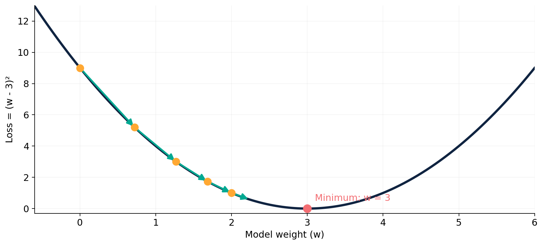
01 · CONCEPTS
What does an optimizer do?
Training seeks weights that reduce an objective (loss).
Gradient update
w_next = w - η × g
η = learning rate
g = estimated gradient
Illustrative quadratic loss, not a measured neural-network experiment.
DEEP LEARNING FOUNDATIONS
03

Slide 4
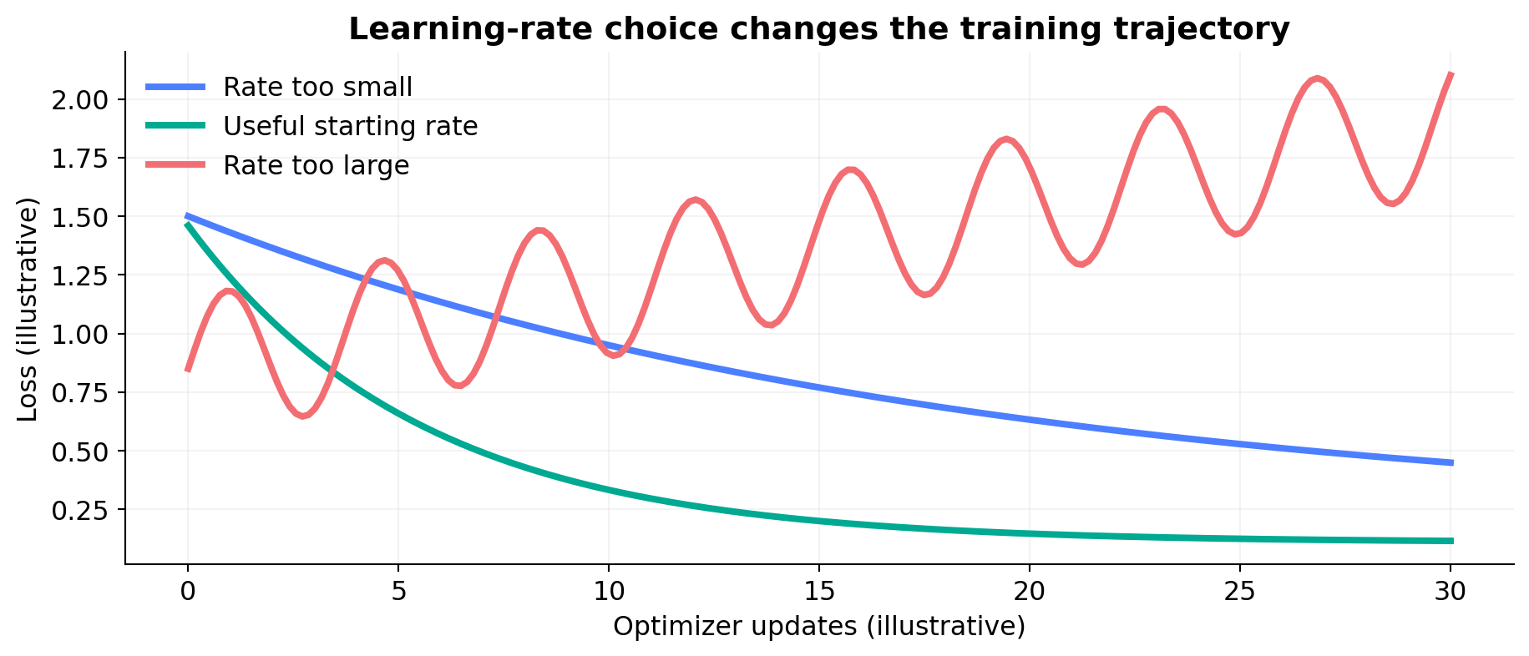
01 · INTUITION
Choosing the learning rate
Too small can learn slowly; too large can oscillate or diverge.
Curves are conceptual examples, not accuracy or loss from the lab.
DEEP LEARNING FOUNDATIONS
04

Slide 5
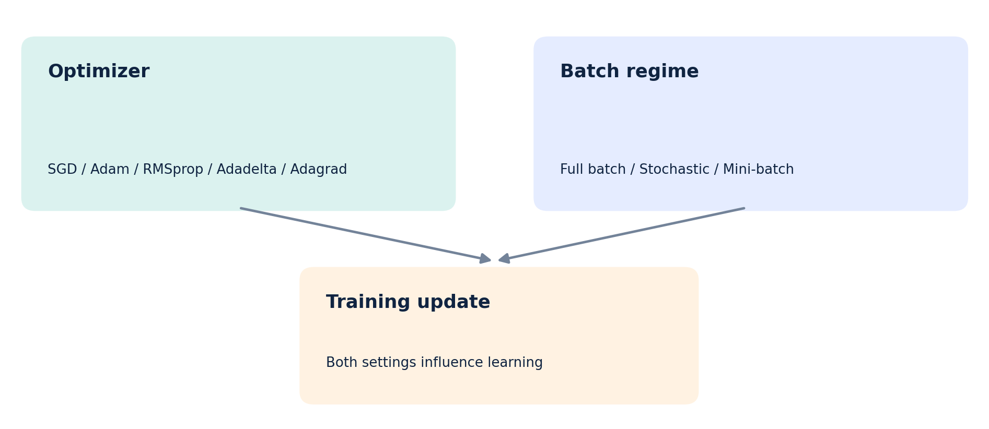
01 · FOUNDATIONS
Two independent training decisions
Adam is an optimizer; mini-batch is a choice of training batch size. They can be used together.
DEEP LEARNING FOUNDATIONS
05

Slide 6
01 · LIVE CODING
The exact Keras syntax
Capitalization matters in Python; SGD is not SDG.
tf.keras.optimizers.SGD(learning_rate=0.01)
tf.keras.optimizers.Adam(learning_rate=0.001)
tf.keras.optimizers.RMSprop(learning_rate=0.001)
tf.keras.optimizers.Adadelta(learning_rate=1.0)
tf.keras.optimizers.Adagrad(learning_rate=0.01)
These are explicit classroom starting values, not claims about the current API defaults.
DEEP LEARNING FOUNDATIONS
06

Slide 7
01 · ALGORITHM
SGD: our nonadaptive baseline
Core update
Strength
Limitation
w ← w − ηg
The global η is shared; gradients change across training.
Simple and widely useful; learning-rate schedules and momentum can help.
May require more careful tuning and can oscillate in steep directions.
Code: tf.keras.optimizers.SGD(learning_rate=0.01)
DEEP LEARNING FOUNDATIONS
07

Slide 8
01 · ALGORITHM
Adagrad: remember every squared gradient
Gₜ = Gₜ₋₁ + gₜ²
wₜ₊₁ = wₜ − η × gₜ / (√Gₜ + ε)
Adapts the step size separately for each parameter.
Accumulated squared gradients make later updates smaller.
Often associated with sparse-feature problems; steps can shrink too far.
DEEP LEARNING FOUNDATIONS
08

Slide 9
01 · ALGORITHM
RMSprop: use a moving window
vₜ = ρvₜ₋₁ + (1 − ρ)gₜ²
wₜ₊₁ = wₜ − η × gₜ / (√vₜ + ε)
Replaces Adagrad’s ever-growing accumulator with an exponential average.
Adjusts learning rates by recently observed squared gradients.
Often useful for noisy or nonstationary gradients.
DEEP LEARNING FOUNDATIONS
09

Slide 10
01 · ALGORITHM
Adadelta: scale updates adaptively
E[g²]ₜ = ρE[g²]ₜ₋₁ + (1−ρ)gₜ²
Δwₜ = − RMS[Δw]ₜ₋₁ / RMS[g]ₜ × gₜ
Tracks running averages of both gradient squares and update squares.
Designed to avoid continuously shrinking Adagrad steps.
The original-form configuration often uses learning_rate=1.0.
DEEP LEARNING FOUNDATIONS
10

Slide 11
01 · ALGORITHM
Adam: momentum + adaptive scaling
mₜ = β₁mₜ₋₁ + (1−β₁)gₜ [mean]
vₜ = β₂vₜ₋₁ + (1−β₂)gₜ² [square]
w ← w − η × m̂ₜ / (√v̂ₜ + ε) [bias-corrected]
Tracks both a gradient average and a squared-gradient average.
Common general-purpose starting point; not always best on every task.
DEEP LEARNING FOUNDATIONS
11

Slide 12
01 · COMPARISON
What changes between the five algorithms?
Algorithm | Main idea | Practical observation
SGD | One global base rate | Simple control; often needs tuning
Adagrad | Accumulate squared gradients | Effective rates can shrink over time
RMSprop | Moving average of squares | Responds to recent scale
Adadelta | Running gradients and updates | Adaptive step magnitude
Adam | Momentum + squared gradients | Strong general baseline
All may need learning-rate tuning; no universally superior optimizer.
DEEP LEARNING FOUNDATIONS
12

Slide 13
01 · PROTOCOL
How to make a fair optimizer comparison
Use exactly the same training, validation and test subsets.
Keep architecture, preprocessing, epochs and batch size constant.
Start from identical model weights for each optimizer.
Choose the “best” using validation data, not the test set.
Record accuracy, loss, training time and the learning rate.
DEEP LEARNING FOUNDATIONS
13

Slide 14
01 · LAB 1
Lab 1 | ANN and MLP on MNIST
Two fully connected architectures; five optimizers each.
ANN · 1 hidden
MLP · 2 hidden
28×28 → Flatten → Dense(64) → Dense(10)
28×28 → Flatten → Dense(128) → Dense(64) → Dense(10)
A shallow ANN here is also a multilayer perceptron; “MLP” labels the deeper network.
Report 10 results: 2 architectures × 5 optimizers.
DEEP LEARNING FOUNDATIONS
14

Slide 15
01 · LAB 1
Lab 1 | Change this ONE line
optimizer = tf.keras.optimizers.SGD(learning_rate=0.01)
# Then choose Adam / RMSprop / Adadelta / Adagrad
model.compile(optimizer=optimizer,
loss="sparse_categorical_crossentropy",
metrics=["accuracy"])
Keep all other settings unchanged for the initial comparison.
DEEP LEARNING FOUNDATIONS
15

Slide 16
01 · LAB 2
Lab 2 | CNN on Fashion-MNIST
Learn filters and image features before comparing optimizers.
Convolution
Classification
Comparison
Conv2D(16) → Pool → Conv2D(32) → Pool
Flatten → Dense(32) → Dense(10)
SGD / Adam / RMSprop / Adadelta / Adagrad
CNN input has shape (28, 28, 1); keep architecture fixed across all 5 runs.
DEEP LEARNING FOUNDATIONS
16

Slide 17
01 · LAB OUTPUTS
What should the students submit?
A working .py or Colab notebook with commented code.
A CSV/table of measured validation and test accuracy.
A validation-accuracy line graph for each model.
A 150-word interpretation comparing convergence and time.
One limitation: fixed rates and short runs do not prove universal rankings.
DEEP LEARNING FOUNDATIONS
17

Slide 18
01 · DISCUSSION
Short classroom check
Why should each optimizer start from the same weights?
Does an optimizer automatically change the batch size?
Can Adagrad initially do well and then slow down?
Why might a small test-accuracy difference be meaningless?
What would you tune next: rate, epochs, or regularization?
DEEP LEARNING FOUNDATIONS
18

Slide 19
01 · SOURCES
Further reading and reference links
Official documentation and teaching references
• Keras Optimizers
https://keras.io/api/optimizers/
• Adam API
https://keras.io/api/optimizers/adam/
• Adadelta API
https://keras.io/api/optimizers/adadelta/
• Fashion-MNIST tutorial
https://www.tensorflow.org/tutorials/keras/classification
• CNN tutorial
https://www.tensorflow.org/tutorials/images/cnn
DEEP LEARNING FOUNDATIONS
19

