Slide 1
COURSE MATERIALS
LECTURE 08
Gradient Descent
Techniques
GD
Batch vs stochastic vs mini-batch: one line of fit() code
LECTURE + HANDS-ON CODE | TensorFlow / Keras
DEEP LEARNING FOUNDATIONS
01

Slide 2
02 · OBJECTIVES
Learning outcomes
Explain weights, gradients, loss and one training update.
Compute updates per epoch from dataset size and batch size.
Visualize why stochastic trajectories look noisy.
Change batch_size while keeping SGD and its rate fixed.
Compare full-batch, stochastic and mini-batch using three models.
DEEP LEARNING FOUNDATIONS
02

Slide 3
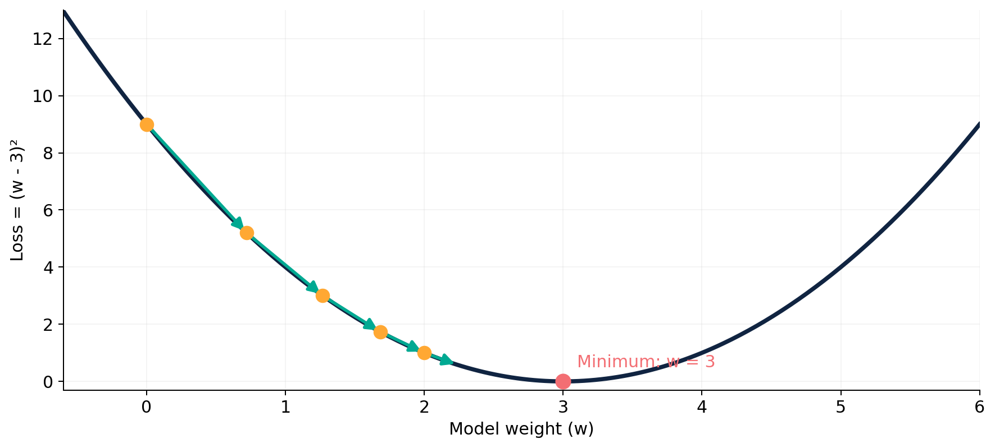
02 · INTUITION
Gradient descent: follow the downhill direction
Rule
w ← w − ηg
Repeat until
loss is low
The example shows a convex one-parameter loss function.
DEEP LEARNING FOUNDATIONS
03

Slide 4
02 · MATH
Work one update by hand
Loss: L(w) = (w − 3)²
Gradient: dL/dw = 2(w − 3)
Start: w = 0, η = 0.1
Update: w_new = 0 − 0.1 × (−6) = 0.6
Check: L(0) = 9 and L(0.6) = 5.76 → loss decreases.
DEEP LEARNING FOUNDATIONS
04

Slide 5
02 · MATH
Where does the gradient estimate come from?
Full batch: g = mean(gradients of ALL N examples)
Stochastic: g = gradient of ONE example
Mini-batch: g = mean(gradients of B examples)
Optimizer = the update rule (we hold SGD fixed in Lab 3).
Batch size = how many samples enter one update.
DEEP LEARNING FOUNDATIONS
05

Slide 6
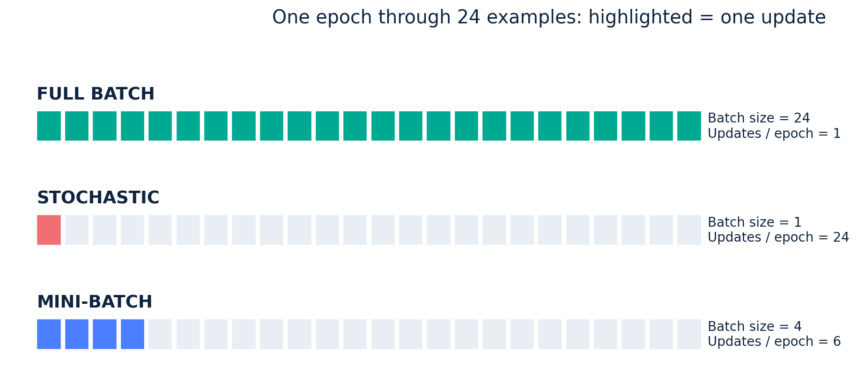
02 · VISUALIZATION
Example: 24 training examples in one epoch
All 24 examples are seen each epoch; the number of parameter updates differs.
DEEP LEARNING FOUNDATIONS
06

Slide 7
02 · TECHNIQUE
1 | Full-batch gradient descent
Batch size
Update frequency
Trade-off
B = N (use the entire training set)
One optimizer update per epoch
Stable gradient estimate, but large batches can use more memory.
DEEP LEARNING FOUNDATIONS
07

Slide 8
02 · TECHNIQUE
2 | Stochastic gradient descent
Batch size
Update frequency
Trade-off
B = 1 (one training example)
N updates per epoch
Noisier gradients; many small updates can be slow.
DEEP LEARNING FOUNDATIONS
08

Slide 9
02 · TECHNIQUE
3 | Mini-batch gradient descent
Batch size
Update frequency
Trade-off
1 < B < N (e.g., B = 32)
ceil(N / B) updates per epoch
Common compromise between efficiency and noisy gradients.
DEEP LEARNING FOUNDATIONS
09

Slide 10
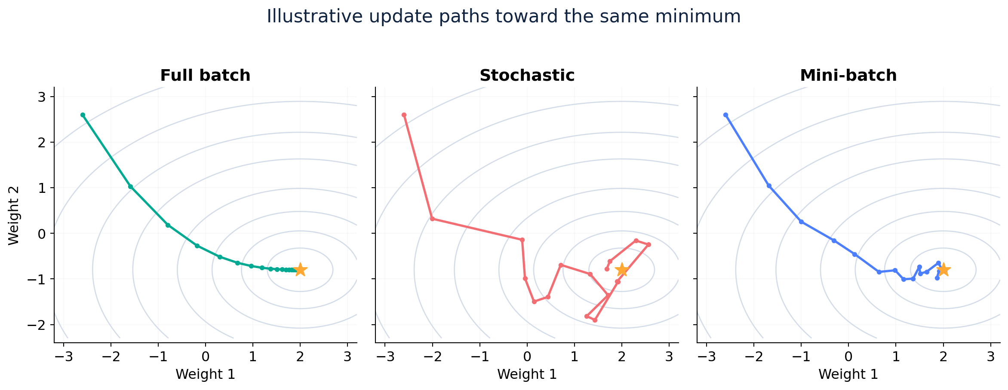
02 · ILLUSTRATION
Different paths toward the same objective
A conceptual picture: stochastic steps wander more.
Schematic optimization paths generated for a quadratic objective; not experimental CNN results.
DEEP LEARNING FOUNDATIONS
10

Slide 11
02 · COMPARE
Compare the three sampling approaches
Technique | Batch size | Updates per epoch | Typical gradient variance
Full batch | N | 1 | Lower
Stochastic | 1 | N | Higher
Mini-batch | B, with 1 < B < N | ceil(N / B) | Intermediate
Exact runtime and generalization depend on the model, hardware and hyperparameters.
DEEP LEARNING FOUNDATIONS
11

Slide 12
02 · ARITHMETIC
How many updates? N = 600 and E = 3
Technique | batch_size | Updates/epoch | Total updates (3 epochs)
Full batch | 600 | 1 | 3
Stochastic | 1 | 600 | 1,800
Mini-batch | 32 | ceil(600/32) = 19 | 57
Important: same number of epochs ≠ same number of weight updates.
DEEP LEARNING FOUNDATIONS
12

Slide 13
02 · LIVE CODING
Change batch size in ONE line
optimizer = tf.keras.optimizers.SGD(learning_rate=0.02)
model.fit(x_train, y_train, epochs=3, batch_size=600) # Full
model.fit(x_train, y_train, epochs=3, batch_size=1) # SGD
model.fit(x_train, y_train, epochs=3, batch_size=32) # Mini
Train from newly initialized / reset weights each time. Do NOT call fit() three times on one continuing model.
DEEP LEARNING FOUNDATIONS
13

Slide 14
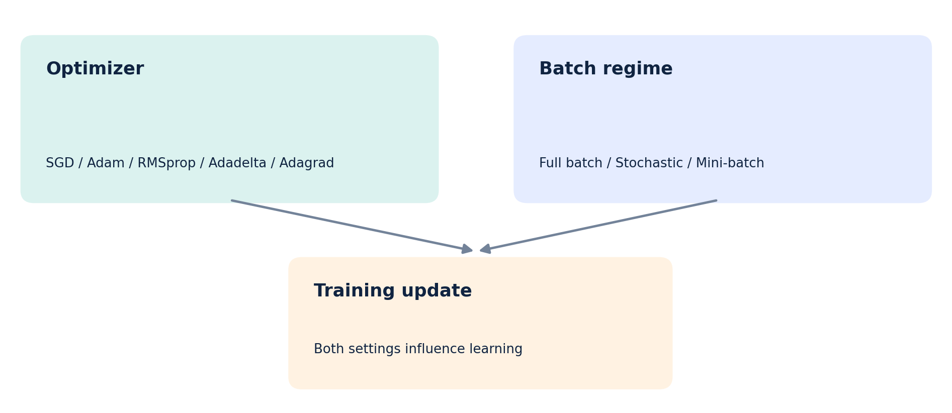
02 · DISTINCTION
Avoid mixing optimizer and sampling regime
Keras calls the optimizer “SGD” even when fit(batch_size=600) gives full-batch updates.
DEEP LEARNING FOUNDATIONS
14

Slide 15
02 · LAB 3
Lab 3: one experiment, three architectures
ANN
MLP
CNN
Flatten → 64 → 10
Flatten → 128 → 64 → 10
Conv → Pool → Conv → Pool → Dense
All architectures use the same Fashion-MNIST subsets and fixed SGD learning rate = 0.02.
DEEP LEARNING FOUNDATIONS
15

Slide 16
02 · LAB 3
Lab 3 workflow for 9 training runs
Choose a model (ANN, MLP or CNN).
Record one set of starting weights for that model.
Reset model weights; train batch_size = 600.
Reset again; train batch_size = 1, then 32.
Repeat across models and export CSV + accuracy graphs.
DEEP LEARNING FOUNDATIONS
16

Slide 17
02 · RESULTS
What makes the comparison meaningful?
Model | Method | Updates/epoch | Best val accuracy | Test accuracy
ANN | Full / SGD / Mini | 1 / 600 / 19 | Record | Record
MLP | Full / SGD / Mini | 1 / 600 / 19 | Record | Record
CNN | Full / SGD / Mini | 1 / 600 / 19 | Record | Record
Interpret: at equal epochs, update count differs. A lower accuracy is not proof a method is generally worse.
DEEP LEARNING FOUNDATIONS
17

Slide 18
02 · PRACTICE
Ask students to explain, not guess
Why is the stochastic path noisier than the batch path?
Which method uses one update for an entire epoch?
Why can “fastest in epochs” differ from “fastest in seconds”?
What would change in a matched-update comparison?
Why must the CNN receive shape (N, 28, 28, 1)?
DEEP LEARNING FOUNDATIONS
18

Slide 19
02 · REFERENCES
Further reading and reference links
Official documentation and teaching references
• Google ML Crash Course
https://developers.google.com/machine-learning/crash-course/linear-regression/hyperparameters
• Google ML Glossary
https://developers.google.com/machine-learning/glossary/fundamentals
• Keras training API
https://keras.io/api/models/model_training_apis/
• Keras Optimizer API
https://keras.io/api/optimizers/
• TensorFlow Fashion-MNIST
https://www.tensorflow.org/tutorials/keras/classification
DEEP LEARNING FOUNDATIONS
19

