Slide 1
FlowPic: A Generic Representation for Encrypted
Trafﬁc Classiﬁcation and Applications Identiﬁcation
Presentation By:
Mr. Hasib Shamshad

Slide 2
The Growing Challenge of Internet Traffic Classification
The Problem: The surge of encrypted traffic (VPNs, Tor) makes traditional monitoring ineffective (blind).
Traditional Solution:
  Extract handcrafted statistical features from traffic flows (e.g., packet count, average size).
  Use supervised ML (SVM, KNN, Decision Trees etc.) for classification.
The Limitation: Feature-based models fail to capture modern encrypted traffic patterns

Slide 3
Introduction: A New Vision for Traffic Analysis
Why Classify Traffic?
  Enables network management & traffic engineering
  Critical for security to detect policy-violating applications.
  The Encryption Hurdle: VPNs and encryption hide the content, making identification very difficult.
Research Background → The Encryption Hurdle
Traffic classification enables traffic engineering and security policy enforcement. However, widespread use of encryption (VPN/TOR) undermines traditional methods relying on handcrafted statistical features and supervised learning (SVM, KNN, etc.).

Slide 4
Introduction: A New Vision for Traffic Analysis
Research Gap
Existing methods either rely on manual feature extraction (limited by encryption) or use non-intuitive flow images (e.g., Chen et al.’s auto-convolution approach).
No generic method leverages full time/size flow info for intuitive, accurate classification.
This Paper's Novel Idea:
classifying Internet trafﬁc into categories (VoIP, video, ﬁle transfer, chat and browsing) and for application identiﬁcation.
Transform a raw network flow into a 2D image ("FlowPic") using packet sizes and arrival times.
Use Convolutional Neural Network (CNN) to classify the FlowPic.
A generic approach for Internet trafﬁc classiﬁcation w.r.t time and size related information available in a network ﬂow, instead of using information from manually extracted features.

Slide 5
Framework
Data Acquisition
Sources: Public datasets from the University of New Brunswick (UNB).
Contains: Labeled traffic for categories like VoIP, Video, Chat, etc., under different encryption conditions (Non-VPN, VPN, Tor).
2. Data Pre-processing:
A unified dataset was created from five main traffic categories.
Raw packet capture (pcap) files were cleaned and split into individual, unidirectional "flows."

Slide 6
Methodology (cont..)
3. Sensitivity Analysis
The Problem: Raw network data is naturally imbalanced (some apps are used more than others).
The Solution: Random Undersampling to create a balanced dataset.
4. FlowPic Creation
For each flow, data points are extracted: {Packet Size, Arrival Time}.
These points are used to generate a 2D histogram, which becomes the "FlowPic" image for that flow.

Slide 7
Methodology (cont..)
5. FlowPic Exploration
Scatter Plot
Each packet becomes a point with (arrival_time, packet_size) coordinates
ii. 2D Binning
Time and size axes divided into discrete bins for quantization
iii. Image Creation
Bin counts become pixel intensities in 1500×1500 grayscale
6. Image Classification:
These generated FlowPic images are fed into a CNN to be trained and classified into traffic categories.

Slide 8
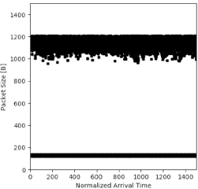
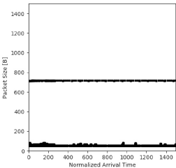
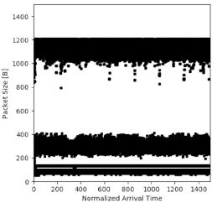
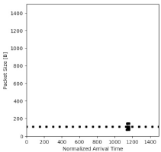
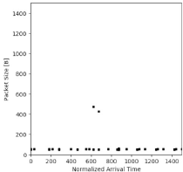
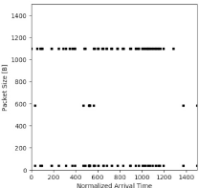
Non-VPN FlowPic Examples
Facebook
(Social Media)
Netflix
Google Hangouts
(VoIP Application)
VPN FlowPic Examples
Non-VPN: Chat
VPN: Chat
Tor: Chat

Slide 9
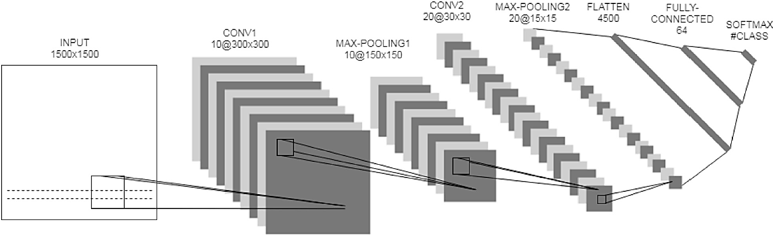
Methodology (cont..)
Input image
(1500x1500)
2 convolutional blocks (ReLU based)
2 Max-Pooling layers
1D Flattened layer
Fully-connected layer (ReLU based)
Output
(Softmax)
An LeNet-5 style CNN for FlowPic

Slide 10
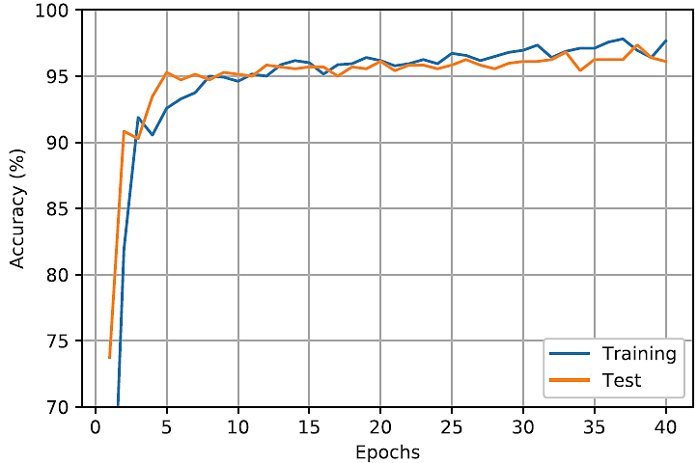
Methodology (cont..)
CNN Classification Specifications
Training set: 90%
Key hyperparameters include:
1280 samples per epoch
40 epochs of 10 batches
Early stopping technique
Categorical cross entropy as a cost function
Adam Optimizer (by default α =0.001)
Dropout in CONV2 and Fully-connected layers
(values: 0.25 & 0.5, respectively)
Time lapse: 5 to 10 minutes per epoch
Model Fitting Curve

Slide 11

Results (cont..)
The authors have used “Accuracy” as the performance metric for various trafﬁc categories
- Overall, the results are categorized in 2 parts, each contains 3 encryption techniques: non-VPN, VPN and Tor.
Three kinds of multiclass classiﬁcation are computed:
Trafﬁc categorization
Multiclass encryption techniques
Application identiﬁcation
Class vs. All
Contains samples of the speciﬁc trafﬁc category, and an equal number of samples of all other trafﬁc categories with an equal share(balanced dataset).

Slide 12
Results (cont..)
Multiclass encryption techniques - consists of 3 classes representing the encryption techniques; Non-VPN (contains only regular sessions), VPN and Tor.
Performance Evaluation(Accuracy):
Non-VPN - 85%
VPN – 98.4%
Tor – 67.8%

Slide 13
Results (cont..)
Merged Training Generalization
Non-VPN Performance : 88.2%
VPN Performance: 98.4%
Tor Performance: 67.8%

Slide 14
Results (cont..)
Encryption Techniques Classiﬁcation
Performance Evaluation(Accuracy):
Non-VPN – 91.8%
VPN – 66.4%
Tor – 97.7%

Slide 15
Results (cont..)
Application Identiﬁcation
Performance Evaluation(Accuracy):
Non-VPN – 99.7%
VPN – 100%
Tor – 44.3%

Slide 16
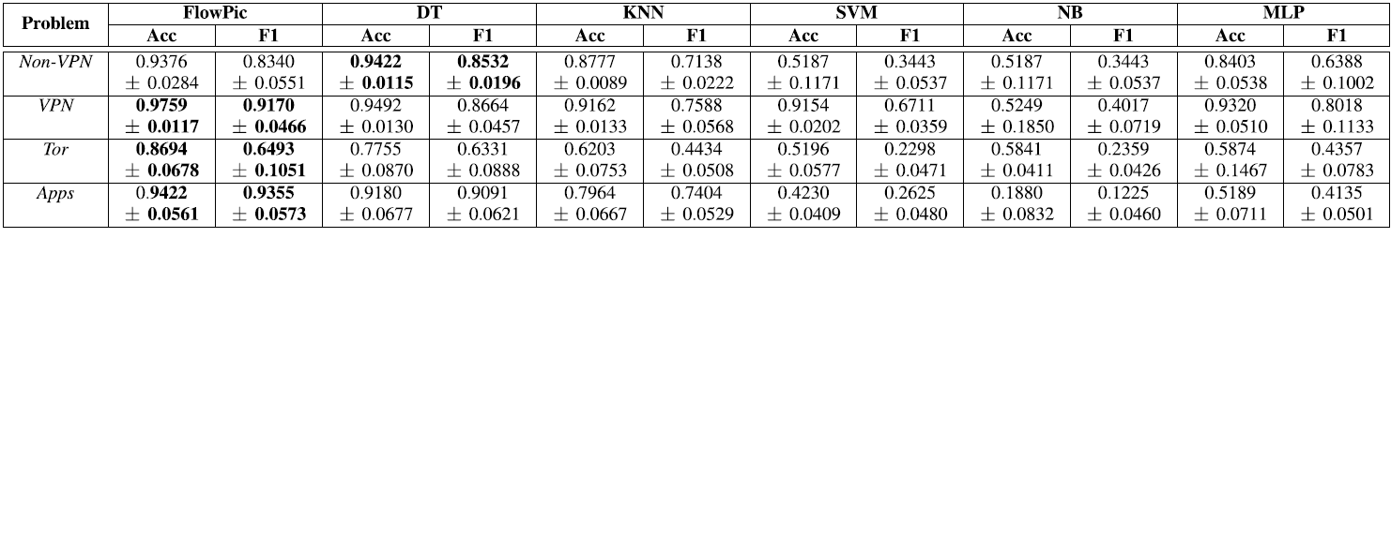
Comparative Analysis
FlowPic results comparison is done with 5 ML Classifiers

Slide 17
Limitations & Future Directions
Tor remains the most challenging regime.
Tor shows reduced accuracy over File transfer.
Chat-browsing overlap persists.
Future Directions:
Alternative CNN architectures, hyperparameter optimization
Image downsampling to ~300×300, 1-bit quantization
shorter time windows.

Slide 18
Our Remarks
Model Optimization: The CNN used default parameters.
Future work could optimize hyperparameters (layers, activation functions) and employ cross-validation to enhance performance and robustness.
Data Balance Technique: Using random undersampling risks losing data and overfitting. A promising alternative is using Generative AI (e.g., GANs) to create synthetic traffic samples for a richer, balanced dataset.
Efficiency & Scalability: Runtime and memory use could be reduced by tuning input parameters like FlowPic resolution and block length.

Slide 19
Our Remarks
Noted Omissions from the Paper
Missing standard ML evaluation curves (e.g., Model Fitting Curve) for direct comparison with other methods.
Lack of clarity and access regarding the final unified dataset used for training.

