Slide 1


Loan Approval Prediction
Machine Learning Project
Submitted By : Pandit Moses
Roll Number : 24R11A05CQ
Department : Computer Science and Engineering
College : Geethanjali College of Engineering and Technology
Academic Year : 2026 - 2027
Notes:
1

Slide 2
What is the Project
The goal is to predict whether an individual loan application will be approved or rejected using historical application data and supervised machine learning. This automated prediction supports consistent, fast underwriting decisions and reduces manual review workload.
Why it matters: banks and credit teams need reliable, auditable decision support to accelerate processing, reduce operational costs, and improve fairness by relying on consistent rules learned from past outcomes.
Notes:
2

Slide 3



The Data (Overview)
We analyzed 500 past loan applications. Each record contains core borrower and loan attributes used by underwriters to assess risk.
Sample Size
Key Features
Quality
500 loan applications, balanced preprocessing to avoid skew where possible.
Age, Income, Credit Score, Loan Amount, Employment History (tenure, type).
Dataset prepared and cleaned — missing values addressed, outliers examined.
Notes:
3

Slide 4
How We Prepared the Data
01
02
03
1. Remove incomplete records
2. Encode categorical fields
3. Standardize numeric values
Rows with critical missing fields (credit score, income) were removed or imputed based on best practices to avoid biasing the model.
Employment type and loan purpose converted from text to numeric encodings so models can interpret them consistently.
Continuous features (income, loan amount, credit score) were standardized to zero mean and unit variance for fair model comparison.
Notes:
4

Slide 5





Models We Tested
We evaluated a set of common classification algorithms to compare predictive performance, robustness, and interpretability.
Logistic Regression
Decision Tree
Random Forest
Baseline linear model, interpretable coefficients for feature effects.
Interpretable rule-based splits — prone to overfitting without pruning.
Ensemble of trees that improves stability and reduces overfitting.
XGBoost
K-Nearest Neighbors
Gradient-boosted trees offering strong predictive power and tuning flexibility.
Instance-based approach used as a non-parametric comparison.
Notes:
5

Slide 6






Tools & Environment
Python
Pandas
Main language for data processing and modeling.
Data ingestion, cleaning, and feature engineering.
Scikit-learn
Matplotlib
Model training, cross-validation, and evaluation utilities.
Charts and visualizations for results and diagnostics.
XGBoost
Jupyter Notebook
High-performance gradient boosting implementation used for top performance.
Interactive development and experiment tracking during prototyping.
Notes:
6

Slide 7
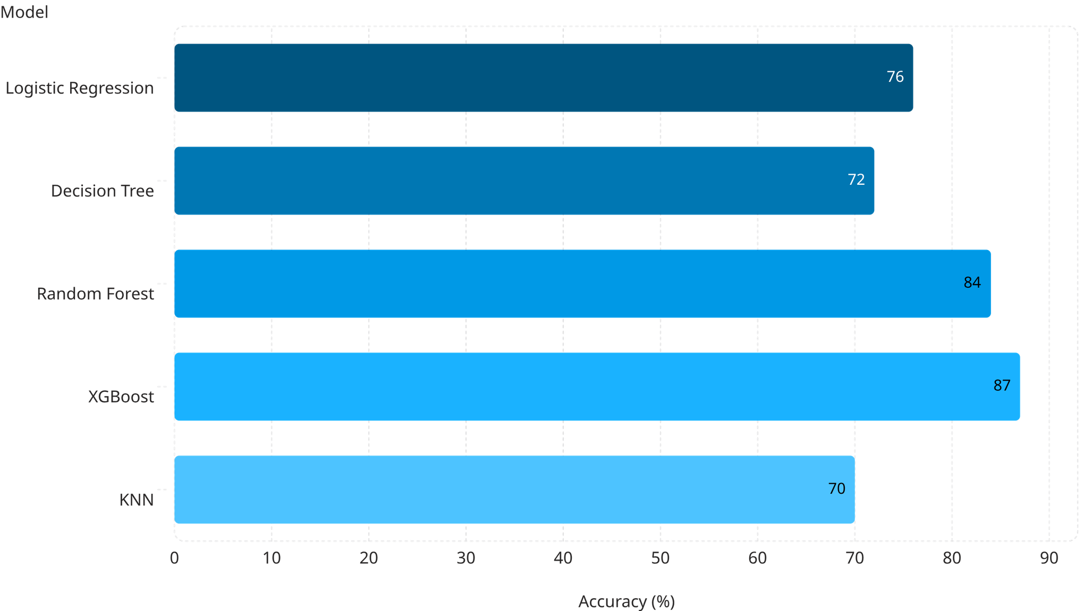
Results — Model Comparison
Comparison of model accuracy on a held-out test set. Bars show accuracy percentages; the top performer is highlighted in blue.
Key result: XGBoost achieved the highest accuracy (87%), followed by Random Forest (84%). These ensemble methods provided the best balance of performance and robustness on our dataset.
Notes:
7

Slide 8

How the Model Makes Decisions — Examples
Approved Case
High income, strong credit, stable employment
Rejected Case
Low credit, large loan, short employment
Example 1: Applicant with high income, strong credit score, and multi-year employment is predicted Approved — model weights favor positive credit indicators. Example 2: Applicant with low credit score, large requested loan relative to income, and short employment history is predicted Rejected — risk features dominate the decision.
Notes:
8

Slide 9
Key Takeaways
Accuracy
Important Drivers
Operational Benefit
XGBoost produced the best result: 87% test accuracy on this 500-sample dataset.
Credit score, debt-to-income ratio, and employment tenure were the strongest predictors of approval.
Model can accelerate decisioning, reduce manual workload, and provide consistent recommendations for frontline loan officers.
Notes:
9

Slide 10
Next Steps & Recommendations
Immediate
Recommended Follow-up
Deploy model as an advisory score in parallel with current underwriting for 3 months.
Run a larger validation with more diverse historical data to confirm generalization.
Implement explainability (SHAP or feature importances) for auditability and regulator readiness.
Set up monitoring for drift and regular retraining cadence.
Define human-in-the-loop thresholds where manual review is required.
Notes:
10

