Slide 1

Global Electronics
Illuminating Insights for Global Electronics
- by Suresh kumar R

Slide 2
Introduction & Objective
Project Aim: To identify key insights that will enhance marketing strategies, optimize inventory management, and improve sales forecasting. This will help tailor marketing campaigns, develop better products, plan effective promotions, and decide on store expansions and optimizations. Additionally, understanding the impact of currency exchange rates on sales will allow for better international pricing strategies. Overall, these insights will help Global Electronics increase customer satisfaction and drive business growth.

Slide 3
Data Sources and Tools Used
Data Sources:
sales data
Product data
Customer data
Store and currency exchange data
Tools Used:
Power BI
Python
SQL
Analysis conducted using Power BI visualizations.

Slide 4
Methodology
1. Data Preparation:
Data cleaning, handling missing values, and formatting for analysis and Feature engineering
2. EDA Analysis:
To analysis the Demographic Distribution, Purchase Patterns, Overall Sales Performance, Sales by Store, Product Popularity, Profitability Analysis, Category Analysis, Geographical Analysis, Sales by Currency..
3. Insights from the Dashboard:
Trends and patterns identified using power bi.

Slide 5
1. Data Preparation
First of all identify the missing values then remove that after remove unwanted characters and empty spaces like (&,$,-,/).
Order date, birthday, open date and date columns are change the datetime format.
The feature engineering steps extract the hidden insights that’s very useful for analysis. So I created age column from the birthday column that represented the customer age.

Slide 6
2. EXPLORATORY DATA ANALYSIS (EDA)
First of all I analyze the gender distribution. That steps easy to understand the age group and gender.
Then identify the average order value, top 10 preferred product, total sales based on different age group.
Identify the overall sales performance on over time period, top 10 product sales bases on quantity wise, top 10 revenue generated product, sales wise store, currency wise sales and more…
These all steps are very useful for business growth.

Slide 7
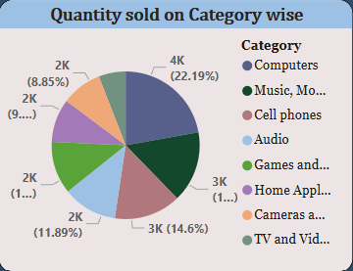
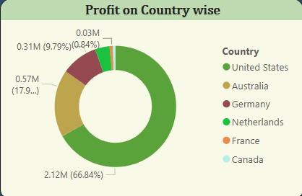
Identify the highest sales on Category wise
3.Insights from the Dashboard
Highest profit generated country

Slide 8
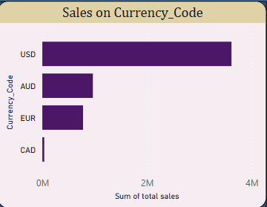
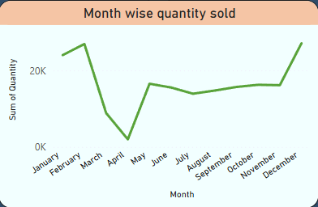
Sum of total sales by currency code
Monthly wise quantity sold

Slide 9
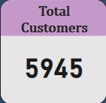
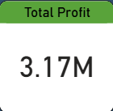
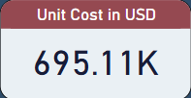
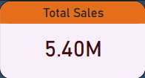
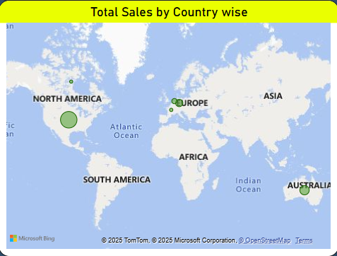
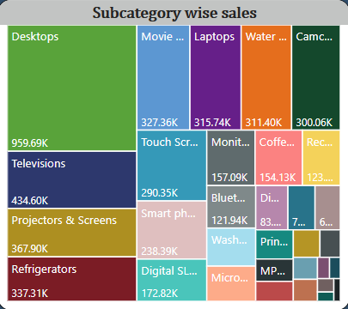
Subcategory wise sales, total profit, total sales, total customers, unit cost inn USD and country wise total sales

Slide 10

Recommendations
Introduce loyalty programs or seasonal discounts to stimulate sales during off-peak seasons.
To introduce combo offers on multiple category-related products such as fashion and electronic products.
Remember to provide customers with a coupon code for high-value purchases, as this can increase their continued purchase behaviour.
Launch targeted promotions or discounts based on previous purchases to enhance customer retention and loyalty.
Develop a targeted marketing campaign for the customer segment.

Slide 11
Recommendations
Focus marketing efforts and promotions on regions with high product demand.
Consider expanding successful product lines to stores where sales are lower, if demand seems to match customer profiles.
Negotiate better lead times with suppliers to maintain optimal stock levels and reduce carrying costs.
Identify low-margin products and explore whether they are worth continuing or could be optimized for better profitability.
Track which stores have the highest profit margins and study their operations for best practices that can be applied company-wide.

Slide 12
Conclusion
Summary:
We collect insights from global electronics companies and provide recommendations to enhance their growth.
THANK YOU

