Slide 1


SUBJECT CODE
TYPE THE SUBJECT NAME HERE
FINAL REVIEW
Name : KARTHICK M
Reg. Number : 412419104049
Name : TARUN H
Reg. Number : 412419104137
Name : SYED ABUTHAHIR A
Reg. Number : 4124191040136
ORDER DEMAND FORECASTING THROUGH CUSTOMER BEHAVIOR AND SEASONAL PATTERN
IV
VIII
CS8811
PROJECT GUIDE: Mr. T. PRABAHAR GODWIN JAMES M.Tech.,
MAJOR PROJECT – FINAL REVIEW

Slide 2
CS8811
MAJOR PROJECT – FINAL REVIEW
PROBLEM STATEMENT
The Dynamic nature of the retail stores or warehouses.
Bull Whip effect in the supply chain network.
Excess or reduced inventory stock due to inaccurate forecasts.
Lead to great loss for firm or organization.
Inability to handle the disruptions as soon as it occurs in the supply chain network.

Slide 3
CS8811
MAJOR PROJECT – FINAL REVIEW
OBJECTIVE OF THE PROJECT
Improving the financial planning of the system which lays out necessary steps to generate future income and cover future expenses.
Reducing the impact of disruption in traditional dynamic forecasts.
Accurate order forecasting and dynamic Bull-Whip (BE) forecasts.
Overcoming the bullwhip effect by coming up with an enhanced forecasting model which predicts accurate results.
Enable the organization to estimate the future quantity and quality of people required for material production.

Slide 4
CS8811
MAJOR PROJECT – FINAL REVIEW
EXISTING SYSTEM
Regresssion Analysis.
Qualitative methods.
It uses CNN – LSTM model to forecast product demand.
LIMITATION
Inability to handle outliers.
Cannot adapt to changing market conditions.
Limited Scope: weather conditions, unexpected events.

Slide 5
CS8811
MAJOR PROJECT – FINAL REVIEW
PROPOSED SOLUTION
Implementing machine learning techniques to forecast product demand in a more accurate way.
Implementing the RNN-LSTM model in particular for better forecasts.
Reducing at least one section of the bullwhip effect in the supply chain as much as possible.

Slide 6
CS8811
MAJOR PROJECT – FINAL REVIEW
ADVANTAGES OF THE PROPOSED SYSTEM
Analysing and classifying Customer Order Behavior (COB)
Increased profit of the organization due to the advancement in the prediction of future sales.
Reducing the bullwhip effect in the supply chain network.
Automation in the raw material purchase system for defective products/items.
Stock management in the retail store to meet the customer demand
Implementation of a fully transparent system between different supply chain users.

Slide 7
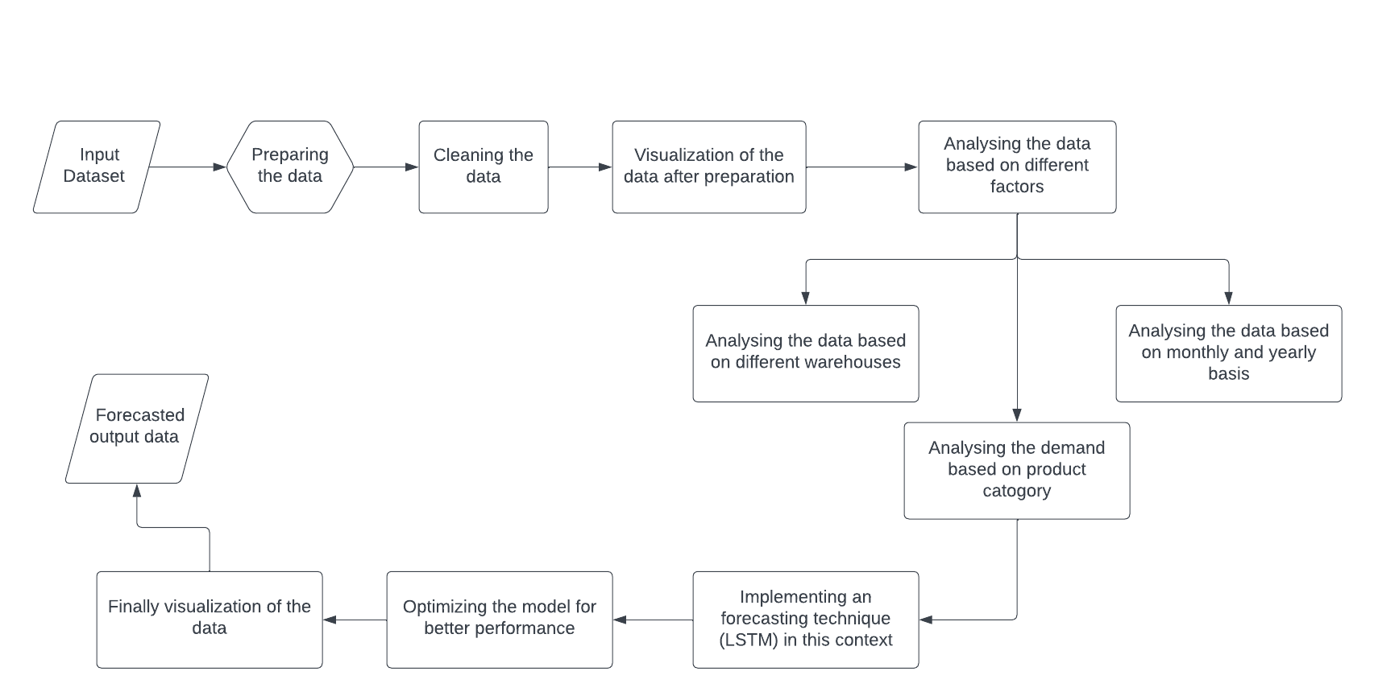
CS8811
MAJOR PROJECT – FINAL REVIEW
ARCHITECTURE DIAGRAM

Slide 8
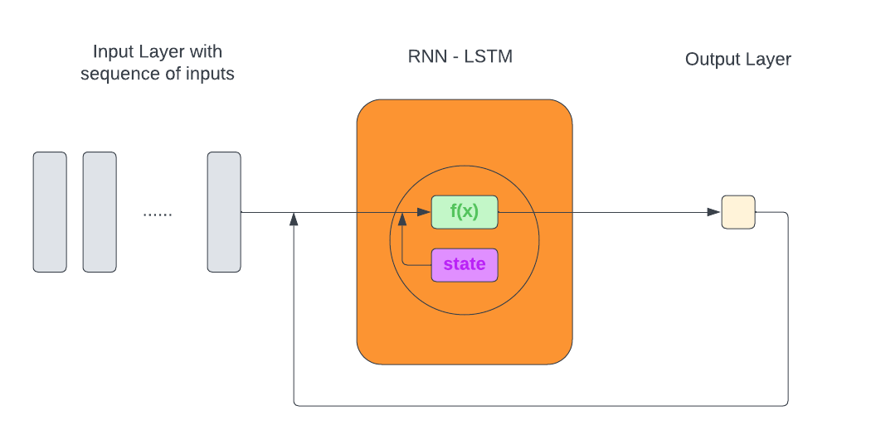
CS8811
MAJOR PROJECT – FINAL REVIEW
MODEL WORKING

Slide 9
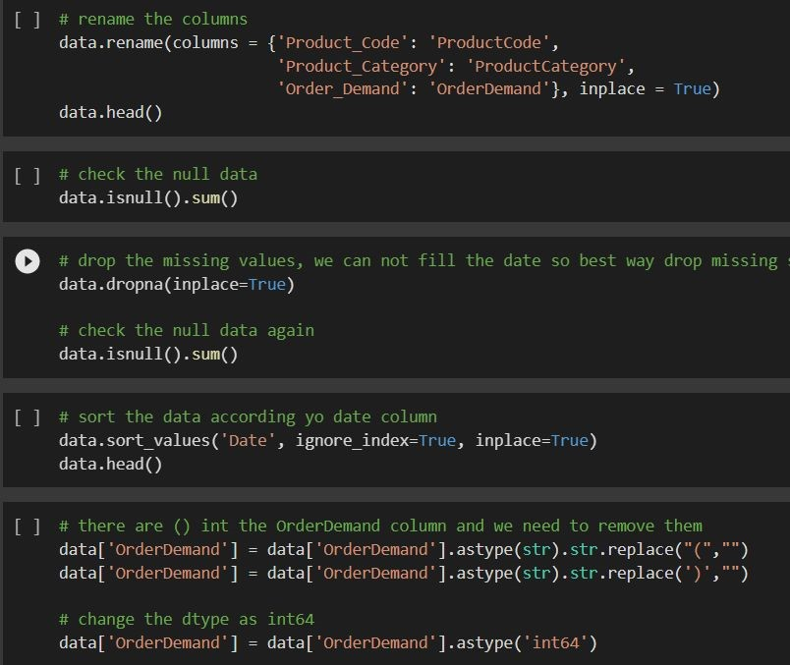
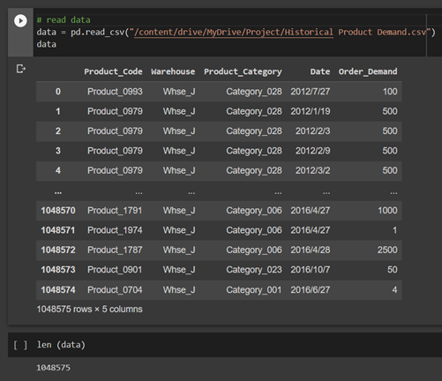
CS8811
MAJOR PROJECT – FINAL REVIEW
DATA PREPROCESSING

Slide 10
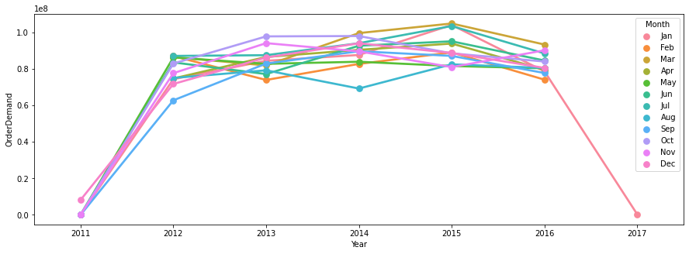
CS8811
MAJOR PROJECT – FINAL REVIEW
DATA VISUALIZATION
MONTHLY ANALYSIS

Slide 11
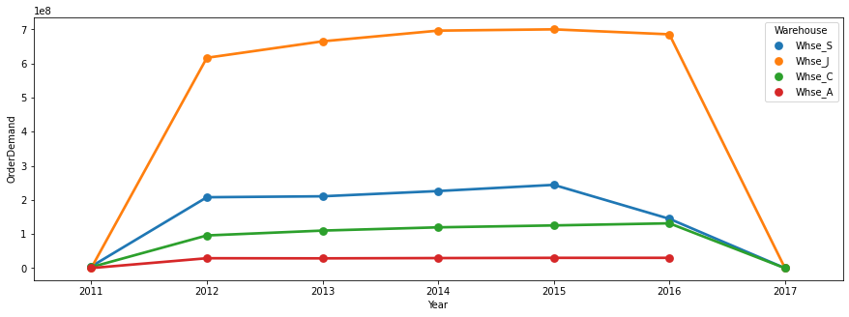
CS8811
MAJOR PROJECT – FINAL REVIEW
DATA VISUALIZATION
WAREHOUSE BASED ANALYSIS

Slide 12
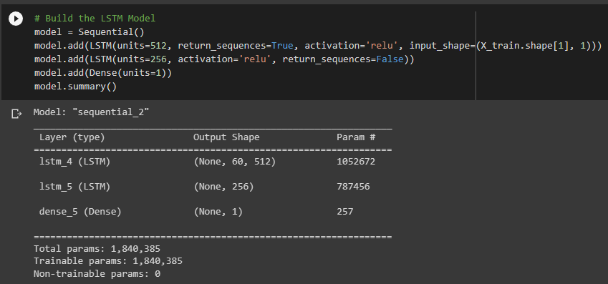
CS8811
MAJOR PROJECT – FINAL REVIEW
MODEL TRAINING

Slide 13
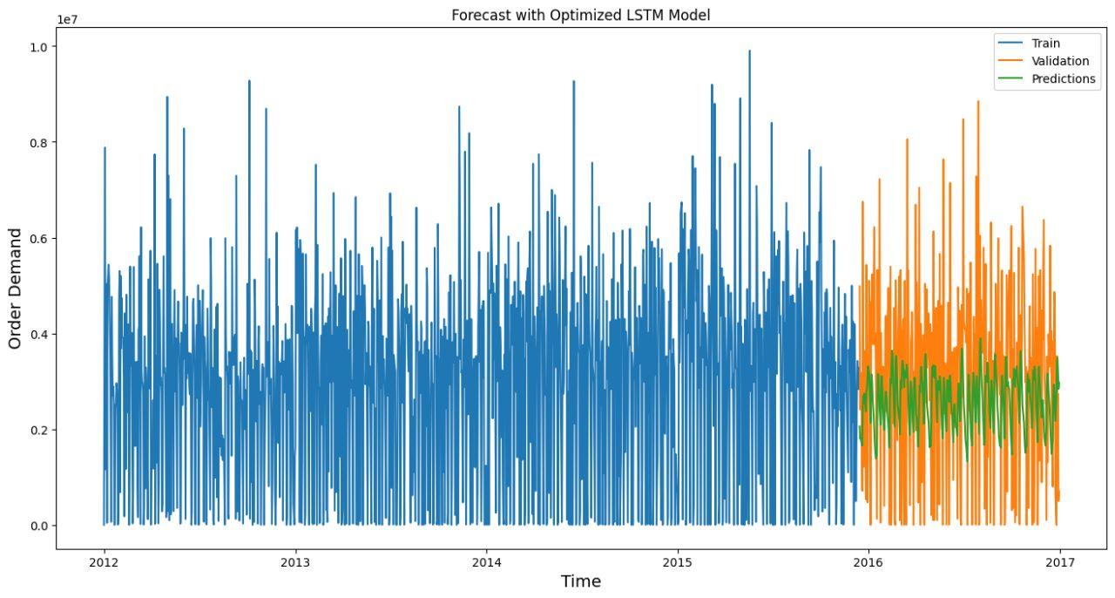
CS8811
MAJOR PROJECT – FINAL REVIEW
PREDICTED OUTPUT

Slide 14
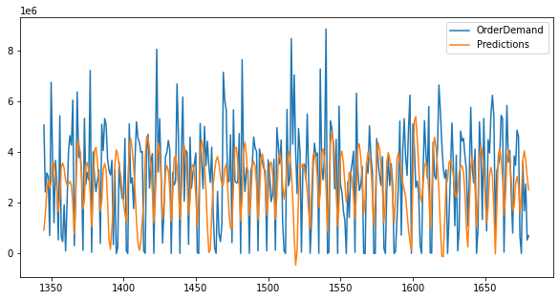
CS8811
MAJOR PROJECT – FINAL REVIEW
PREDICTED OUTPUT

Slide 15
CS8811
MAJOR PROJECT – FINAL REVIEW
JUSTIFICATION FOR SDG
Decent work and economic growth (SDG GOAL NO : 8)
Since the demand is already known the workforce can either be laid off or put to overtime only when required
Industry, innovation, and infrastructure (SDG GOAL NO : 9)
Increase the access of small-scale industrial and other enterprises, particularly in developing countries aiding financial growth, including affordable credit, and their integration into value chains and markets.
Responsible consumption and production (SDG GOAL NO : 12)
Since we only procure as many raw materials as we require for production, the wastage is significantly reduced.

Slide 16
CS8811
MAJOR PROJECT – FINAL REVIEW
REVIEW OF LITERATURE
SL NO | TITLE OF THE PAPER | TECHNOLOGY | JOURNAL NAME | YEAR
1 | Solar Radiation Forecasting Based on the Hybrid CNN-CatBoost Model | Machine Learning | IEEE Access ( Volume: 11) | 2023
2 | Customer Order Behavior Classification via Convolutional Neural Network in the semi conductor industry. | Machine Learning | IEEE TRANSACTIONS ON SEMICONDUCTOR MANUFACTURING, VOL. 35, NO. 3, AUGUST 2022 | 2022
3 | Profit Prediction Using ARIMA, SARIMA and LSTM Models in Time Series Forecasting: A Comparison | Machine Learning | IEEE Access ( Volume: 10) | 2022

Slide 17
CS8811
MAJOR PROJECT – FINAL REVIEW
REVIEW OF LITERATURE
SL NO | TITLE OF THE PAPER | TECHNOLOGY | JOURNAL NAME | YEAR
4 | Retail Demand Forecasting using CNN- LSTM Model | Machine Learning | 2022 International Conference on Electronics and Renewable Systems (ICEARS) | 2022
5 | Sales Forecasting of Retail Stores using Machine Learning Techniques. | Machine Learning | 3rd IEEE International Conference on Computational Systems and Information Technology for Sustainable Solutions 2018 | 2018
6 | Information Sharing in the Supply Chains of Products With Seasonal Demand | Machine Learning | IEEE TRANSACTIONS ON ENGINEERING MANAGEMENT, VOL. 64, NO. 1, FEBRUARY 2017 | 2017

Slide 18
CS8811
MAJOR PROJECT - FINAL REVIEW
THANK YOU

