Slide 1
TkInter
By: Trent Weikel

Slide 2

GitHub
https://github.com/24tweikel/TkInterTutorial

Slide 3
Table of Contents
What is TkInter
Creating A Window and Canvas
Basic Shapes
Colors
The End
Do It Yourself

Slide 4

What is TkInter?
TkInter is a Python package that allows you to create GUI application.

Slide 5


More About TkInter
Tk is a library of basic GUI elements
Another library that is commonly used is Qt
TkInter is just the name for Pythons version of Tk
It is built into Python
You can use it to build forms like in Visual Basic, or you can use it to make images

Slide 6
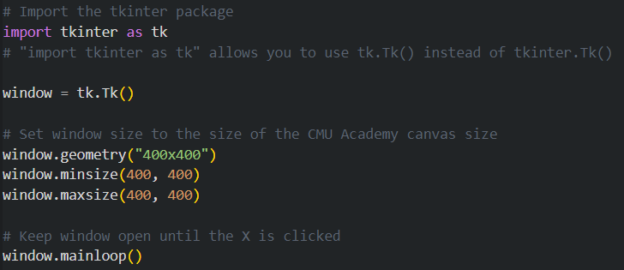
How To Open A TkInter Window

Slide 7
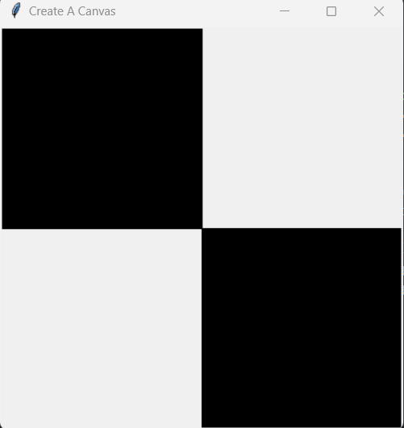
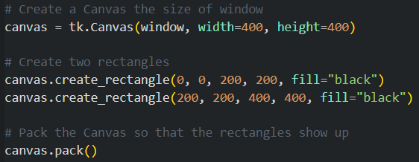
Creating A Canvas
This code creates a canvas that can be used to draw shapes and pictures like in CMU Academy
canvas.create_rectangle(x1, y1, x2, y2, options)

Slide 8
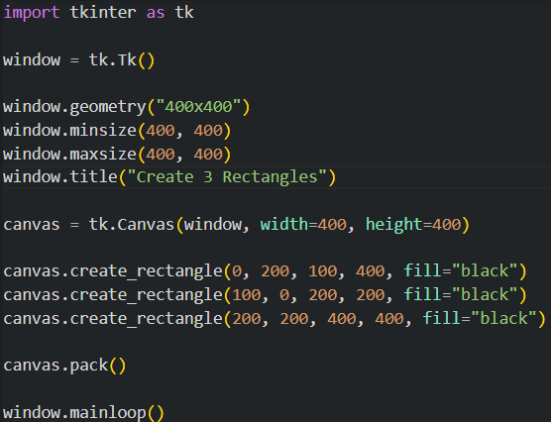
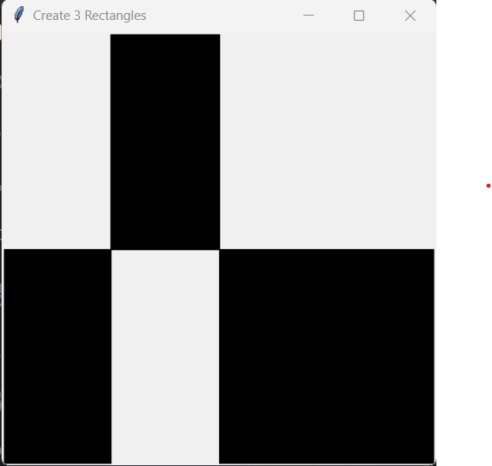
Create 3 Rectangles

Slide 9
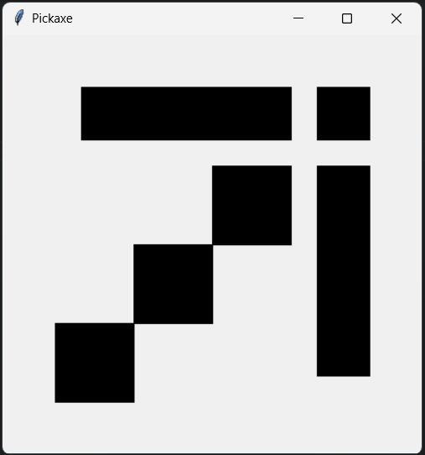
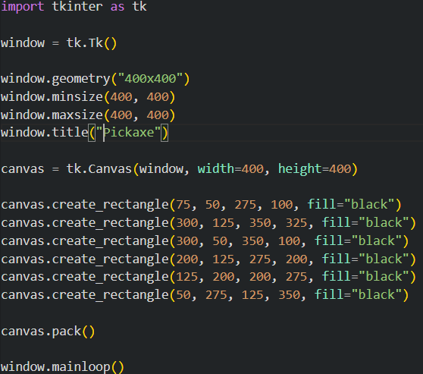
Pickaxe

Slide 10

RGB Function
No built-in function for RGB values
rgb((255, 255, 255))

Slide 11
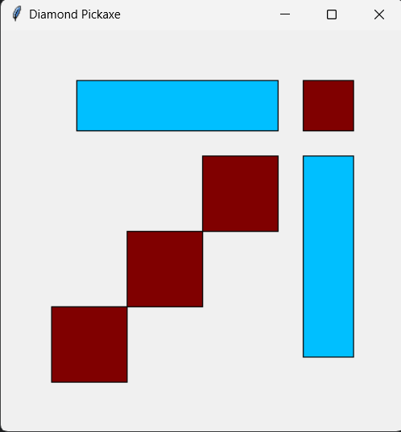
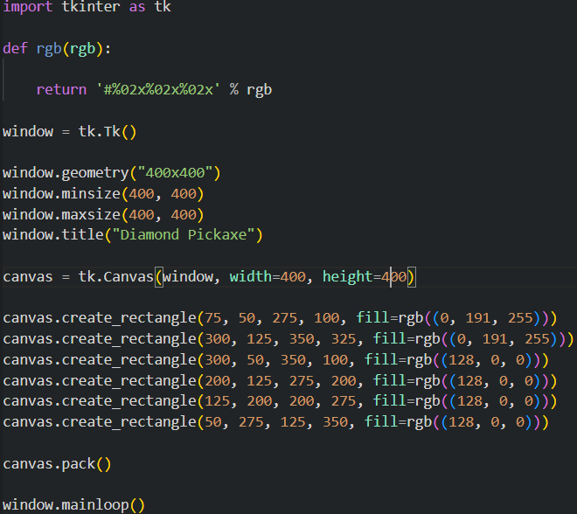
Diamond Pickaxe

Slide 12
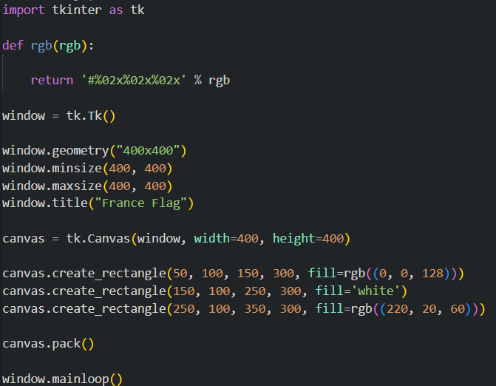
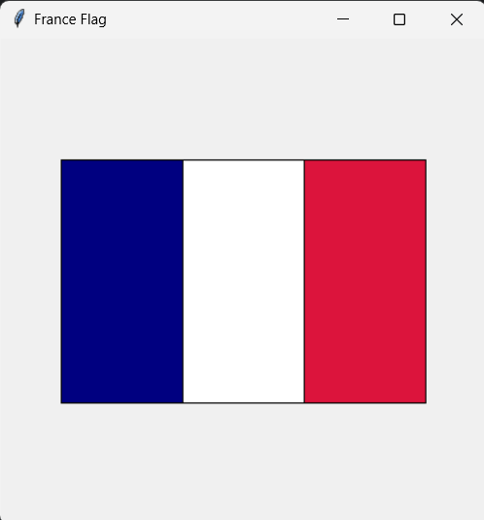
France Flag

Slide 13
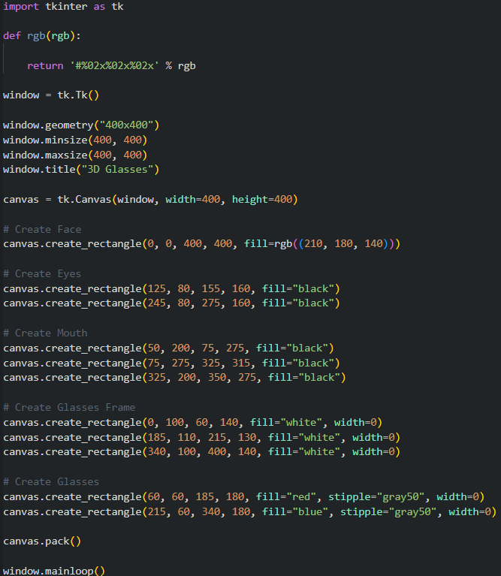
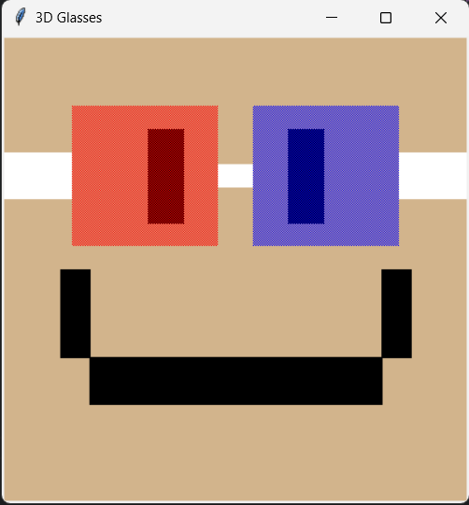
3D Glasses

Slide 14

The End
Questions?

