Slide 1
TkInter
By: Trent Weikel

Slide 2

Table of Contents
What is TkInter
Creating A Window and Canvas
Basic Shapes
Colors

Slide 3


What is TkInter?
TkInter is a Python package that allows you to create GUI application

Slide 4
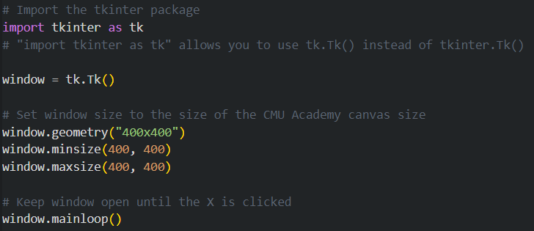
How To Open A TkInter Window

Slide 5
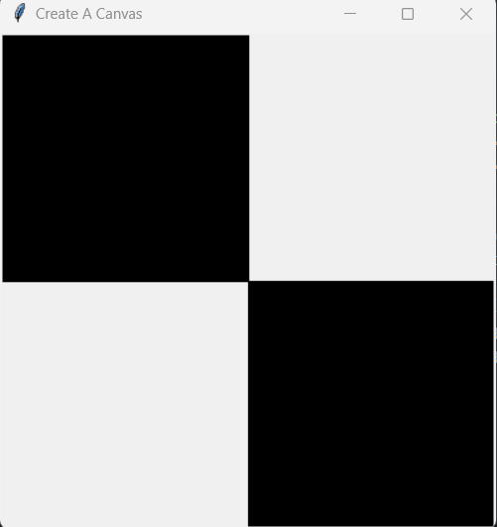
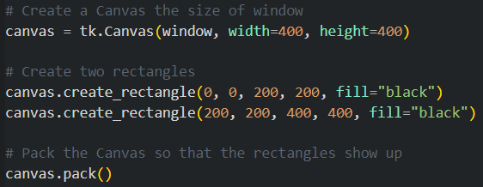
Creating A Canvas
This code creates a canvas that can be used to draw shapes and pictures like in CMU Academy
canvas.create_rectangle(x1, y1, x2, y2, options)

Slide 6
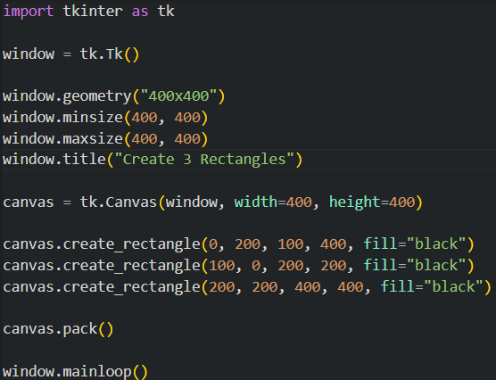
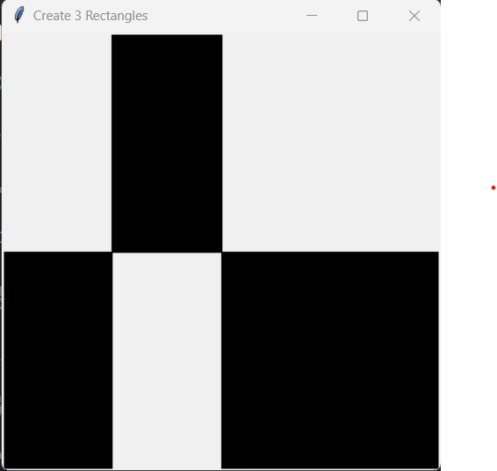
Create 3 Rectangles

Slide 7
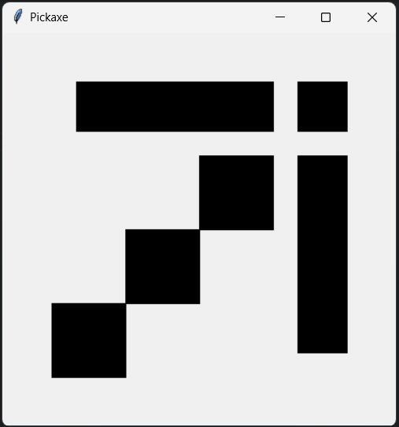
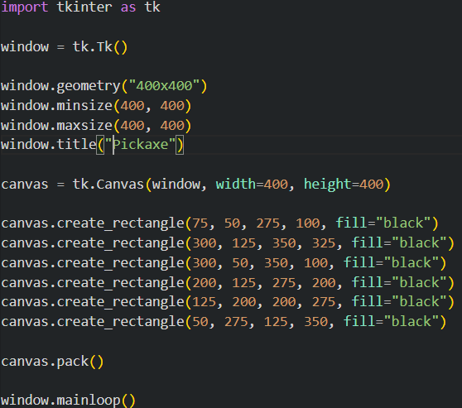
Pickaxe

Slide 8

RGB Function
No built-in function for RGB values
rgb((255, 255, 255))

Slide 9
