Slide 1
DAA Macro Project
Five algorithm techniques, five AI-generated visualizations
Group 10 | Design and Analysis of Algorithms
I
II
III
IV
V
Notes:
Group 10 was allotted projects 1, 5, 7, 12 and 14, one from each unit.

Slide 2
Our five projects
I
Project 1 Sorting Complexity Visualizer
n log2 n: 33 / 664 / 9,966 for n = 10 / 100 / 1000
Unit I · Algorithm Analysis
II
Project 5 Strassen's Matrix Multiplication
7 products instead of 8; C = [[19, 22], [43, 50]]
Unit II · Divide and Conquer
III
Project 7 Traveling Salesperson (Held-Karp DP)
Minimum cost 80: A > B > D > C > A
Unit III · Dynamic Programming
IV
Project 12 Graph Coloring by Backtracking
1 backtrack; A = Red, B = Blue, C = Green, D = Red
Unit IV · Backtracking
V
Project 14 TSP Branch-and-Bound Search Tree
11 nodes, 5 pruned; optimal cost 80
Unit V · Branch and Bound
Notes:
One project per unit: Merge vs Quick Sort chart, Strassen, TSP with DP, Graph coloring with backtracking, TSP with branch and bound.

Slide 3
How each project was built
1
2
3
4
5
Write the algorithm
Craft the AI prompt
Generate the visual
Run and verify
Document on GitHub
Pseudocode and complexity first
Faculty prompt expanded with exact data
AI draws the chart, tree or flowchart
Python output checked against the picture
README, Prompt.txt, Visualization.png
Every number in each picture is traceable to the program output shown in this deck.
Notes:
Follows the faculty instructions: pseudocode, prompt, AI visualization, explanation, GitHub repo with README per project, PPT.

Slide 4
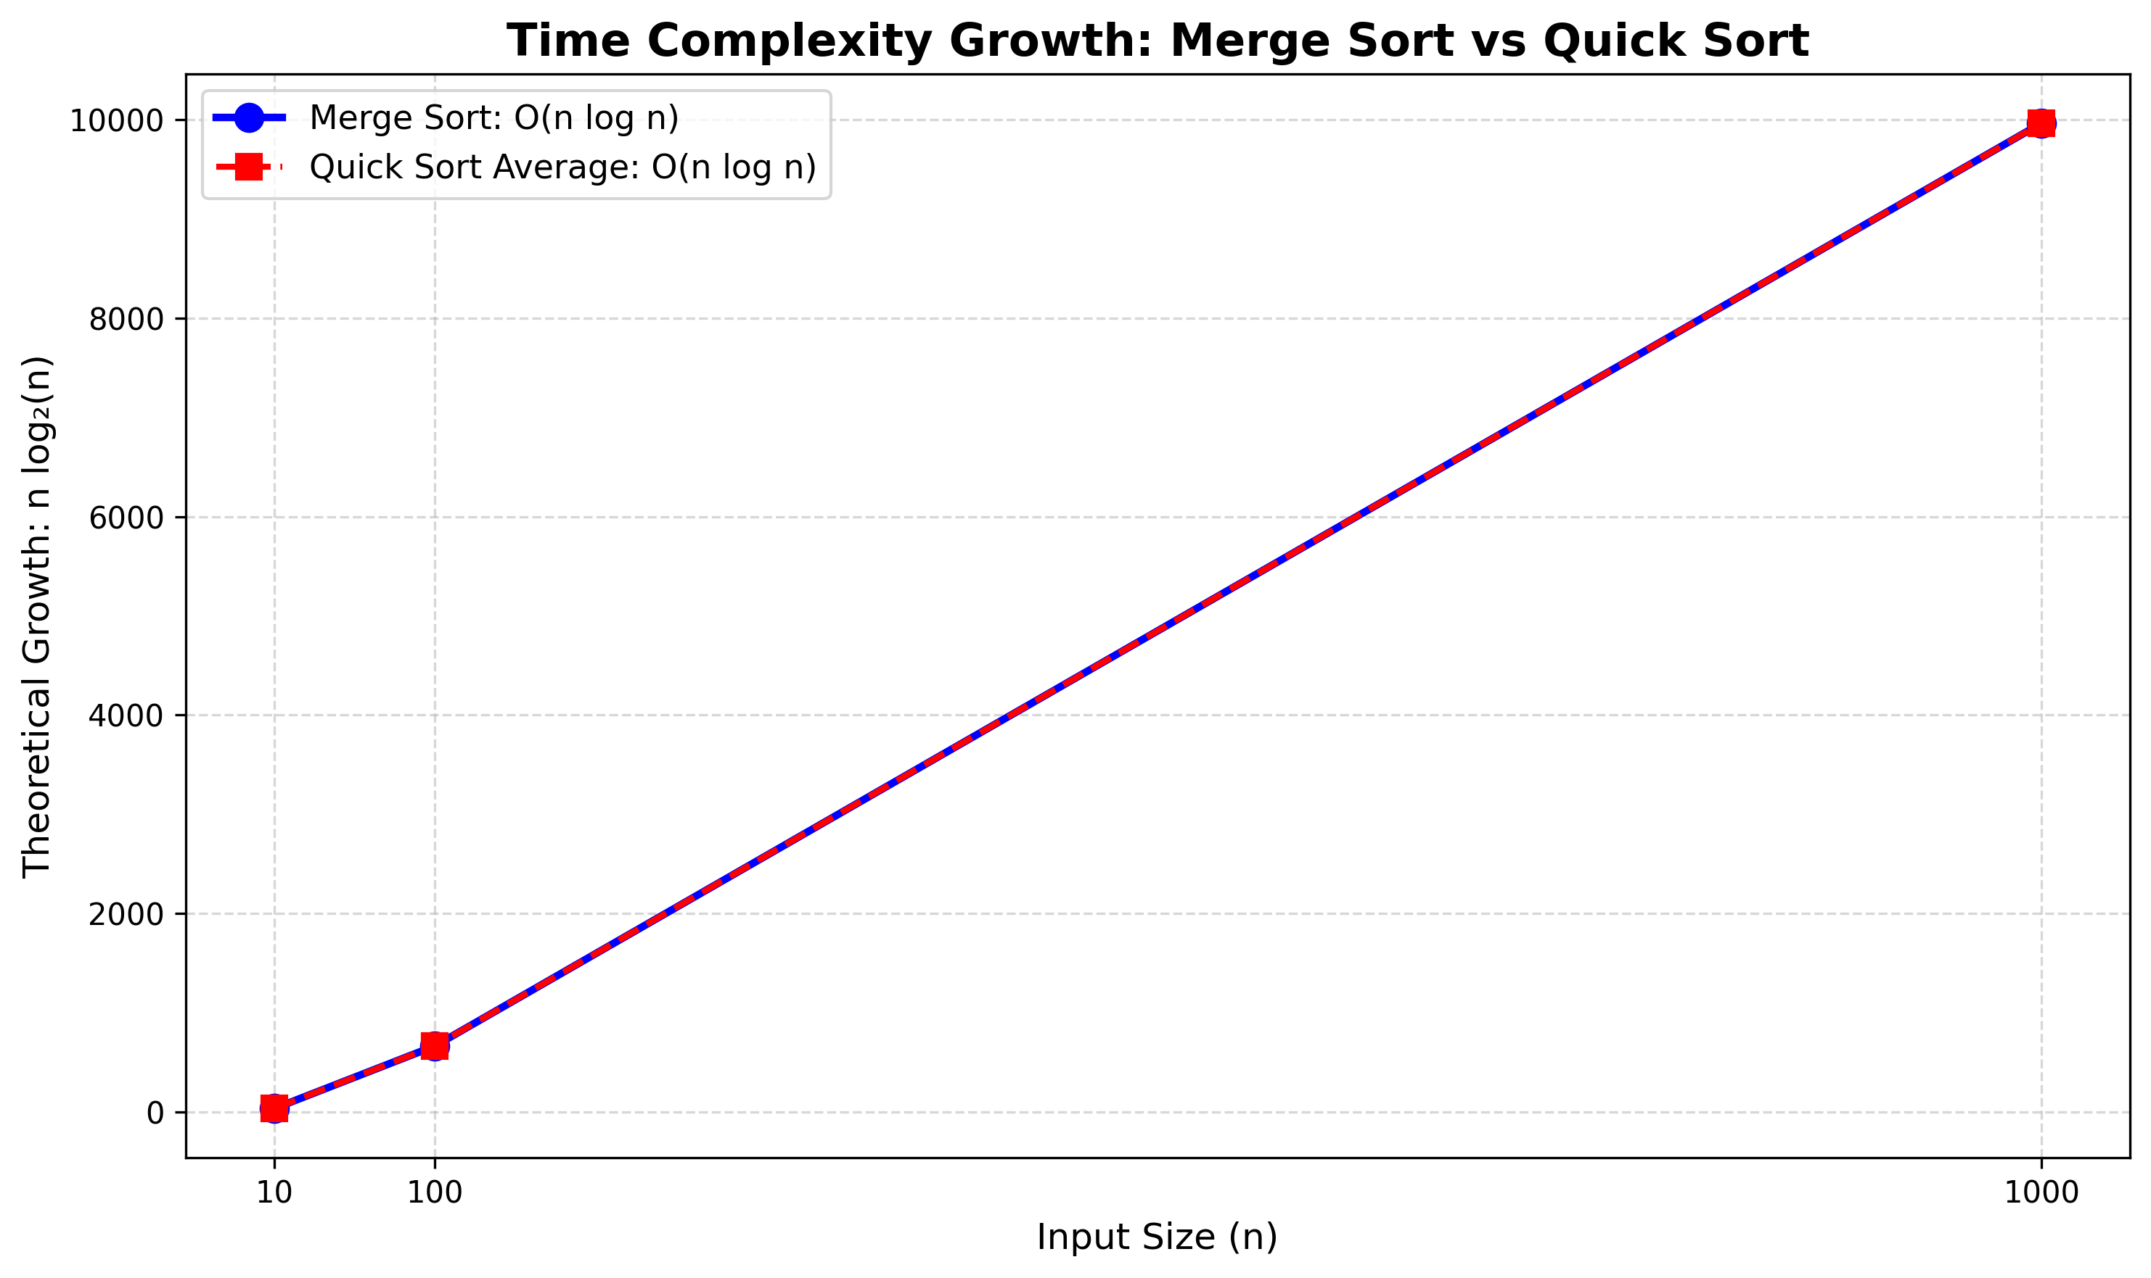
Merge Sort vs Quick Sort Growth
I
9,966
n log2 n at n = 1000
(33 at n = 10, 664 at n = 100)
Both curves overlap: same average-case O(n log n)
Quick Sort worst case is O(n²)
Notes:
Line chart of theoretical n log2(n). The two lines overlap because both algorithms share the same average-case growth rate. We deliberately did not plot measured execution time.

Slide 5
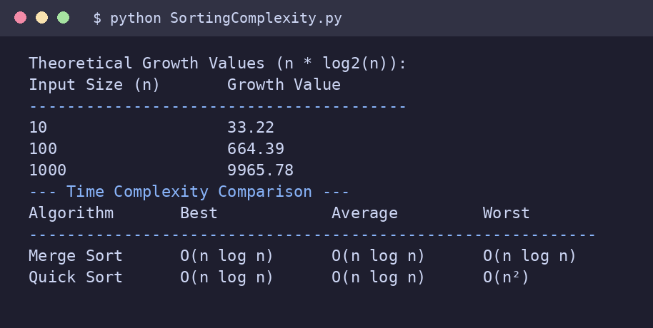
Project 1: Merge Sort vs Quick Sort
I
MERGE_SORT(A):
if |A| <= 1: return A
L <- MERGE_SORT(left half)
R <- MERGE_SORT(right half)
return MERGE(L, R)
QUICK_SORT(A, lo, hi):
if lo < hi:
p <- PARTITION(A, lo, hi)
QUICK_SORT(A, lo, p-1)
QUICK_SORT(A, p+1, hi)
Real program output
Time: Merge: O(n log n) all cases; Quick: O(n log n) avg, O(n²) worst
Prompt (faculty)
“Generate a graph comparing time complexity of Merge, and Quick Sort for n = 10, 100, 1000.”
Notes:
Pseudocode on the left matches the Python file in the repository. The screenshot is the actual console output of that file.

Slide 6
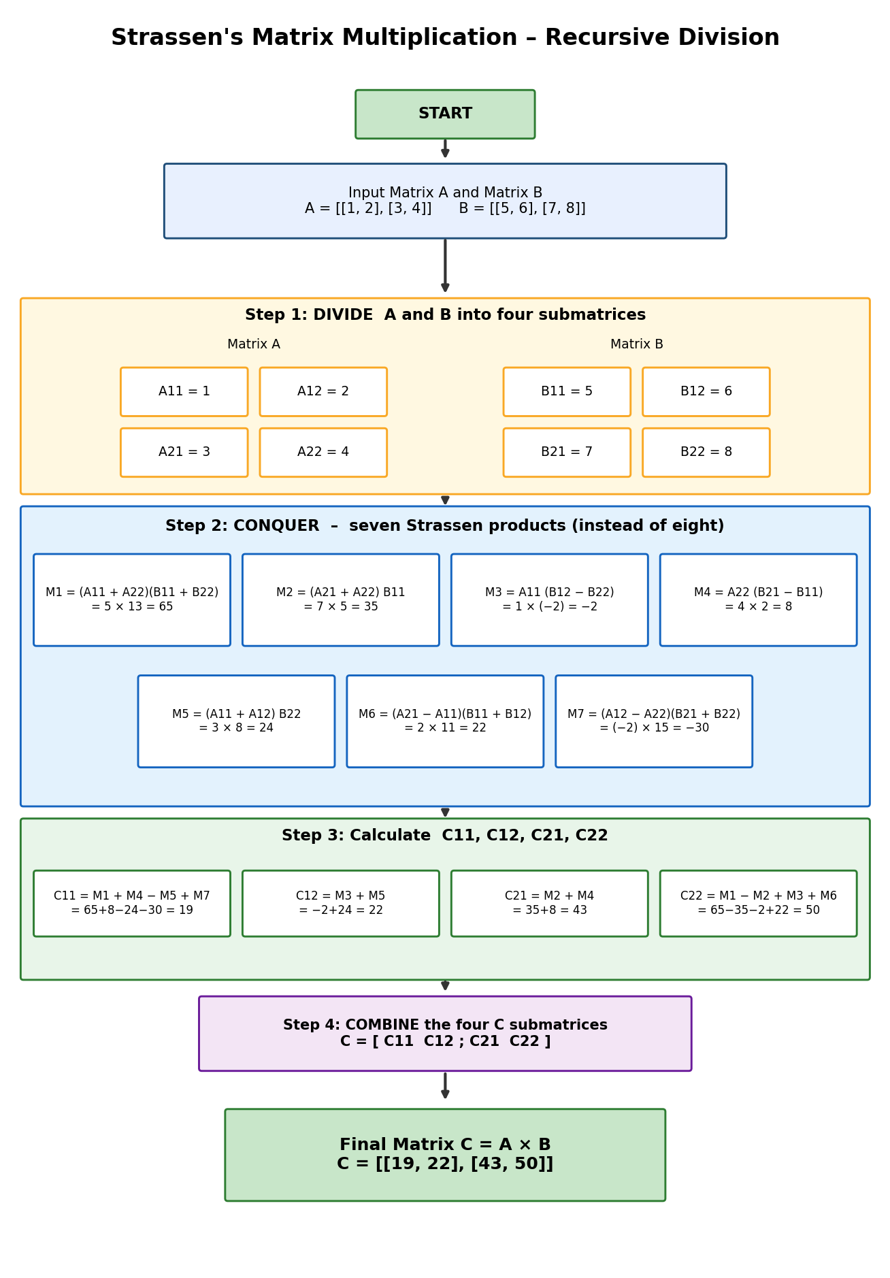
Strassen - Block Diagram
II
7 vs 8
multiplications per level,
Strassen vs standard
A and B each split into four quadrants
M1 to M7 rebuild C11, C12, C21, C22
Result C = [[19, 22], [43, 50]]
Time O(n^2.81) vs O(n³)
Notes:
Block diagram read top to bottom: START, inputs, DIVIDE into quadrants, seven products M1 to M7, formulas for C11 to C22, COMBINE, final matrix. The program verifies the result against ordinary multiplication and prints Both results equal: True.

Slide 7
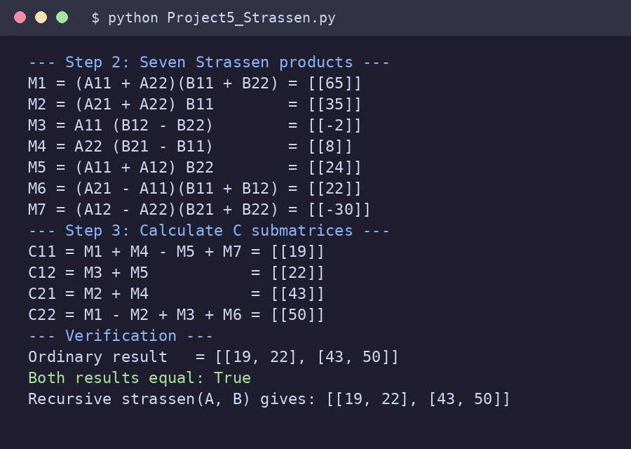
Project 5: Recursive matrix division
II
STRASSEN(A, B):
if n = 1: return A * B
split A, B into 4 quadrants each
M1..M7 <- 7 recursive calls
C11 <- M1 + M4 - M5 + M7
C12 <- M3 + M5
C21 <- M2 + M4
C22 <- M1 - M2 + M3 + M6
return COMBINE(C11,C12,C21,C22)
Real program output
Prompt (faculty)
“Illustrate recursive division of matrices in Strassen’s algorithm.”
Time: O(n^2.81) vs O(n³) standard
Notes:
Pseudocode on the left matches the Python file in the repository. The screenshot is the actual console output of that file.

Slide 8
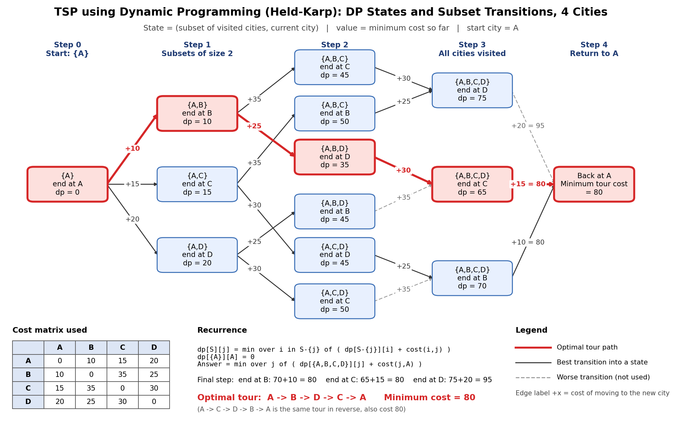
TSP DP - State Transitions
III
80
minimum tour cost
A → B → D → C → A
Red path = optimal route
Dashed grey = worse transitions, not used
Notes:
Each box is a DP state (subset, current city) with its minimum cost so far. Arrows are transitions labelled with the cost from the matrix. Closing the tour: end at B 70+10=80, end at C 65+15=80, end at D 75+20=95.

Slide 9
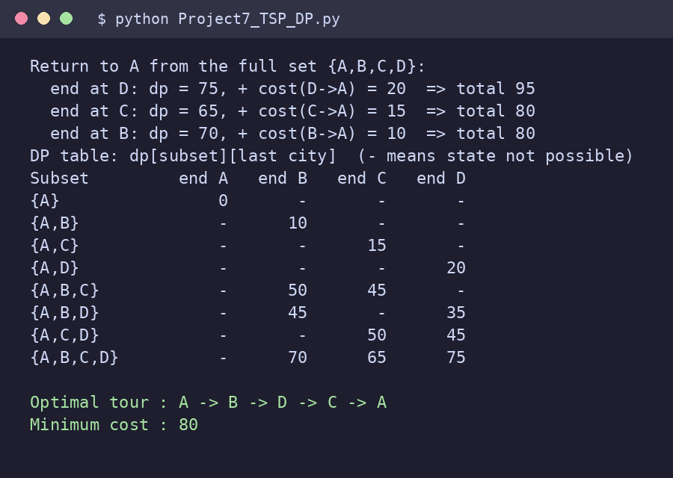
Project 7: DP over subsets of cities
III
dp[{A}][A] <- 0
for each subset S (by size):
for j in S, k not in S:
dp[S+k][k] <- min(dp[S+k][k],
dp[S][j] + cost[j][k])
answer <- min over j != A of
dp[ALL][j] + cost[j][A]
rebuild tour from parent table
Real program output
Prompt (faculty)
“Visualize DP state transitions for TSP with 4 cities.”
Time: O(n² 2^n) vs O((n-1)!) brute force
Notes:
Pseudocode on the left matches the Python file in the repository. The screenshot is the actual console output of that file.

Slide 10
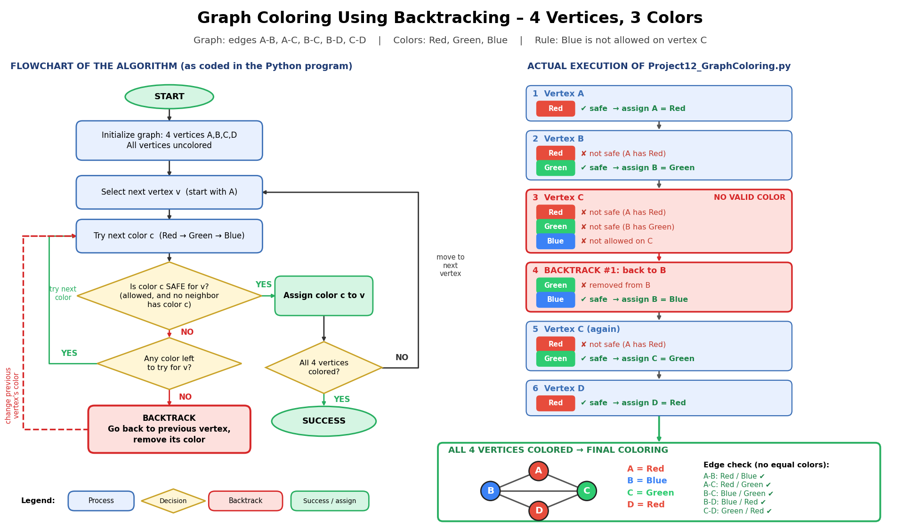
Graph Coloring - Backtracking Flow
IV
1
backtrack: C had no valid color,
so B changed Green → Blue
Left: algorithm flowchart
Right: the real run, step by step
Notes:
Rule added to force a real backtrack: Blue is not allowed on vertex C. A = Red, B = Green, then C has no valid color, so the algorithm goes back to B, changes it to Blue, then C = Green and D = Red.

Slide 11
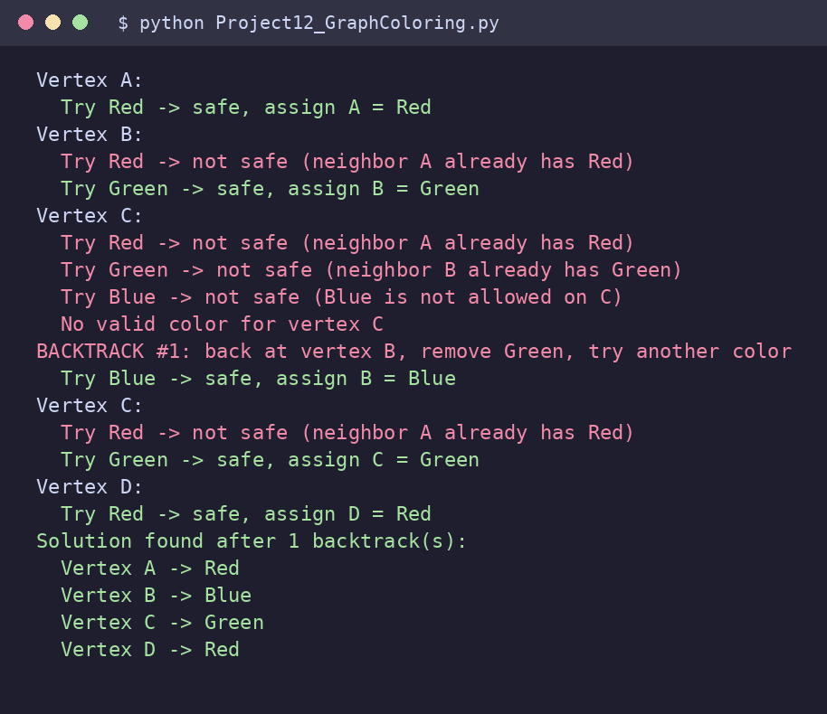
Project 12: 4 vertices, 3 colors
IV
SOLVE(v):
if v = V: return true
for color in (Red, Green, Blue):
if SAFE(v, color):
assign color to v
if SOLVE(v+1): return true
remove color from v # backtrack
return false
Real program output
Prompt (faculty)
“Illustrate backtracking steps for coloring a 4-vertex graph using 3 colors.”
Time: O(M^V) worst case; here 3^4 = 81
Notes:
Pseudocode on the left matches the Python file in the repository. The screenshot is the actual console output of that file.

Slide 12
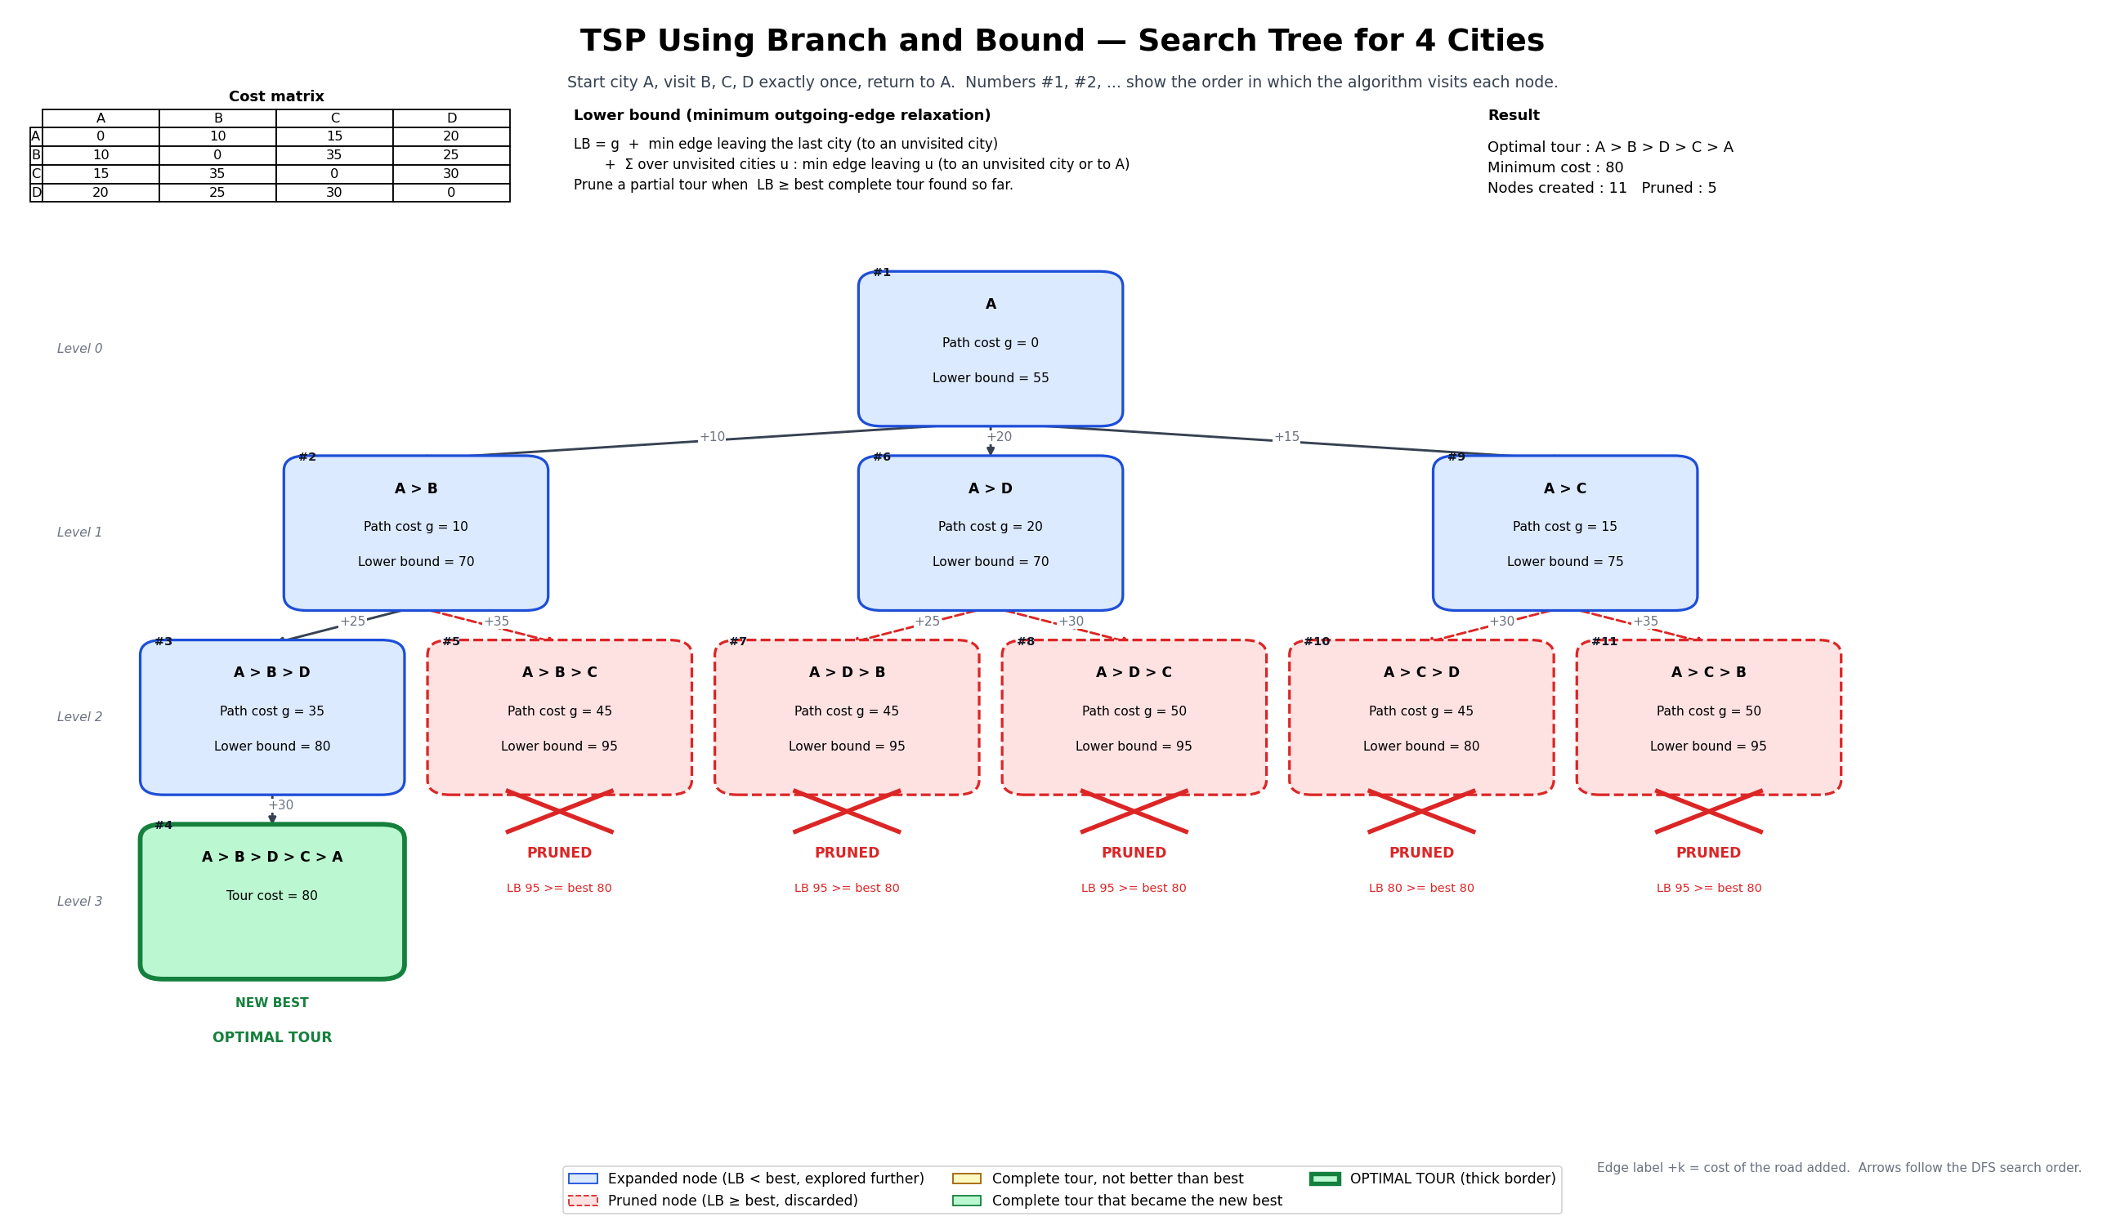
TSP Branch and Bound - Search Tree
V
5 of 11
nodes pruned
(lower bound ≥ best 80)
Red dashed = pruned branch
Green thick border = optimal tour, cost 80
Notes:
Each node shows its partial tour, path cost g and lower bound. After the first complete tour (cost 80) is found, any node with LB at or above 80 is pruned. Only 1 of the 6 possible tours was ever generated; the result matches a brute-force check.

Slide 13
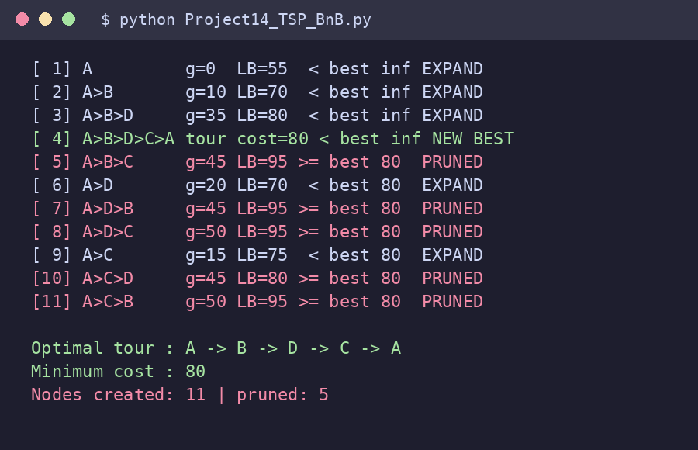
Project 14: Bounding and pruning
V
BNB(node):
if complete tour: update best; return
if node.LB >= best: PRUNE; return
for each unvisited city c:
child <- node + c; compute LB
sort children by LB (smallest first)
for child in children: BNB(child)
LB = g + min edge out of last city
+ min edge out of each unvisited
Real program output
Prompt (faculty)
“Draw a search tree showing bounding and pruning for TSP with 4 cities.”
Time: O(n!) worst case, far fewer in practice
Notes:
Pseudocode on the left matches the Python file in the repository. The screenshot is the actual console output of that file.

Slide 14
Techniques and complexity at a glance
Project | Technique | Time complexity | Key idea
1. Sorting Complexity Visualizer | Divide and conquer | Merge: O(n log n) all cases; Quick: O(n log n) avg, O(n²) worst | Theoretical growth n log2 n, not timings
5. Strassen's Matrix Multiplication | Divide and conquer | O(n^2.81) vs O(n³) standard | 7 recursive multiplications, not 8
7. Traveling Salesperson (Held-Karp DP) | Dynamic programming | O(n² 2^n) vs O((n-1)!) brute force | State = (visited subset, current city)
12. Graph Coloring by Backtracking | Backtracking | O(M^V) worst case; here 3^4 = 81 | Undo a choice when a vertex has no color
14. TSP Branch-and-Bound Search Tree | Branch and bound | O(n!) worst case, far fewer in practice | Discard a branch when LB ≥ best known
Notes:
Summary of the five techniques.

Slide 15
What we learned
Choosing the right technique: divide and conquer, DP, backtracking, branch and bound
Pruning (backtracking and bounds) avoids exploring branches that cannot win
Prompt engineering: exact data in the prompt gives accurate diagrams
Verifying AI visuals against real program output
Professional GitHub documentation
DAA-Macro-Project-Group10/
README.md
Unit1_Algorithm_Analyser/
Unit2_Divide_And_Conquer/
Unit3_Dynamic_Programming/
Unit4_BackTracking/
Unit5_ Branch and Bound/
PPT/
each unit folder holds:
code, Prompt.txt,
Visualization.png, README.md
Notes:
One repository for all five projects, following the faculty structure.

