Slide 1
N-Queens Problem using Backtracking
State space tree visualization through prompt engineering
Design and Analysis of Algorithms – Macro Project
Unit IV: Backtracking (Project 10) | Group 1

Slide 2
Problem and Approach
Place N queens on an N × N board so that no two queens attack each other.
Queens attack along the same row, column or diagonal.
Approach: place one queen per row, trying columns 1 to N.
If a column is unsafe, prune it. If no column works in a row, backtrack to the previous row.
This project uses N = 4, which has exactly 2 solutions.
Language: Java | Repo: DAA-macro-project-G1
DAA Macro Project | Group 1 | Unit IV – Backtracking

Slide 3
Algorithm (Pseudocode)
NQueens(row, N):
if row == N + 1:
print solution; return
for col = 1 to N:
if isSafe(row, col):
place queen at (row, col)
NQueens(row + 1, N)
remove queen from (row, col) // backtrack
isSafe(row, col):
for each earlier row r < row:
c = column of queen in row r
if c == col or |c - col| == |r - row|:
return false
return true
Key points
One queen per row
isSafe checks column and diagonal conflicts
Removing the queen after the recursive call is the backtracking step
Worst-case time: O(N!)
DAA Macro Project | Group 1 | Unit IV – Backtracking

Slide 4
Prompt Used
“Visualize the state space tree for N=4 queens, marking invalid branches in red.”
The prompt was given to an AI tool to generate the state space tree.
The tree was checked against the program output (root, 4 children in row 1, red pruned nodes, 2 solution paths).
Prompt and image are saved in the repo (Prompt.txt, Visualization.png).
DAA Macro Project | Group 1 | Unit IV – Backtracking

Slide 5
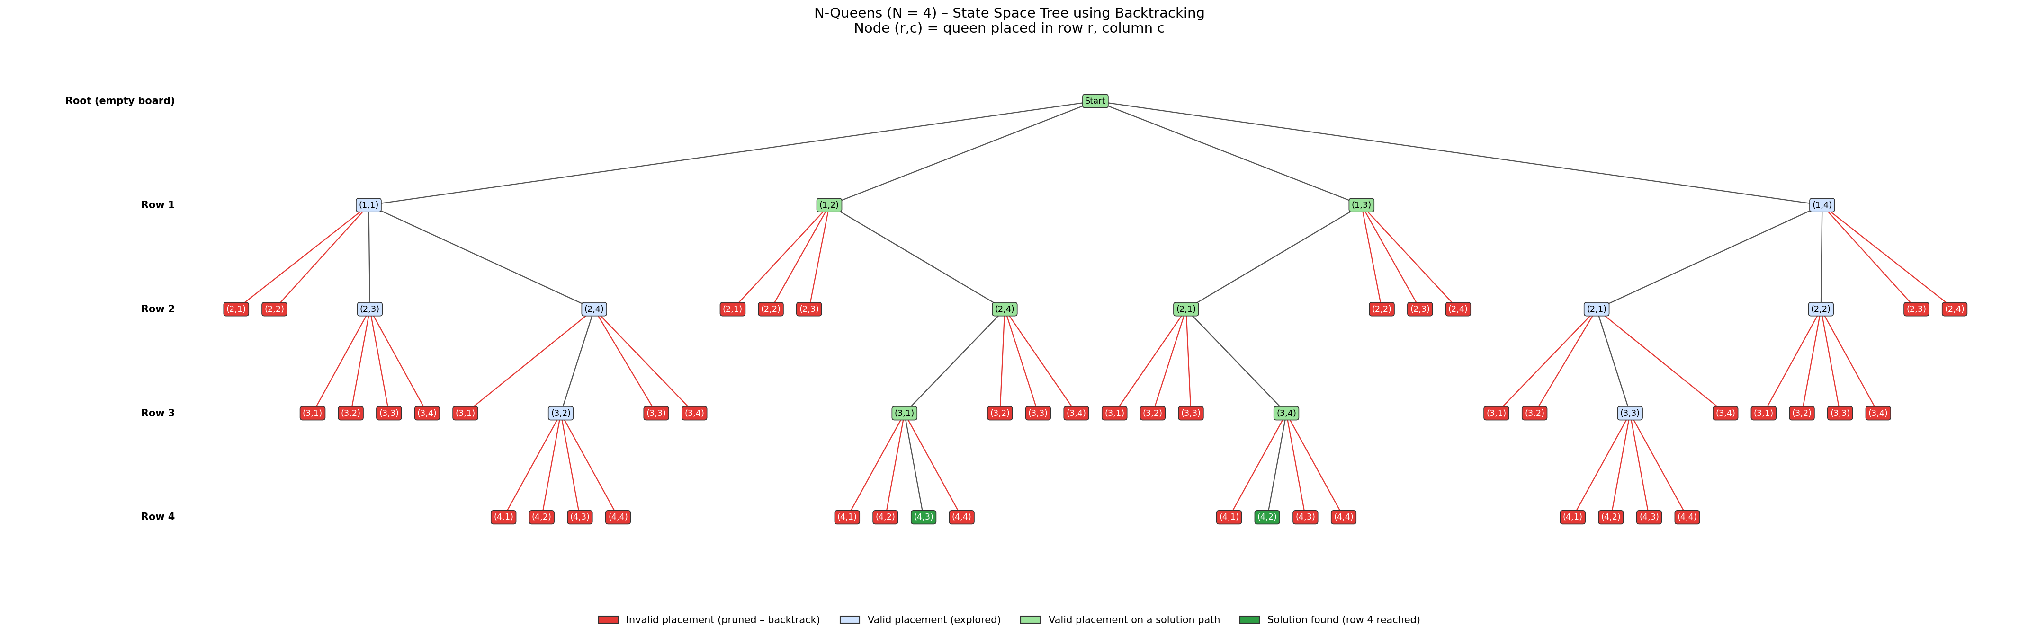
State Space Tree (N = 4)
Red = pruned Blue = explored dead end Green = solution path
DAA Macro Project | Group 1 | Unit IV – Backtracking

Slide 6
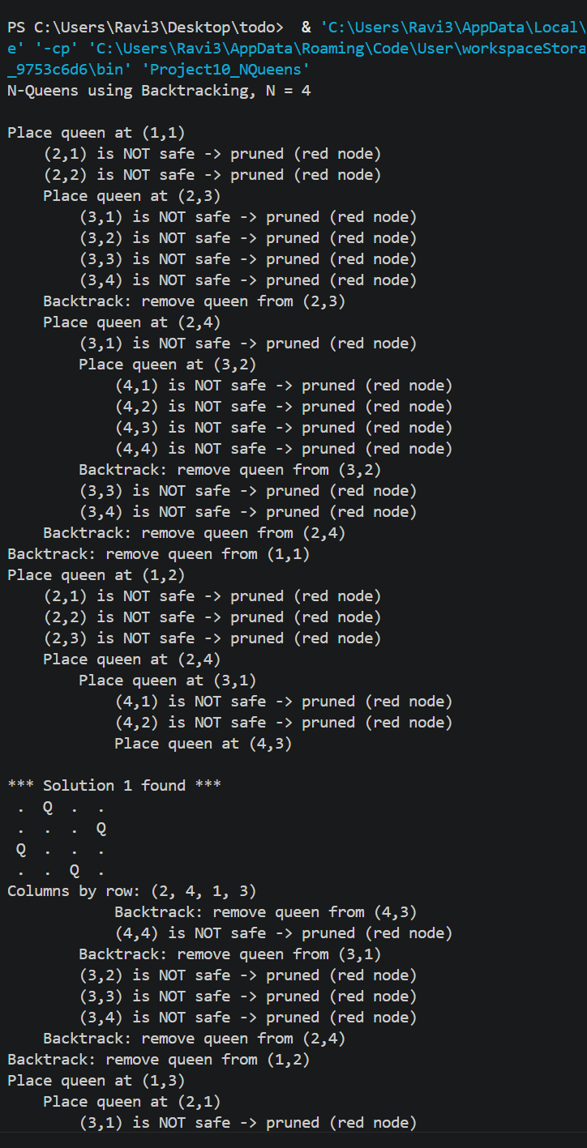
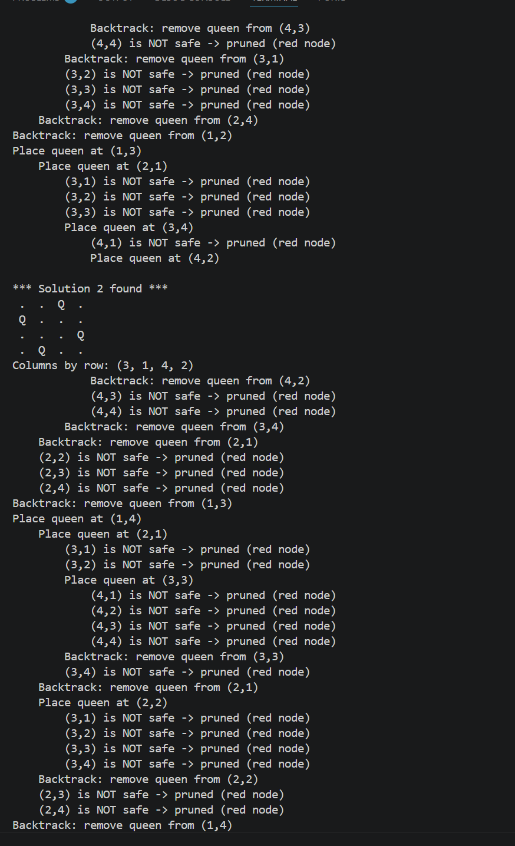
Program Output
Solution 1: (2, 4, 1, 3)
. Q . .
. . . Q
Q . . .
. . Q .
Solution 2: (3, 1, 4, 2)
. . Q .
Q . . .
. . . Q
. Q . .
DAA Macro Project | Group 1 | Unit IV – Backtracking

Slide 7
Explanation and Learning Outcome
How backtracking is shown
Root is the empty board; each level is a row.
Red nodes are conflicts. They are pruned, so the algorithm backtracks instead of exploring below them.
Blue nodes are valid but lead to a dead end.
Green paths reach row 4 and give the 2 solutions.
Learning outcome
Understood recursive backtracking
Learned prompt-based visualization
Practiced GitHub documentation
DAA Macro Project | Group 1 | Unit IV – Backtracking

