Slide 1
Design and Analysis of Algorithms
Five algorithm design paradigms explained through five classic problems
UNIT 1
UNIT 2
UNIT 3
UNIT 4
UNIT 5
Algorithm Analysis
Divide and Conquer
Dynamic Programming
Backtracking
Branch and Bound
Notes:
Welcome. This presentation covers one representative problem from each of the five units of Design and Analysis of Algorithms: sorting analysis, Strassen's matrix multiplication, 0/1 knapsack, N-Queens and the travelling salesman problem.

Slide 2
What we will cover
OVERVIEW
Complexity
1
Merge Sort vs Quick Sort
O(n log n)
Comparing running times of two sorting algorithms
2
Strassen's Matrix Multiplication
O(n^{2.81})
Divide and conquer with only 7 sub-multiplications
3
0/1 Knapsack
O(nW)
Dynamic programming table and traceback
4
N-Queens Problem
O(N!) worst case
Backtracking on a state space tree
5
Travelling Salesman Problem
(n−1)! worst case
Branch and bound search tree with pruning
Notes:
One problem per unit. For each one we first state the problem and the idea, then walk through the diagram.

Slide 3
Merge Sort and Quick Sort
UNIT 1 · ANALYSIS OF ALGORITHMS
 | Merge Sort | Quick Sort
Approach | Split at the middle, sort both halves, merge | Pick a pivot, partition around it, sort both sides
Recurrence | T(n) = 2T(n/2) + O(n) | T(n) = T(k) + T(n−k−1) + O(n)
Best case | O(n log n) | O(n log n)
Average case | O(n log n) | O(n log n)
Worst case | O(n log n) | O(n²) (very unbalanced pivots)
Extra space | O(n) temporary array | O(log n) stack, sorts in place
Stable | Yes | No
Key idea: asymptotically both are O(n log n) on average, so the real difference shows up in constant factors, memory use and worst-case behaviour.
Notes:
Both algorithms use divide and conquer. Merge sort does its work while merging; quick sort does its work while partitioning around a pivot. The table summarises the theoretical differences before we look at measured running times.

Slide 4
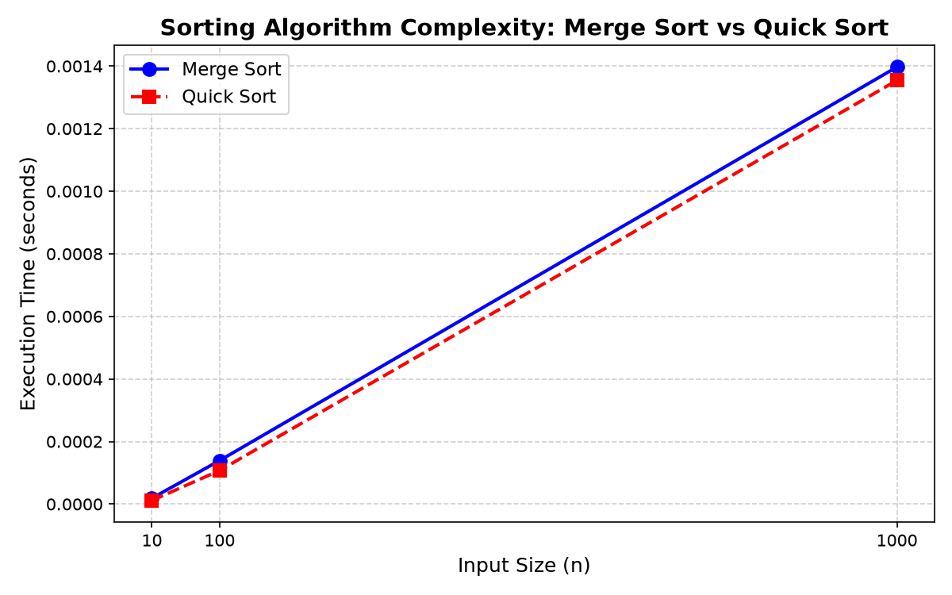
Measured running time
UNIT 1 · EXPERIMENTAL COMPARISON
Setup
Both algorithms timed on inputs of size 10, 100 and 1000.
Observation
The curves rise together. Quick sort stays a little below merge sort at n = 1000.
Why
Quick sort sorts in place with good cache use. Merge sort copies into temporary arrays.
Caution
Random data hides quick sort’s O(n²) worst case.
Notes:
The graph plots execution time in seconds against input size for n = 10, 100 and 1000. Both curves grow at almost the same rate, which matches the O(n log n) average case. Quick sort is slightly faster at n = 1000, roughly 0.00135 s against 0.0014 s. Single timing runs are noisy, so treat small gaps with care.

Slide 5
Strassen’s matrix multiplication
UNIT 2 · DIVIDE AND CONQUER
Problem: multiply two n × n matrices A and B to get C = A × B.
8
Classical divide and conquer
8 block multiplications
T(n) = 8T(n/2) + O(n²)
→ O(n³)
7
Strassen’s algorithm
7 block multiplications
T(n) = 7T(n/2) + O(n²)
→ O(n^{2.81})
1
Divide
2
Conquer
3
Combine
→
→
Split each matrix into four n/2 × n/2 blocks.
Compute 7 products M1 to M7, each by recursion.
Build C11, C12, C21, C22 using only additions and subtractions.
Notes:
Problem: multiply two n by n matrices. The classical divide and conquer method needs 8 recursive multiplications of half-size blocks. Strassen found a way to do it with 7, at the cost of extra additions. That single saving changes the exponent from 3 to about 2.81.

Slide 6
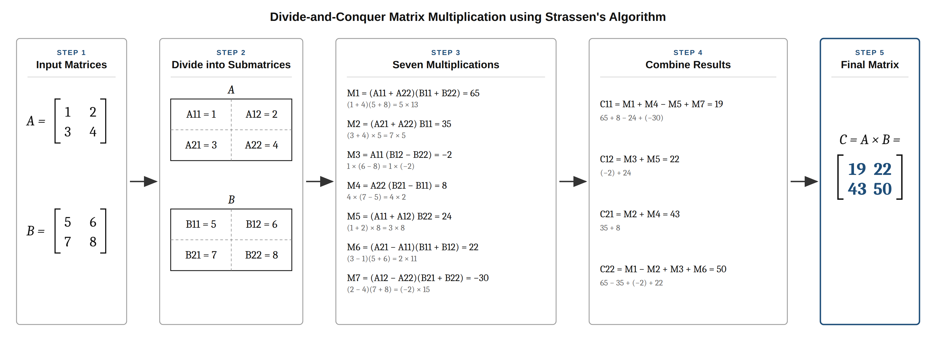
Strassen on a 2 × 2 example
UNIT 2 · WORKED EXAMPLE
Seven products: M1 to M7 replace the usual eight multiplications.
Cheap combining: Each C block uses only additions and subtractions.
Correct result: C = [19 22; 43 50], the same as A × B.
Notes:
A = [[1,2],[3,4]] and B = [[5,6],[7,8]]. Seven products M1 to M7 are computed: 65, 35, -2, 8, 24, 22, -30. Combining them gives C11 = 19, C12 = 22, C21 = 43, C22 = 50, which equals the ordinary matrix product.

Slide 7
0/1 Knapsack problem
UNIT 3 · DYNAMIC PROGRAMMING
The problem
Pick items, each taken whole or not at all, to maximise total profit without exceeding capacity W = 10.
RECURRENCE
K[i][w] = max( K[i−1][w] , pᵢ + K[i−1][w − wᵢ] )
Exclude item i: K[i−1][w]
Include item i: pᵢ + K[i−1][w − wᵢ]
If wᵢ > w, only exclude is possible
Item | Weight (w) | Profit (p)
Item 1 | 2 | 3
Item 2 | 3 | 4
Item 3 | 4 | 5
Item 4 | 5 | 6
TIME
SPACE
O(nW)
O(nW)
Why DP? Subproblems repeat, and the best answer for n items is built from best answers for n−1 items.
Notes:
Given items with weights and profits and a bag of capacity W, choose a subset that maximises total profit. Each item is taken whole or left out. Dynamic programming works because the problem has optimal substructure and overlapping subproblems, so we fill a table once instead of recomputing.

Slide 8
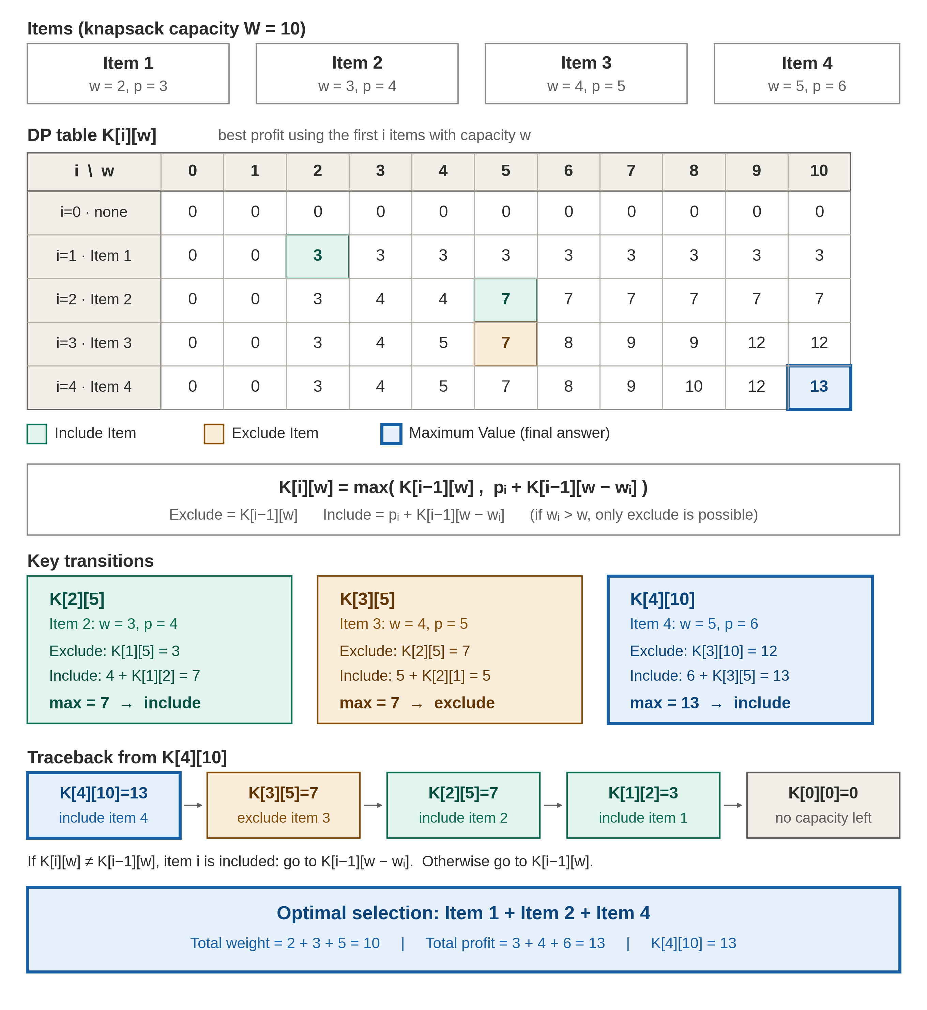
Filling the table, finding the items
UNIT 3 · DP TABLE AND TRACEBACK
How to read it
K[i][w] is the best profit using the first i items with capacity w. Each cell compares exclude with include and keeps the larger.
K[2][5] = 7
Exclude 3, include 4 + K[1][2] = 7
→ INCLUDE
K[3][5] = 7
Exclude 7, include 5 + K[2][1] = 5
→ EXCLUDE
K[4][10] = 13
Exclude 12, include 6 + K[3][5] = 13
→ INCLUDE
Traceback
K[4][10] → K[3][5] → K[2][5] → K[1][2] → K[0][0]
Optimal: Items 1 + 2 + 4 | weight 10 | profit 13
Notes:
Each cell K[i][w] is the best profit using the first i items with capacity w. The three highlighted cells show an include decision, an exclude decision and the final answer. Tracing back from K[4][10] = 13 shows items 4, 2 and 1 are selected, with total weight 10.

Slide 9
N-Queens problem
UNIT 4 · BACKTRACKING
The problem
Place N queens on an N × N board so that no two share a row, a column or a diagonal.
Place
Put a queen in the next row and try each column in turn.
1
Check
Reject the cell if the column or either diagonal already has a queen.
2
Q
One valid solution for N = 4
Queens in columns 2, 4, 1, 3 (rows 1 to 4). No two attack each other.
Q
Go deeper
If the cell is safe, move on to the next row and repeat.
3
Q
Backtrack
If no column in a row is safe, undo the last queen and try its next column.
Q
4
Worst case: O(N!) Pruning removes most of it.
Notes:
Place N queens on an N by N board so that no two attack each other. We place one queen per row, test each column, prune any unsafe choice, and backtrack when a row has no safe column. For N = 4 there are exactly 2 solutions.

Slide 10
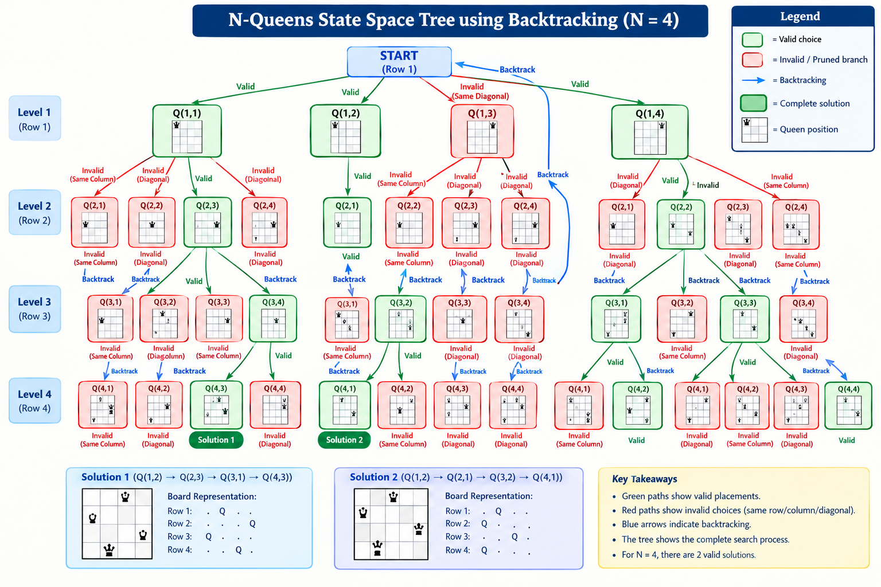
Search tree for N = 4
UNIT 4 · STATE SPACE TREE
Reading the tree
Green: valid choice. Red: pruned branch. Blue arrows: backtracking.
Two solutions
Columns 2, 4, 1, 3
Columns 3, 1, 4, 2
Mirror images of each other.
Pruning cuts off a branch as soon as a conflict appears.
Notes:
The tree explores one row per level. Green nodes are valid placements, red nodes are pruned because of a column or diagonal conflict, and blue arrows show backtracking. N = 4 has two solutions, which are mirror images of each other: columns 2, 4, 1, 3 and columns 3, 1, 4, 2.

Slide 11
Travelling salesman problem
UNIT 5 · BRANCH AND BOUND
The problem
Find the cheapest tour that visits cities A, B, C, D once each and returns to A.
Branch
Extend the partial tour by one unvisited city.
1
Bound
bound = cost so far + cheapest possible way to finish the tour.
Cost | A | B | C | D
A | – | 10 | 15 | 20
B | 10 | – | 35 | 25
C | 15 | 35 | – | 30
D | 20 | 25 | 30 | –
2
Prune
Discard a branch when its bound is not below the best complete tour found.
3
Best first
Always expand the node with the smallest bound next.
4
Edge costs as used in the search tree.
Notes:
Find the cheapest tour that visits every city exactly once and returns to the start. Brute force checks (n-1)! tours. Branch and bound expands the partial tour with the smallest bound first and discards any branch whose bound is not better than the best complete tour found so far.

Slide 12
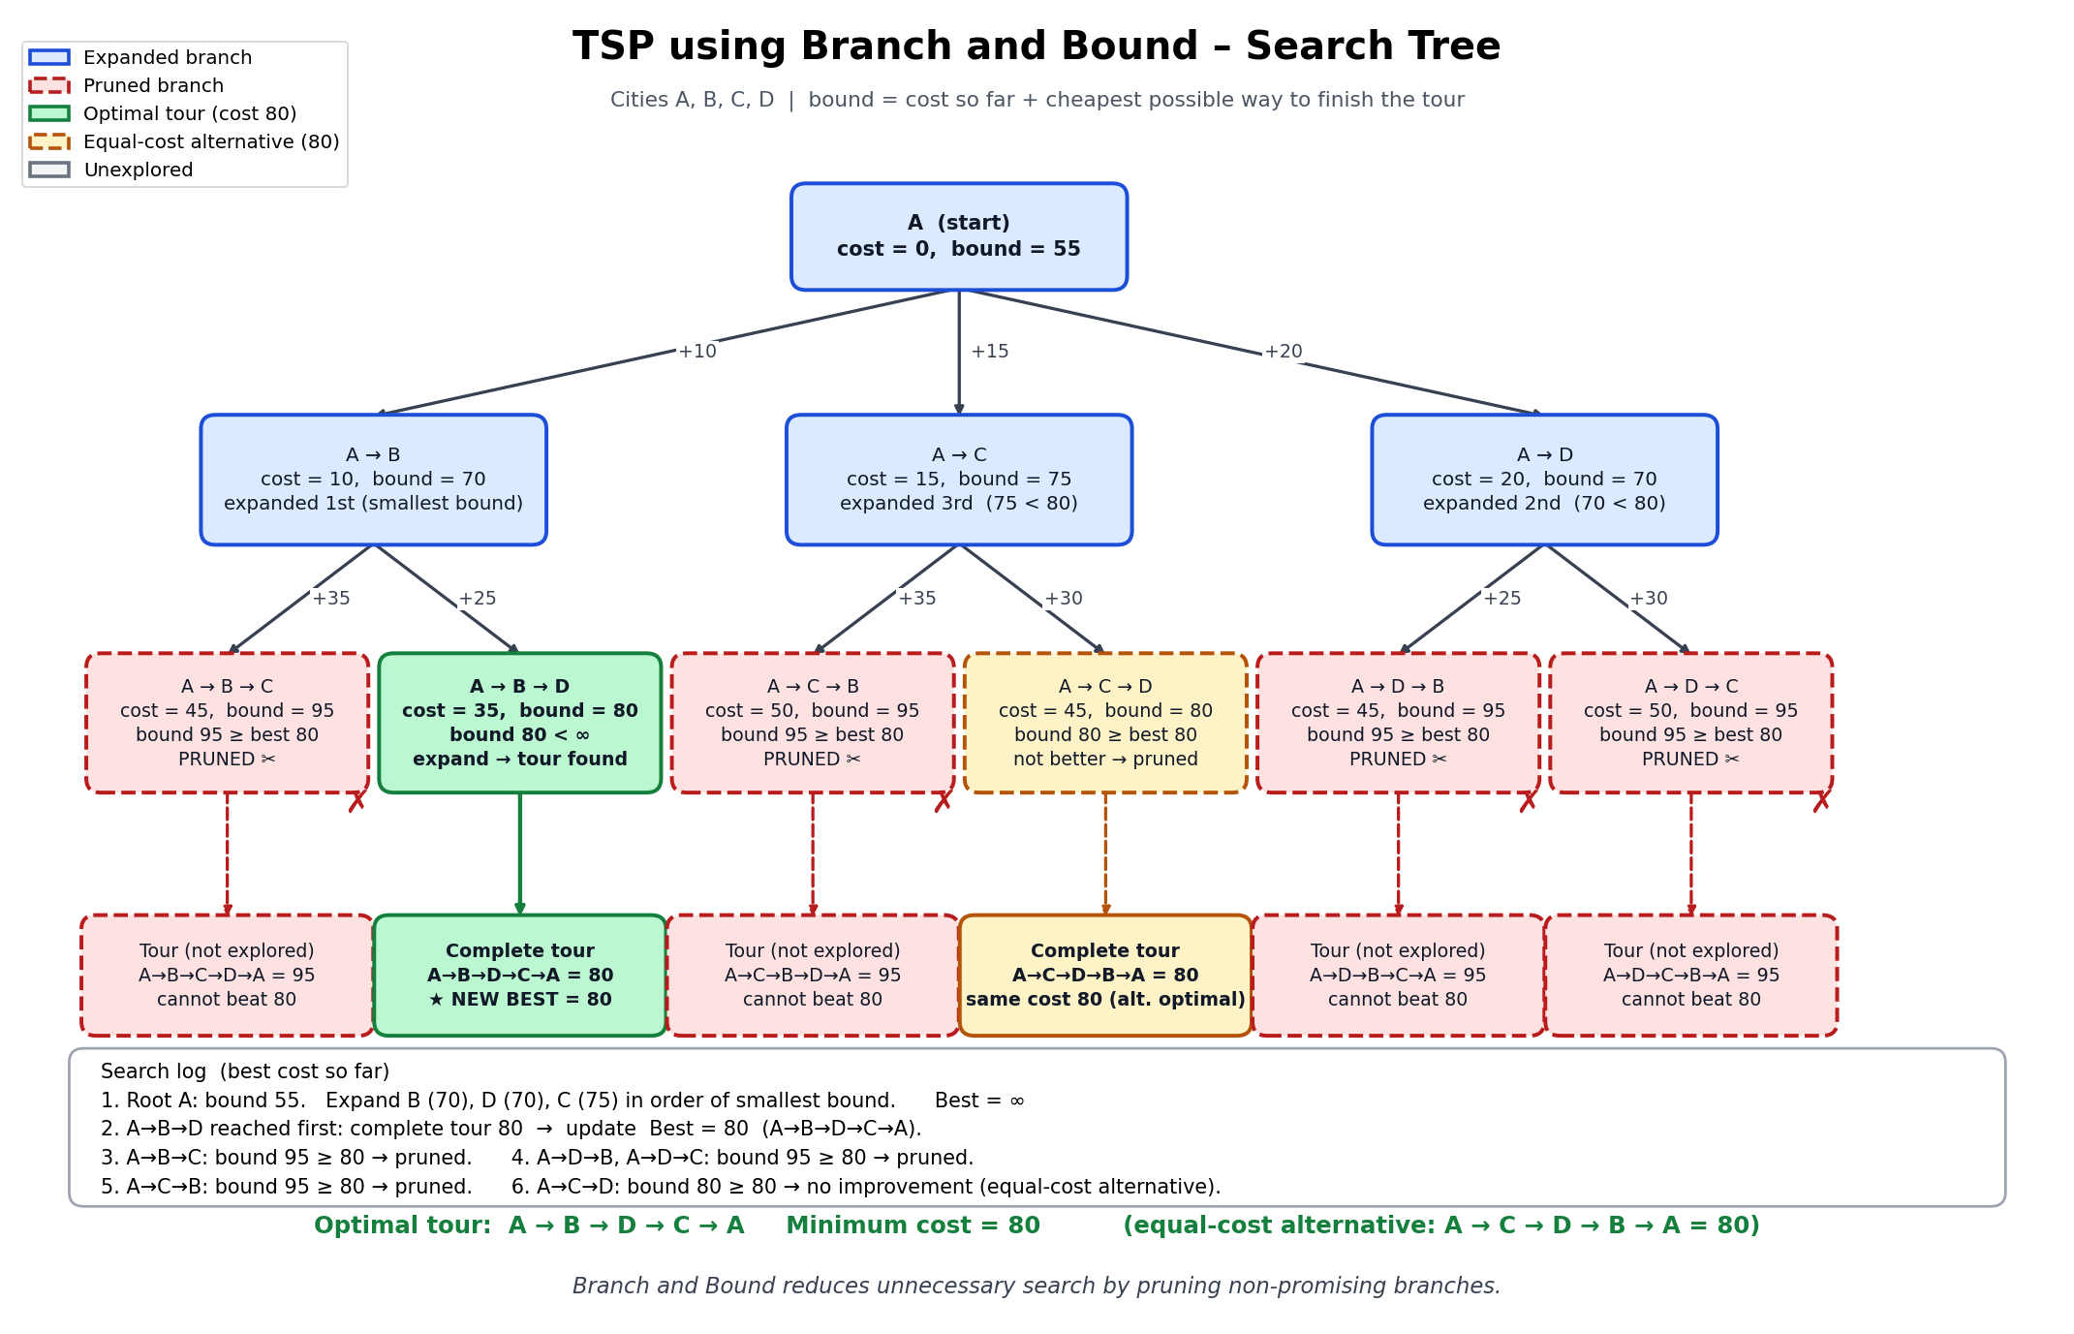
Branch and bound on four cities
UNIT 5 · SEARCH TREE
Search order
Expand B (70), D (70), then C (75), smallest bound first.
First tour
A→B→D→C→A costs 80, so best = 80.
Pruned
Four branches with bound 95, plus A→C→D (80, no improvement).
Result
Minimum cost 80. The alternative A→C→D→B→A is the same tour reversed.
Notes:
The root has bound 55. A to B and A to D have bound 70 and A to C has 75, so B is expanded first. A to B to D gives the first complete tour with cost 80, so best = 80. Four branches with bound 95 are pruned, and A to C to D has bound 80 which cannot improve on 80. The optimal tour A-B-D-C-A costs 80. The equal-cost alternative is the same tour travelled in reverse.

Slide 13
All five units at a glance
SUMMARY
Unit | Problem | Paradigm | Time complexity | Key idea
1 | Merge vs Quick Sort | Divide and conquer | O(n log n) | Compare measured growth with theory
2 | Matrix multiplication | Divide and conquer | O(n^{2.81}) | 7 products instead of 8
3 | 0/1 Knapsack | Dynamic programming | O(nW) | Fill a table, then trace back
4 | N-Queens | Backtracking | O(N!) worst case | Prune conflicts, undo bad choices
5 | Travelling salesman | Branch and bound | (n−1)! worst case | Prune branches using bounds
Common thread: break a hard problem into smaller ones, and avoid repeated or useless work.
Notes:
This table links each problem to its design paradigm and typical complexity. The common thread is to break a hard problem into smaller ones and avoid repeated or useless work.

Slide 14
Key takeaways
1
Analysis: equal growth rates can still differ in speed and memory.
Thank you
2
Divide and conquer: fewer sub-problems lower the exponent.
3
Dynamic programming: store sub-results once and reuse them.
Questions?
4
Backtracking: abandon a path at the first conflict.
5
Branch and bound: use bounds to skip tours that cannot win.
Notes:
Close by restating that the right paradigm depends on the structure of the problem. Invite questions.

