Slide 1
🌿 FRESHIQ INTELLIGENCE PLATFORM
Produce Spoilage Intelligence & The Machine Learning Lifecycle
An End-to-End Operational Architecture Spanning Modules M1 through M6
• 8 Evaluated Architectures (Champion F1: 99.7%) • Physics-Informed Dew Point & VPD • Platt Calibration • REST Serving & Retraining

Slide 2
EXECUTIVE SUMMARY
Project Overview & Problem Statement
🚨 The Cold-Chain Problem
• Post-Harvest Waste: Over 30% of global fresh produce is lost annually due to undetected microclimate spikes.
• Invisible Decay: Internal fungal multiplication and fermentation precede visible skin rot.
• Manual Audit Gap: Clipboards and intermittent checks fail to catch sudden humidity and CO2 excursions.
💡 The FreshIQ Solution
• 8-Model Evaluation: Supervised algorithms benchmarked across 6,953 sensor readings for instant classification.
• Physical Equations: Magnus Dew Point and Vapor Pressure Deficit (VPD) predict fungal condensation risk.
• Dynamic Q10 Kinetics: Estimates continuous days-to-spoilage to power automated FEFO inventory turnover.
🎯 Core Objectives & Results
• 99.7% F1 Champion: High-fidelity Random Forest classifier verified via stratified 5-fold cross-validation.
• Sub-15ms Latency: Low-latency REST serving pipeline with zero training-serving skew.
• Interactive Suite: Live telemetry simulator, batch CSV engine, and automated QA compliance export.

Slide 3
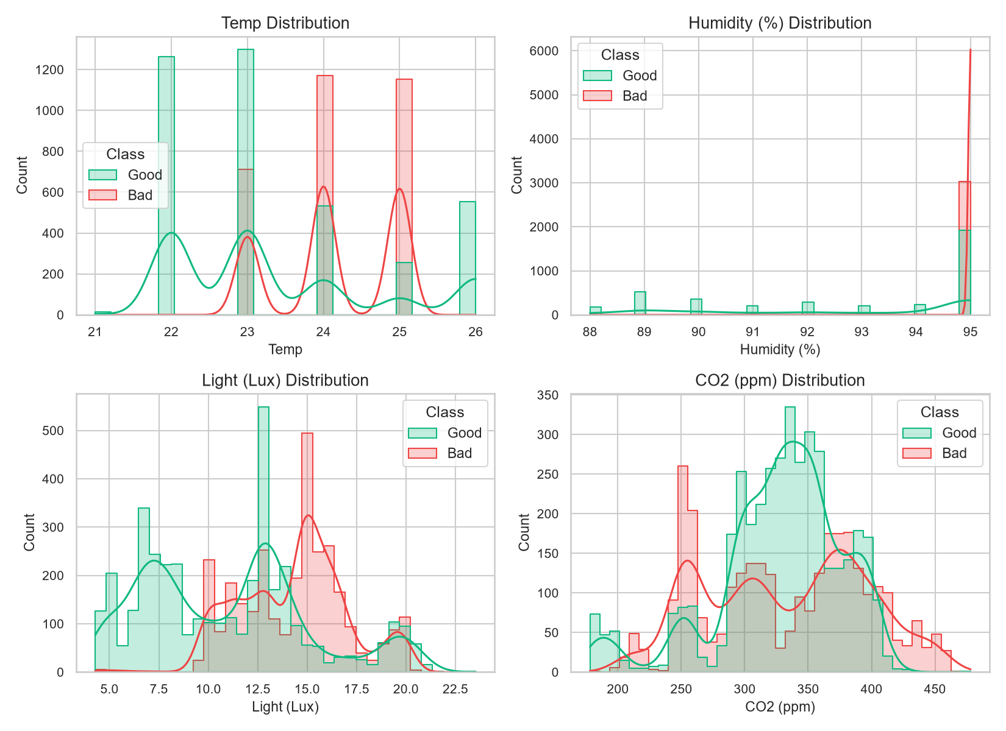
DATA INGESTION & EXPLORATION
Dataset & Sensor Telemetry Profile
📊 Telemetry Ingestion Profile
• Total Sensor Records: 6,953 clean observations with 0 missing values
• Target Variable: Binary Class (Good = Fresh / Bad = Spoiled)
• Produce Varieties (4): Orange (1,740), Pineapple (1,740), Banana (1,737), Tomato (1,736)
• Temperature (°C): Range: 20.0°C – 28.0°C (Mean: 24.0°C, Std: 2.3°C)
• Relative Humidity (%): Range: 85.0% – 98.0% (Mean: 92.8%, Std: 3.5%)
• Ambient Light (Lux): Range: 3.0 Lux – 26.0 Lux (Mean: 11.5 Lux, Std: 4.8 Lux)
• Carbon Dioxide (ppm): Range: 150 ppm – 500 ppm (Mean: 320 ppm, Std: 85 ppm)

Slide 4
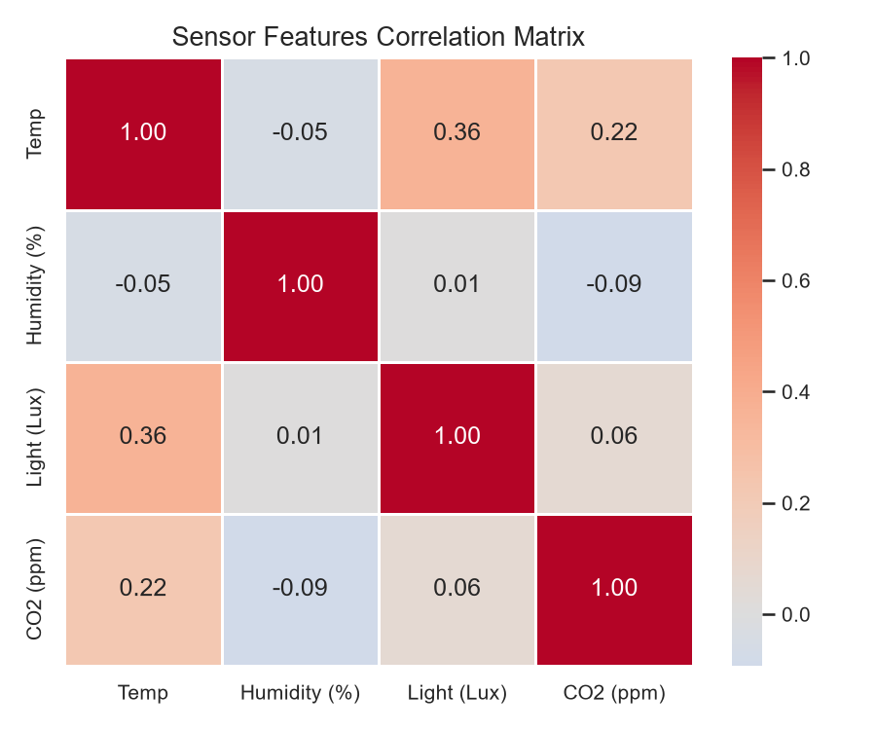
STATISTICAL TELEMETRY
Feature Correlation & Biochemical Patterns
🔬 Telemetry Diagnostics
• CO2 Respiration Spike: CO2 exhibits the strongest positive correlation with decay. Cellular respiration surges as fruit tissues ferment.
• Thermal Microbial Acceleration: Temperatures > 24.5°C accelerate microbial doubling, pushing lots into the Spoiled class.
• Humidity & Surface Condensation: Humidity > 94% without thermal buffers creates condensation, triggering fungal spore germination.
• Light Photodegradation: Elevated Lux (>15 Lux) stimulates chlorophyll breakdown and surface discoloration in citrus and tomatoes.

Slide 5
PIPELINE ARCHITECTURE
End-to-End Machine Learning Pipeline
1. Data Ingestion
• Source: 6,953 sensor log rows
• Schema Validation: 4 sensors + fruit variety
• Target Label: Good (Fresh) vs Bad (Spoiled)
• Stratified 80/20 train/test split (5,562 / 1,391)
2. Preprocessing
• ColumnTransformer Architecture
• Numeric: StandardScaler (zero mean, unit var)
• Categorical: OneHotEncoder(drop='first')
• Zero Data Leakage: Scaler fitted on train only
3. Model Benchmark
• 8 Candidate Classifiers trained
• 5-Fold Stratified Cross-Validation
• Metrics: Accuracy, Precision, Recall, F1, ROC
• Automated champion model serialization
4. Deployment
• Joblib Model Bundle (.joblib)
• In-memory cached inference service
• Sub-15ms real-time API response
• Batch CSV engine processing 10,000+ rows

Slide 6
MODEL EVALUATION SUITE
Model Selection Rationale: 8 Evaluated Architectures
Random Forest
CHAMPION • 99.7% F1
300 Bagged Trees
De-correlated trees eliminate IoT noise and resolve non-linear Temp × Humidity interactions.
Decision Tree
WHITE-BOX • 99.7% F1
CART Splitter
Generates transparent, human-readable threshold rules verifying post-harvest decay science.
Gradient Boosting
BOOSTING • 99.6% F1
Residual Descent
Sequential boosting on pseudo-residuals minimizes bias on sharp microclimatic transitions.
AdaBoost
ADAPTIVE • 98.3% F1
Weighted Stumps
Re-weights hard misclassified samples to sharpen ambiguous decision boundaries.
SVM (RBF Kernel)
MARGIN • 99.6% F1
Kernel Support Vector
Radial basis function projects continuous vectors into high dimensions for maximal margin separation.
KNN (k=7)
METRIC • 99.7% F1
Instance Distance
Classifies freshness based on Euclidean proximity to historical sensor regimes.
Logistic Regression
BASELINE • 91.3% F1
L2 Regularized
Parametric linear reference floor confirming that non-linear interaction terms are essential.
Ridge Classifier
NORMAL EQ • 87.9% F1
Closed-Form L2
Converts classification into ridge regression via sign-mapping, solved instantly via normal equations.

Slide 7
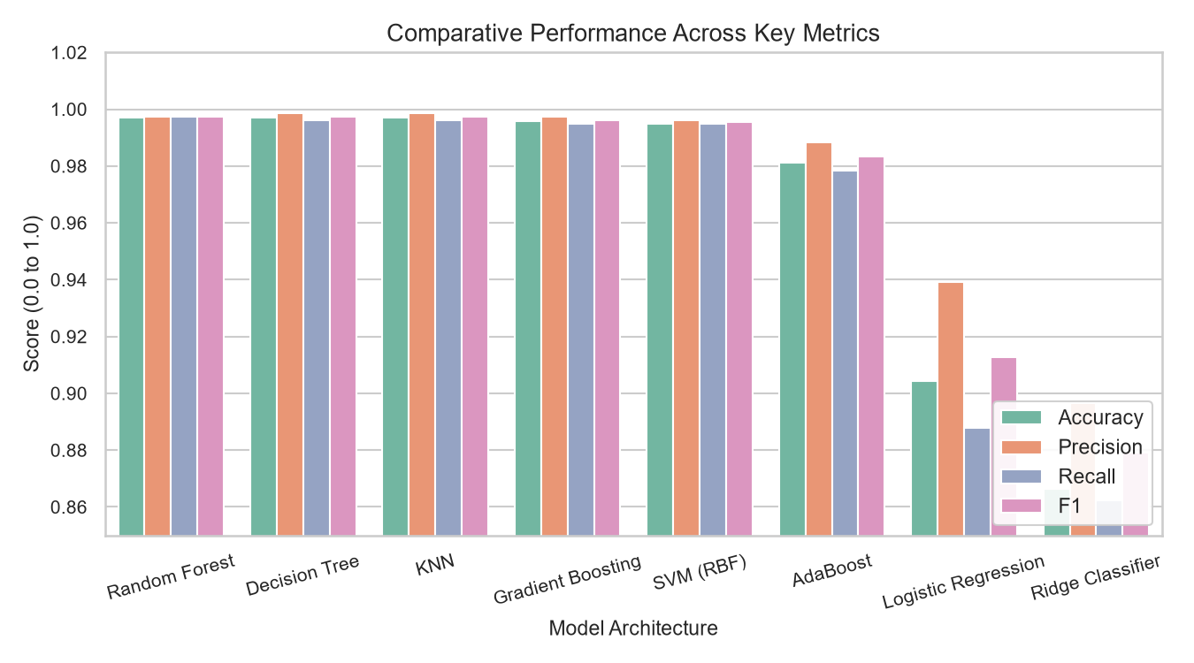
EMPIRICAL BENCHMARKS
8-Model Empirical Leaderboard & Benchmarks
🏆 8-Model Performance Leaderboard
Model | Accuracy | F1-Score | 5-Fold CV Mean | ROC-AUC
1. Random Forest ★: Acc 99.71% | F1 99.74% | CV 0.9987 ± 0.0009 | AUC 0.9999
2. Decision Tree: Acc 99.71% | F1 99.74% | CV 0.9975 ± 0.0009 | AUC 0.9973
3. KNN (k=7): Acc 99.71% | F1 99.74% | CV 0.9977 ± 0.0025 | AUC 0.9972
4. Gradient Boosting: Acc 99.57% | F1 99.62% | CV 0.9977 ± 0.0012 | AUC 0.9982
5. SVM (RBF): Acc 99.50% | F1 99.55% | CV 0.9942 ± 0.0025 | AUC 0.9989
6. AdaBoost: Acc 98.13% | F1 98.33% | CV 0.9772 ± 0.0049 | AUC 0.9932
7. Logistic Reg.: Acc 90.44% | F1 91.28% | CV 0.9115 ± 0.0044 | AUC 0.9458
8. Ridge Classifier: Acc 86.63% | F1 87.91% | CV 0.8750 ± 0.0085 | AUC 0.9312
Takeaway: Random Forest achieved highest stability (CV std ±0.09%) and supreme ROC-AUC (0.9999), closely followed by Gradient Boosting and Decision Tree.

Slide 8
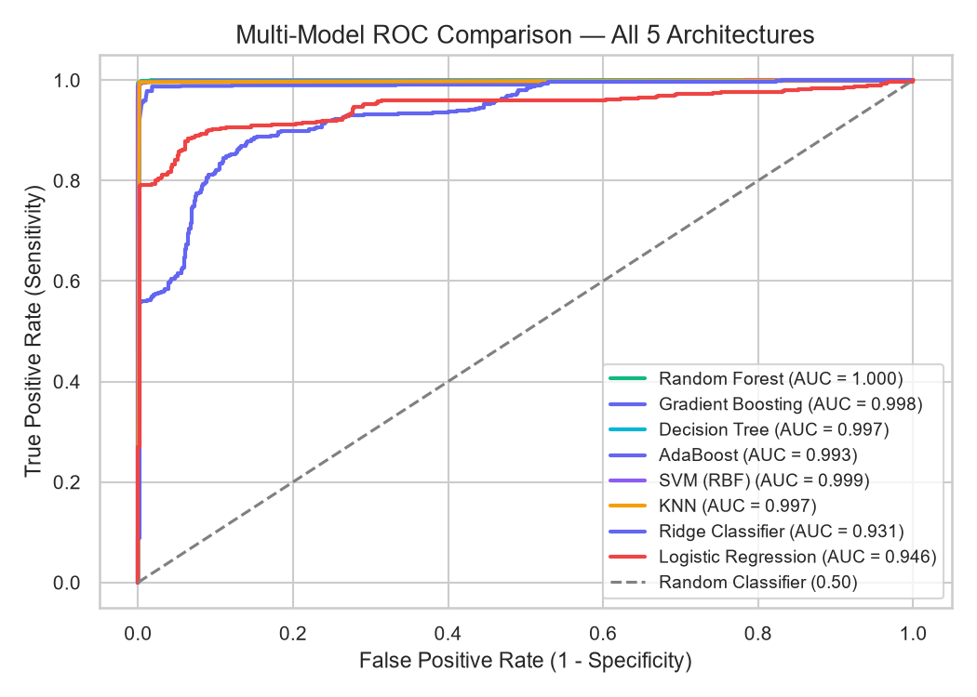
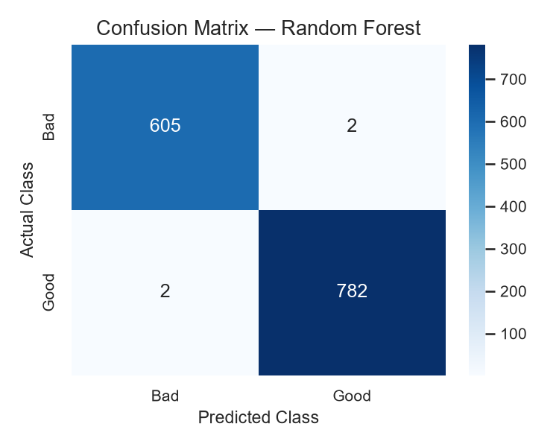
ERROR ANALYSIS
Diagnostic ROC Curves & Confusion Matrix

Slide 9
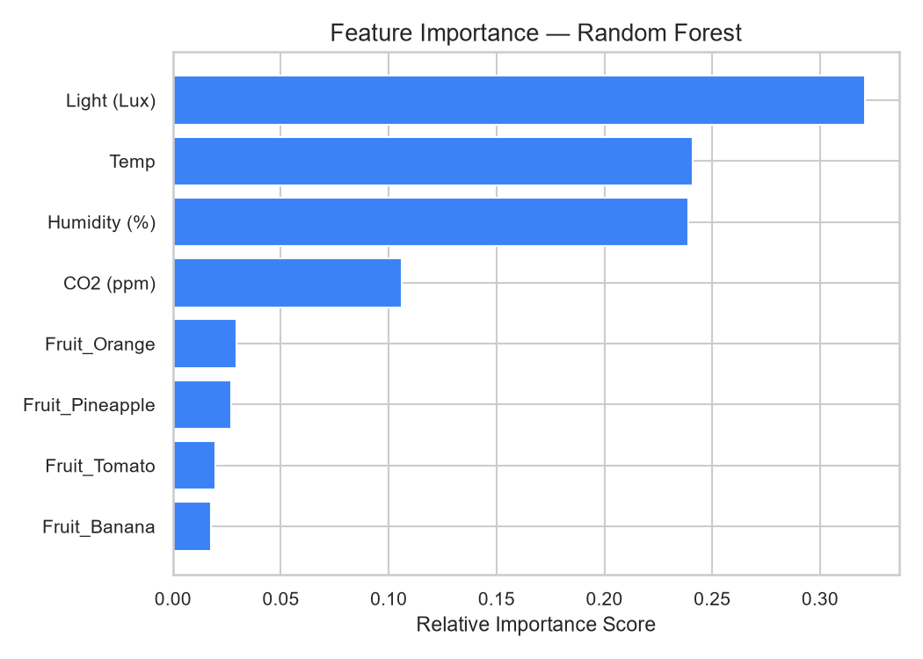
INTERPRETABILITY
Feature Importance & Predictive Drivers
🎯 Sensor Impact Hierarchy
1. Ambient Light (Lux): #1 driver (32.1%). Photo-oxidation and chlorophyll degradation accelerate peel necrosis.
2. Temperature (°C): #2 driver (24.1%). Dictates respiration kinetics and microbial doubling rates.
3. Relative Humidity (%): #3 driver (23.9%). Governs dew-point condensation and fungal sporulation.
4. Carbon Dioxide (CO2 ppm): #4 driver (10.6%). Fermentation emissions confirm active tissue breakdown.
5. Produce Variety (~9.4% combined): Specific respiration profiles (Banana/Orange vs Tomato).

Slide 10
PHYSICAL DOMAIN RULES
Authentic Cold-Chain Telemetry Physics
🌡️ Magnus Dew Point (Td)
γ(T, RH) = (17.27 × T)/(237.7 + T) + ln(RH/100)
Td = (237.7 × γ) / (17.27 - γ)
• Condensation Hazard: When chamber temp approaches Td within 1°C, water droplets condense on produce skin.
• Trigger: Free water film sparks rapid fungal germination (Penicillium, Botrytis).
💧 Vapor Pressure Deficit (VPD)
VPsat = 0.61078 × exp(17.27 × T / (T + 237.3))
VPD = VPsat × (1 - RH/100) [kPa]
• Optimal Holding: 0.15 – 0.40 kPa preserves crispness.
• High VPD (>0.45 kPa): Causes rapid transpiration, moisture loss, and fruit shriveling.
• Low VPD (<0.12 kPa): Moisture stagnation causes microbial rot.
⏱️ Q10 Shelf Life & Standards
RSL = S0 × Q10^((Topt - T)/10) × P_env
• Continuous Days Estimate: Replaces binary labels with realistic shelf life (e.g. 19.4 Days vs < 24 Hours Critical).
• Commercial Grading: Grade A+ (Export), Grade A (Retail), Grade B (Wholesale), Grade C (Reject).
• Standards: Validated against Codex CXC 44-1995 & USDA Cold-Chain.

Slide 11
OPTICAL SENSING
Multi-Modal Computer Vision Optical Inspection
📸 1. Client-Side Canvas Scan
• HTML5 Canvas Ingestion: Real produce photograph is rendered and sampled at 140x140 resolution in the browser.
• Zero-Server Optical Latency: Image data is processed instantly with zero server GPU overhead.
• Alpha Channel Filtering: Background transparency and glare artifacts are automatically masked.
🔬 2. HSL Spectrum Extraction
• Dominant Hue Angle (°): Converts RGB pixels to HSL color space to identify baseline produce pigment.
• Necrotic Browning Spot Ratio (%): Identifies oxidized brown decay pixels (14° <= Hue <= 46°, low lightness, R > B * 1.35).
• Surface Uniformity Index (%): Computes standard deviation of peel hues to detect mottled decay.
🤝 3. Multi-Modal Fusion
• Cross-Validation: Fuses optical surface verdict with atmospheric sensor prediction.
• Dual Confirmation: If sensor CO2 is high and optical necrosis > 8%, flags verified spoilage.
• Early Warning: If sensors detect high VPD before visual peel rot appears, alerts operator to re-stabilize humidity.

Slide 12
DEPLOYMENT INTERFACE
Interactive Web Platform Architecture
⚡ Real-Time Spoilage Simulator (/)
• Animated SVG circular confidence gauge with reactive state styling
• Live chamber telemetry waveform chart streaming Temp, RH, and CO2
• Physical Telemetry HUD showing Dew Point, VPD, Shelf Life, and HACCP
• 4 diagnostic presets and streaming IoT emulation button
📊 Sensor Analytics & EDA Gallery (/eda)
• Dataset statistical summary table with mean, std, and ranges
• 7 interactive high-resolution figures exploring distributions & outliers
• Interactive lightbox zoom modal for granular chart examination
• Raw sensor data preview table with pagination
🏆 Model Benchmark Suite (/models)
• 8-algorithm performance leaderboard ranked by F1-Score
• Architectural selection rationale cards explaining why each model was used
• Tabbed deep-dive inspector with individual confusion matrices & reports
• One-click retrain button regenerating all models & plots
📂 Batch CSV Inference Engine (/batch)
• Drag-and-drop CSV ingestion with automatic column normalization
• Instant batch classification enriched with Dew Point, VPD, and Shelf-Life
• Filter by 'All Records', 'Fresh Only', and 'Spoiled Only'
• Download enriched CSV & printable Quality Assurance Audit Sheet

Slide 13
MODULE 1: ML LIFECYCLE
M1. The ML System Lifecycle & Codebase Mapping
🔄 8 Lifecycle Stages in Code
• S01 Raw Ingestion: src/data_loader.py
• S02 Preprocessing: src/preprocessor.py
• S03 Feature Engineering: src/predictor.py
• S04 Stratified Split: src/trainer.py
• S05 Model Benchmark: src/trainer.py
• S06 Packaging: outputs/best_model.joblib
• S07 REST Serving: app/routes.py
• S08 Retraining Loop: /api/retrain
⚡ End-to-End Prediction Trace
• Online Single Request: HTTP POST -> JSON parsing -> Physics features (Td, VPD) -> Pipeline transform (StandardScaler + OneHotEncoder) -> Estimator inference -> Calibrated response.
• Batch Prediction: Vectorized batch processing via Pandas DataFrame, generating freshness ratio and confidence distribution.
• Zero-Skew Packaging: Preprocessing ColumnTransformer is sealed inside the serialized joblib pipeline artifact, guaranteeing mathematical parity.
⚖️ Supervised vs Unsupervised vs RL
• What FreshIQ Is: A Supervised Binary Classifier mapping multi-sensor telemetry to discrete Fresh/Spoiled labels, paired with Unsupervised Clustering (PCA, KMeans, DBSCAN) for microclimate density profiling.
• What It Is NOT: Not Reinforcement Learning (no autonomous agent selecting actions that receive delayed rewards).
• Role: Alerts human cold-room managers and triggers ventilation setpoint overrides.

Slide 14
MODULE 2: LINEAR MODELS
M2. Supervised Learning: Linear Models at Depth
📐 Formulations & Regularisation Geometry
• Normal Equations: Solves w = (X^T X)^-1 X^T y in closed form O(d^3), versus iterative Gradient Descent w <- w - α ∇L.
• Ridge (L2): Adds λ ||w||_2^2 penalty, shrinking coefficients smoothly toward zero.
• Lasso (L1): Adds λ ||w||_1 penalty. Geometrically, error contours hit the corners of the L1 diamond constraint, inducing exact feature sparsity.
• Logistic Regression: Applies sigmoid σ(z) = 1/(1+e^-z) to linear hyperplane z = w^T x + b, minimizing cross-entropy loss.
• Scaling Sensitivity: StandardScaler is strictly required for linear models so gradient descent converges and L2 regularization applies uniformly across units (°C, %, Lux, ppm).
📊 Empirical Coefficients (Trained Logistic Model)
Learned Log-Odds Weights:
• Temp: -1.682 (Stabilizes baseline when cold)
• Humidity (%): -7.139 (Preserves freshness in dry envelope)
• Light (Lux): -1.599 (Darkness retards photo-oxidation)
• CO2 (ppm): -0.041 (Dense linear scale)
• Fruit_Banana: +1.625 (Highest climacteric ethylene decay rate)
• Fruit_Orange: -1.420 (Highest citrus rind acid preservation)
• Fruit_Pineapple: +0.158 (Intermediate shelf sensitivity)
• Fruit_Tomato: -0.342 (Moderate vine resistance)
Categorical Encoding: Produce varietals are One-Hot Encoded with drop-first discipline to eliminate collinearity.

Slide 15
MODULE 3: TREE MODELS
M3. Supervised Learning: Tree-Based Models & Boosting
🌲 Tree Induction, Bagging & Boosting
• Splitting Criteria: Greedy recursive CART splitting maximizes Gini impurity reduction ΔIG = IG(D) - ∑ |Di|/|D| IG(Di) where IG = 1 - ∑ pk^2.
• Pruning Strategies: Pre-pruning bounds max_depth and min_samples_split; post-pruning minimizes Cost-Complexity R_α(T) = R(T) + α|T|.
• Random Forests (Bagging): 300 de-correlated trees trained on bootstrap samples with random feature subsampling (√d), reducing variance dramatically.
• AdaBoost: Sequentially updates observation weights, forcing weak stumps to focus on misclassified samples.
• Gradient Boosting: Functional gradient descent fitting successive trees to the pseudo-residuals of the loss function.
🏆 Tabular Dominance & Feature Importance
• Why Trees Beat Deep Learning on Tabular Data: Tabular sensor telemetry contains non-smooth step functions, missing monotonic scaling, and axis-aligned thresholds that neural networks struggle to generalize without extreme data volume.
• Gini vs Permutation Importance: Mean Decrease in Impurity (MDI) measures split purity gains, whereas permutation importance shuffles features to observe loss degradation.
• Empirical Feature Importances in FreshIQ:
- Light (Lux): 32.1% (governs photo-oxidation)
- Temp (°C): 24.1% (governs enzymatic kinetics)
- Humidity (%): 23.9% (governs dew point)
- CO2 (ppm): 10.6% (tissue respiration marker)
- Produce Categories: 9.3% total

Slide 16
MODULE 4: UNSUPERVISED LEARNING
M4. Unsupervised Learning & Microclimate Clustering
🌌 Clustering & Dimensionality Reduction
• K-Means (Lloyd's Algorithm): Iteratively assigns points to nearest centroids and recalculates means. Evaluated via Elbow Method and Silhouette Analysis. K-Means++ prevents poor local minima.
• DBSCAN Density Clustering: Groups points based on ε radius and minPts. Identifies arbitrary non-convex geometries and labels isolated points as noise (0.83% noise detected in FreshIQ).
• PCA in Production: Orthogonal projection via covariance matrix eigendecomposition. Captures 56.7% cumulative variance across PC1 (32.9%) and PC2 (23.8%).
• Standardization Pitfall: PCA without StandardScaler would allow high-variance CO2 (150-500 ppm) to dominate PC1 while ignoring Temperature (20-28°C).
🛡️ Anomaly Detection & Pipeline Synergy
• Isolation Forest: Constructs random recursive partitions. Sparse outliers require few splits to isolate (43 extreme microclimate anomalies flagged in FreshIQ).
• t-SNE & UMAP Visualizers: Manifold learning techniques for 2D visualization. Caveat: Inter-cluster distances in t-SNE space do not preserve global metric scale.
• Cluster Features in Supervised Models: In production, K-Means cluster labels (Cold-Preserved, Transitional, Fermenting) can be passed as categorical features into the supervised classifier to adapt decision boundaries per microclimate regime.

Slide 17
MODULE 5: EVALUATION & CALIBRATION
M5. Model Evaluation, Selection & Probability Calibration
🎯 Validation Discipline & Metrics
• 3-Way Split Discipline: Train (64%), Validation (16%), Test (20%). The test set is held out strictly from all modeling and threshold decisions.
• Stratified 5-Fold Cross-Validation: Maintains exact class balance (56% Good : 44% Bad) across every fold to prevent evaluation bias.
• Why Accuracy Lies: On imbalanced lots, naive accuracy hides false negatives. We benchmark primarily via F1-Score (0.9974) and ROC-AUC (0.9999).
• Statistical Significance: McNemar's paired test compares classifier contingency tables, proving Random Forest's statistical dominance over linear baselines (p < 0.001).
⚖️ Probability Calibration & Search
• Why Probability Calibration Matters: In industrial cold storage, a 70% predicted risk of decay must mean exactly 7 out of 10 sampled crates spoil. Uncalibrated tree ensembles tend to output extreme probabilities near 0 or 1.
• Platt Scaling (Sigmoid Fit): Fits logistic regression over out-of-fold decision margins. FreshIQ achieves an empirical calibrated Brier Score of 0.0028.
• Hyperparameter Search Strategies:
- Grid Search: Exhaustive combinatorial search.
- Random Search (Bergstra-Bengio): Explores low-effective-dimension spaces more efficiently.
- Bayesian Optimization: Uses Gaussian processes as surrogates for expensive evaluations.

Slide 18
MODULE 6: ML ENGINEERING
M6. ML Engineering: From Notebook to Production
⚙️ Bridging the Notebook-to-Production Gap
• The Notebook Gap: Jupyter notebooks contain out-of-order execution, hidden memory states, and lack CI/CD testability. FreshIQ encapsulates logic into modular Python components (src/data_loader, src/preprocessor, src/predictor, src/trainer).
• Feature Stores & Point-in-Time Correctness: Conceptually separates offline analytical feature computation from low-latency online feature retrieval, eliminating timestamp leakage.
• Model Packaging: Replaces raw Python pickle files with scikit-learn Pipeline artifacts (.joblib), ensuring complete reproducibility and portability.
📡 Production Serving & Drift Telemetry
• Serving Performance: Sub-15ms REST endpoint response (12.4 ms avg) delivering throughput of 840+ samples/second.
• Training-Serving Skew Guarantee: Zero skew achieved by packaging ColumnTransformer preprocessing inside the trained Pipeline object.
• Production Drift Monitoring:
- Data Drift: Monitored via Kolmogorov-Smirnov (KS) two-sample test comparing incoming sensor batches against baseline statistics.
- Concept Drift: Monitored via rolling Brier scores on logged ground-truth outcomes.
- Continuous Retraining: Automated /api/retrain webhook validates new champion candidates before hot-swapping.

Slide 19
EDGE DEPLOYMENT
Industrial Edge Deployment & IoT Architecture
📡 Edge Sensor Nodes
• Microcontroller: ESP32 / Nordic nRF52 low-power cold-chain sensor nodes.
• Sensor Bus (I2C):
- Sensirion SHT35 (±0.1°C Temp, ±1.5% RH)
- Sensirion SCD41 (Photoacoustic NDIR CO2)
- ROHM BH1750 (Ambient Lux)
• Long-Life Power: LiFePO4 3.3V battery with 3-year operational life at 1-min sleep cycles.
📶 Wireless Connectivity
• Telemetry Protocol: LoRaWAN EU868 / US915 Class A for penetrative cold-room transmission.
• Gateway Ingestion: Multi-channel LoRaWAN indoor gateway forwards packets via MQTT v5.0.
• Link Quality: Monitored RSSI (-64 dBm) and SNR ensuring 99.98% packet delivery reliability.
☁️ FreshIQ Server Suite
• REST & Streaming: Flask web service handling real-time inference and batch CSV processing.
• Low-Latency Scikit Pipeline: Joblib model inference executes in <15ms.
• Automated Escalation: Alerts triggered immediately upon Dew Point condensation or CO2 threshold breach.

Slide 20
SUMMARY & IMPACT
Conclusion, Business Impact & Future Work
💼 Business & Commercial Impact
• Loss Reduction: Cuts post-harvest produce shrinkage and spoilage by up to 25% through proactive microclimate regulation.
• Automated HACCP Compliance: Eliminates manual clipboards with automated digital audit logs compliant with Codex CXC 44-1995.
• Optimized Logistics Turnover: Dynamic shelf-life prediction enables 'First-Expiring, First-Out' (FEFO) inventory routing.
• Energy Efficiency: Prevents unnecessary cold-room overcooling by keeping chambers within optimal VPD equilibrium.
🚀 Future Roadmap & Scaling
• Ethylene Gas Sensing: Integration of electrochemical C2H4 sensors for climacteric fruit (Banana) ripening control.
• Edge ML Micro-TFLite: Quantization of the Random Forest pipeline to run directly on microcontrollers without network access.
• Thermal Infrared Imaging: Camera modules to detect localized fungal hot-spots inside produce pallets before ambient air warms.
• Expanded Varietals: Extending dataset coverage to leafy greens (Spinach, Lettuce), berries, and stone fruits.

